Slide 1
With thanks to our Sponsors:

Slide 2


Access the EECC App here:
http://eventmobi.com/
eecchungary/
Further instructions are in the workpack (Page 2)
App Kindly Sponsored by:
www.intrum.com

Slide 3
Translation
English to Hungarian
Channel 1
Hungarian to English
Channel 2

Slide 4

Afternoon Technical Session
Kindly Sponsored by:
www.netbid.com & oaklins.com

Slide 5
Harmonisation of education of IPs across Europe, practicalities
Emmanuelle Inacio, Université du Littoral Côte d’Opale, France
Niculina Somlea, CITR, Romania
Judit Siket, Legal Training Academy of Judicial Services, Ministry of Justice, Hungary

Slide 6
Harmonisation of education of IPs across Europe, practicalities
Emmanuelle Inacio
Université du Littoral Côte d’Opale, France

Slide 7
1. Comparative models of Insolvency Practitioners across Europe

Slide 8
2. Professional Bodies: INSOL Europe

Slide 9
2. Professional Bodies: INSOL Europe
2.1. INSOL Europe’s 2010 Report on “Harmonisation of insolvency law at EU Level”
“(XII) The laws of EU Member States have different rules on the qualifications and eligibility for the appointment, licensing, regulation, supervision and professional ethics and conduct of insolvency representatives
[…] Because of the substantial differences between EU Member States, there is no merit in seeking to harmonise these issues until a further harmonisation of substantive insolvency law and company law has been achieved.”

Slide 10
2. Professional Bodies: INSOL Europe
2.2. Working Group: INSOL Europe’s Insolvency Office Holders Forum
“Qualification and training - IOHs candidates should meet relevant qualification and practical training Standards. Qualified IOHs should keep their professional skills updated with regular continuing training. Member States should encourage cross-border training and exchange of knowledge and best practice standards. For this purpose, any Continuing Professional Education system in the Member States should encourage and allow for theoretical and practical training in other Member States.”

Slide 11

2. Professional Bodies: INSOL Europe
2.3. Educational Course: INSOL Europe High Level Course on Insolvency Law in Eastern European Jurisdictions

Slide 12
3. European Requirements for Insolvency Practitioners:
Proposal for a Directive of the European Parliament and of the Council on preventive restructuring frameworks, second chance and measures to increase the efficiency of restructuring, insolvency and discharge procedures and amending Directive 2012/30/EU

Slide 13
Proposal for a Directive of the European Parliament and of the Council on preventive restructuring frameworks, second chance and measures to increase the efficiency of restructuring, insolvency and discharge procedures and amending Directive 2012/30/EU
“ Article 25
Practitioners in the field of restructuring, insolvency and second chance
1. Member States shall ensure that mediators, insolvency practitioners and other practitioners appointed in restructuring, insolvency and second chance matters receive the necessary initial and further training in order to ensure that their services are provided in an effective, impartial, independent and competent way in relation to the parties.
2. Member States shall encourage, by any means which they consider appropriate, the development of, and adherence to, voluntary codes of conduct by practitioners in the field of restructuring, insolvency and second chance, as well as other effective oversight mechanisms concerning the provisions of such services. “

Slide 14
Harmonisation of education of IPs across Europe, practicalities
Niculina Somlea, CITR, Romania

Slide 15
Romania
Access to the profession:
  University degree + knowledge + experience
Appointment system:
- Selection by Judge, final selection by creditors
Remuneration
- Determined by the judge, by the creditors
Professional training

Slide 16
Harmonisation of education of IPs across Europe, practicalities
Judit Siket
Deputy Head of Legal Training Academy of Judicial Services
Ministry of Justice, Hungary

Slide 17
Map of Presentation
Government’s Justice Policy
The Amendment 2014 of Act XLIX of 1991
Professional Training of Practitioners
Legal Training Academy of Judicial Services
Conferences and Practical Trainings in 2016-2017

Slide 18
Government’s Justice Policy
Strengthening of public trust
  professional requirements
  control of insolvency procedures
  control competence and measurements of registration authority
  regular professional reports

Slide 19
Modification of Act XLIX of 1991
2014
(1) Liquidation activities may be performed by business associations only if having at least two persons in their employ either as members who participate in liquidation activities in person, or under employment or under long-term civil relationship concluded with the company, and if these persons act on behalf and to the benefit of the company and if they have the required training in the field of liquidation and property administration (hereinafter referred to as “professional qualifications”). As regards the professional qualifications the body operating the register of liquidators shall be entitled to obtain the specialist authority’s assessment decision. A person with professional qualifications may be employed by not more, then three business associations engaged in liquidation activities.

Slide 20
Modification of Act XLIX of 1991
2014 (2)
(1a) The person having the professional qualifications referred to in Subsection (1) shall attend a course of continuing professional training of at least two years, and shall present the certificate thereof to the liquidator.

Slide 21
Professional trainings
high level education
special qualification
4 semesters
special trainings
Legal Training Academy of Judicial Services
1 September 2016
advanced studies

Slide 22
Legal Training Academy of Judicial Services
responsibilities of Minister of Justice
1/9/2015
professional and ethical trainings for legal professions:
  judicial experts, liquidators, legal aid, victim support, probation officers, judicial bailiffs, mediators
  education/exam

Slide 23
Conferences 2016-2017
Date | Venue | Topics | number of participants
02/09 | Siófok | Provisions on credit assurance registration of New Code of Civil Law, Latest decisions of Hungarian Supreme Court, Named Curia and the Regional Courts of Appeals Further development directions of electronic sale system | 300
04/11 | Gödöllő | Dual role of Hungarian National Tax Authority (creditor and authority), related decisions Cost accounting, due date | 251
10/03 | Szeged | Trust property management New Civil Procedure Code Judicial experiments of forced cancellation procedures The winding-up of associations, foundations | 150
12/05 | Budapest | Winding up of (assetless) companies in Central-Eastern Europe – The reality show | ?

Slide 24
Practical trainings 2016-2017
Date | Venue | Topics | number of participants
09/13 | Budapest | Legal background and practice of electronic treatment of documents and electronic invoicing, Electronic communication with courts and other authorities, Different types of electronic signatures. | 32
26/10 | Budapest | Legislative and methodological review of the winding-up procedure from designation to cancellation | 26
21/11 | Budapest | Development of electronic sale system in 2016, and the expected improvements | 20
03/22 | Budapest | Methodology of accounting the insolvency costs, interpretation of its legal background Guidance of the Registration Authority | 26
19/04 | Budapest | Accounting rules for insolvency proceedings | 44

Slide 25
Thank you for your kind attention.
sara.judit.siket@im.gov.hu

Slide 26

Coffee Break
Kindly Sponsored by:
﻿www.troostwijkauctions.com

Slide 27
Directors’ liability across Europe
Evert Verwey (Clifford Chance LLP, Netherlands)
Zoltán Fabók (DLA Piper LLP, Hungary)
Mgr. Ing. Dávid Oršula (bnt attorneys-at-law, Slovakia)
Robert van Galen (NautaDutilh, Netherlands)

Slide 28
Introduction
Hungary, England, Netherlands, Slovakia
Considerations

Slide 29
Issues for consideration
Obligation to file for insolvency
Liability for directors against third-parties
Higher risks during restructuring?
Liability for winding up assetless companies (out of court)
Tips and tricks for directors ?
Issues for consideration
Should there be harmonization
Criminal liability
Obligation:
Information sharing
Obligation:
Filing annual accounts
Obligation:
Books and records

Slide 30
Practical solutions of selling assets
Panel Leader:
Emese Túróczi, Dr. Túróczi Emese Law Office, Hungary
Balázs Polgár, Patik and Varga Zrt., Hungary
Maxence Dutat, Troostwijk, The Netherlands
Andreas Weinberger, NetBid, Germany
Cornel Florea, CONSULTA 99, Romania

Slide 31
Introduction of the Hungarian electronic asset-selling system (EÉR)
Dr. Túróczi Emese
attorney, member of the Legal Committe of Hungarian Association of Insolvency Practitioners

Slide 32





Slide 33


Slide 34
The vision: an on-line insolvency „marketplace” that...
meets the requirements of modern information society
accelerates sale procedures and enhances efficiency
draws more potential buyers than the „old fashioned” way of tendering/auctioning
creates higher revenues from sales
prevents/filters out fraudulent transactions
is readily available, transparent and and easy-to use
supports both means of public sale (tenders & auctions)
similar projects: e-auction sites of Hungarian Chamber of Court Bailiffs (judicial enforcement proceedings) & National Tax and Customs Adminstration (tax enforcement proceedings)

Slide 35
Why a centralized, government-operated system?
availability: (as the use of the system in insolvency asset sales is mandatory with very few exceptions) all public insolvency sale proceedings take place at one virtual marketplace
transparency: the logging of user activities & the compulsory data/documents to be uploaded into the system make sale proceedings and transactions traceable (by creditors/stakeholders and the operator)
government control: the sale-related activities may easily be monitored by the IP’s supervisory authority/operator

Slide 36
Facts and figures
EÉR has been introduced in January 2015
by Govt.regulation No. 17/2014. (II. 3.)
operated by the Ministry of National Development’s Authority of Registration of Insolvency Practitioners
mandatory platform: all public asset sale procedures (tenders & auctions) must be realized by way of the system, except for the sale of:
  arable land
  stocks/company shares (if a credit institution or investment service provider is involved)
  small-value assets (expected sale revenues – minus costs – would not exceed HUF 100K)
  individual cases when the Creditor’s Committee agrees on a different means of public sale (ie. via an international auction site, etc.)

Slide 37
Year | Number of registered users
2015 | 2163
2016 | 1941
2017 | 556

Slide 38
Year | Number of cases
2015 | 3147
2016 | 6121
2017 | 609

Slide 39
Auction/tender ratio

Slide 40
Distribution of assets

Slide 41
Expectations at introduction
good for the IP’s/sellers: their asset-sale related tasks are supported by up-to-date IT solutions (AND – maybe more importantly - if the system generates more revenues, they can collect respectively higher fees)
good for the (potentional) buyers: the system is user-friendly and easily accessible to anyone
good for the operator: the fees and commissions paid by registered sellers and buyers make the system financially self-sustaining (AND if it generates more revenues, the amount gathered from commissions will increase)
good for the creditors: on-line selling draws more buyers (AND generates higher revenues, enhancing chances of greater creditor satisfaction)
good for the „public good”: the system makes sale proceedings and transactions more transparent & traceable thus reducing the chance of fraud and manipulation

Slide 42
Some „first glance” observations
What about marketing? Where is all the information buyers might like to know about these goods to make an informed decisoin?
What about e-auctions? Why sellers don’t make use of (electronic) bidding?
What about unsuccessful cases? Are buyers that uniterested? Or is there another reason?
What about the international market? Why foreign buyers cannot make advantage of the Hungarian insolvency asset market?

Slide 43
Practical solutions of selling assets
Balázs Polgár
Member of the board
Patik&Varga Zrt.

Slide 44
Practical solutions of selling assets
Balázs Polgár
member of the board
Patik&Varga Zrt.

Slide 45
EÉR - Hungarian electronic asset-selling system
About the hungarian system: EÉR (Electronic Asset-selling System)
  The system’s objects
  Background
  Tenders, Auctions: what kind of assets and how can you sell
  Members of the EÉR
    Buyer
    Seller
  Buyer’s view
  Seller’s view

Slide 46
Object of the EÉR
Transparency / Quality assurance
Regulated
Publicity
Simple using
Efficiency

Slide 47


Tenders, Auctions
Real estate
Movable property
Small value assets
Business shares
Claim

Slide 48

Buyer’s view
What’s important for the Buyers
  Information about the assets
  Interactive communication
  Flexibility
What do they want to know about the selling methods?
  Timing, prices, rules, visit options, etc
How can You use the EÉR website?

Slide 49

Seller’s view
Compulsory data (minimum datas / most important datas of the assets, the enterprise)
  Title
  Name of the enterprise
  Details of the tender/auction
  Visit information, date

Slide 50
Item of the asset
Item of the assets (the item data
  Specific datas (help for buyers to find the assets, for example: location, condition, size, owner, etc)
  Pictures
Documents, Tender issue

Slide 51

Experiences, possibilities
Experiences
Possibilities for the future
  Available other languages for using
  Use EUR/HUF
  Developing the payment methods (card, transfer)
Envisaged developments

Slide 52

Business case
Maxence Dutat
Troostwijk auctions

Slide 53
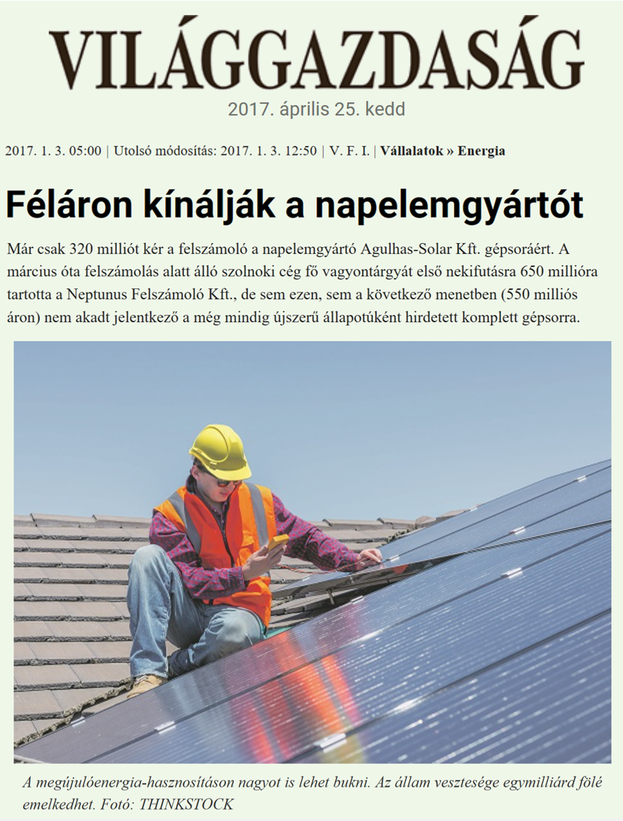

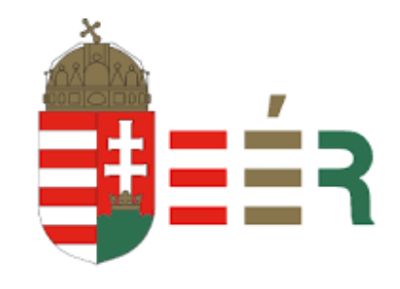
2.000 registrered
500.000 registrered
127 countries

Slide 54
As consultant, we do:
The inventory with pictures (multiple languages)
Expansive marketing and PR campaign
Organising the viewing
Arrange the handover and export documents
The buyer pays our fees
Safe
Get the best revenue
Fast
Transparent

Slide 55
INDUSTRY
KNOWLEDGE
90 years experience
500.000 B2B
BUYERS AROUND
THE WORLD
20 OFFICES
ACROSS EUROPE
Auctions > 1,500
Valuations > 2,500
lots sold > 500,000
REVENUE > €185 MILLION
PAGE VIEWS 285.000.000

Slide 56


Presentation
Practical solutions of selling assets
Andreas Weinberger
Managing Director NetBid GmbH
www.netbid.com

Slide 57

Remarketing – Flowchart
1. Preparation
2. Sale / Auction
3. Clearing / Completion
Verification
Sales processing
Debt collection
Inventory
Inform buyers
Dismantling and
pick up
Photos
Accounting
Valuation
Implementing marketing plan
Organizing viewing

Slide 58
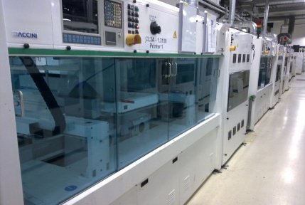
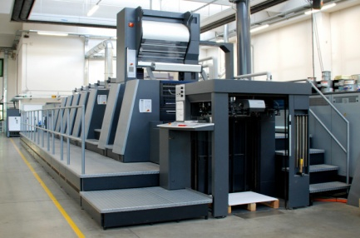



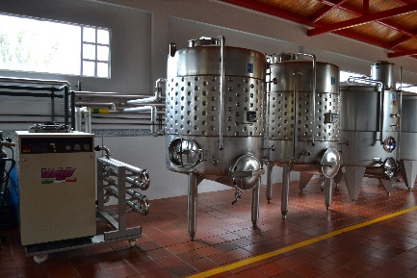


Industry
Clear identification of
common industries
Production
Printing Industry
Industry research
Market development
Tailor-made marketing strategy
Taking into account country specific conditions (e.g. delivery restrictions, VAT and custom issues, demand of special documents, etc.)
Automotive
Construction
Transport
Food & Beverages
Commerce
Technology

Slide 59
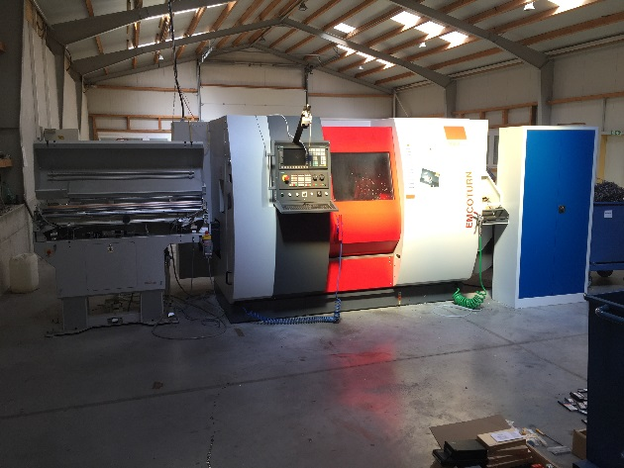
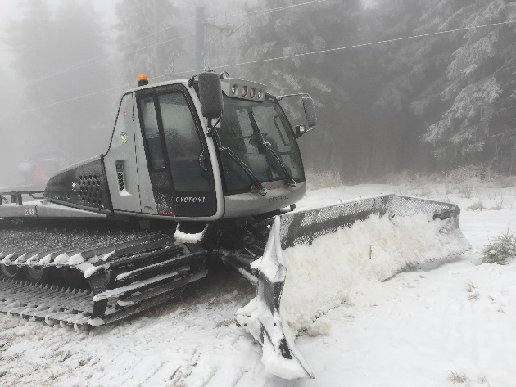
Successful remarketing is based on a proper valuation
Verification of plant & machinery
  Liquidation value
  Going concern value
The projected value represents:
  the expected achievable resale price
  of the asset
    at a certain point in time
    within a projected specified period
    based on “where it is – as it is“,
    i.e. with no functionality guarantee given
Notes:
59

Slide 60

Marketing
International, multilingual auction platform
Remarketing on selected international marketplaces
Involvement of independent marketing departments (Eastern and Western Europe, USA, Asia)
Mailings & telephone marketing
Use of various platforms
International customer database

Slide 61

Global Approach
Germany
Hamburg (Headoffice)
Baden-Wurttemberg
Worldwide
Warsaw - Poland
Prague - Czech Republic
Barcelona - Spain
Vienna - Austria
Maribor - Slovenia
Sofia - Bulgaria
Seoul - South Korea
St. Gallen - Switzerland
Budapest - Hungary

Slide 62
Remarketing – Flowchart
1. Preparation
2. Sale / Auction
3. Clearing / Completion
Inventory
Sales processing
Debt collection
Photos
Inform buyers
Dismantling and pick up
Valuation
Accounting
Implementing marketing plan
Organizing viewing

Slide 63
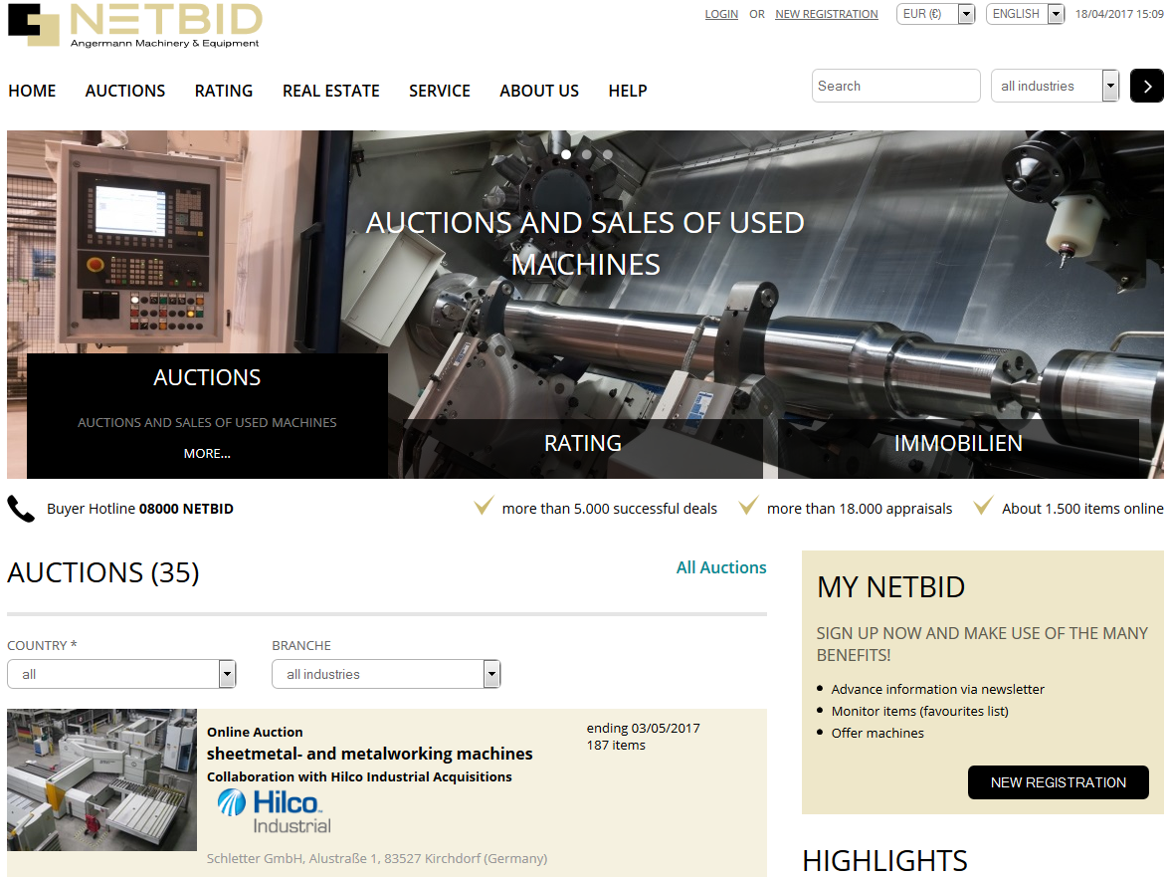
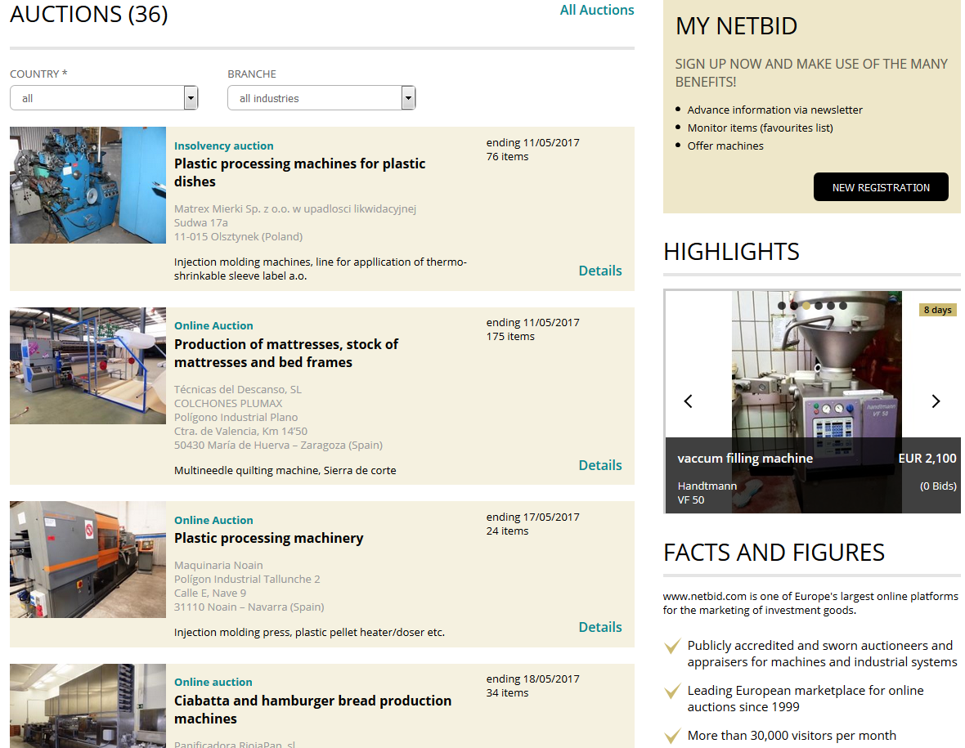
Auction / Trading

Slide 64
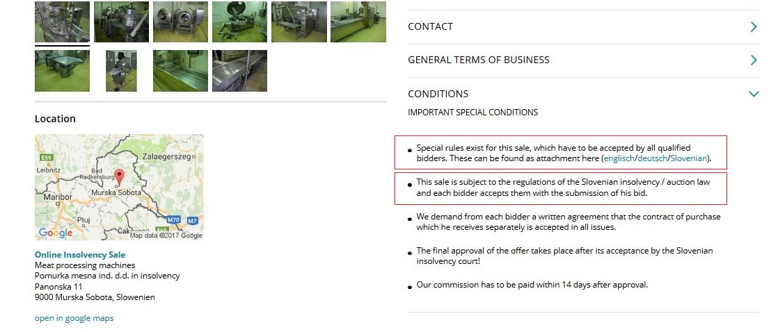
Tailor-made approach, according to local insolvency law
• Erre az értékesítésre speciális szabályok vonatkoznak, amelyeket minden jóváhagyott ajánlattevőnek el kell fogadnia. Ezek a csatolmányban találhatóak (angol/német/szlovén).
• Az értékesítésre a szlovén csődtörvény szabályai vonatkoznak, melyet minden ajánlattevő elfogad azzal, hogy ajánlatot tesz .

Slide 65
3-Step Strategy: Timeline
1. Going-Concern Sale
min. 3 months
2. En bloc Sales
3 – 6 months
3. Liquidation/Auction
6 – 9 months
Going concern sales on site (asset deal) en bloc sale of property, office building, machinery & equipment
Revitalization of company
Highest proceeds
But: chances are limited
Liquidation sales machinery en bloc
Individual sale of property and machinery
Potential additional interest for alternative use of property
Chances for (foreign) investors to export the entire machinery to a third location; “ready to start“
Liquidation sales of individual lots
Online auction
Quick clearance of property
Chances for individual bidders of different interest

Slide 66
Remarketing – Flowchart
1. Preparation
2. Sale / Auction
3. Clearing / Completion
Inventory
Sales processing
Debt collection
Photos
Inform buyers
Dismantling and pick up
Valuation
Accounting
Implementing marketing plan
Organizing viewing

Slide 67
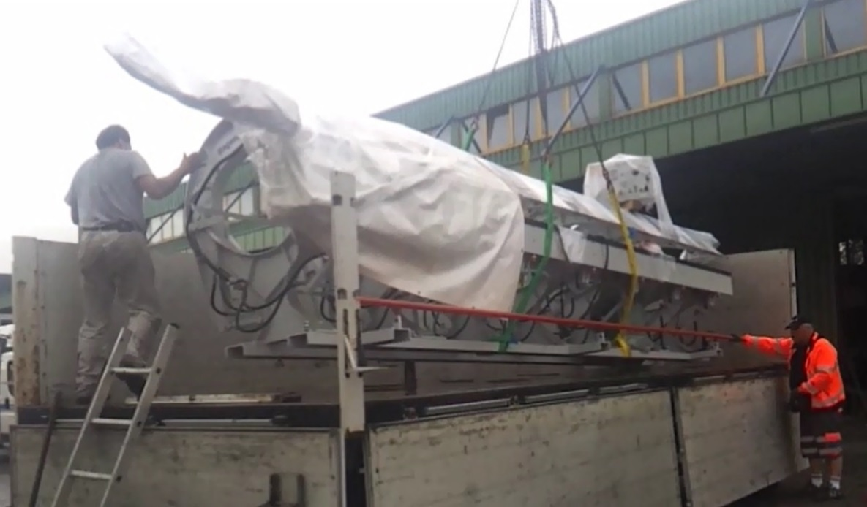
Clearing / Completion
  Administrative support
    Dealing with requirements of prevention of money laundering act
    Collecting payments
    Technical support
    Dismantling, transport, custom duties, collecting documents
    Providing detailed reports
Notes:
67

Slide 68
Any questions? Please, don‘t hesitate to contact us!
CEE-/SEE-Team
Andreas Weinberger
Managing Director
NetBid GmbH
Angermann Machinery & Equipment
Bräuhausgasse 37
A-1050 Vienna
T (43) 1 890 66 70-401
M (43) 6991 666 82 62
weinberger@netbid.com
www.netbid.com
Fruzsina Lencses
Executive Assistant /
Project Assistant
NetBid GmbH
Bräuhausgasse 37
A-1050 Vienna
T (43) 1 890 66 70-402
lencses@netbid.com
Attila Bugovits
Country Manager Hungary /
Project Manager
NetBid GmbH
Szent Korona str. 212.
H-1162 Budapest
M (36) 20 416 54 55
bugovits@netbid.com

Slide 69

Practical solutions of selling assets
Negotiating a transaction
A case study

Slide 70

Selling assets in Romania
According to the Romanian Insolvency Law, in the bankruptcy stage, the assets of the debtor are sold, either individually or in block, through:
public auction,

Slide 71

Selling assets in Romania
According to the Romanian Insolvency Law, in the bankruptcy stage, the assets of the debtor are sold, either individually or in block, through:
public auction,
direct negotiation, or
a combination of the two that means
organizing a …

Slide 72




Direct negotiation with overbidding - Who offers more?
This method is complex and the insolvency practitioner undertakes to use its full capacity as a negotiator.
The proceeding starts with the receipt of an offer to buy at a price accepted by the creditors.
To preserve the transparency of the proceeding, the Romanian law obliges the liquidator to publish a notice of the transaction and the terms of overbidding.

Slide 73




Direct negotiation with overbidding
Adjudicated
Who offer more ?
This method is complex and the insolvency practitioner undertakes to use its full capacity as a negotiator.
The proceeding starts with the receipt of an offer to buy at a price accepted by the creditors.
To preserve the transparency of the proceeding, the Romanian law obliges the liquidator to publish a notice of the transaction and the terms of overbidding.
If within 30 days there is an overbid, the liquidator shall hold an overbidding session
I won
Double
Triple

Slide 74

Case study
Direct negotiation with overbidding to sell the assets of
SC PIRAMIDA SA

Slide 75




Assets to be negotiated
A building land
near to the highway
in front of a large hardware store owned by an international company hereafter named EXTRAMARKET SA
At the date of the transaction, the land was rented by a multinational company hereafter named FASTFOOD SA that built there a restaurant

Slide 76



Negotiation attendants
The liquidator of PIRAMIDA SA as Seller
EXTRAMARKET SA as first offerer and known buyer
FASTFOOD SA as Overbidder

Slide 77
Strategy
1.The Liquidator
Objective:
To sell the asset
With the price:
  Starting: the sum of full liability, the fee and 15% extra
  Objective: the sum of full liability and the fee
  Resistance: market value minus 10% (under this value the deal is not possible)
Payment conditions:
  10% guarantee deposit at the start of negotiation
  90% at contract signature, guaranteed by an escrow account
Style:
Integrative negotiation Win – Win oriented
Vision:
Closure of the liquidation proceedings by full repayment of liability
Resistance
(No less)
Objective (expected)
Starting (asked)
No
deal
Seller price

Slide 78
Strategy
Starting (offered)
Objective (expected)
Resistance
(No more)
2.SC EXTRAMARKET SA
Objective:
To buy the asset in order to gain access the highway
With a price:
  starting: market value minus 15%
  objective: market value
  resistance: market value plus 30%
Accept the seller’s conditions
Style:
Integrative negotiation Win – Win oriented
Vision:
Creating optimal conditions in order to develop his project by gaining access to the highway
Buyer price
No deal

Slide 79
Strategy
2.SC FASTFOOD SA
Objective:
to ensure the continued operation of the restaurant
With a price:
  starting: market value minus 5%
  objective: market value
  resistance: market value plus 30%
Accept the seller’s conditions
Style:
Integrative negotiation Win – Win oriented
Vision:
Although the company's policy is NOT to purchase real estate, it makes an exception in order to continue working

Slide 80

Development of negotiation
During the Overbidding Session
The Practitioner stressed the complementarity of interests of the three parties, so that an agreement was reached ...

Slide 81
Negotiation result
The land was sold to SC EXTRAMARKET SA
SC EXTRAMARKET SA decided to continue the lease agreement with SC FASTFOOD SA, considering that the restaurant business is also useful for its business
The price obtained was higher by 12% compared to the starting price

Slide 82

A HAPPY END
If we negotiate well, we can dream of ...

Slide 83
Closing Remarks
Evert Verwey
Co-Chair of the EECC
Clifford Chance, The Netherlands
Steffen Koch
President of INSOL Europe
hww hermann wienberg Wilhelm, Germany

Slide 84

Young Members Group
Drinks Reception
Kindly Sponsored by:
﻿www.schiebe.de

Slide 85


﻿Eastern European Countries’
Committee Conference 2018
Riga, Latvia, 31st May-1st June 2018
Sponsorship opportunities are available – for details contact
Hannah Denney, email: hannahdenney@insol-europe.org

