Slide 1
Our grateful thanks go to our 2018 Annual Congress Sponsors

Slide 2




Athens Congress App available at:
crowdcomms.com/insolea2018
App Kindly Sponsored by:
www.citr.ro
www.schubra.de

Slide 3

Morning Technical Session
Kindly Sponsored By
www.hoche-avocats.com

Slide 4
Opening remarks of the Annual Congress
Congress Facilitator:
Frank Tschentscher (Schultze & Braun, Germany)
Co-Chairs:
Frank Tschentscher (Schultze & Braun, Germany)
George B. Bazinas (Bazinas Law Firm, Greece)
President of INSOL Europe:
Radu Lotrean (President of INSOL Europe/CITR, Romania)

Slide 5
Keynote speaker:
Prof. Evangelos Venizelos
Professor of Constitutional Law at the Aristotle University of Thessaloniki
Member of the Hellenic Parliament
1993-95 Minister for Press and Mass Media - Government Spokesman
1995-96 Minister for Transport and Communications
1996 Minister for Justice
1996-99 Minister for Culture & Sports
1999-2000 Minister for Development, Energy, Industry, Trade, Tourism and Technology
2000-04 Minister for Culture & Sports
2009-11 Minister for National Defence
2011-12 Deputy Prime Minister and Finance Minister
Former Deputy Prime Minister and Former Minister of Foreign Affairs of Greece

Slide 6
The Holy Grail of Greek Insolvency Law
Moderator: George B. Bazinas (Bazinas Law Firm, Greece)
Giorgio Cherubini (EXP, Italy)
Agustín Bou (Jausas, Spain)
David Ereira (Paul Hastings, UK)

Slide 7
Introduction
During the last 8 years, Greece has been forced to impose strict fiscal austerity measures. This has been EU’s policy response for economic recovery;
The exhaustive measures did not (and could not) improve the economy;
At the same time, Greek insolvency legislation is being constantly amended, as if insolvency law is expected to revert the downward spiral in which debtor companies have descended;
Similar austerity measures may well be imposed in other Member States; a possibility that is not so distant considering recent developments in other EU countries;
The ramification of such austerity policies could threaten Europe’s future.

Slide 8
Panel Discussion Topics
Using the example of Greece and drawing from the experience and lessons from Spain, Italy and the United Kingdom, the panel will discuss:
The interrelation between amendments to national insolvency laws and the economic climate on which entities in distress are called to function;
The desired role and function of insolvency regimes in conditions of economic recession, considering the prospect of a substantive, harmonized EU insolvency law;
Can insolvency law operate efficiently in conditions of economic collapse?
Whether insolvency and restructuring proceedings can be instigated by law;

Slide 9
Panel Discussion Topics
Using the example of Greece and drawing from the experience and lessons from Spain, Italy and the United Kingdom, the panel will discuss:
Whether readily available financing and favorable market conditions are a necessary precondition for the efficient operation of insolvency proceedings;
How insolvency proceedings are affected in times of economic recession in terms of the volume of proceedings and their corresponding success rate;
Whether the efficiency of an insolvency code can be tested in conditions of economic recession;
The significance of empirical evidence when reforming insolvency provisions and ways to implement systems that would provide such data;

Slide 10
Panel Discussion Topics
Using the example of Greece and drawing from the experience and lessons from Spain, Italy and the United Kingdom, the panel will discuss:
Is austerity the suitable response to recession? What are the policy priorities required for the economy to grow and the overlooked reforms that are necessary to attracted investments? Alternative ways?
Is EU harmonization of insolvency laws necessary at a substantive level (or desirable)?
If so, is such harmonization feasible? What would that mean for domestic company law as well as property, third party rights in-rem, set-off, retention of title, financial payment systems, employment law provisions etc?

Slide 11
Panel Discussion Topics
Using the example of Greece and drawing from the experience and lessons from Spain, Italy and the United Kingdom, the panel will discuss:
- Concluding remarks
- The way forward

Slide 12
Brexit: Are we prepared?
Moderator: Simeon Gilchrist (Edwin Coe, UK)
Andrew Shore (Insolvency Service, UK)

Slide 13

Exit Day ………….
Towards 29 March 2019 – 23.00GMT

Slide 14
The UK Legislative Landscape:
  The European Union (Withdrawal) Act 2018
The EU Legislative Landscape:
  The Draft Withdrawal Agreement – as at 19 June 2018
“Nothing is agreed until everything is agreed”

Slide 15
The timeline:
UK Labour Party Conference – 23 to 26 September;
UK Conservative Party Conference 30 Sept. to 3 October;
European Council Meeting 18 October;
European Council Meeting 13-14 December;
UK Parliamentary vote TBC.

Slide 16
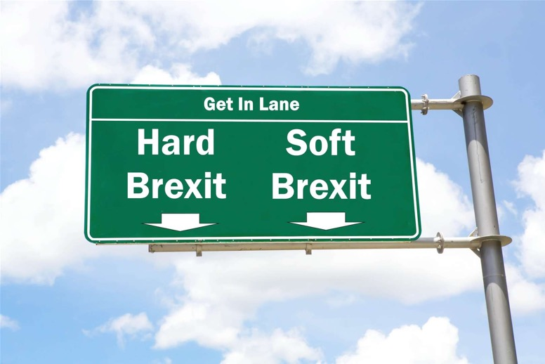
Or in other words: What have we decided ?

Slide 17
Practical Application - EU Regn 2015/848
Assuming Soft Brexit of some description
Withdrawal Agreement : Article 63(c)
  The Regn will have effect providing main proceedings opened before the end of the transition period
  I.e. before 31 December 2020.

Slide 18

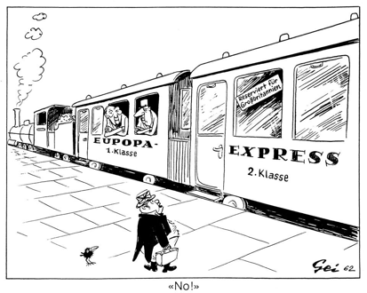

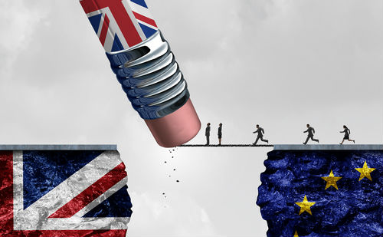
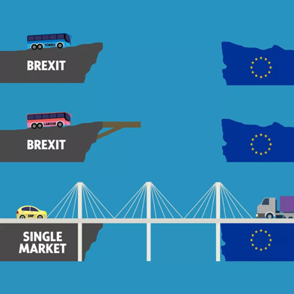
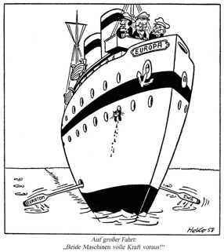
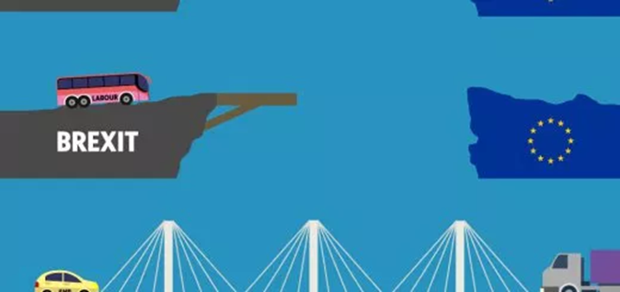

Slide 19
Challenges
  Asymmetric application
  Separate judicial interpretation; and
  Separate legislative development

Slide 20
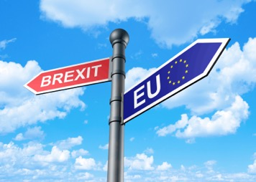
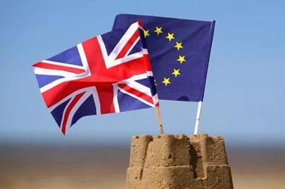
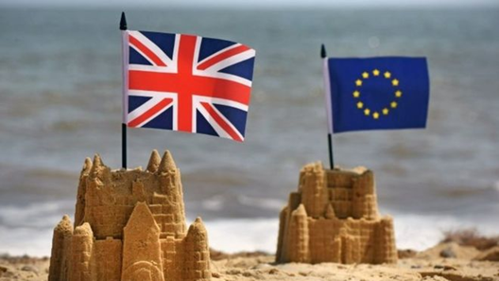
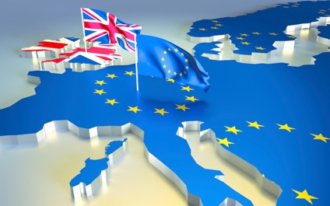

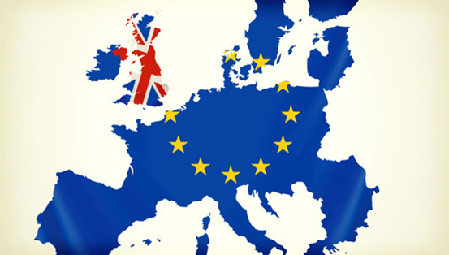


Slide 21
Goodwill – as at 30 August 2018
“Partenariat étroit et spécial“ Theresa May, 20/01/18
Mais cette voie spéciale devra être compatible avec la préservation du marché unique et de nos intérêts collectifs. Emmanuel Macron, 20/01/2018

Slide 22
Preventive Restructuring Frameworks
Moderator: Prof. Reinhard Dammann
(Clifford Chance/Sciences Po Law School, France)
Prof. Christoph Paulus
(Humboldt-Universität zu Berlin, Germany)
Prof. Francisco Garcimartin
(University Autonoma of Madrid, Spain

Slide 23
The EU Proposal – Quo vadis?
Where are we going ?
Reinhard Dammann
(Partner, Clifford Chance Europe)

Slide 24
What is the main issue ?
There is a necessity to open preventive restructuring proceedings as early as possible in order to increase the chances of success
But
The reverse side of the coin : opening of proceedings constitute a departure from the pacta sunt servanda principle, i.e the interference into creditors’ and equity holders’ rights (automatic stay, cram-down).

Slide 25
The French response
Two stages model:
Conciliation phase followed by
SFA-SA as a closing mechanism

Slide 26
The French response (continued)
First phase
Consensual debt restructuring
Individual stay mechanism available
protection against the opening of adverse regular insolvency proceedings
inclusion of guarantors; provisions favouring new money financing

Slide 27
The French response (continued)
Second phase:
Cram-down within creditors’ committees (to be reformed) and
Automatic stay of all concerned creditors
But no cross-class cram-down, including for equity holders, to be reformed

Slide 28
The French response (continued)
Areas of improvement
Classes of creditors
Cross –class cram-dow
Debt to equity swap

Slide 29
Solutions proposed by the Directive
The Directive’s Proposal is based on a combination of:
The French model
The scheme of arrangement model (with respect to classes of creditors and cram-down)
Enriched by the US Chapter 11 approach on cross-class cram down (which is a variation to the German model)

Slide 30
Policy recommendations
Clarification of scope
Free choice of frameworks for Member States
Regular Insolvency proceedings are excluded from the scope of the Directive

Slide 31
Policy recommendations
No treshold needed to open preventive restructuring proceedings
No need for an automatic stay during the first phase
Possibility to appoint an IP
Possibility for individual stay of enforcement measures

Slide 32
Policy recommendations
Simplified model of cross-class cram-down mechanism (e.g. German model):
Majority of classes of creditors for cross-class cram-down purposes (incuding equity holders)
Fairness test
Softened absolute priority rule

Slide 33
Policy recommendations
Court’s intervention is necessary:
When preferential rights are granted in favor of creditors when sanctioning the restructuring plan
If Safe Harbor mechanism is implemented
In case of cram down and cross-class cram-down in order to protect minority creditors and other third party stake holders

Slide 34
Policy recommendations
Reduction of the length of the automatic stay
In a two phases scenario the maximum stay is three months

Slide 35
Policy recommendations
Cross-class cram-down
Best interest test seems to be questionnable
Fairness test seems to be sufficient
The absolute priority rule should be softened

Slide 36
Policy recommendations
Special provisions for group of companies
Third party effect of the restructuring plan on guarantors
Coordination provisions for group of companies in cross-border situations

Slide 37
Delegate Coffee Break
Kindly Sponsored By
www.troostwijkauctions.com

Slide 38
Break-out-session I.
NPLs: a solution or a mistake?
Moderator: Stathis Potamitis (POTAMITISVEKRIS, Greece)
Adrian Thery (Garrigues, Spain)
Nico Tollenaar (RESOR, The Netherlands)
Theodore Athanassopoulos (Alpha Bank, Greece)

Slide 39
Break-out-session II.
How to crack down on offshore companies
Moderator: Eitan Erez (Eitan S. Erez & Co, Israel)
Frances Coulson (Moon Beever, UK)
Stephane Bonifassi (Bonifassi Avocats, France)
Michael Murphy (McCann Fitzgerald, Ireland)

Slide 40
Break-out-session III.
New mobility – challenge or opportunity for the automotive industry?
Moderator: Riaz Janjuah (White & Case, Germany)
Jens Haas (AlixPartners, Germany)
Hans Remsing (Deutsche Bank, Germany)
Patricia Godfrey (CMS, UK)

Slide 41
Break-out-session IV.
Distressed Assets Sales and Insolvency legal tools
Moderator: Konstantinos Issaias
(Kyriakides Georgopoulos Law Firm, Greece)
Alessandro Scarso (PLUTA, Italy)
Lukas Fecker (Innovation Brain, UK)
Martin Heidrich (Taylor Wessing, Germany)

Slide 42
Delegate Lunch
Kindly Sponsored By
www.mcstayluby.ie

Slide 43

Afternoon Technical Session
Kindly Sponsored By
www.moonbeever.com

Slide 44
The Judicial Wing:
Cooperation and Communication between Judges in Cross-Border Insolvencies under the EIR Recast
Moderator: Prof. Heinz Vallender (University of Cologne, Germany)
Judge Caroline Costello (High Court of Justice of Dublin, Ireland)
Judge Luciano Panzani (Court of Appeal of Rome, Italy)
Judge Emil Szczepanik (District Court for the Capital City of Warsaw, Poland)

Slide 45
New challenges for courts and administrators
Art. 42, 43 and Art. 57, 58 EIR establish a duty of cooperation and communication between courts and courts and administrators
- Art. 42 (1), 57 (1) EIR set out the general duty and its limits
- Art. 42 (2), 57 (2) EIR and Art. 42 (3), 57 (3) EIR specify its implementation
Forms of cooperation
Limits -will they prevent an efficient cooperation?

Slide 46
Appointment of an Intermediary
Role models: Art. 27a of the Model Law and 23.4, 23.5 ALI/III Global Principles
The requirement of “independence” of the person or body is not defined further
No specification to the bodies which may be appointed
- Who are suitable bodies? Qualification pp.
Remuneration

Slide 47
The (non)-cooperative court and the (non)-cooperative administrator – consequences?
The (non)-cooperative administrator
  Supervision by the Court
  Dismissal
  Liability
The (non)-cooperative court
  Liability

Slide 48
New challenges for courts and administrators
Language and cultural differences
  the way impartiality is perceived in EU jurisdiction– how judges may (or should refrain from) interact with the parties – mainly debtors and creditors;
  how the activity of the judge (or lack of it) from one jurisdiction may be perceived by stakeholders in another jurisdiction e.g. – creditors from the other jurisdictions.
Organizational limits
  the way insolvency judicial system is organized in EU countries (specialized courts or general commercial courts, technical limitations, commercial and consumer insolvencies – overload of day-to-day practice, position of the court or judge commissionaire;
  limits that are in civil law procedures – usage of different languages, minutes from the direct, electronic communications, presence at court hearings;
  does the regulation needs an internal implementation to be effective - directive on preventive restructuring frameworks, second chance – hope for a level playing field.
Obligation to cooperate.
Remedies against IPs, debtor-in-possession, disciplinary proceedings against judges, claims against the State – is it possible if judges are not willing to cooperate? apart from EU Commission intervention - infringement procedure.

Slide 49
The Italian Perspective
Judge Luciano Panzani
(Court of Appeal of Rome, Italy)

Slide 50
All Courts who deal with procedures referring to group’s undertakings must cooperate communicating each other and exchanging informations.
Art. 57 of the Regulation says that cooperation may , in particular , concern:
(a) coordination in the appointment of insolvency practitioners;
(b) communication of information by any means considered appropriate by the court ;
(c) coordination of the administration and supervision of the assets and affairs of the members of the group;
(d) coordination of the conduct of hearings;
(e) coordination in the approval of protocols where necessary .

Slide 51
The insolvency practitioners may:
a) communicate each other any information relevant to the other proceeding excluded the protection of confidential information.
b) verify if the coordination and supervision of the administration is possible and if the answer is yes, they must act in this direction.
c) try to implement a coordinated restructuring plan.
The insolvency practitioners to achieve this purpose may decide to grant to one of them additional powers if the national laws permit such solution and then they may also agree to grant certain tasks to one of them if it’s allowed by the national legislation.

Slide 52
Limits to the cooperation and communication
a) it must be appropriate to facilitate the effective administration of the proceedings;
b) it must be not incompatible with the rules applicable to the proceedings;
c) it must not entail any conflict of interest.

Slide 53
Communication and Cooperation and National Legislation
CERIL: it is useful for national legislators to safeguard a seamless and effective adoption of a Regulation by arranging for legislation concerning the incorporation of the EIR (including compatibility with certain elements of domestic law) into national law

Slide 54
Italian draft
Communication and cooperation between judges, administrators of insolvency proceedings and judges, and between insolvency proceedings managers opened in Member States addressed to Regulation (EU) 2015/848 is governed by the rules of the same Regulation.

Slide 55
Italian Draft (II)
In the cooperation and communication, judges and administrators adopt the Italian language and, where not possible, the English language.
Costs for cooperation and communication between judicial offices are considered as expenses of justice; those of the directors with the judicial offices and among them are considered costs of procedure.

Slide 56
Critical topics
Appointment of the same I.P. in the Italian and foreign procedure
Appointment of an Independent Person or Body
Who decides if required information is confidential?

Slide 57
Critical topics (II) Protocols
There must be Court or Creditors Committee approval.
Special attention in case of crucial clauses: choice of law applicable or chosen by parties, refraining to call upon a surety, waiving the right to sue directors or clause providing that costs of creating/drafting the protocol will be borne by creditors

Slide 58
Critical topics (III) Protocols
Conflict with mandatory national law:
clauses that infringe rules of mandatory law, a confidentiality clause in the relation to a requirement for instance on transparency of proceedings, or clauses that seem to conflict with the protection of information rights of creditors or a stay of proceedings

Slide 59
Project Reports:
CoCo2 and Cork
Paul Omar
INSOL Europe
Technical Research Coordinator

Slide 60
Communications and Cooperation (CoCo 2)
2006 text; Superseded by Recast EIR and JudgeCo Rules 2015
Joint Project with CERIL
Working Group Co-Chairs: PO and Tomas Richter
First Round Consultation: Project Parameters (Apr-May)
Drafting Phase: Post-Conference
Second Round Consultation and Presentations at 2019 Events

Slide 61
Cork Project (Judicial Cooperation on European Restructuring)
EU-funded bid (JCOERE)
Project Partners: Cork, IE, Florence, Titu Maiorescu Bucharest
Investigating impediments to cross-border reorganisations
Assessing international benchmarks, legal basis for cooperation in Recast EIR and any changes as result of Draft Directive to cross-border restructurings
First phase: Planning Meeting (Nov 2018) determining project steps
Aiming at consulting judiciary in Slovenia and Copenhagen; establishing possible benchmark for cooperation

Slide 62
The Recast of the EU Insolvency Regulation – One year down the road
Moderator: Giorgio Corno (Studio Corno Avvocati, Italy)
John Briggs (South Square, UK)
Nicolas Theys (Dentons, France)
Judge Caterina Macchi (Civil Court of Milan, Italy)

Slide 63
International jurisdiction and examining judgments opening insolvency proceedings:
  Specification if the proceedings opened are main or secondary proceedings (art. 4.1 EIR_R): The experience of the Court of Milan. Comments by panellists on the practice of other courts
  Appeals brought against the judgment on international jurisdiction (art. 5 EIR_R). The English experience before Regulation 848, in cases of bankruptcy tourism by individuals and the practice since the coming into force of Regulation 848

Slide 64
Undertaking under art. 36 EIR_R
  The similar experience of an “undertaking” under EIR
  Lack of known case law on this article 36
  An Italian – French case handled under EIR using art. 36 EIR_R

Slide 65
Publicity and information to creditors in the Member States of the Panellists
  The establishment of insolvency registers (art. 24 EIR_R ff) within Member States; brought into effect or not?
  Publication in another Member State and in public registers of another State(arts. 28 & 29 EIR_R)
  Duty to inform known foreign creditors pursuant to art. 54 EIR_R

Slide 66

Delegate Coffee Break
Kindly Sponsored By
www.cpo.nl

Slide 67
The Anti-Fraud Forum:
The “Sherlock Holmes” Session
Moderator: David Ingram (Grant Thornton, UK)
Claude Montgomery (Dentons, USA)
Col. (Res.) Dakar Eilat (Initiative Defense Solutions, Israel)
Moti Golan (Spyshop, Israel)

Slide 68
Anti-Fraud Forum: Sherlock Holmes
David Ingram
Grant Thornton UK LLP
Moti Golan
GolanTec CEO
Dakar Eilat
IDS CEO
Claude Montgomery
Dentons

Slide 69
Detection and Tracking in the Commercial World
Moti Golan
GolanTec CEO
Dakar Eilat
IDS CEO

Slide 70
A few words on personal experience from the Anti-Fraud Forum Co-Chair
David Ingram
Partner and Head of Proceeds of Crime Team
Grant Thornton UK LLP

Slide 71
I Spy and the Limits of Private Investigation for Lawyers
Why I can’t know everything, even if I wanted.
Claude Montgomery
Partner, Dentons

Slide 72
Why Lawyers Use Private Investigators
Competence
  Nature of the investigation may be beyond the capabilities of the lawyer or members of her/his team.
  All investigative material is subject to discovery in the US
Witness
  All investigators who generate material are subject to being deposed or to being compelled to appear as a witness in court by subpoena
  Lawyers as witnesses for clients
    Bad idea - in US normally not allowed due to attorney client privilege waiver issues
    Ethics rules render counsel subject to disqualification if their testimony is material to the case.
  RULE 3.7 of the New York Rules of Professional Conduct (the “NY RPC”) generally precludes a lawyer from acting as an advocate and witness. C.P.L.R. Part 1200 et. seq.

Slide 73
Evidence Exclusion Issues
Wire Taps and Electronic Surveillance Rules
Federal courts always exclude illegal surveillance
  Wire and Electronic Communications Interception and Interception of Oral Communications Act
  “Whenever any wire or oral communication has been intercepted, no part of the contents of such communication and no evidence derived therefrom may be received in evidence…”
State Courts often exclude electronic eavesdropping
  Under NY Civil Procedure Law and Rules evidence obtained in violation of Penal Law Article 250 (eavesdropping and wiretapping) is inadmissible. (C.P.L.R§4506). *

Slide 74
Unlawful to Gather Electronic Surveillance
Electronic eavesdropping US
  37 states, Puerto Rico and D.C. require consent of at least one party to the conversation to consent
  13 states require both parties to consent before recording can be made
  Criminal conduct to record conversation without required consent(s)
No EU regulation found
  “A corollary of the EU’s lack of competence in the area of surveillance is its lack of authority to legislate on secret surveillance in order to limit it and/or impose stricter safeguards.” [https://www.loc.gov/law/help/intelligence-activities/europeanunion.php]
German Federal Data Protection Act
  Ban subject to permission: The collection, storage and use of personal data is in principle prohibited unless permitted by a legal provision or the affected individual’s consent ] https://www.bfna.org/research/echos-of-history-understanding-german-data-protection/

Slide 75
Digital Photography may also be Restricted
“Such infringements of privacy rights by means of photographs is also subject to Paragraph 201a of the German Criminal Code. This was made more stringent in 2015. What does it refer to? Paragraph 201a refers to special violations of highly private areas of a person’s life,…”[https://www.goethe.de/en/kul/med/20849366.html ]
Article 9 of French Civil Code states: “Everyone has the right to respect for his private life”.
This is generally considered to include one's right to their own image, even if it is taken in a public space. According to case law and legal doctrine, photographs taken of (one or more) individuals require authorization. [https://commons.wikimedia.org/wiki/Commons:Country_specific_consent_requirements (footnotes omitted)]

Slide 76
High Profile Investigators
Gordon Novel (February 7, 1938 – October 3, 2012 )
  “worked…as private investigator to the DeLorean Motor Company chairman John DeLorean in 1982. DeLorean claimed there was a conspiracy between Britain's Conservative Party and U.S. and British intelligence agents to close DeLorean's manufacturing plant in Northern Ireland. DeLorean's claims relied on Gordon Novel's investigation and resulting evidence.” [https://en.wikipedia.org/wiki/Gordon_Novel]
  Jonathan Rees UK Citizen (Born September 1954 in Doncaster, Yorkshire)
  Reportedly hired by News of the World…”worked regularly on behalf of the Daily Mirror and the Sunday Mirror, as well as the News of the World, investigating the bank accounts of the royal family, and obtaining information on other public figures. …He was also alleged to have commissioned burglaries on behalf of journalists.”
  [https://en.wikipedia.org/wiki/Jonathan_Rees (citations omitted)]

Slide 77
Private Investigator Horror Stories
An Arkansas lawyer has been reprimanded in South Carolina for sending private investigators into the state to pose as customers, make false statements and gather evidence of intellectual property infringement. The conversations were tape-recorded without notice to the employees. http://www.abajournal.com/news/article/arkansas_lawyer_is_reprimanded_over_use_of_private_investigators_who_misrep
A private investigator has pleaded guilty to charges that he bribed employees of the Lafayette, Louisiana, District Attorney’s Office in exchange for favorable treatment for his clients. http://www.abajournal.com/news/article/investigator_pleads_guilty_to_bribing_da_staffers_in_exchange_for_favorable/

Slide 78
Private Investigator Horror Stories
A former police officer turned private detective has been accused of setting up divorcing men for drunken driving arrests with the help of alluring women who pretended to have a romantic interest in their targets. The private detective has also been accused in a federal indictment of selling drugs for police and helping cops open and operate a brothel, the Los Angeles Times reports. http://www.abajournal.com/news/article/private_detective_accused_of_setting_up_divorcing_men_for_duis_with_help_of/

Slide 79
Rules and Issues
Electronic Surveillance Limits
  Wire and Electronic Communications Interception and Interception of Oral Communications Act 18 U.S.C.§2511 (Interception and disclosure of wire, oral or electronic communication).
  The Electronic Communications Privacy Act, 1986 as amended 2017, 18 U.S.C.§2701 et seq. (ECPA.)
  Communications Assistance for Law Enforcement Act, 47 U.S.C.§1004 et seq. (CALEA) (Interception of Digital and Other Communications).
  The USA PATRIOT Act (“Uniting and Strengthening America by Providing Appropriate Tools Required to Intercept and Obstruct Terrorism Act of 2001“).
  Graham Leach Billy Act (Makes it unlawful for banks to make available to third parties retail customer information without consent. PL 106-102 (1999))

Slide 80
Anti-Fraud Forum: Sherlock Holmes
Questions?
David Ingram
Grant Thornton UK LLP
Moti Golan
GolanTec CEO
Dakar Eilat
IDS CEO
Claude Montgomery
Dentons

Slide 81
Closing remarks of the day
Radu Lotrean
President of INSOL Europe
CITR, Romania

Slide 82

Young Members’ Group Reception
Kindly Sponsored By
www.schiebe.de

