Slide 1
Break-out-session II.
How to crack down on offshore companies
Moderator: Eitan Erez (Eitan S. Erez & Co, Israel)
Frances Coulson (Moon Beever, UK)
Stephane Bonifassi (Bonifassi Avocats, France)
Michael Murphy (McCann Fitzgerald, Ireland)

Slide 2
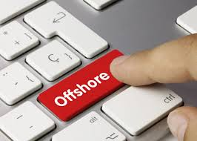
How to crack down on offshore companies
Adv. Eitan Erez
Co-Chair of the Anti-Fraud Forum
in INSOL-Europe

Slide 3
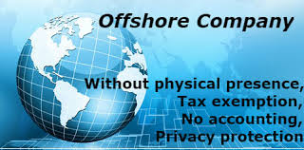

Off-Shore Company
Classifying offshore companies
Characteristics of offshore companies
They are broadly not subject to taxation in their home jurisdiction.
The corporate regime will be designed to promote business flexibility. Regulation of corporate activities will normally be lighter than in a developed country.
© EITAN S. EREZ & CO. - LAW OFFICE

Slide 4
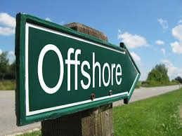
Uses of Off-Shore Companies
A tool for money hiding & laundering.
“Cloud money” – no legal space
A tool to evade taxation .
A tool to circumvent religious laws.
© EITAN S. EREZ & CO. - LAW OFFICE

Slide 5
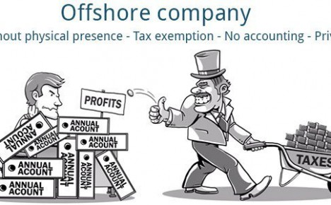
Some illegal reasons for the establishment of an offshore company
Hide funds from the tax authorities
Funds obtained from criminal activity
Hiding funds from creditors or spouses
To evade payment under the laws of inheritance and inheritance tax (tax planning)
© EITAN S. EREZ & CO. - LAW OFFICE

Slide 6

Popular Tax Shelters
Most off shores venues are linked to the U.K.
The U.K. makes a profit of 150 billion GBP a year from off shore companies.
Cayman islands hold 1.6 billion GBP but actually the money is not there.
© EITAN S. EREZ & CO. - LAW OFFICE

Slide 7
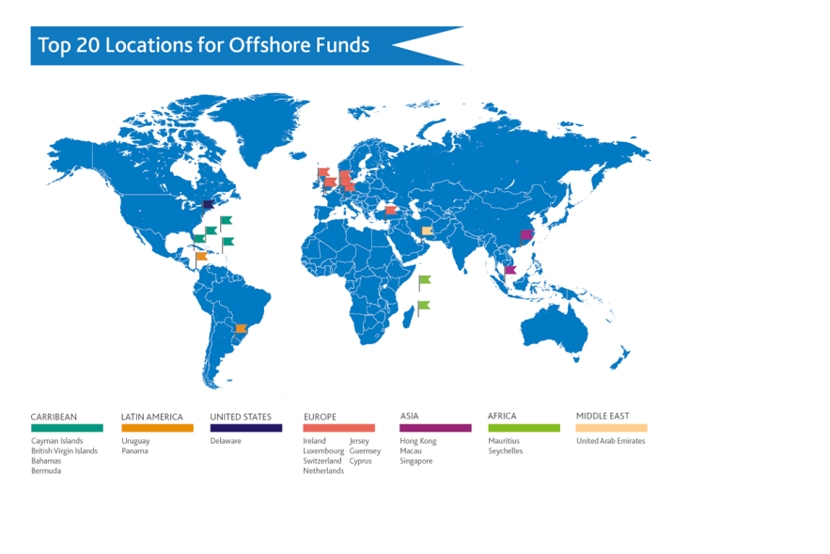
Popular Tax Shelters
© EITAN S. EREZ & CO. - LAW OFFICE

Slide 8
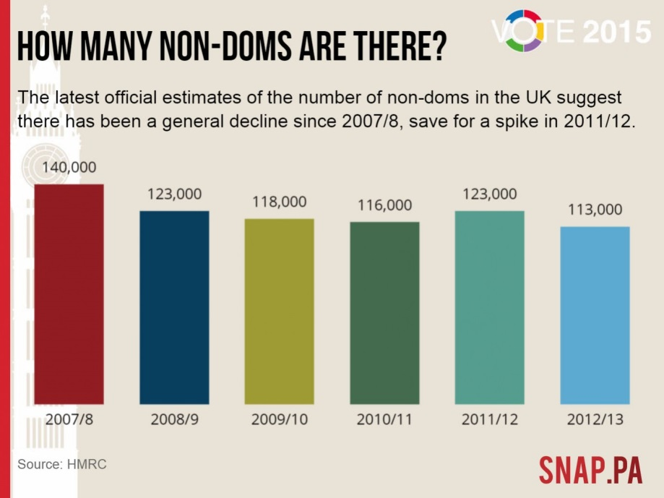
Non-Domiciled status in the UK
Non-domiciled status, sometimes called a 'non-dom', is a person living in the United Kingdom who is considered under British law to be domiciled(resident) in another country. This can have significant tax advantages for the wealthy. In 2010, non-doms became a political issue. Note that this status is not the same as citizenship; a non-dom may be a British passport-holder, or may be a foreign national.
© EITAN S. EREZ & CO. - LAW OFFICE

Slide 9
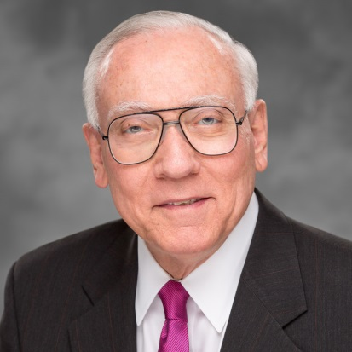
Raymond W.Baker:
Off Shore Banking is ugly !
“Offshore banking” is a modern day Conquistador system for plundering the developing world of its wealth or, as Global Financial Integrity director Raymond Baker puts it:
“The tax haven system is the ugliest chapter in global economic affairs since slavery.”
And I am adding that off shore companies are also the no. 1 tool for fraudsters to hide assets from creditors and from the tax authorities.
© EITAN S. EREZ & CO. - LAW OFFICE

Slide 10
IP is sild to an off shore company and the big company pays royalties to the off shore company! outcome is no taxation
Singapore, Bermuda, Cayman island ,Switzerland receive 75% of profit of all multinationals
Irish double standard, Ireland imposed 12.5% companies tax but closes an eye and enables evasions
70% of Apple incomes are diverted to Ireland all though the R&d and production are in California multinationals don't pay tax anywhere
Google pay only 6 M GBP a year in Brittan – that’s it!
I recommend in this issue an interesting film “the price we pay” by Harold Crocks
© EITAN S. EREZ & CO. - LAW OFFICE

Slide 11
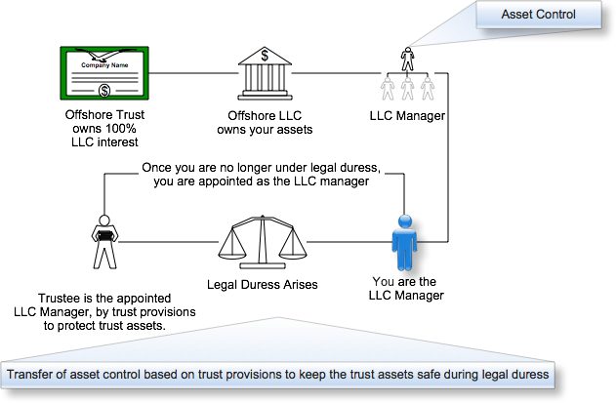
Registered Agent
© EITAN S. EREZ & CO. - LAW OFFICE

Slide 12
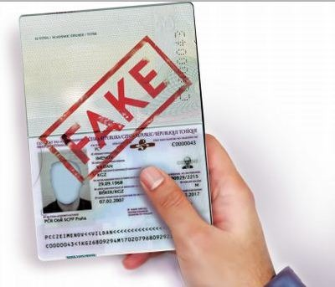
The Agent Best Profit – keep mail
Examples of cracking an off shore company
Rachel S. Soffer – BVI
Eli Reifman – Cyprus
© EITAN S. EREZ & CO. - LAW OFFICE

Slide 13
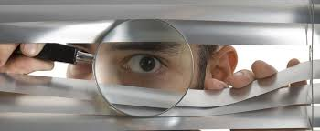
How to deal with the phenomenon
Tracking the debtor's mail without his knowledge
3% Property tax a year
Open and hidden investigations of the debtor and his acquaintances
Cross-reference of passport data to the entry and exit report
Cross-checking of credit card data and withdrawals in current accounts
A global effort is needed and I urge IE to start an effort for a global treaty
© EITAN S. EREZ & CO. - LAW OFFICE

Slide 14

How to crack down on offshore companies
Frances Coulson – Senior Partner, Moon Beever

Slide 15

HISTORY OF OFFSHORE TRUSTS

Slide 16
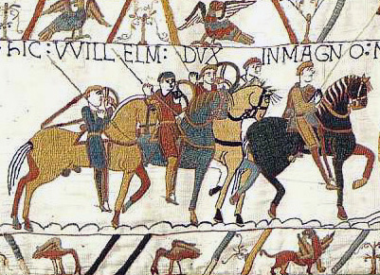
HISTORY OF OFFSHORE TRUSTS

Slide 17
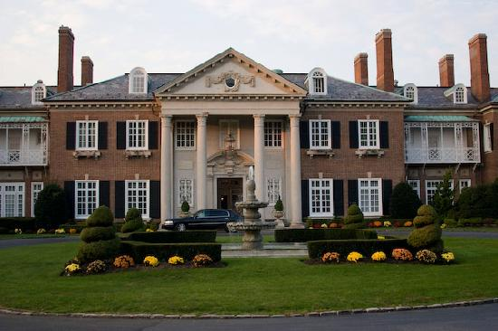
Notes:
International Credit & Investment Co (Overseas) Ltd v Adham [1998] BCC 134 (at 136)
https://www.emmlegal.com/news/freezing-injunctions-discretionary-trusts-voyage-discovery

Slide 18

Bahamas, Bermuda, British Virgin Islands, Cayman Islands, Cook Islands, Cyprus, Gibraltar, Guernsey, Isle of Man, Jersey, Liechtenstein, Madeira, Malta, Mauritius, Monaco, Nevis, New Zealand, Panama, Seychelles, Turks & Caicos, Vanatu.

Slide 19
CREATION OF AN (OFFSHORE) TRUST
Trust:- 3 essential conditions, -certainties of intention, subject matter and objects
What is “offshore”?
Generally this refers to nil tax jurisdictions whereby corporate structures are used for their legal certainty and flexibility.
Purpose trusts/charitable trusts
Notes:
Trust:-
three essential conditions, namely the certainties of intention, subject matter and objects
What is “offshore”?
Generally this refers to nil tax jurisdictions whereby corporate structures are used for their legal certainty and flexibility.
Purpose trusts/charitable trusts
https://www.insol.org/_files/Fellowship%202015/Session%2016/Off-Shore%20Insolvency%20&%20Restructuring.pdf

Slide 20
Breaking the Trust- Information
Freezing orders
Disclosure/Norwich Pharmacal/Bankers’ Trust Orders
Notes:
Bankers Trust Co v Shapira [1980]
Dadourian v Azuri [2005] EWHC 1768 (Ch)
JSC BTA Bank v Ablyazov [2010] EWHC 1779
Prest v Petrodel Resources Ltd [2013] UKSC 34
JSC BTA Bank v Ablyazov 2014 EWHC 2788 (Comm)

Slide 21

Breaking the Trust
Notes:
Pugachev [2015] EWCA Civ 906
JSC Mezhdunarodniy Promyshlenniy Bank and another v Pugachev and others [2017] EWHC 2426 (Ch)

Slide 22
UK Legislation & Approach Historic & New
Insolvency Act 1986 –s423
Criminal Finances Act 2017
Transparency
Fourth Anti-Money Laundering Directive.
HM Revenue & Customs

Slide 23
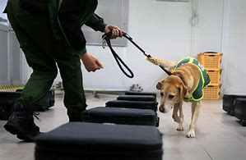
FOLLOW THE MONEY!

Slide 24
An Irish Perspective
Michael Murphy
Partner, Insolvency and Restructuring
McCann FitzGerald

Slide 25
Court Appointed Receiver
Powerful tool
Discretionary remedy
Powers tailored to specific circumstances of each case
Court appointed officer. Interference with powers contempt of Court

Slide 26
Winding up of Foreign Companies
Jurisdiction extends to both European and non-European companies and to partnerships
COMI must be within the State
Test
- unable to pay its debts or just and equitable that the Company be wound up

Slide 27
Consequences of winding up
Liability of shareholders and related companies
- pooling and contribution orders
- piercing the corporate veil
Set aside provision
- unfair preference
- fraudulent dispositions
Potential liability of directors
- reckless and fraudulent trading
- disqualification and restriction proceedings

Slide 28
Other Remedies
Share receiver as a tool to appoint nominees to the boards of companies
Asset freezing or mareva injunction
- Identify assets in Ireland or susceptible to an Irish Court order
- Risk assets will be dissipated
- Indicators of dishonesty powerful
- Full disclosure
Discovery and cross examination in aid of execution

