Slide 1
Our grateful thanks go to our 2018 Annual Congress Sponsors

Slide 2

Morning Technical Session
Kindly Sponsored By
www.alixpartners.com

Slide 3
Opening remarks by the Co-Chairs
Frank Tschentscher (Schultze & Braun, Germany)
George B. Bazinas (Bazinas Law Firm, Greece)

Slide 4
Keynote Speaker
Mr. Dimitrios Vervessos
President of the Athens Bar Association
and the Plenary Session of Greek Bars

Slide 5
Law & Economics:
A valuable relationship?
Bart De Moor (Strelia Law Firm/University of Leuven, Belgium)
George Georgakopoulos (Piraeus Bank, Greece)
Michael Thierhoff (Andersen Tax & Legal, Germany)
Prof. Jocelyn Martel (ESSEC Business School, France)

Slide 6
Law & Economics:
A valuable relationship?
Do the insolvency regulations and legislations work ?
Are they efficient ?
The views of a Professor of Finance and Law & Economics, a Director of a bank and an Advisor in Corporate Restructuring

Slide 7
The Economics of Bankruptcy
Jocelyn Martel
(Professor of Finance, ESSEC Business School)

Slide 8
2 solutions for firms in financial distress
Out-of-court restructuring
Court-supervised procedure
Role of a bankruptcy law
“The basic problem that bankruptcy law is designed to handle, both as a normative matter and as a positive matter, is that the system of individual creditor remedies may be bad for the creditors as a group when there are not enough assets to go around. Because creditors have conflicting rights, there is a tendency in their debt-collection efforts to make a bad situation worse. Bankruptcy law responds to this problem.” (Jackson, 1986)

Slide 9
Bankruptcy law should:
Offer a collective procedure in order to avoid a common property problem
Freeze the proceedings of all creditors
Allow for a valuation of the assets and the rights of all creditors involved
See to the distribution of the proceedings from the sale of the assets to creditors in the event of liquidation
Allow for a negotiation between the debtor and the creditors in the event of reorganization
Desirable criteria for a bankruptcy law
Provide the right incentives before bankruptcy (ex ante efficiency)
Maximize the value of the firm in bankruptcy (ex post efficiency)
Save viable firms & eliminate non-viable firm
Respect Absolute Priority Rule (APR)
Leave the firm’s future in the hands of affected creditors
Minimize bankruptcy costs
Question: is saving jobs desirable?

Slide 10
European directives: a preliminary analysis
Main objectives: establish minimum standards to:
  Reinforce preventive restructurings
    Early warning of financial distress
    Stay of proceedings for all creditors
    Acceptance of restructuring plans (simply majority of claims) by affected parties
    Confirmation of plans (Best-interest test) & cramdown provision
    Protection for new financing
  Reinforce the second chance policy for debt discharge (entrepreneurs)
  Data collection procedure to evaluate the impact of the new policy

Slide 11
Views and expectations
of an advisor in the field
Michael Thierhoff
(Andersen Tax & Legal)

Slide 12
Quality & Costs
Quality
Judges:
Anglo-Saxon approach
senior & seasoned
vs.
German approach young, gifted, generalist
Practitioners:
IP-Profession regulatory body, creditor involvement
vs.
Liberal approach, low access barrier, court discretion, limited influence of creditors

Slide 13
Quality & Costs
Costs
IP-Remuneration:
Incentives – you get what you measure
Time spent
Value
Budgets
SME-Illusion:
Complexity
Quality
Safeguarding minority interests
Negotiations with professional
lenders

Slide 14
Bank perspective of the economic efficiency of insolvency process
George Georgakopoulos
(Piraeus Bank, Executive Board Member)

Slide 15
Bank concerns & priorities for the insolvency regime
Encourage business growth and expansion
  Critical driver for the core banking product: loans
Predictability
  So that we can estimate outcomes and price risk
Restructure businesses to make them viable and able to grow in the long term
  Saving companies in itself seldom helps the economy or the banking sector if they are not fit
Avoid prevarication as delay leads to value destruction and uncertainty
  Facing up to business failure is very difficult and the law can help

Slide 16
How well does the Law address these at the moment?
Differs hugely between countries and across time
  Greece currently working through a mammoth number of cases from the long economic crisis with limited inherited infrastructure
Law generally does not do enough to force market players to face up failings of businesses
  Suggestion in the preamble to Directive (para 16)
Restructuring that “kicks the can down the road” too easy
  Viability should be tested and challenged not only at the approval phase but throughout process
Law needs execution by a community of professionals
  Need expertise and practice and creditors need tools to hold them to account
  Nomination and removal of office holders by creditors is missing
  Restructuring will always be more complex and professionally demanding than liquidation and where professional resources are limited can not be expected to be a universal solution

Slide 17
Piraeus Bank economic research: non-viable Greek companies
Starting from a very conservative definition, according to which a non-viable enterprise is an enterprise that is in operation for at least five (5) – in order to exclude the start-ups – and for three (3) consecutive years its profitability levels are so low that they are insufficient to cover current interest expenses (i.e. in technical terms, the financial expense coverage ratio is less than one). Based on the above, the following conclusions can be reached:
Non-viable enterprises account for 7.1% of the total sample in 2016. The percentage of non-viable enterprises aged between 21 and 40 years is particular high (37.8%).
Most non-viable enterprises (8.2%) are micro enterprises, followed by medium-sized (6%) and small (5.2%) enterprises, while the lowest percentage (4.4%) is recorded amongst large enterprises. However, because of their size, the economic impact of large non-viable enterprises is significantly higher compared to that of other size cohorts.
Trapped in non-viable enterprises is productive capacity (as reflected by their asset value) amounting to €28.4 bn, which equals to 16.3% of GDP.
Accordingly, non-viable enterprises have undertaken €23.5 bn liabilities or 22.6% of the total liabilities (which by and large are non-performing) and have €613 mn of annual financial expenses.
On average, viable enterprises do not have very high liabilities to assets ratio (56.1%), whereas non-viable enterprises have a significantly higher ratio (82.6%).
The results of non-viable businesses at EBITDA level amount to €-413 mn, while at the level before taxes they reach €-1.3 bn. Thus, the EBITDA margin stands at -10.3% and the return on assets ( ROA) at -1.5%.

Slide 18
The fact that more than 16.5% of the total productive capacity (assets) of the non-financial sector of the Greek economy is trapped in non-viable business schemes presents a huge cost not only for the enterprises themselves and their creditors (suppliers, banks, public state bodies, etc.) but for the whole community as well.
The methodology developed to assess the potential benefit from a restructuring programme for non-viable enterprises is a simulation exercise according to which the total assets and a part of liabilities of the enterprises identified as non-viable are absorbed by viable enterprises of similar size. The results of this exercise show that:
The potential profitability (EBITDA) increase is €2.6 bn.
The potential operating revenue increase is estimated at €16.7 bn.
The liabilities that – through their takeover by viable enterprises – could be repaid again amount to €15.9 bn.
The cost of restructuring in terms of “haircutting” part of the liabilities – that will not be transferred to the viable enterprises – is estimated at €7.6 bn.

Slide 19
How helpful could the Directive on “preventive restructuring frameworks” be?
Emphasis on the skills and expertise of professionals is very welcome in any case (Title IV)
Nations keeping insolvency “performance statistics” will advance monitoring of the system and be basis for further improvements (Title V)
Pro forma restructuring plans prepared by the authorities will reduce the entry barriers to the process for companies with less access to expertise
The time limits on “Stay” are welcome (Article 6), for early stage intervention and all restructuring processes
Welcome that process starts outside the court; hopefully they can be concluded outside the court as well
More should be done to encourage early recognition of problems by insiders and observers
The procedure(s) envisaged appear well designed, but unfortunately in Greece where economic troubles have been long standing, and so financial distress is seldom at an early stage

Slide 20
INSOL International
Adam Harris
(President of INSOL International
& Bowmans, South Africa)

Slide 21

Delegate Coffee Break
Kindly Sponsored By
www.bnt.eu

Slide 22
Legal Tech: how is modern technology affecting the work of advisers, IOHs, insolvency courts?
Frank Heemann (Moderator)
Partner, bnt attorneys in CEE
Aidas Kavaliauskas
Founder/Chief Innovation Officer, AMEA Legal
Bart Heynickx,
Counsel, ALTIUS Lawyers

Slide 23
Legal Technology (LT) – Introduction
  Definition(s)?
  Significance!
  What we will and won’t cover

Slide 24
Generations of LT* + examples
  LT 1.0 (technology empowering human players within the current system – examples: law practice management software, legal research data bases)
  LT 2.0 (technology replacing increasing number of human players within the current system, becoming disruptive – examples: machine learning in e-discovery, document assembly systems, automised legal service systems)
  LT 3.0 (the power of computational technology for communication, modeling and execution permit a radical redesign, if not a full replacement, of the current system itself – examples: smart contracts, AI)
  *accd. to Goodenough, https://www.huffingtonpost.com/oliver-r-goodenough/legal-technology-30_b_6603658.html?guccounter=1

Slide 25
Selected Examples in more detail
  Preventive monitoring of companies (Belgium)
  Online Central Solvency Register (Belgium)
  Algorithm based IOH selection systems – “IT selects IP” (e.g. Hungary, Lithuania, Slovakia, Portugal)

Slide 26
Preventive monitoring of companies (Belgium)
  Belgian Commercial Courts - Commercial investigations
  Identifying, assisting and/or eliminating companies in financial difficulty
Alert system
  Collecting information
  Different databases
  Accountants
  Working on uniform system

Slide 27
Preventive monitoring of companies (Belgium) (cont’d)
Monitoring by the court
  Delegated judge
  Report
  Liquidation / Bankruptcy
Monitoring outside of court
  Specialised organisations;
  Sharing data
  Parliamentary questions

Slide 28
Online Central Solvency Register (Belgium)
  Since 1 April 2017 – extended since 1 May 2018
  Founded by Bar Associations
  Multiple goals
    Bankruptcy
    Reorganisation under Court Protection
    Amicable agreement

Slide 29
Online Central Solvency Register (Belgium) (cont’d)
  Multiple functions
    Apply as debtor
    File as creditor – access
    Follow-up by court – receivers – provisional administrators
  Follow-up
    Requests and (court) decisions
    Claims and follow-up thereof

Slide 30
Algorithm based IOH selection systems – “IT selects IP” (e.g. Hungary, Lithuania, Slovakia, Portugal)
  More likely in countries / societies with low degree of trust in public institutions, including courts, IOH?
  Various degrees of application (from only to some types of proceedings (LT, HU), to all types of proceedings (SK))
  Various degrees of sophistication (from ‘Lottery’ (SK) to more complex ‘IT selects IP’ (LT))

Slide 31
Algorithm based IOH selection systems – “IT selects IP” – Lithuania
  Restricted to in-court bankruptcy proceedings (vast majority of proceedings)
  IP selected by software and appointed by judge
  Based on a categorization of (i) IPs and (ii) companies (debtors)
  Strict limitations for IPs to refuse the appointment

Slide 32
Algorithm based IP selection systems – “IT selects IP” – Lithuania (cont’d)
IP categorization criteria:
  General experience (number of past cases weighted according to certain rules)
  Special experience (e.g. cross-border bankruptcy, ongoing business)
  Current Workload (number of nominal bankruptcies administrated)
  Past refusals + current disciplinary sanctions

Slide 33
Algorithm based IP selection systems – “IT selects IP” – Lithuania (cont’d)
Company categorization (small, medium, large) by (not-specialized) judge – criteria:
  Volume of creditor claims (small: up to 30k EUR; medium: 30k - 300k EUR medium; large: > 300k EUR)
  Assets to be administered (small: up to 30k EUR; medium: 30k –300k EUR medium; large > EUR 300k)
  Number of creditors (small: up to 40 small; medium: 41-80 medium; large: > 80)
  Area of activity of company (if this is relevant for required special experience of IP)

Slide 34
Challenges & questions
  Human factor: to what extent should human beings remain decision makers
    Judiciary as a fundamental cornerstone of a democratic society
  Checks & Balances and Security issue: who controls the system?
    how to ensure adequate control by human beings?
    Need for professions like “Legal Technician”?
    E.g. GDPR – profiling & automated decision taking (cf. Recital 71 GDPR)

Slide 35
Challenges & questions (cont’d)
  Funding (Initial and cont’d) for implementation + maintenance of LT in the public sector
  Who can / should push for modernization in the public sector?
  Regulating / permitting access to (big) data of public institutions
  Information gap: is necessary information (publicly) available ?

Slide 36
Challenges & questions (cont’d)
  Law firm challenges: level of LT used today? How to move from 0 to LT 3. Can I skip development stages? Recommendations?
  Law firm challenges: pricing of LT? On-Demand Software (SaaS)?
  Widening gap between “tech savvy” and well equipped IPs and (small) unequipped IP? Are you still a good lawyer / IP if you are not “tech savvy”?
  Is legal technology really going to be ‘disruptive’? When?
  Insolvency & restructuring: what to expect in the future? (connectivity, big data, predictive analytics, Technology Assisted Review (TAR), mobile solutions, software on demand, AI)

Slide 37
Challenges & questions (cont’d)
  Role of INSOL Europe in accompanying / shaping the use of LT in the future?

Slide 38
Further reading
  Heemann/Stonys/Pikaly/Bodis ‘IP Appointment Lottery: Experiences in Lithuania, Slovakia and Hungary with random IP selection systems’ Eurofenix, Spring Edition s2018
  Heemann/Gasparke ‘Lottery and liability’, Eurofenix 2015, Spring Edition
  Cohen ‘Global Legal Tech is Transforming Service Delivery’, Forbes, 29/8/2017
  Heynickx/Vermeersch, ‘Insolvency goed digital: Regsol and its innovations’, www.internationallawoffice.com, June 2018
  Heynickx, ‘Follow-up monitoring of companies in financial difficulty’, www.internationallawoffice.com, September 2018
  https://www.regsol.be/

Slide 39
Digital assets
Moderator: Piya Mukherjee (Horten Law Firm, Denmark)
Tom Braegelmann (BBL Bernsau Brockdorff
& Partner Rechtsanwälte, Germany)
Ilya Kokorin (Buzko & Partners, Russia/
University of Leiden, The Netherlands)
Jay Doyle (Swansea University, UK)

Slide 40
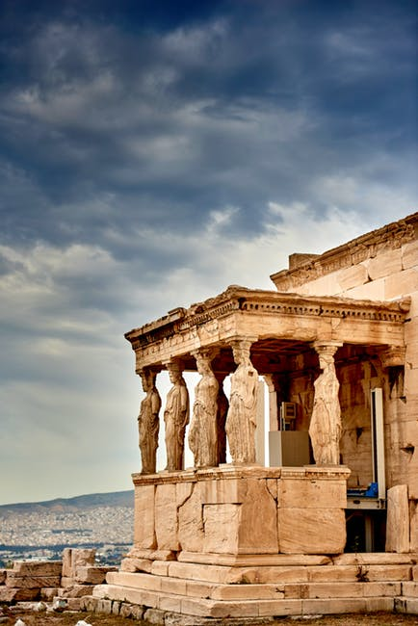

Athens
Annual Congress
2018
Digital Assets in Insolvency
Piya Mukherjee (Horten Law Firm, Denmark)
Tom Braegelmann (BBL Bernsau Brockdorff & Partner Rechtsanwälte, Germany)
Ilya Kokorin (Buzko & Partners, Russia/Leiden University, The Netherlands)
Jay Doyle (Swansea University, UK)
6 October 2018

Slide 41




Contents
Introduction to blockchain technology
Initial coin offerings (ICOs)
Cryptocurrencies
Traceability and uncovering fraudulent transactions
Regulatory and legal considerations
Smart contracts
6 October 2018, Athens

Slide 42

Poll
Have you ever bought Bitcoin or any other crypto asset?
Yes
No
What is Bitcoin?
6 October 2018, Athens

Slide 43
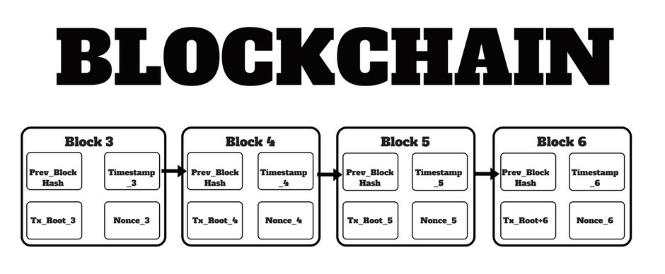
What is blockchain?
Decentralized
Non-repudiable
Transparent
Anonymous
Fast
6 October 2018, Athens

Slide 44

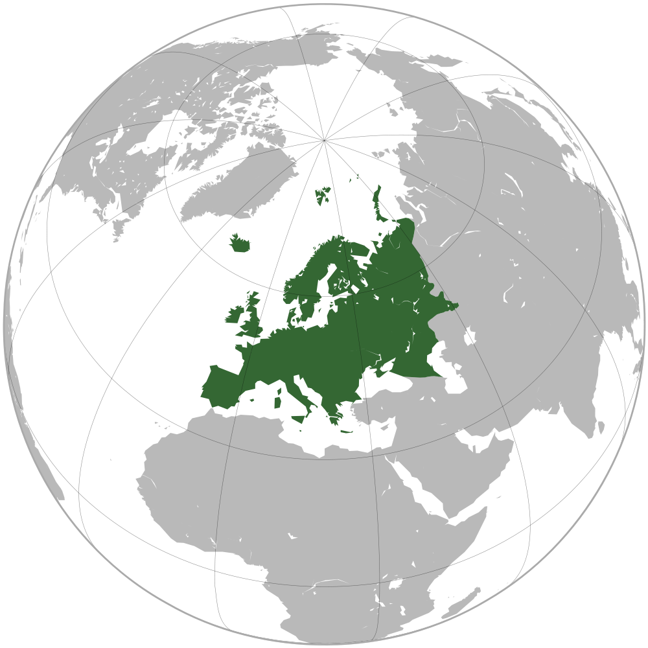
The story of Cutting Edge Ltd.
Facts about
Cutting Edge Ltd. (CEL)
Founded in 2015 in an EU member state;
In 2016 it raised EUR 1 million in an ICO;
From the white paper: “Building next generation platform, based on a decentralized network that puts users in the driver’s seat…”
In 2017 it invested in various types of crypto assets;
In August 2018, its CEO went missing, the website of CEL stopped responding;
In September 2018 creditors of CEL initiated insolvency proceedings in Europe.
6 October 2018, Athens

Slide 45

6 October 2018, Athens

Slide 46
What is an initial coin offering?
What are ICOs?
Facts about ICOs
A fundraising tool, linked to the creation of new coins or digital tokens, which are offered for sale to (usually) retail investors. Unlike in case of IPOs, most of the time ICO investors do not get an equity stake in the company distributing tokens. Instead, tokens purchased can be exchanged for future goods/services or sold at profit.
In 2017 ICOs raised over USD 7 billion, and in 2018 have exceeded USD 12 billion;
Scams and fraud constitute as much as 20% of projects, over 50% of ICO projects have failed to raise funds or are no longer operational;
What should we know about ICOs?
ICOs can be securities offerings;
They may need to be registered;
Tokens sold in ICOs can be called many things;
ICOs may pose substantial risks to investors;
Ask questions before investing.*
*https://www.sec.gov/ICO
The majority of tokens are designed and sold using the protocols of public smart-contract technology called Ethereum;
Global regulation has not come to agreement about ICOs.
* Sources: Autonomous NEXT, SEC
6 October 2018, Athens

Slide 47
Balance sheet of Cutting Edge Ltd.
Balance sheet of Cutting Edge Ltd. (as of 1 May 2018), in thousands of EUR
Assets |  | Liabilities
Cash | 100 | Tokens payable (ICO’s) | 1000
Operating equipment | 10 | Premium on tokens payable | 100
Cryptocurrencies | 500 | License obligations (smart contracts) | 100
Investment tokens (ICO’s) | 200 | Wages payable | 10
 |  | Equity | (400)
Total assets | 810 | Total liabilities | 810
6 October 2018, Athens

Slide 48
Cryptocurrencies: new asset class?
General payment (monetary) instrument
Cryptocurrency Market Capitalization, Aug. 2018
Decentralized digital “currency” created via and on blockchain
Monetary instruments used as a payment unit (medium of exchange) and value storage
Not emitted by a central banking authority and give rise to no claims on their issuer
Can be purchased on exchanges, or directly from other people via marketplaces (OTC)
Payments in cryptocurrencies for real life goods and services are rare, but possible.
* Sources: Autonomous NEXT, FINMA, Brooklyn Project, CoinMarketCap
6 October 2018, Athens

Slide 49
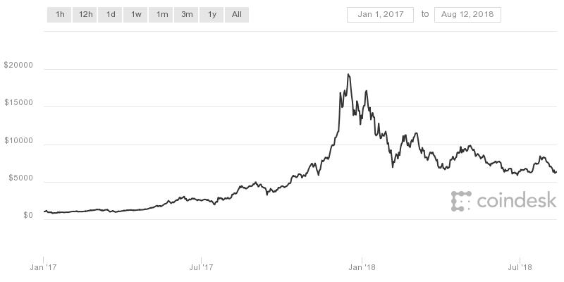
Cryptocurrency: typical characteristics
Bitcoin (USD) price, Jan. 2017 – Aug. 2018
Liquidity
Most popular cryptocurrencies, such as BTC, BCH and LTC can (relatively) easily be converted into other coins or fiat currency, and transferred between users across national borders.
Pseudonymity
Blockchains make it possible for a person to store information or engage in transactions without revealing one’s true identity.
Price volatility
With some USD 900 in value in early 2017, the price of Bitcoin reached nearly USD 20,000 in Dec. 2017, now trading at around USD 6,300.
Security concerns
Crypto-businesses are prone to fraud and hacks, as a results of which tokens can be stolen. Difficulty in traceability makes it hard to retrieve the stolen tokens.
* Sources: Coindesk, De Filippi/Wright
6 October 2018, Athens

Slide 50




Valuation and realization of cryptocurrencies
Private and insolvency law issues
How to evaluate and sell cryptocurrency?
Part of the debtor’s estate?
Debtor has to provide private key to the IP?
Disposal via crypto trading platform, or private sale?
May an IP sell off found Bitcoins at all?
Regulatory and AML issues for IPs?
Timing of sale - Bitcoin as “perishable good” due to extreme price volatility?
Property rights over cryptocurrencies
Courts in Russia and the Netherlands have recently recognized property rights over cryptocurrencies and considered them to be a part of the insolvency estate.*
* See INSOL Europe Inside Story from May 2018.
6 October 2018, Athens

Slide 51
Poll
What would you do as an administrator of an insolvent debtor who owns 10 Bitcoins?
Immediately put them up for sale on a crypto trading platform
Wait, who knows maybe the price will go up
Give up on a sale, as there are too many risks
6 October 2018, Athens

Slide 52

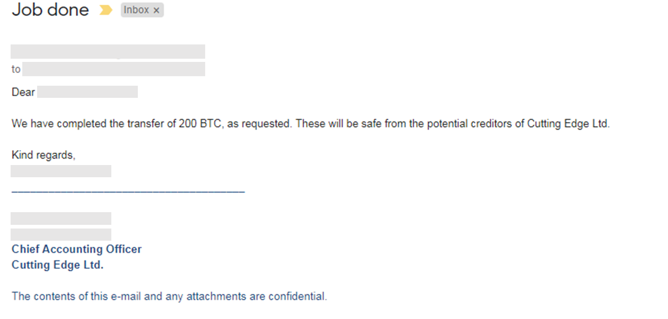
Traceability and uncovering fraudulent transactions
“What we want is fully anonymous, ultra-low transaction cost. If we get that going, the banks will become the obsolete dinosaurs they deserve to become.”
Adam Back (inventor of Hashcash, a precursor to Bitcoin)
Digital (crypto) assets: traceable by design?
Traceability of non-disclosed assets
Uncovering fraudulent transactions
6 October 2018, Athens

Slide 53
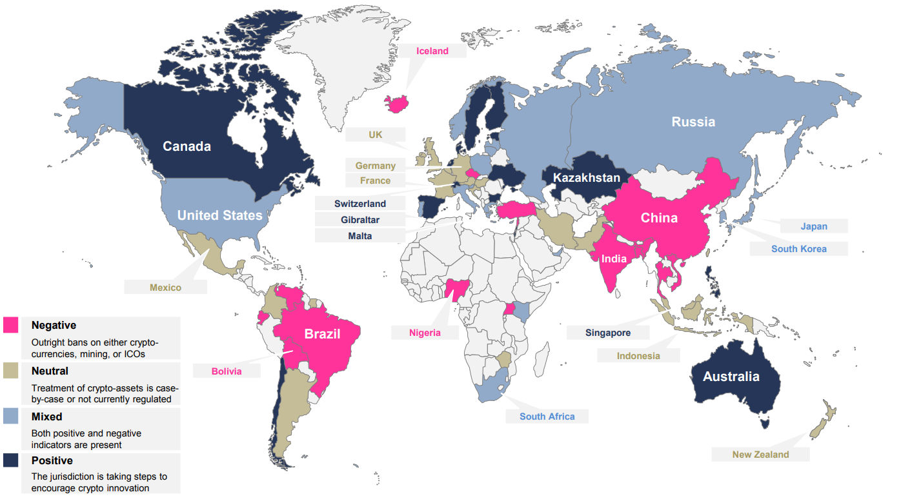
Regulatory and legal considerations
* Global Crypto Temperature at a Glance
* Source(s): Autonomous NEXT, using analysis from Bloomberg, as of March 19th, 2018, Thomson Reuters, Latham & Watkins LLP
6 October 2018, Athens

Slide 54

Cutting Edge Ltd. – self-governed company?
Cutting Edge Ltd. post filing
In October the court imposed a stay on individual enforcement actions and a moratorium on disposition of insolvency estate;
IP appointed and director’s powers ceased;
Despite the stay, CEL continued trading in cryptocurrencies, buying and selling them;
Ex-director claimed that transactions were self-enforcing and he could not stop them.
6 October 2018, Athens

Slide 55
Smart contracts: challenges for IPs
What are smart contracts?
Insolvency rules
Programmable contracts that are defined by program code and which are then automatically implemented and executed (often via a blockchain).
The “immutable and unstoppable” force of smart contracts enables them to be “their own trustee”:
At specific points in time, smart contracts automatically check conditions which are defined in advance. They can thus automatically determine, for example, whether a transaction will be executed or rescinded.
The risks associated with smart contracts primarily have to do with the lack of a central entity which can take corrective action against any intentional or unintentional misconduct.
Stay on enforcement actions and moratorium on asset realization?
Avoidance actions / preference law suits.
Reversal of smart contracts?
Discharge of debt? What if it is technically not possible due to the smart contract‘s code?
Directors’ liability for violation of a moratorium?
Do we need to rethink bankruptcy and insolvency law in this new space?
6 October 2018, Athens

Slide 56
Poll
Would you agree to be paid in Bitcoin for your services?
Why not?
No way!
6 October 2018, Athens

Slide 57

From bust to boom: how 50 Cent became an accidental bitcoin millionaire
* Source: The Guardian, 24 January 2018.
6 October 2018, Athens

Slide 58

Ευχαριστώ!
6 October 2018, Athens

Slide 59
INSOL Europe Strategic Taskforce 2025
Steffen Koch (hww hermann wienberg wilhelm, Germany)
Wolf Waschkuhn (One Square Advisors, UK)

Slide 60
Closing of the day
Radu Lotrean
President of INSOL Europe
CITR, Romania

Slide 61

Delegate & Guest Lunch
Kindly Sponsored By
www.hww.eu

