Slide 1

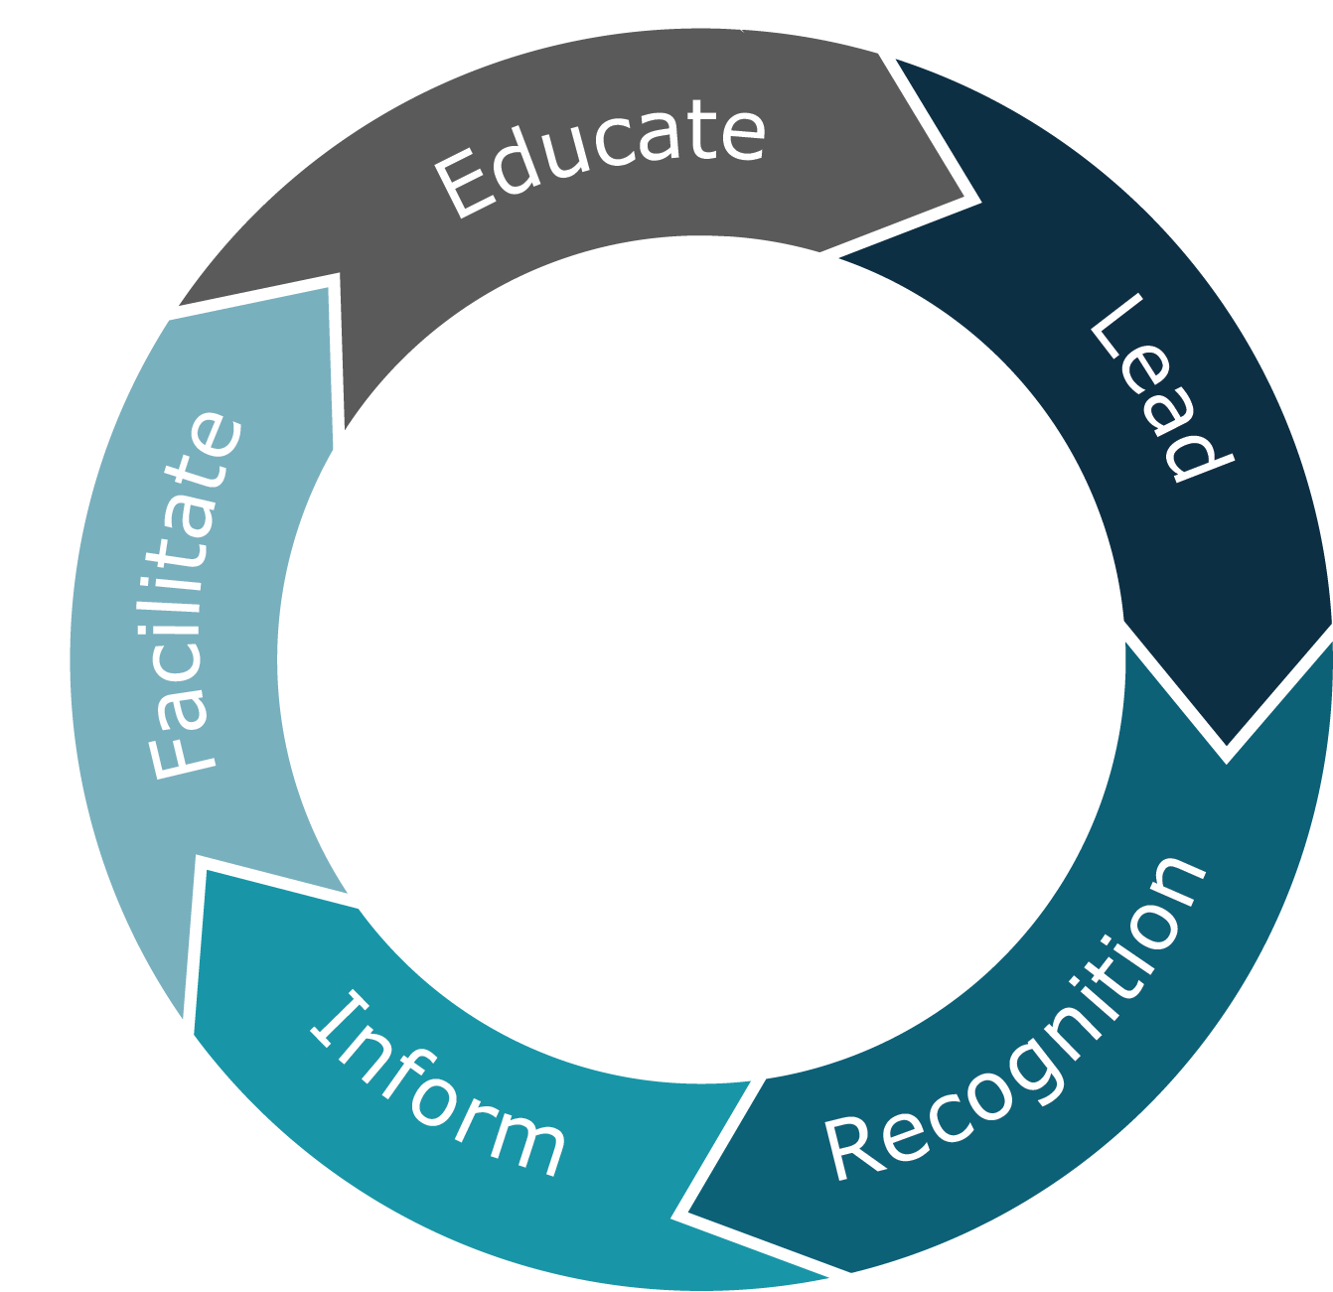
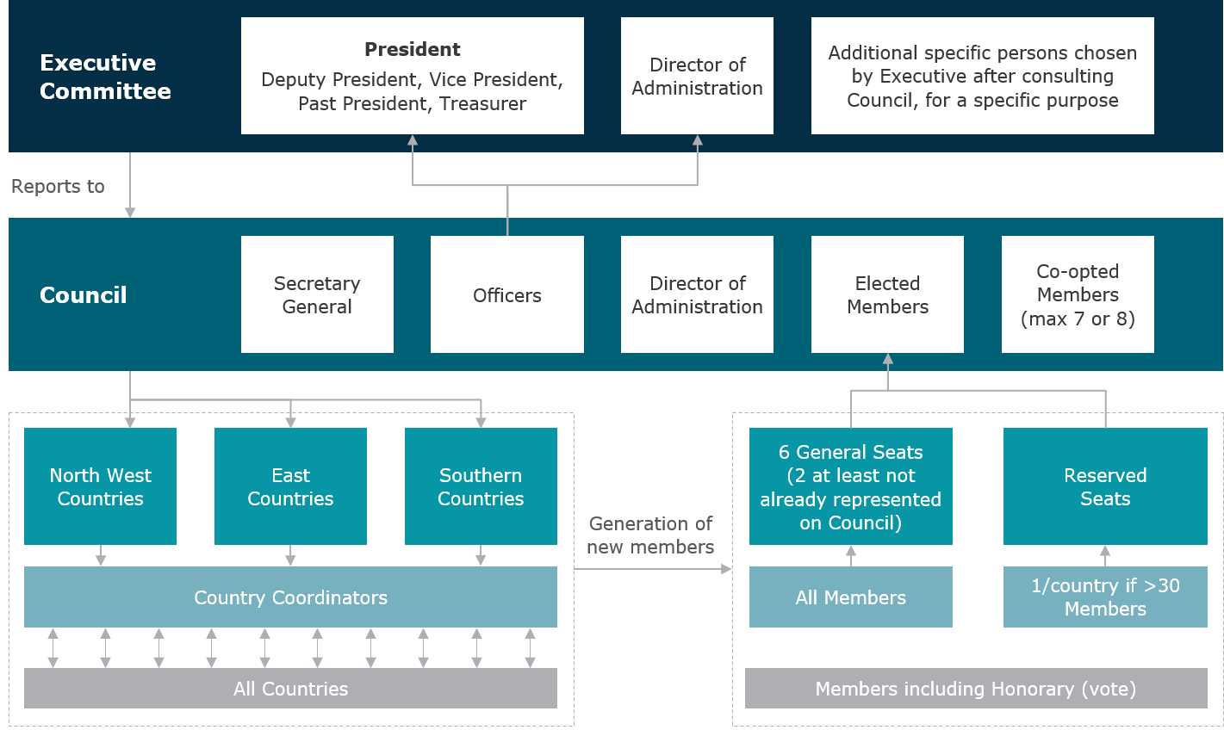



INSOL Europe Taskforce 2025
INSOL Europe objectives
INSOL Europe Objectives
  As part of standard good corporate governance a strategic review was commissioned in 2017. INSOL Europe created the Taskforce 2025 to ensure it recognises the needs of its members.
Lead the development of restructuring and insolvency law, techniques and practice in Europe
Recognition by European and international bodies as the first port of call for all matters regarding restructuring and insolvency in Europe
Inform through dissemination of technical and topical information on restructuring and insolvency
Facilitate business development and the exchange of professional experience among its members
Educate and train members, their staff and others to further technical capabilities
5
  To better understand and incorporate member views into the future strategy, the Taskforce undertook a member survey in July 2017
1
  The resulting objectives and proposals were submitted and approved at the Athens 2018 Congress. The updated organisation structure is outlined below:
4
3
2
  Growth increase membership from 1,200 to 1,500 over the next five years
  Cooperation strengthen relationship with other restructuring
  organisations
  Target
  focus on maintaining core membership and global players

Slide 2



To achieve the 2025 INSOL Europe objectives, we will focus on three key strategy areas:
INSOL Europe Objectives
INSOL Europe aims to increase its membership from 1,200 to 1,500 over the next 5 years
Growth + Footprint
There is room for further membership growth both within existing member states and into new countries.
A Development Committee of three Council members will drive our membership and footprint objectives through:
Allocating countries to regional groups: North and West, South and East Europe
Source and appoint individual country Co-ordinators
Develop bespoke strategies for each country
14 of 27 countries are represented in the INSOL Europe council
Cooperation
Target Groups
Continue to expand on current support structure with well-regarded organizations to underpin our overall objectives.
We have already planned events with the following:
1
1 | Strengthening our core membership through: Revise the conference structure, guidelines and content Update and maintain social media and website Review applicability of Eurofenix in paper format Forums/Wings – review relevance and objective focus
2 | Maintaining links with global restructuring players
2
The strategic review process has been an important milestone for INSOL Europe. A special thanks to Wolf Waschkuhn, Steffen Koch and all participants.

