Slide 2

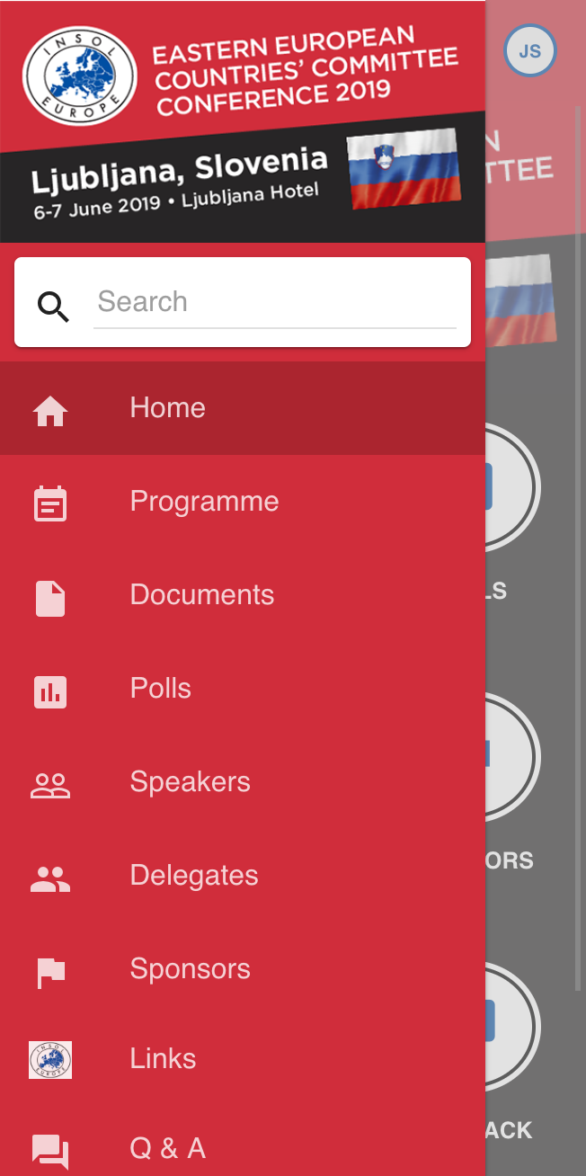
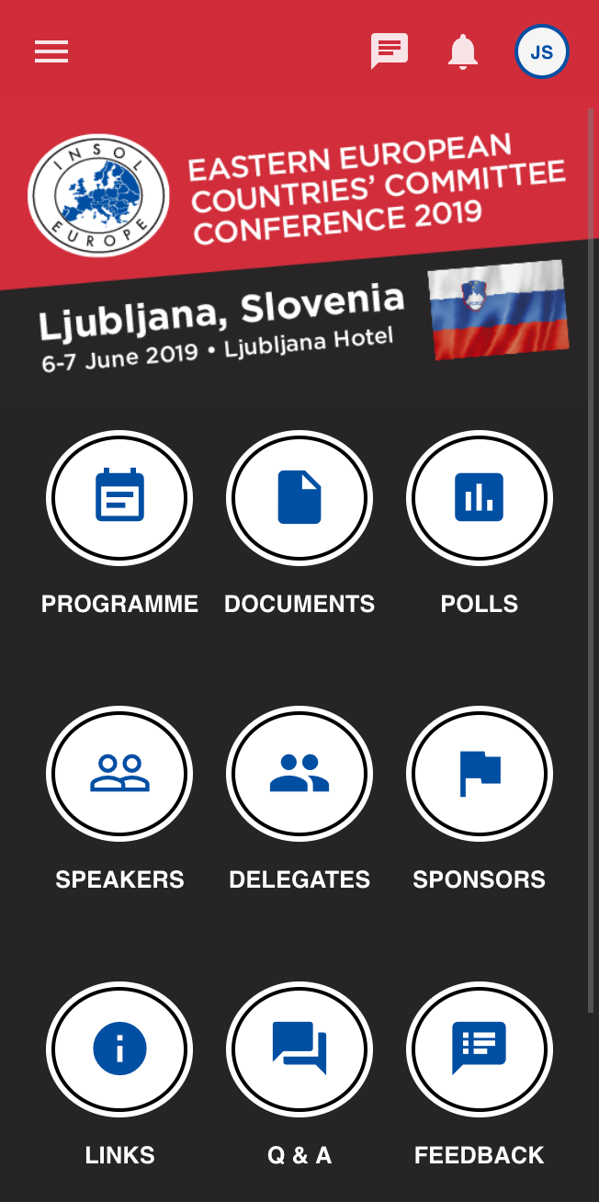


Get the App
Search
INSOL Europe
in your app store

Slide 3
Welcome Address
Radu Lotrean
Immediate Past President of INSOL Europe,
Co-Chair of the INSOL Europe EECC,
CITR, Romania
Evert Verwey
Co-Chair of the INSOL Europe EECC,
Clifford Chance LLP, The Netherlands

Slide 4
Keynote Speaker
Prof. Marko Simoneti
Department of Legal and Economic
Science of the Faculty of Law,
University of Ljubljana, Slovenia

Slide 5
Turnaround of the Slovenian economy: restructuring of Banking, Corporate and State sectors after the crisis
Prof. Marko Simoneti
Faculty of Law, University of Ljubljana

Slide 6
CONTENT:
Foreign debt financed dynamic growth (2000-2008)
Financial crisis and systemic insolvency of the banking,
corporate and state sectors (2009-13)
Coordinated approach to restructuring (2014-18)
Three pillars of restructuring
In court and out of court solutions for companies
Turnaround results
The future of institutional framework for insolvency in Slovenia

Slide 7
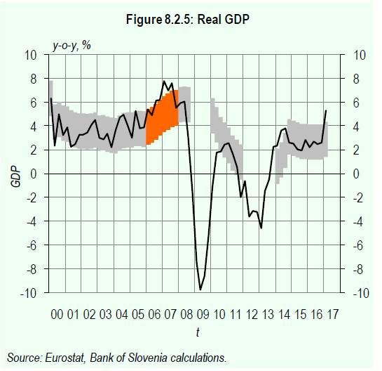

Slide 10
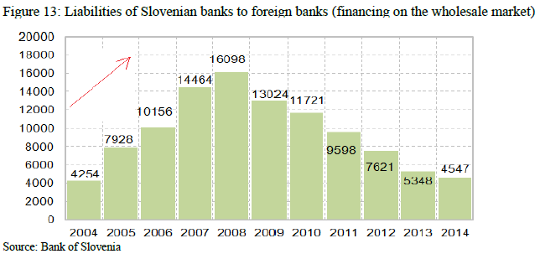

Slide 11
Perfect storm for the corporate sector in the financial crisis
High leverage: MBOs, LBOs and Financial holdings
Debt financing of speculative investments
Short term financing of long term projects
Recession and decreased cashflows
NPLs in banking are a mirror picture of corporate debt overhang in Slovenia !!

Slide 13
Sequencing of restructuring efforts in Slovenia
State aid for banks after „Bail in“ of qualified investors:
  Transfer of NPLs to national Bad Bank (BAMC)
  State recapitalization of large banks
  State financing of banking rescue w/o troika:
  (debt/GDP from 25% to 80%)
  Active management of NPLs and deleveraging of the corporate sector as a precondition for economic growth

Slide 14
Three pillars:
Bad bank approach to bank restructuring
Restructuring of the corporates by creditors
Restructuring of the state sector:
privatization and fiscal consolidation

Slide 15
Institutional framework for corporate workouts in the financial crisis
Systemic insolvency: out of court restructuring !!
Formal insolvency regime is the benchmark:
  Compulsory Consolidation (CC): going concern and NCWR
  Bankruptcy and APR
Two „fake“ assumptions in CC for the systemic crisis:
  Secured creditors can be repaid from collaterals
  (illusions of the bankers!!)
  Value of equity is still positive
  (illusion of the owners-managers !!)
Solution: virtual bankruptcy approach in CC

Slide 16
Modernizing and adjusting the insolvency law (1)
More powers to creditors: start and lead the CC process
100% write-offs for shareholders in CC
  APR rule based pay-offs in CC: nothing for owners if net liquidation value of assets negative
Haircuts for secured creditors in CC
  Inclusion of secured creditors in CC and adequate compensation (split of claims into secured and non-secured part)
Pooling of collateral
CC only for financial creditors and shareholders, not for commercial creditors

Slide 17
Modernizing and adjusting the insolvency law (2)
Spin offs to Good Co. and liquidation of Bad Co.
Pre-bankruptcy (preventive) procedure for large firms and financial creditors
Simplified CC for SMEs
Issues:
  Limited capacity of courts and insolvency administrators??
  Complexity of the rules ??
  Can bank creditors play the active role in CC ??
  NewCC for medium and large companies as benchmark for out of court solutions (MRAs) ?

Slide 18
% of cases
Years
Figure: New restructuring tools in CC, 2014-2018
Source: Ministry of Justice RS, 2018

Slide 19
Collective out of courts actions by creditors
(80 MRAs, representing 50% of NPLs)
Banks rules for out of court restructuring of large and small companies (London approach)
New lead bank and consolidator: BAMC !!
AQR, loan transfers to BAMC and new reality in valuating corporate loans
New insolvency rules as benchmarks for repayment
Issues:
  Financial vs. operational restructuring by bankers ?
  Temporary debt to equity for banks ??
  Banks exit via sales to foreign investors and politics ?

Slide 20
Full range of legal possibilities for debt restructuring
Out of court and voluntary
one creditor or all creditors collectively (MRAs)
In court and non-voluntary
separate recovery or collective procedures:
  Preventive restructuring
  Simplified Compulsory Consolidation for SMEs (SCC)
  New Compulsory Consolidation (NewCC)
  Bankruptcy

Slide 21
Turnaround results for Slovenia 2014-18
Stabilization and deleveraging of banks completed
Privatization of the largest nationalized banks in progress
Deleveraging of corporates mostly completed
Acquisitions of many SOEs and distressed companies by strategic foreign investors (FDIs)
Revival of the housing and commercial property market and development of NPL market
Strong economic growth
Fiscal consolidation (sales of SOEs and economic growth)

Slide 27
Ex-post efficiency of the insolvency framework:
  administrative/operational costs
  time required for repayment of creditors
  level of repayment for different classes of creditors
  long term financial stability of troubled debtors

Slide 28
Table: Ordinary claims in CC and Bankruptcy, 2018
 | Large & Medium CC | Simplified CC | Bankruptcy legal persons | Bankruptcy natural persons
Total number | 7 | 27 | 1,342 | 4,230
With some repayment of claims (% of cases) | 100% | 100% | 22% | 20%
Rate of repayment (%) | 32% | 39% | 14% | 14%
Repayment period | 4.1 years | 3.7 years | 3.7 years | 3.4 years
Source: Ministry of Justice RS, 2018

Slide 29
Conclusions on the present framework for the corporate restructuring
New CC relatively effective for large companies, simplified CC and preventive restructuring less so
In-court solutions are important for out-of-court negotiations with bankers (MRAs) : haircuts for owners and secured creditors in NewCC!!
Long term sustainability of debt reductions?
Low repayment in bankruptcy?

Slide 30
Harmonization with EU or/and the new insolvency law ??
Complexity of the law is the problem
Additional classes of creditors, large cram-downs
Less restrictions on restructuring measures in CC
No „opt-out“ in debt to equity swaps in CC
„Going concern“ values in haircutting the owners
Sell of core assets without debt from bankruptcy (article 363, USA Insolvency)

Slide 31
Future: Too important to fail in the corporate sector ?
Resolution of systemic banks in the Banking Union
Higher standards: Capital adequacy from day one !!
Bail-ins of qualified investors
Decision making by regulators vs creditors
Valuation issues ex-ante and ex-post
Efficient and transparent exit of converted creditors
Who manage the institution during the process
Ex-ante prepared rescue plans (living wills)
The group approach to resolution
Lex Agrokor, Lex Parmalat, Lex Mercator,…??

Slide 32
Conclusions on the comprehensive approach to the corporate insolvency
  EX-ANTE (preventive)
  responsibilities of the boards, company law, CG codes
  monitoring by investors, rating agencies, bussiness partners, employees…
  risk management, EWS and supervision in the banking sector
  EX-POST (curative)
  good legal system for debt enforcement and corporate insolvency
  Alternative solutions:
  out-of court restructuring and market for NPLs

Slide 33

Technical Session
Kindly Sponsored by:
www.netbid.com

Slide 34
Session 1:
The sooner the better:
Harmonisation of preventive restructuring frameworks in the European Union
Moderator: Edvīns Draba,
Technical Co-Chair of the INSOL Europe 2019 Ljubljana EECC Conference; Sorainen, Latvia
Florian Bruder, DLA Piper, Germany
Pawel Kuglarz, Kuglarz & Partners / University of Cracow, Poland
Ondřej Vondráček, DG Justice and Consumers, European Commission, EU

Slide 35
Directive of the European Parliament and of the Council on preventive restructuring frameworks, second chance and measures to increase the efficiency of restructuring, insolvency and discharge procedures and amending Directive 2012/30/EU
(Directive 2019/…/EU)
Ondřej Vondráček
DG Justice and Consumers, European Commission, EU

Slide 36
Main objectives
Reduce the barriers for cross-border investment, increase investment and job opportunities in the internal market (Capital Markets Union Action Plan)
Reduce the costs and increase the opportunities for honest entrepreneurs to be given a fresh start (Single Market Strategy)
Support efforts to reduce future levels of non-performing loans (ECOFIN Council Conclusions of July 2016)

Slide 37
I Introduction

Slide 38
Quick facts - 2016
200 000 insolvencies yearly in the EU, at least 25% have a cross-border dimension
1.7 million jobs lost in liquidations
1 in 6 insolvencies is caused by the insolvency of another company in the supply chain
Recovery rates are lower in liquidation than in insolvency by about 25 cents on the dollar (WB)
Impossible to restructure a groups of companies with establishments in more than 2 MS
Discharge periods vary from 1 year to indefinite periods
Different level of efficiency – in 10 MS procedures last over 2 years

Slide 39
What is the Directive about?
A. Preventive restructuring proceedings
B. Early warning mechanisms
C. Discharge of debt for insolvent entrepreneurs + limitations
D. Enhancing the efficiency of procedures
E. Data collection

Slide 40
Preventive restructuring proceedings in general
Enterprises will have more opportunities to deal with their financial difficulties everywhere in the Union
- all Member States will have in place preventive restructuring procedures
- these procedures will be more efficient, faster and cheaper than before –> 7 main elements to ensure that these requirements are met

Slide 41
7 main elements
- debtor in possession
- stay (moratorium)
- class-formation + cross-class cram down
valuation
court approval of the plan + effects of the plan
  (absolute priority vs relative priority rule)
- possibility of appeal
- interim and new financing protection

Slide 42
Preventive restructuring proceedings in general (cont‘d)
Debtors have the possibility of restructuring before they become insolvent ('insolvency' is defined in national law)
There must be a likelihood of insolvency – alignment with the EIR 2015/848
the sooner a business initiates restructuring proceedings, the lower the costs of restructuring and the higher the management powers and success
Early warning tools will be in place to support debtors

Slide 43
II Issues

Slide 44
Issue 1 – Debtor in possesion
Debtors will be left in control of the day-to-day operation of their business
incentive to restructure early
least disruption to the operation of the business
Practitioners appointed on a case-by-case basis, with some exceptions

Slide 45
Issue 2 - Stay of individual enforcement actions
Debtor will be able to request a court the suspension of individual enforcement actions
to address the hold-out problem
against any type of creditor (secured, unsecured etc.)
Limitations when workers' claims are concerned

Slide 46
Issue 2 - Stay of individual enforcement actions (continued)
Safeguards to protect creditors:
  duration of the stay: max 4 months; possibility for Member States to allow an extension of initial duration or a new stay
  prolongation of the stay: in duly justified circumstances
  maximum period of the stay after prolongations and new stays: 12 months
  possibility to have the stay lifted

Slide 47
Issue 2 - Stay of individual enforcement actions (continued)
Suspension of duty to file for insolvency and suspension of creditors' request to open such proceedings
Executory contracts: creditors cannot terminate for debts which came into existence before the stay
  No such restriction for debts which arise during the stay
Inapplicability of ipso facto clauses when debtor starts negotiations or is granted a stay
Netting arrangements are exempted from the stay

Slide 48
Issue 3 - Adoption of restructuring plans and cross-class cram-down
Creditors must be treated in classes according to their interests
- MSMEs can opt not to form more than one class
Plans must be adopted by creditors in each class representing:
- the majority in the value of claims,
- and, where provided in national law, the majority in number of creditors;
- majority must be stipulated in national law

Slide 49
Issue 3 - Adoption of restructuring plans and cross-class cram-down (continued)
Courts may confirm plans against the dissent of certain classes via a cross-class cram-down mechanism, under certain conditions:
- appropriate number of supporting classes; as a minimum one single class should be sufficient
- adequate protection on dissenting classes; as a minimum, a 'relative priority rule'

Slide 50
Issue 4 – Absolute priority rule vs. relative priority rule
- in the COM proposal: only absolute priority rule
- in the adopted version: possibility for MS to opt for relative priority rule (modification adopted on the basis of MS + experts/stakeholders)
  MS: non-familiarity with the absolute priority rule
  Experts/stakeholders: APR creates disincentives for plan approval (dissenting paid in full whereas consenting accept haircut) / RPR: more incentives for SMEs to participate in restructuring plan (higher chance to receive stg)

Slide 51

Coffee Break
Kindly Sponsored by:
﻿www.troostwijkauctions.com

Slide 52
Session 2:
When it comes to bankruptcy:
Maximising value for investors
Moderator: Roman-Knut Seger, BDO Restructuring, Germany
Radek Werich, Giese & Partner, Czech Republic
Dr. Wojciech Wąsowicz, Noerr, Poland
Inna Zhuranskaya, Kredirel Group, UK

Slide 53
When It Comes to Bankruptcy: Maximising Value for Investors
Inna Zhuranskaya, Kredirel Group, CEO
Mgr. Radek Werich, Giese & Partner
Dr. Wojciech Wąsowicz, Noerr
Roman-Knut Seger, BDO Restructuring GmbH, CEO

Slide 54
Resolution of bankruptcy situation from a lender’s perspective (a mid-size lending institution)
Role of bankruptcy procedure / focus of work-out unit:
    1. verifying assets and liabilities of a debtor
    2. coordinating among claimholders
    3. protecting third-party claimants
    4. maintaining asset values during the process
    5. alleviating the impact of liquidity constraints
    Debtor friendly approach vs. creditor friendly approach (difference between the USA=debtor friendly and the EU + UK = creditor friendly)
    Costly bankruptcy procedure = incentive for avoiding of a financial distress
    Recent trend: opt out of bankruptcy laws, alternative methods of resolution of financial distress

Slide 55
Maximising value in bankruptcy situation:
  checking for signs of internal fraud and/or reckless business practice
  ● take a loan sample of smaller loans in less prominent locations (preferred by fraudsters);
  ● request support calculation & documents (watch for absent / uncomplete document);
  ● monitor for any collusion between originators & underwriters (watch for patterns).
  stopping any cash bleed and gaining control of the situation i.e. suspend suspects, inform banks, conduct forensic audit, watch for attempts to destroy the documents / records. Check that any actions do not endanger the borrower’s project
  assessing and dividing affected loans and properties into 4 categories
  ● recoverable: negotiable with a borrower;
  ● non-recoverable A: foreclose and manage in-house, sell individually;
  ● non-recoverable B: foreclose and manage in-house, sell as a portfolio;
  ● non-recoverable C: sell affected loans as a portfolio.

Slide 56
  Aspects to consider: relationship with a borrower, ease of foreclosure, original vis-a-vis appraisal valuation, availability of qualified personnel and distance to HQ, costs associated with the foreclosure
Example:

Slide 57
Recoverable: Negotiate with a borrower
Typical conditions: an experienced and a willing to co-operate borrower
Solution: Agree a restructuring plan (i.e. loan extension), following any mechanisms provided in an original loan agreement.
Expected result: 90-100% recovery.
Non-recoverable A: Foreclose and manage in-house, sell individually
Borrower type: Experienced developer.
Asset: Large stand-alone project in either a very traditional asset class, which is suited to a smaller REPE fund / family office or a project in a very niche sector suitable for a specialist investor or an owner-occupier.
Solution: Push for a quick foreclosure. Simultaneously identify interested parties through own contacts, approach specialists and preferably local buyers directly / through specialist sector agents. Minimise involvement of brokers and agents.
Expected result: 75-90% recovery.

Slide 58
Non-recoverable B: Foreclose and manage in-house, sell as a portfolio
Typical conditions: Borrowers with an intermediate level of experience, often not willing to co-operate. Subject property is relatively easy to foreclose on without the need of a constant local presence.
Solution: Do not get involved into a protractive negotiation. Look for a good local agent from the very beginning of the process. Minimise the involvement of the lender’s team as it does not have enough local knowledge to drive the fragmented projects forward.
Expected result: 50-70% recovery.
Non-recoverable C: Sell affected loans as a portfolio
Typical conditions: Borrowers very difficult / projects are too small or fragmented
Solution: Sell the loans as soon as possible as any foreclosure attempts will only lead to increased costs and wasted time.
Expected result: 30-60% recovery.

Slide 59
NB: Care should be taken re stakeholders without explicit financial claims on the firm/ SPV, such as current employees dependent on the firm for salaries, previous employees reliant on the firm for pensions, tax authorities with unpaid taxes owed to them, and the society at large affected by the firm’s actions through effects on the environment.
A negative externality can be created by the fact that these non-financial stakeholders are not present at the bargaining table with the debtors and creditors.
Bankruptcy policymakers, particularly in Europe, have identified protection of these third party stakeholders as an important task of bankruptcy law

Slide 60
Maximising value – the German position
Introduction and history of the legal framework:
  Change in 1999 from a liquidation-proceeding (Konkursordnung) to a judicial restructuring-proceedings of the Insolvency Code (Insolvenzordnung) e.g. by implementing “debtor in possession” (§§ 270 ff InsO) and “insolvency-plan-proceedings” (§§ 217 ff InsO) known from chapter 11 of US-Bankruptcy code.
  Further improvement of legal restructuring framework through ESUG in 2012 trigger earlier filing by
    strengthening the “debtor in possession” e.g. by extending the competence also in the preliminary insolvency proceedings
    impairment of the rights of debtor and creditors against the will of the shareholders to the benefit of the insolvency estate
    debtor and creditors received more rights to determine the court appointed Trustee or Administrator

Slide 61
Maximising value – the German position
Further innovations on restructuring law are ahead by implementing the so called “out-of-court”-restructuring proceeding
  EU-Parliament enacts the new approach to business failure and insolvency by March 28, 2019
  A out-of-court proceeding can be initiated without proving the existence of insolvency reasons such as illiquidity or over indebtedness
  Implementation of a so called “early warning system” in the debtors organisation that enables the management to have full transparency not only within the accountancy but also with regard to e.g. debt-collection, the development of clients and suppliers as well as market settings with appropriate documentation of these information
  Early restructuring is not supervised by a Court, Administrator or Trustee
The understanding and conclusion of the legislator is, that a early restructuring scenario is effective and saves the value the debtors company and its assets

Slide 62
Maximising value – Poland’s experience
Drivers of change:
Low effectiveness of traditional liquidation bankruptcy – varies across the country but on average does not reach 20% of a claim value
High costs of proceedings reaching out to 40% of the value of the estate-in-bankruptcy
High percentage of applications rejected due to formal reasons – over 40%
Intensive but not highly motivating sanctions for delayed filings
New ideas:
Separation of liquidation bankruptcy from restructuring

Slide 63
Maximising value – Poland’s experience
Problems – continued:
No incentives to early restructuring measures
Out of court restructuring – viewed with suspicions
Some optimistic statistics and trends:
Over 450 restructuring proceedings opened in 2018
Increased awareness of restructuring proceedings
Development of restructuring related advisory business

Slide 64
Maximising value – Poland’s experience
Obstacles to overcome
High aversion to financing companies entering into restructuring
Practical elimination of restructured companies from certain areas of business, in particular state or community financed
Length of proceedings from initial filing to the acceptance of arrangement
Protracted communication with enforcement and fiscal authorities
Misuse of restructuring proceedings leading to high ratio of ineffectively closed proceedings

Slide 65
Maximising value – Czech Republic
- No official process / guidelines for out of court restructuring
- Private bankruptcy – most frequent
Bankruptcy by liquidation:
extremely low recovery of claims (secured creditors in average apporx. 25 – 30% of claims, unsecured creditors less than 5% of claims)
No recovery for creditors in approx. 50% of proceedings
Average length of proceedings – 28 months (larger cases more than 60 months)
Bankruptcy by reorganization (restructuring):
Limitations: for businesses only, net turnover of at least CZK 50m (approx. EUR 2m) or at least 50 employees
Pre-packed reorganization

Slide 66
Maximising value – Czech Republic
Bankruptcy by liquidation:
2016: 902
2017: 783
2018: 665
01-04/2019 220
Bankruptcy by reorganization:
2016: 26
2017: 17
2018: 17
01-04/2019 7

Slide 67
Maximising value – Czech Republic
conversion from reorganization to bankruptcy
recovery: reorganization vs. liquidation
pre-packed reorganization
reorganization – debtor in possession
restructuring methods
out of court restructuring – contractual basis vs. ring-fencing of liabilities
bank practice

Slide 68
Session 3:
The use of technology in bankruptcy:
Online auctions system
Moderator: Anto Kasak, Kasak & Missik; Tartu University, Estonia
Ales Weiksler, NetBid, Slovenia
Peeter Viirsalu, TGS Baltic, Estonia
Marc André, Etude Marc André, France

Slide 69
Online Auctions
The Globe is our marketplace
Aleš Weiksler
Net Bid Country manager Slovenia

Slide 70
Introduction
Working in online Auction business for more than 5 years
Total expirience in financial sector of more than 15 years
Responsible for ex Yugoslavian countries (Slovenia, Croatia, Serbia, Macedonia,...)
www.netbid.com is one of Europe’s leading internet platforms for the sale of used machinery, equipment and real estate
Sworn and publicly appointed auctioneers and appraisers for machinery and industrial equipment
Certified according to DIN EN ISO 9001:2015
Database system for valuation trend analysis (volume per year approx. one billion euro)

Slide 71
Online Auctions in Slovenia in 2014 & Today
2014
Legislation was accepting hiring remarketing specialists in insolvency process, but there was no experience with it
The insolvency administrators were open to online auctions from their side, but were also without experience and didn't know the response from the court
At annually meeting from insolvency administrators online auctioning was presented and got very positive response
First online auction for insolvency process was organized and successfully concluded

Slide 72
Online Auctions in Slovenia in 2014 & Today
Today
Online auctioning is common tool for selling insolvency goods
Slovenia is part of global online auctioning market
Very good cooperation between auction houses, insolvency administrators, debtors and court
Good Fundaments to open other ex Yugoslavian markets

Slide 73
Advantages of online Auctions / Trading
Reach of remarketing (global market)
Transparency (you can see exact time and sum of every bid)
Costs (insolvency administrator has no costs, auction fee is on buyers side)
Additional costumer services (dismantling and transport if needed)
Sale specialists
Creating a competitive environment on auction platform
Adapting to local insolvency law
Atracting forein investors for projects in Slovenia
Buyers can bid on computer and dont need to come to the location
Easy to follow (you see every position with pictures and data on the computer)
No hidden arrangments possible (every costumer has his own nickname)

Slide 74
Online Auctions / Trading in Slovenia (from NetBid GmbH)
App. 40 online auctions concluded in Slovenia since 2014
17 insolvency online auctions & trading's concluded since 2014
Over 20.000 overall bids on Slovenian projects
Bidders coming from more than 60 countries
Over 100 new jobs were open on our remarketing projects in Slovenia

Slide 75
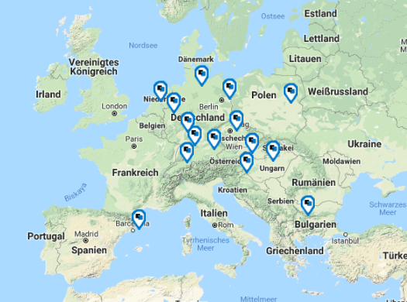
Comparison with other SEE markets
From legislation point of view is Slovenia on the same level with other countries that allow online auctions in insolvency procedures
Trough very good relationship between auction houses, debtors and insolvency administrators is Slovenia one of the more developed markets regarding using online auctions in insolvency
In other ex Yugoslavian markets we use experience from Slovenia to start with online auctioning system
Using conections of NetBid network and strong cooperation with Austrian chamber of commerce it is easier to aproach and develop new markets.

Slide 76

Case study Online Marketing
Auction platform
Auction diary

Slide 77
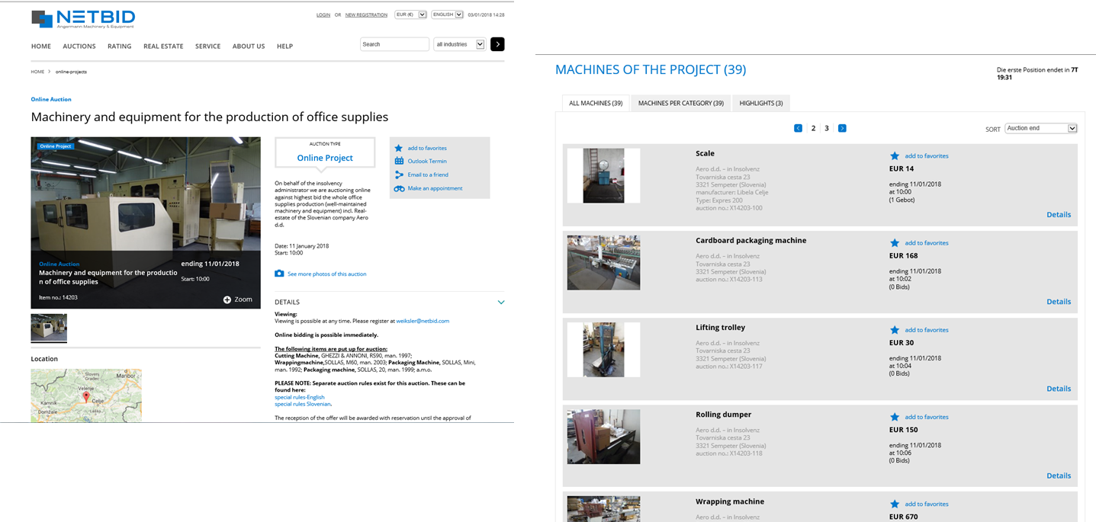
Case study Online Marketing
Auction overview

Slide 78
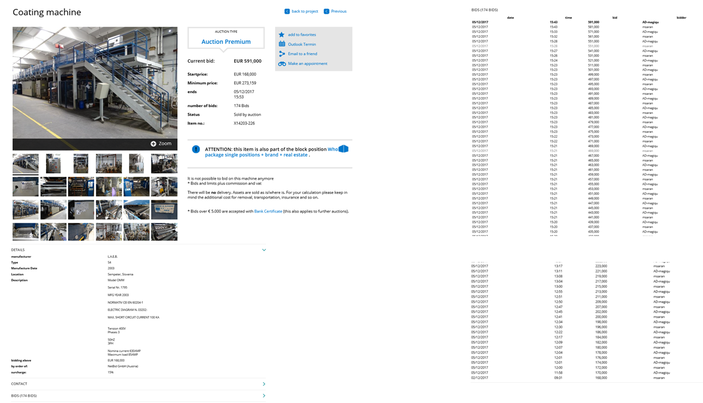
Case study Online Marketing
Product description
Bidding history

Slide 79


Case study Online Marketing
Real estate description

Slide 80
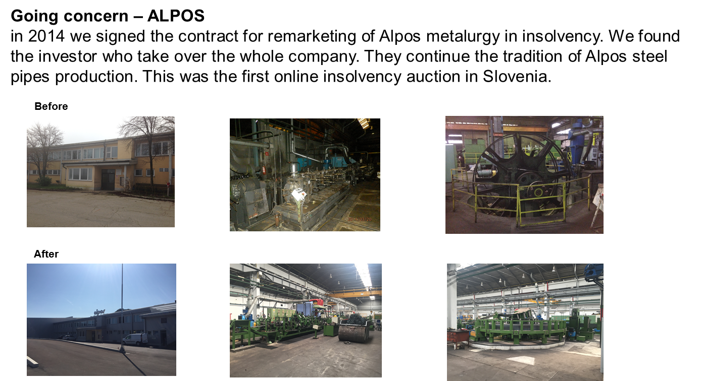
Case study Online Marketing

Slide 81
I would like to thank Insolvency chamber of Slovenia with all insolvency Administrators, all Banks and Leasing companies, Austrian chamber of commerce and INSOL Europe for excellent cooperation trough the years.

Slide 82
The use of technology in banckruptcy
Marc ANDRE
OFFICE HOLDER
CNAJMJ PARIS

Slide 83
One of the French CNAJMJ'S responsabilities:
- Offering secure electronic services related to the activities of Court-Appointed Administrators and Court-Appointed Liquidators

Slide 84
An electronic portal presenting assets to be sale in bankruptcy proceedings:
https://ventes-actifs.cnajmj.fr

Slide 85
It is required by law to put on the website a description of assets in the process of selling in liquidation:
Article L 642-22 Commercial Code
Article R 622-40 Commercial Code

Slide 86
The French electronic portal already allows:
- Buyers including professional to check out assets for sale in liquidation proceedings
- Buyers including professional to contact sellers
- Buyers including professional to do deals at a national and international level

Slide 87
  The next step:
  Set up secure public electronic portal where automatic bids are possible and where the bid at the best price must be regarded as a sale.
  THANK YOU

Slide 88
The use of technology in bankruptcy: Online auctions system
Public Electronic auction in Estonia
Peeter Viirsalu
TGS BALTIC
Associated Partner

Slide 89
THE NEED FOR A PUBLIC ELECTRONIC AUCTION
Public electronic auction was introduced to the Code of Enforcement Procedure in 2010.
Public electronic auction is used when assets are sold in bankruptcy proceedings or in enforcement proceedings.
Before the public electronic auction was introduced auctions were conducted orally.
Oral auctions entailed the problem of prior price agreements.

Slide 90
A PUBLIC ELECTRONIC AUCTION – HOW DOES IT WORK
An electronic auction is preferred to oral auction.
Electronic auctions are conducted in an electronic auction environment on-line.

Slide 91
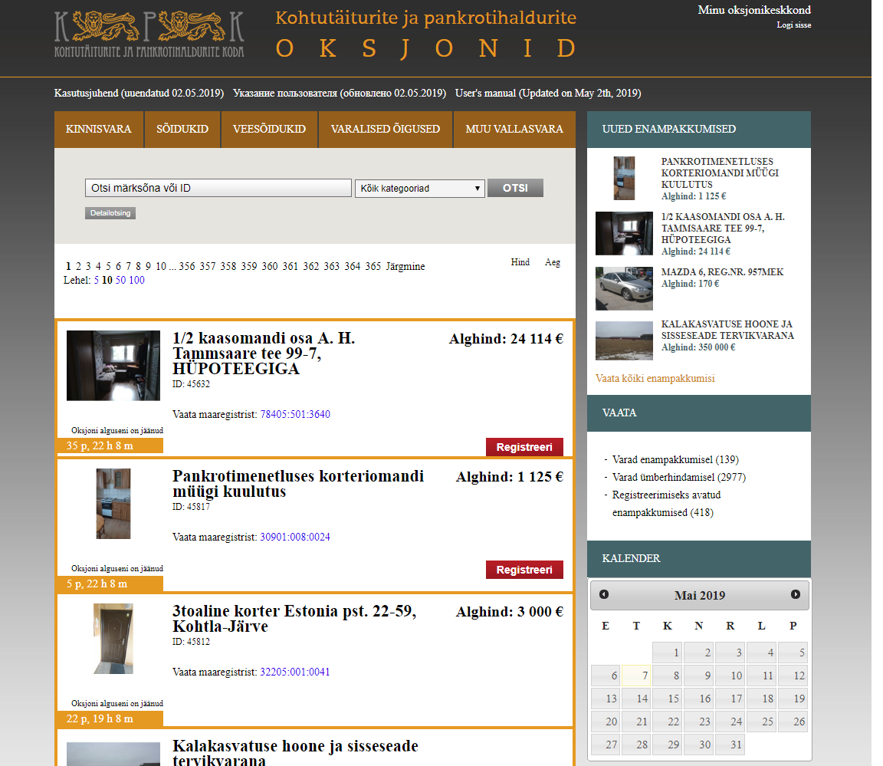
https://www.oksjonikeskus.ee/

Slide 92
A PUBLIC ELECTRONIC AUCTION – HOW DOES IT WORK
To use the electronic auction environment, one needs an ID-card or Mobile-ID or a username and a password.
It is possible to participate at an electronic auction through authorization.
A notification of an auction is published at least 10 days before the auction in the publication Ametlikud Teadaanded and in a public computer network. A bailiff may also publish an announcement in a newspaper which is on sale at the place of the auction. At the request of a claimant or a debtor, a bailiff shall publish the announcement in other publications at the expense of the claimant or the debtor.
The starting price of an asset at an auction is the price which is based on its valuation and set out in an instrument of seizure. In case of bankruptcy the starting price of assets shall be determined by the trustee and approved by the bankruptcy committee.
In the case of an auction, a bailiff may determine a deposit for the auction participants in the amount of up to ten per cent of the starting price. If deposit is determined, a person who wishes to participate in the auction shall pay the deposit. A deposit paid by a purchaser shall be included in the purchase price and, in the case of others who participated in the auction, a deposit shall be refunded on the working day following the date of the auction.

Slide 93
A PUBLIC ELECTRONIC AUCTION – HOW DOES IT WORK
After an auction is opened the participants start bidding from the starting price. The auction participants shall enter their bids in electronic form in full euros in accordance with the bidding increment. Automatic bids are possible.
An electronic auction terminates at the time specified in the announcement of the auction. If a new bid is made during the interval by which the end of an auction is extended before the time the auction ends, the end of the auction is extended by the extension interval and the auction shall last until bids are made.

Slide 94
A PUBLIC ELECTRONIC AUCTION – HOW DOES IT WORK
At an electronic auction the bid with the highest price submitted in the auction environment by the end of the auction is declared to be the best.
The payment of purchase price by loan is possible.
Ownership regarding a thing sold at an auction is created upon delivery of the thing on the basis of a report on the auction.

Slide 95
A LITTLE BIT OF STATISTICS AND CONCLUDING REMARKS (1)
Data from The Estonian Chamber of Bailiffs and Trustees in Bankruptcy
2018
 | Ads published | Auctions that ended with a sale | Price raise %
ALL ASSETS | 6897 | 1319 | 10,1
Real-estate | 3778 | 801 | 21,9
Water crafts | 4 | 2 | 5,3
Vehicles | 267 | 70 | 48,4
Monetary rights | 1181 | 169 | 48,7
Movables | 1667 | 277 | 8,3

Slide 96
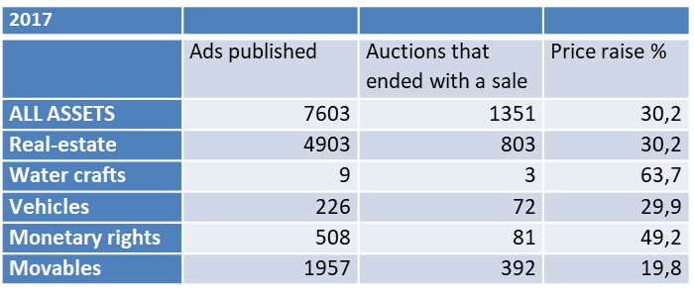
A LITTLE BIT OF STATISTICS AND CONCLUDING REMARKS (2)
Data from The Estonian Chamber of Bailiffs and Trustees in Bankruptcy

Slide 97
A LITTLE BIT OF STATISTICS AND CONCLUDING REMARKS (3)
Data from The Estonian Chamber of Bailiffs and Trustees in Bankruptcy
In 2017 there were 7 registered complaints concerning the electronic auction system. In 3 cases the webpage was unavailable; in 1 case there was a report on false information displayed on the webpage; in 3 cases there was a report that some actions could not be performed on the webpage, but investigation revealed no errors on the webpage.
In 2018 there were 4 registered complaints concerning the electronic auction system. In 2 cases the webpage was unavailable; in 1 case there was a report on false information displayed on the webpage but investigation did not confirm this; in 1 case there was a suspicion that an ID card was used not by its rightful owner.

Slide 98

Lunch Break
Kindly Sponsored by:
www.bnt.eu

Slide 99
Technical Session
Kindly Sponsored by:
www.cnajmj.fr

Slide 100
Session 4:
Pre-packaged insolvency tools:
Where are we now?
Moderator: Glen Flannery, CMS, UK
Michał Barłowski, Wardyński & Partners, Poland
Peter Sprinz, HAVEL & PARTNERS, Czech Republic
Dr Nina Plavsak, ABC NEPREMIČNINE, Slovenia

Slide 101
Pre-packs - The UK’s model
Watch this space…

Slide 102
Pre-packaged insolvency tools: Where are we now?
Michal Barlowski
Attorney-at-law
Senior counsel at Wardynski & Partners

Slide 103
Pre-packs under Draft Directive
Art. 2 - preventive proceedings allowing a sale of assets or parts of a business which enables the enterprise to continue.
Preamble p. 62 - sale of business (enterprise): results in transfer of employees rights to the buyer (rights to wages): see also ECJ case
C-126/16 on Directive 2001/23/EC, where pre-pack “not ultimately aimed at liquidating the undertaking” (when all or a part of the undertaking concerned is transferred).

Slide 104
Use of pre-pack - consider
Insolvent vs solvent debtor – determined by country specific legislation.
Debtor Insolvent: best interest of (which) creditors?
Proportion of secured vs unsecured creditors – right of objection or required consent of secured creditors?

Slide 105
Pre-pack is good when…
no rescue of business is possible
no financing (new money) for restructuring
going concern value (much) higher than peace-meal asset value
no liquidity to cover post-opening costs
stay (during restructuring proceedings in Poland) not sufficient for business recovery

Slide 106
Applicable provisions: current Polish Bankruptcy Law
Possible only when/with liquidation insolvency (bankruptcy).
Court rules on terms and conditions of a sale contract filed by
the debtor (agreed with by purchaser).
Sale possible to a related party – only at a price not lower than stemming from compulsory valuation.

Slide 107
Applicable provisions: Current Polish Bankruptcy Law
Transfer of possession of business as a going concern possible before receiver transfers ownership (under a sale contract) to purchaser - then limitation to ordinary business transactions.
Receiver enters into sale contract within 30 days from date of court approval of the transaction.
Buyer purchases business (enterprise) free of any charges
(rights in rem) and with no liabilities (change with the reform?).

Slide 108
Current problems with Polish Pre-packs – anticipated reform a cure?
M&A lawyer vs Insolvency lawyer approach- most of the preparation to be done pre-filing.
Expert valuation; method of valuation.
Admissible sale price; discounted by savings and „social needs”.
No discount for speed of process, certainty of transaction.

Slide 109
Challenges to transaction terms: creditors in rem to agree before the sale; who decides? Court or creditors?
No shareholder support for pre-pack being a liquidation tool.
Transfer of rights and obligations from executory (ongoing) contracts.
Relations between the purchaser and the receiver (right to terminate contracts).

Slide 110
No Purchaser liability for pre-opening debt plus charges (rights in rem) on business, except for when:
  Purchaser enters into rights and obligations from employment contracts with all pre-bankruptcy employees
  Purchaser liable for liabilities for the period between post-bankruptcy opening till signing of transfer of title agreement.

Slide 111
Why there is no pressing need for a pre-pack model under Slovenian law?
Nina Plavšak
Senior independent consultant

Slide 112
Types of insolvency procedures under Slovenian insolvency law
Preventive restructuring, which can be proposed by a large or medium-sized company, which is, without proper restructuring, likely to become insolvent in a period of one year (imminent insolvency)
Compulsory settlement (Chapter 11 Type of rerganization):
  May be initiated either by creditors or by debtor
  Debtor stays in possession – Creditors may propose a change of management
  Automatic stay
  Ultra priority for new financing
  Financial restructuring plan (Plan) may be proposed either by debotr or by creditors – voting on creditors plan takes priority
Liquidating bankruptcy

Slide 113
Financial restructuring plan with spin-off
Plan may provide for a restructuring by a spin-off of assets that form an on-going (profitable) concern to a New company
In such case Plan shall also contain a Division plan according to Company law
Special rules apply to the New company formed by a spin-off under the Plan
  The obligations (debt) of the New company shall be limited only to the debt allocated under the Division plan ⇨ only secured claims after restructuring
  The new company shall not be held liable for the remaining obligations of the Debtor (i.e. Transferring company)
Viability of the proposed Plan shall be assessed by a Certified business evaluator.
Plan takes affect upon Court‘s approval ⇨ Court approves the Plan if it has been accepted by a required majority of creditors (60% of unsecured claims and 75% of secured claims)
The sale of the remaining assets of the debtor (including the shares of the New company) shall be implemented in the voluntary company liquidation proceedings or in liquidating bankruptcy proceedings ⇨ Creditors shall be repaid from the realised (distribution) estate under the general rules that apply to the order of repayments.

Slide 114
Secured value of assets
(a basis of restructuring of secured claims under FRP)
Secured claims which are not covered (in whole) by the secured value of assets that are subject to the right to separate settlement may also be restructured under FRP
In order to establish which part of the claim is covered with the value of assets, the value of the assets is assessed according to the market value methodology by a certified evaluator
The assessed value of assets is increased by a buffer of 20% of that value ⇨ secured value of assets
If a certain asset is subject to multiple collaterals the order (priority of secured claims) has to be taken into account ⇨ residual secured value

Slide 115
Restructuring of secured claims under Plan
Possible outcomes when comparing the (residual) secured value and the amount of claim
  Residual secured value (120) > amount of secured claim (100) ⇨ the entire amount of claim remains secured
  Residual secured value (30) < amount of claim (100) ⇨ claim is split in two claims:
    New secured claims in the amount of residual secured value (30)
    New unsecured claim in the residual amount (70)
  Residual secured value = 0 ⇨ claim (in the entire amount) becomes an unsecured claim

Slide 116
Pre-packaged insolvency tools: Where are we now? Czech Republic
Petr Sprinz
Partner at HAVEL & PARTNERS

Slide 117
Overview of pre-packaged reorganisations
Basic legal preconditions apart from general requirements for reorganisation:
  reorganisation plan has support of at least 50% of all secured and 50% of all unsecured creditors counted as per the value of their claims
  reorganisation plan is submitted together with the debtor’s insolvency petition (the debtor might, however, accede to the creditor’s previously filed insolvency petition)
Available since 2008; about one third of all reorganisations
Flexibility of the content of the reorganisation plan (SPA, sale of assets, issuance of a new debt, etc.)
Notes:
Few = malo
A few = nekolik

Slide 118
Pros of pre-packaged reorganisations
Debtor in insolvency faces immense number of difficulties – a pre-pack increases the credibility of the debtor’s business case
For “smaller” debtors, a pre-pack is the only way to reach reorganisation (turnover less than approx. EUR 2 million and less than 50 employees)
A pre-pack in certain respects simplifies the decision-making process (pre-packaged reorganisations generally take less time); similarly a pre-pack enables the debtor-in-possession to manage its business with fewer limitations faster
Possibility to determine the appointment of the insolvency trustee
Possibility to affect the appointment of an expert for the valuation

Slide 119
Timeline of pre-packed reorganisations
Ruling on insolvency, incl. appointment of insolvency trustee
Approval of reorganisation
Appointment of an expert for valuation
Insolvency petition
Reorganisation plan
Review hearing
(assessment of claims)
Creditors' meeting decision on expert's valuation
Creditors' meeting decision on reorganisation
(voting by classes)
Confirmation of reorganisation plan by court
(appeal possible)
Efectiveness of reorganisation plan
Implementation of reorganisation plan

Slide 120
Potential abuse of pre-packaged reorganisations
Up to 2014, in principle, not possible to replace the court-appointed insolvency trustee chosen in a pre-packaged reorganisation plan
Since 2014, possible to replace the insolvency trustee but only after conversion of the reorganisation into liquidation (yet the die is cast …)
Group insolvencies – generally one insolvency trustee
Statistics

Slide 121
Session 5:
Increasing efficiency in insolvency proceedings: The appointment of IPs
Moderator: Frank Heemann, bnt attorneys in CEE, Lithuania
Dmitry Konstantinov, Ilyashev & Partners, Russia
Hans-Georg Kantner, Kreditschutzverband von 1870 (KSV1870), Austria
Judge Kersti Kerstna-Vaks, Tartu Circuit Court, Estonia

Slide 122
Introduction: IT selects IP – relevance today and tomorrow
Some things to consider:
  Reasons for using IT
  Trust
  Efficiency
  Accountability
  Evolution
  Limits

Slide 123
IT selects IP – EU Directive on preventive restructuring frameworks
Selection of practitioner (Recital 88):
“Member States should not be prevented from providing for a practitioner to be selected by other methods, such as random selection by a software programme, provided that it is ensured that in using those methods due consideration is given to the practitioner's experience and expertise.”

Slide 124
Survey – IT selects IP in selected jurisdictions
Does selection of practitioner by software exist?
If so – does it meet the criteria set in the EU Directive?
If not – are there any legislative initiatives to introduce it?

Slide 125
Survey – IT selects IP in selected jurisdictions (cont’d)
Survey of some European countries:
Austria | France | Poland
Belarus | Germany | Portugal
Bulgaria | Hungary | Russia
Czech Republic | Italy | Slovakia
England | Latvia | Spain
Estonia | Lithuania | Ukraine

Slide 126
Survey – IT selects IP in selected jurisdictions (cont’d)
IT selecting IP: mostly in CEE countries (e.g. Slovakia, Hungary, Latvia, Lithuania, Ukraine, Belarus (bill)); exception Portugal in Western Europe
Usually “Lottery”, i.e. randomized selection; exception Lithuania
Scope of application depends on jurisdiction at hand

Slide 127
Survey – IT selects IP in selected jurisdictions (cont’d)
2005 Slovakia
2009 Hungary
2015 Portugal
2019 Ukraine
Belarus (draft)
2019 Latvia
2015 Lithuania

Slide 128
Some things to consider:

Slide 129
Reasons for using IT

Slide 130
Trust

Slide 131
Efficiency

Slide 132
Accountability

Slide 133
Evolution

Slide 134
Limits

Slide 135
Questions & Answers

Slide 136
Further reading
  Heemann/Stonys/Pikaly/Bodis ‘IP Appointment Lottery: Experiences in Lithuania, Slovakia and Hungary with random IP selection systems’, Eurofenix, Spring Edition 2018
  Heemann/Gasparke ‘Lottery and liability’, Eurofenix 2015, Spring Edition
  Till ‘Revolution im Insolvenzwesen durch die Künstliche Intelligenz (KI)? Wie Künstliche Intelligenz das Insolvenzwesen radikal verändern wird’, Neue Zeitschrift für Insolvenz- und Sanierungsrecht (NZI) 2019, 405-409
  Braegelmann ‘The Digital Judiciary – The Digitization of Restructuring Law as a Case Study’, The Legal Revolutionary (LR) 2018, 4-9

Slide 137
Coffee Break
Kindly Sponsored by:
﻿www.troostwijkauctions.com

Slide 138
Session 6:
Cross-border insolvency issues in aviation
Moderator: Dr Christof Schiller, Anchor Rechtsanwälte, Germany
Dr. Ulla Reisch, ULRS, Austria
Tobias Schulten, Clifford Chance, Germany
Dr. Paulius Markovas, COBALT, Lithuania

Slide 139
Cross-border insolvency issues in aviation
Dr. Ulla Reisch

Slide 140
1. The Niki Case
August 15th, 2017: preliminary insolvency proceedings were opened concerning the assets of Air Berlin
December 2017: the deal with Lufthansa regarding the Austrian subsidiary of Air Berlin, NIKI Luftfahrt GmbH, failed due to reasons of competition law
Therefore on December 13th, 2017: Niki management filed for insolvency proceedings at the District Court Charlottenburg in Berlin/Germany
➔ Were the German courts competent (Art 3 EU Insolvency regulation)?

Slide 141
District Court Charlottenburg considered itself competent and opened preliminary insolvency proceedings due to the following main aspects:
  Niki was controlled by the Air Berlin Group
  CEO lived in Germany and worked from Berlin
  Niki was fully operative integrated in the Air Berlin group
  the only customer of Niki was Air Berlin – passengers bought tickets on the Niki homepage and thought they were booking with Niki, but internally in the background they were forwarded to the Air Berlin booking system
  Niki flights were all organized from the centre of flight operations in Berlin
  Niki aircrafts were leased by Air Berlin and subleased by Niki from Air Berlin, most of them stationed in Germany
  most Niki flights started from Germany

Slide 142
January 2nd, 2018: a creditor appealed against this decision and filed for insolvency proceedings at the Regional Court Korneuburg, Austria.
January 8th, 2018: The Regional Court Berlin overruled the opening of the preliminary proceedings and decided that the COMI is in Austria. It acknowledged the arguments for the COMI in Germany, but also argued that there were reasons for a COMI in Austria:
  The registered company seat is in Austria
  Shareholders of Niki are all Austrian companies
  the Niki management directed from an office in Austria, 100 management employees were in Austria, only 1 in Germany
  850 employees were in Austria, only 100 in Germany
  Taxes were paid in Austria
  Niki had an Austrian operating license and Air Operator Certificate (“AOC) for the airline business
  For the Regional Court Berlin the connections to both countries were equally strong. Therefore it ruled that the COMI was in Austria due to the presumption of Art 3 EU insolvency regulation (=when in doubt, COMI lies at the location of the registered seat)

Slide 143
January 12th, 2018: Regional Court Korneuburg opened insolvency proceedings regarding Niki as main insolvency proceedings:
  It argued that the decision of the District Court Charlottenburg was effectively overruled by the decision of the Regional Court Berlin.
  The Regional Court Berlin had ordered no suspensive effect.
  According to the legal opinion of the Regional Court Korneuburg at the time of its decision the insolvency proceedings in Germany were already terminated and no longer effective (Art 19 EU Insolvency regulation). Why?

Slide 144
According to Art 102 c § 4 German EGInsO an appeal to the German Supreme Court has no suspensive effect, but the Regional Court could order suspensive effect, which it didn’t
On the other hand according to § 6 paragraph 3 German Insolvency Regulation, an appeal has, in principle, suspensory effect and it can be argued that this regulation shall be applicable also for an appeal on grounds of international jurisdiction according to Article 5 EU Insolvency Regulation
In the meantime there are numerous essays on the question of whether the German insolvency proceedings had already ended at the time of the opening of insolvency proceedings in Austria or not.
However, we had to deal with a situation in which we had two main insolvency proceedings for a while.

Slide 145
2. Specialities of an airline
Main assets of an airline are their slots:
  = right to start and land at a certain airport at a certain time
  There is only a limited amount, what makes them extremely valuable, especially at popular flight times and popular airports.
  Transfer of slots through registration in a slot management system, information to the slot coordinator in advance.
  According to European laws only active airlines can transfer slots.
  ➔ An active airline needs a valid operating license and an Air Operator Cerficate (AOC).

Slide 146
Operating license:
  authorizes an airline to transport passengers in commercial air traffic
  Relevant authority in Austria: BMVIT
  Austrian operating license can only be obtained when the airline has its principle place of business in Austria.
  Conditions for an operating license are an AOC and that the financial capacity of the airline is secured.
  The relevant authorities may grant a temporary operating license, but only for a limited time period (max 12 months).

Slide 147
Air Operator Certificate (AOC):
  a certificate delivered to an airline confirming it has the professional ability and organization to ensure the safety of operations specified in the certificate
  Relevant authority in Austria: Austrocontrol
  When granting an AOC general requirements for air traffic operations as well as specific conditions associated with the respective fleet are taken into account.

Slide 148
3. Allocation of assets
One of the difficulties in the sale of Niki was where the slots as the main assets were located and therefore the question to which estate they belonged.
Article 2 point 9 EU Insolvency regulation contains no regulations for the allocation of slots and there are no Court decisions
There are 3 possibilities:
  Located in the Member State that issued the operating license and the AOC
  Located in the Member State where the aircrafts using the slots are stationed
  Located in the Member State that issues the slots (Article 2 point 9 lit iv)?)

Slide 149
➔ A dispute over the allocation of the assets would have blocked the sale.
To ensure a legally secure sale, the German preliminary insolvency administrator and I decided to conclude a cooperation agreement regarding the sale.
  split of the purchase price at the ratio of 50 to 50
  German preliminary insolvency administrator committed to withdraw the appeal to the German Supreme Court
  German preliminary insolvency administrator committed to not appeal against the opening of the main insolvency proceedings in Austria and
  German preliminary insolvency administrator committed to file for secondary insolvency proceedings in Germany

Slide 150

Cross-border insolvency issues in aviation: small planet airlines case
Dr Paulius Markovas (LL.M. (Finance))
COBALT Partner,
Head of Bankruptcy & Restructuring Practice Group
7 June, 2019
Ljubljana

Slide 151
Only sky is the limit but decisions are made in the courts...

Slide 152





Key facts of the case: Small Planet group
400 mln. turnover
Over 1000 employees
2017 year operating profit over 10 mln.
Operating profit, 2018 9 month, €
3m
-6m
-28m
Restructuring:
Notes:
Taigi, truputis konteksto:
Small Planet Grupė - holdingas inkorporuotas Lietuvoje su keturiom dukterinėm kompanijom: 400mln apyvarta, virš 1000 darbuotojų, 2017 operacinis pelnas virš 10mln. Iš pažiūros, ūgtelėjusi ir neblogai dirbanti įmonė.
2018tais pasitaiko gera galimybė augti Vokietijoje, nes bankrutavo AirBelin, atsivėrė niša. Deja, augimas nepavyksta ir per 9 mėnesius mūsų Vokietijos padalinys įvirina 28m minusą. Sunkiai suvokiamas skaičius, turint omenyje, kad dar prieš metus Vokietijos bendrovė dirbo pelningai, tačiau štai kokia ta aviacija: didžioji dalis šio minuso buvo dėl kompensacijų keleiviams už vėluojančius skrydžius, nes nespėjom įgyvendinti parduotų skrydžių dėl pilotų ir lėktuvų trūkumo
Iš pradžių dar ieškojome investuotojo, tačiau kai jo neradom, vienintelis šansas liko resutrukūrizuotis
Vokietijoje leidimą restruktūrizacijai teismas išdavė per vieną dieną
Lenkijoje taip pat metai klostėsi sudėtingai, taip pat pasukome restruktūrizacijos keliu; Lenkijos teismas priemė teigiamą sprendimą per vieną savaitę
Lietuvoje, kur buvo operacinis pliusas, teismas svarstė daugiu nei mėnesį ir tokio šanso apskritai nedavė

Slide 153

Key considerations of the case
Fast decision making process is crucial
Confidentiality should be an essential element
Variety of temporary restriction measures should be available for the courts
Interaction with Public Law regulations should be considered

Slide 154
Fast decision making process is crucial
Decision regarding the restructuring of local SPA company was issued:
- in Germany within a few hours (the same day)
- in Poland within a week
- in Lithuania it took a month!
Important: each day while the company is seeking a restructuring costs a lot while opportunity to earn the same amount as usual constantly decreases. In this respect fact decision making process plays essential importance in the success of the whole process.

Slide 155
Confidentiality should be an essential element
Decision making process regarding the restructuring of local SPA company until the issuance of Decision was:
- confidential in Germany
- confidential in Poland
- pro-actively public in Lithuania
Important: even transparency and “open-minded” approach with interested parties are welcome, at the same time too much information on potential uncertainty can kill the company.

Slide 156

Variety of temporary restriction measures should be available for the courts
Only “pro-active” temporary restriction measures can help with day-to-day operations (e.g. restriction to terminate contracts, postpone of individual restrictions and etc.). Those should be set either by Law or by the Decision of the court and should be possible to implement regardless of the applicable law.

Slide 157

Interaction with public law regulations should be considered
Restructuring (as well bankruptcy) should not be the ground to imply limitations on the company under the Public Law Regulations (licensing, safety, mandatory insurance limits and etc.) IF the company continues the business as usual.
Restructuring should not be blocked because of possibilities to imply limitations on the company under the Public Law Regulations.
Individual special creditors (like airports) should be limited to imply restrictions under the Public Law Regulations at least during the consideration period.

Slide 158
Cross Border Insolvency Issues in Aviation
Tobias Schulten
Partner, Clifford Chance Deutschland LLP

Slide 159
Air Berlin Insolvency
Germany’s second largest airline with main base at the Berlin Tegel Airport owned by Etihad
1bn debt; operating result of -862m in 2017
Filed for insolvency on 15 August 2017 on the basis of illiquidity and over-indebtness
EUR 150m loan from the German government to continue operations
Management was in control of the business and the M&A process
(“debtor-in-possession” proceedings)
Sale’s process of Air Berlin’s airline operations; sale proceeds pledged to government

Slide 160
Air Berlin Insolvency
Air Berlin entered into agreements with Lufthansa for the sale of the group companies NIKI and LGW (13 October 2017); other parts of the business were transferred to EasyJet by way of a partial take over
Air Berlin did not have the financing to continue operations throughout the insolvency process; wind-down of operations at the end of October
Bidders were not permitted to continue the business immediately until merger clearance; use of slots by wet-leases in the transitional period
Structuring of transactions in compliance with 80/20 rule of the Slot Regulation:
“allocation of slots requires that … air carrier can demonstrate that series of slots has been operated by that air carrier for at least 80% of the time during the scheduling period for which it has been allocated”
Flight operating certificate (AOC) to be maintained during insolvency process

Slide 161
Air Berlin Insolvency
Air Berlin was not the owner of the aircraft, but has leased them from lessors in the medium term
As part of the insolvency process, the administrator was expected to suspend payments and to terminate leases
The lessors were given extensive advice regarding
(i) their rights of termination and separation,
(ii) the status of their claims,
(iii) new leases, and
(iv) in connection with negotiations with potential purchasers
Lessors had extensive and constant need for information
Constant update on developments in the two insolvencies and on the effects of such developments

Slide 162
Key features of the Air Berlin insolvency from a lessor’s perspective
Continuation of ongoing agreements – generally no termination rights
Legal assessment of an enforcement route
Repossession strategy – Risk of a “Continued Use Order”
“Package Deal Strategy”
Main intention: Keep the business running
Providing cash / liquidity for ongoing costs (maintenance / insurance)
Keep the slots
Avoid conflicts with other jurisdictions

Slide 163
How did it end?
Lufthansa purchased 20 aircraft, the purchase of NIKI failed (antitrust reason)
EasyJet purchased 25 aircraft A320
1 November 2017 insolvency proceedings were opened
Partial repayment of the bridge loan

Slide 164
Cross Border Insolvency Issues in Aviation
Dr. Christof Schiller
Rechtsanwalt-Steuerberater
CPA(USA)-CFE(USA)

Slide 165
Dornier filed for insolvency on April 2nd, 2002
It had 3600 employees in Germany and 700 in the US
Dornier manufactured regional aircraft Do328/Do328 Jet
It developed the Do728
It was a supplier to Airbus

Slide 166

Do328

Slide 167

Do328jet

Slide 168
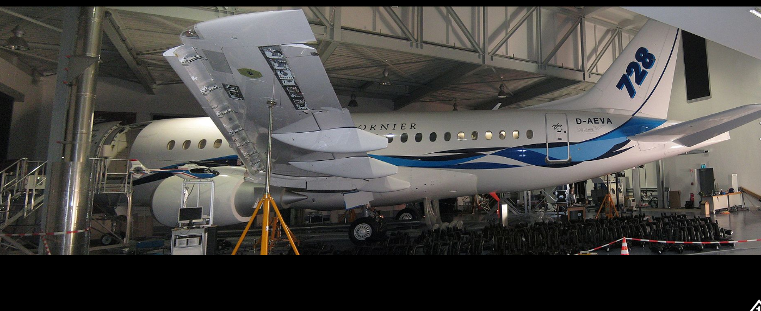
Do728

Slide 169
Operations in the US
Manufacture of wings for Do328 in San Antonio/Tx
Maintenance for about 500 aircraft in San Antonio/Tx
Fleet management in Herndon/VA
Sales office for Dornier aircraft in the US in Herndon/VA

Slide 170
Causes for Insolvency
Abandoned development of Do528
9/11
Cost overrun for the development of Do728

Slide 171
Objectives
Continue the production of Do328
Continue the development of Do728
Continue the Airbus production
=> The operation in the US was crucial

Slide 172
Milestones
With the filing for insolvency in Germany all officers in the US resigned
I was appointed „president“ for all US companies
The US companies went into Chapter 11
The main facility was in San Antonio
The Chapter 11 was supervised by the insolvency court in Alexandria/Va

Slide 173
How did it end?
Not well!
After one year the Airbus production was sold
The development of the Do 728 was discontinued
The Do328 program was sold and discontinued shortly thereafter

Slide 174
Key features
Alignment of different procedures in different jurisdictions
High regulatory requirements
Extreme difficulties in the continuation of the operation

Slide 175
Session 7:
Speech is silver, but silence is gold:
The fine line between access to information and need for confidentiality
Moderator: Evert Verwey, Co-Chair of the INSOL Europe EECC;
Clifford Chance LLP, The Netherlands
Maja Zerjal, Proskauer Rose, US
Anže Pavšek, Zaman and Partners, Slovenia

Slide 176
Information to stakeholders (creditors/ shareholders /directors)
Information to others? Access to information?
Disclosure Proceedings
Trading in debts to get information?
Courts supervision?
Topics
Disclosure obligation in case of distressed trading?
Receiver needs to be transparent?
Protection against competitors?
Information for other (defense) purposes?
Valuation of the company and disclosure?

Slide 177
Closing remarks
Radu Lotrean
Immediate Past President of INSOL Europe,
Co-Chair of the INSOL Europe EECC,
CITR, Romania
Evert Verwey
Co-Chair of the INSOL Europe EECC,
Clifford Chance LLP, The Netherlands

Slide 178

Young Members Group
Drinks Reception
Kindly Sponsored by:
﻿www.schiebe.de

