Slide 1
Valuation Considerations in the Post Pandemic Economy
Panel Discussion
Patrizia Riva, Studio Riva, Milan
Michael Weaver, Duff & Phelps, London
Jason Schiess, NETBID, Hamburg

Slide 2
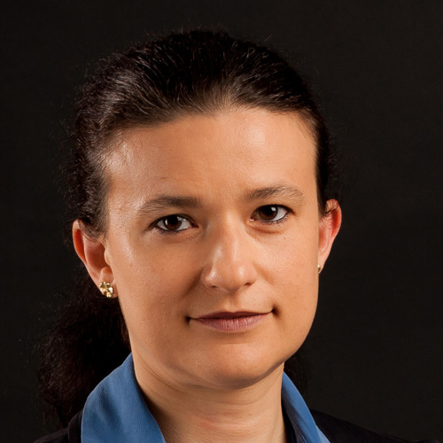
Introductions
Patrizia Riva
Chartered Public Accountant and Auditor since 1993. Senior Partner & Founder of the accounting & auditing firm “Studio Patrizia Riva, Dottori Commercialisti e Avvocati Associati” in Milano and Monza;
Associate professor with teaching appointment in Auditing, Corporate Governance, Internal Auditing at DiSEI Piemonte Orientale University;
Indipendent director and President of the supervisory board in public & private companies (among which Maire, Piquadro, GVS, Atac),
Certified Court Appraiser and Court Appointed Trustee. Government Certified Mediator.
Member of the Insolvency and Crisis Committee of CNDCEC the National Council of Chartered Accountants and of Referee Board of OCRI Company Crisis and Turnaround Research Center.

Slide 3
Top factors affecting valuation in local markets
Pre-pandemic
Currently
Valuation not so frequent - carried out in special situation (M&A, turnaround) or in order to verify book values with impairment test.
Entry into force of the IC-Code which rules early warning system (issued in 2019) has been postponed (to 2023)
Family SMEs organized as SRL were allowed to have low levels of indipendent CG roles and of attention to audit & risks management
In August 2021 a Light early warning has been introduces (DL118/21) - companies are classified using the recovery time index
DL 118/21 Focus on:
  CG Roles,
  Forward Looking Information, Budget, Business plans
  Risk management
  Awarness of the need for turnaround
Expectations of an increase in the frequency of valutions as they:
  they become the appropriate response to growing demand for scrutiny.

Slide 4
Predictions for local markets & tips for success
Focus on company risks may be a positive inheritance of the pandemic
Firms need tools to prevent crisis coming from the lack of monitoring risks … regardless of the legal structure of the company
Strong need for:
  Governance, ex ante control independent roles ( … in Srl )
  Budget, planning
  Valuations for “special situations”
Hopefully we could expect a more genuine (?) attention towards CSR
Sample text
Sample text
Sample text
Sample text
Sample text
Sample text
Sample text
Sample text

