Slide 1
Our grateful thanks go to our 2022 Annual Congress Sponsors

Slide 2



﻿Access the Congress App at:
https://crowdcomms.com/dublincongress2022
We are grateful to CITR and
PROF. DR. PANNEN RECHTSANWÄLTE for
sponsoring our Congress App.
www.citr.ro
www.drpannen.de

Slide 3




Friday Morning Technical Session
Kindly Sponsored By
www.alixpartners.com
www.dentons.com
www.hoche-avocats.com
www.wedlakebell.com

Slide 4
Opening remarks of the Annual Congress
Congress Facilitator
David Rubin, Begbies Traynor, UK
Co-Chairs
Barry Cahir, Beauchamps, Ireland
Giorgio Corno, Studio Corno Avvocati, Italy
Presidents of INSOL Europe
Frank Tschentscher, Deloitte, Germany (2021-2022)
Marcel Groenewegen, CMS, The Netherlands (2020-2021)

Slide 5
Keynote Speaker:
﻿Austin Hughes
Chief Economist, KBC Economics, Ireland

Slide 6
KBC Bank
Back to the future2?
Austin Hughes
4 March 2022

Slide 7

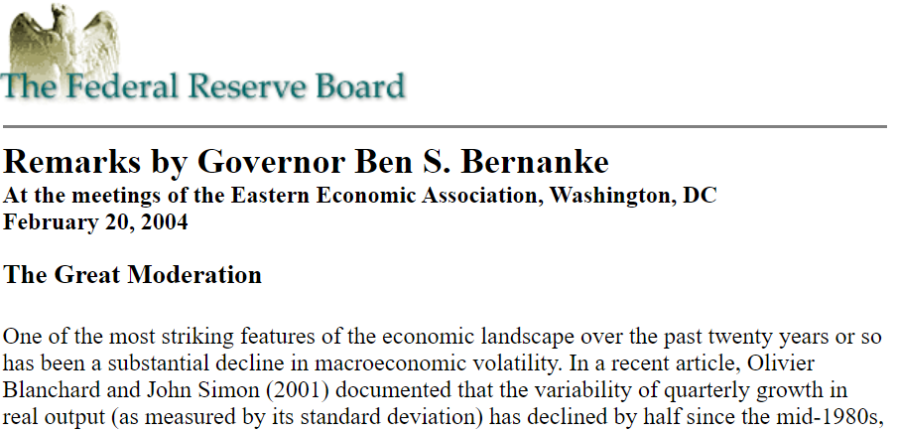

No going back? What sort of future?
No going back? What sort of future?

Slide 8
Turbulent times- the result of economic climate change?
More frequent storms
‘Ní hé lá na gaoithe, lá na scolb’
Global financial crisis
Euro area crisis
Brexit
Trump(ism)
Covid
Ukraine
?
Austerity
Negative interest rates
Economic ‘distancing’
QE
‘build back bigger’
Tariffs/Sanctions
Many unintended consequences
Storm damage rather than a tsunami
More pressures, more policy interventions, more problems, less predictability

Slide 9
Adjustments have been impressive everywhere but local differences important
Pandemic moving into past. Will Putin fade as quickly?
Scale and speed of recovery varies widely…as does underlying damage

Slide 10
Problems in places we didn’t know there were places

Slide 11
Crime and punishment?
Energy ‘sustainability’ varies widely at company level and indirect impacts eg transport, food costs also likely to have different if generally difficult impacts

Slide 12
Back to the 70’s?
Cost squeeze to become a problem for many businesses
Pricing power increasingly important
Rising borrowing costs an extra pressure
..but ‘resurrection rate’ may not be breached

Slide 13
It is important that policymakers do not consider the low number of insolvency filings in Europe as a sign of corporate health.
‘It is important that policymakers do not consider the low number of insolvency filings in Europe as a sign of corporate health.’
ESRB ‘Prevention and management of a large number of corporate insolvencies’ / April 2021 p4
Insolvencies slumped when the economy stopped
But the pain still remains

Slide 14
UK ‘Macro’ bankruptcy relationship has also shifted…but recent data suggest it hasn’t stopped

Slide 15
Where next,and when?
Insolvencies delayed rather than denied
EU27 bankruptcies by sector, source Eurostat

Slide 16
3 handed economists at the ESRB
3 handed economists at the ESRB
‘A major wave of insolvencies may yet happen if crisis management measures are withdrawn too quickly, and the macro-financial amplification dynamics of a “normal” recession may yet set in. If insolvencies of fundamentally viable firms can be avoided and if insolvencies of fundamentally unviable firms can be dealt with efficiently, the damaging economic effects of the COVID-19 shock should be minimised and a robust recovery of the economy might be expected once the pandemic has been brought under control. However, many crisis management measures that focus on the provision of liquidity support to companies could be simply delaying insolvencies and possibly also structural change. ‘
ESRB ‘Prevention and management of a large number of corporate insolvencies’ / April 2021 p3

Slide 17
Where next?
Where next?
Near-term insolvency upswing as supports fade
likely to be amplified by bumpy upswing
and troublesome cost increases with pricing power becoming a critical factor
Looking (slightly further ahead);
Economic climate change likely to mean;
‘Stormier’ and possibly shorter cycles
Greater ‘creative destruction’ and ..
…..slower but significant ‘seemingly random’ destruction
Increased policy unpredictability/ national divergences around political pressures for ‘larger for longer’ support (so more ‘zombies’)
Implication; impact of economic fluctuations on insolvencies may be larger, later and less predictable than in the past

Slide 18
﻿Cross-border schemes and plans:
How they work in different jurisdictions
﻿Panel leader: Chris Laughton, Mercer & Hole, UK
Panellists: Kathy Stones, LexisNexis, UK
Marcel Groenewegen, CMS, The Netherlands
Riaz Janjuah, White & Case, Germany
Michael Murphy, McCann Fitzgerald, Ireland

Slide 19






Cross-Border Schemes & Plans
Chris Laughton – Mercer & Hole (UK)
Michael Murphy – McCann FitzGerald (Ireland)
Kathy Stones – LexisNexis (UK)
Marcel Groenewegen – CMS (Netherlands)
Riaz Janjuah – White & Case (Germany)

Slide 20




 | Ireland |  | UK |  | Netherlands |  | Germany
 | Examinership | Scheme | Restructuring Plan | Scheme | WHOA |  | StaRUG
 |  |  |  |  | Private | Public | Plan
Insolvent (or likely)
Moratorium/stay
Voting (Number, Value)
Cross-class cram down
IP appointed
Jurisdiction test
EU recognition
Challenge/solution
Final word

Slide 21
 | Ireland |  | UK |  | Netherlands |  | Germany
 | Examinership | Scheme | Restructuring Plan | Scheme | WHOA |  | StaRUG
 |  |  |  |  | Private | Public | Plan
Insolvent (or likely) | Y | N
Moratorium/stay | Y | N
Voting (Number, Value) | 50% N&V | 50%N 75%V
Cross-class cram down | Y | N
IP appointed | Y | N
Jurisdiction test
EU recognition
Challenge/solution
Final word

Slide 22
 | Ireland |  | UK |  | Netherlands |  | Germany
 | Examinership | Scheme | Restructuring Plan | Scheme | WHOA |  | StaRUG
 |  |  |  |  | Private | Public | Plan
Insolvent (or likely) | Y | N | Y | N
Moratorium/stay | Y | N | N(Y) | N(Y)
Voting (Number, Value) | 50% N&V | 50%N 75%V | 75%V | 50%N 75%V
Cross-class cram down | Y | N | Y | N
IP appointed | Y | N | N(Y) | N(Y)
Jurisdiction test
EU recognition
Challenge/solution
Final word

Slide 23
 | Ireland |  | UK |  | Netherlands |  | Germany
 | Examinership | Scheme | Restructuring Plan | Scheme | WHOA
 |  |  |  |  | Private | Public
Insolvent (or likely) | Y | N | Y | N | Y | Y
Moratorium/stay | Y | N | N(Y) | N(Y) | N(Y) | N(Y)
Voting (Number, Value) | 50% N&V | 50%N 75%V | 75%V | 50%N 75%V | 66%V | 66%V
Cross-class cram down | Y | N | Y | N | Y | Y
IP appointed | Y | N | N(Y) | N(Y) | N(Y) | N(Y)
Jurisdiction test
EU recognition
Challenge/solution
Final word

Slide 24
 | Ireland |  | UK |  | Netherlands |  | Germany
 | Examinership | Scheme | Restructuring Plan | Scheme | WHOA |  | StaRUG
 |  |  |  |  | Private | Public | Plan
Insolvent (or likely) | Y | N | Y | N | Y | Y | Y (imminent)
Moratorium/stay | Y | N | N(Y) | N(Y) | N(Y) | N(Y) | Y
Voting (Number, Value) | 50% N&V | 50%N 75%V | 75%V | 50%N 75%V | 66%V | 66%V | 75%V
Cross-class cram down | Y | N | Y | N | Y | Y | Y
IP appointed | Y | N | N(Y) | N(Y) | N(Y) | N(Y) | Y/N
Jurisdiction test
EU recognition
Challenge/solution
Final word

Slide 25
 | Ireland |  | UK |  | Netherlands |  | Germany
 | Examinership | Scheme | Restructuring Plan | Scheme | WHOA |  | StaRUG
 |  |  |  |  | Private | Public | Plan
Insolvent (or likely) | Y | N | Y | N | Y | Y | Y (imminent)
Moratorium/stay | Y | N | N(Y) | N(Y) | N(Y) | N(Y) | Y
Voting (Number, Value) | 50% N&V | 50%N 75%V | 75%V | 50%N 75%V | 66%V | 66%V | 75%V
Cross-class cram down | Y | N | Y | N | Y | Y | Y
IP appointed | Y | N | N(Y) | N(Y) | N(Y) | N(Y) | Y/N
Jurisdiction test | COMI (EU), SC | SC
EU recognition
Challenge/solution
Final word

Slide 26
 | Ireland |  | UK |  | Netherlands |  | Germany
 | Examinership | Scheme | Restructuring Plan | Scheme | WHOA |  | StaRUG
 |  |  |  |  | Private | Public | Plan
Insolvent (or likely) | Y | N | Y | N | Y | Y | Y (imminent)
Moratorium/stay | Y | N | N(Y) | N(Y) | N(Y) | N(Y) | Y
Voting (Number, Value) | 50% N&V | 50%N 75%V | 75%V | 50%N 75%V | 66%V | 66%V | 75%V
Cross-class cram down | Y | N | Y | N | Y | Y | Y
IP appointed | Y | N | N(Y) | N(Y) | N(Y) | N(Y) | Y/N
Jurisdiction test | COMI (EU), SC | SC | SC | SC
EU recognition
Challenge/solution
Final word

Slide 27
 | Ireland |  | UK |  | Netherlands |  | Germany
 | Examinership | Scheme | Restructuring Plan | Scheme | WHOA |  | StaRUG
 |  |  |  |  | Private | Public | Plan
Insolvent (or likely) | Y | N | Y | N | Y | Y | Y (imminent)
Moratorium/stay | Y | N | N(Y) | N(Y) | N(Y) | N(Y) | Y
Voting (Number, Value) | 50% N&V | 50%N 75%V | 75%V | 50%N 75%V | 66%V | 66%V | 75%V
Cross-class cram down | Y | N | Y | N | Y | Y | Y
IP appointed | Y | N | N(Y) | N(Y) | N(Y) | N(Y) | Y/N
Jurisdiction test | COMI (EU), SC | SC | SC | SC | SC | COMI
EU recognition
Challenge/solution
Final word

Slide 28
 | Ireland |  | UK |  | Netherlands |  | Germany
 | Examinership | Scheme | Restructuring Plan | Scheme | WHOA |  | StaRUG
 |  |  |  |  | Private | Public | Plan
Insolvent (or likely) | Y | N | Y | N | Y | Y | Y (imminent)
Moratorium/stay | Y | N | N(Y) | N(Y) | N(Y) | N(Y) | Y
Voting (Number, Value) | 50% N&V | 50%N 75%V | 75%V | 50%N 75%V | 66%V | 66%V | 75%V
Cross-class cram down | Y | N | Y | N | Y | Y | Y
IP appointed | Y | N | N(Y) | N(Y) | N(Y) | N(Y) | Y/N
Jurisdiction test | COMI (EU), SC | SC | SC | SC | SC | COMI | COMI
EU recognition
Challenge/solution
Final word

Slide 29
 | Ireland |  | UK |  | Netherlands |  | Germany
 | Examinership | Scheme | Restructuring Plan | Scheme | WHOA |  | StaRUG
 |  |  |  |  | Private | Public | Plan
Insolvent (or likely) | Y | N | Y | N | Y | Y | Y (imminent)
Moratorium/stay | Y | N | N(Y) | N(Y) | N(Y) | N(Y) | Y
Voting (Number, Value) | 50% N&V | 50%N 75%V | 75%V | 50%N 75%V | 66%V | 66%V | 75%V
Cross-class cram down | Y | N | Y | N | Y | Y | Y
IP appointed | Y | N | N(Y) | N(Y) | N(Y) | N(Y) | Y/N
Jurisdiction test | COMI (EU), SC | SC | SC | SC | SC | COMI | COMI
EU recognition | Y | Y
Challenge/solution
Final word

Slide 30
 | Ireland |  | UK |  | Netherlands |  | Germany
 | Examinership | Scheme | Restructuring Plan | Scheme | WHOA |  | StaRUG
 |  |  |  |  | Private | Public | Plan
Insolvent (or likely) | Y | N | Y | N | Y | Y | Y (imminent)
Moratorium/stay | Y | N | N(Y) | N(Y) | N(Y) | N(Y) | Y
Voting (Number, Value) | 50% N&V | 50%N 75%V | 75%V | 50%N 75%V | 66%V | 66%V | 75%V
Cross-class cram down | Y | N | Y | N | Y | Y | Y
IP appointed | Y | N | N(Y) | N(Y) | N(Y) | N(Y) | Y/N
Jurisdiction test | COMI (EU), SC | SC | SC | SC | SC | COMI | COMI
EU recognition | Y | Y | Local Law | Local Law
Challenge/solution
Final word

Slide 31
 | Ireland |  | UK |  | Netherlands |  | Germany
 | Examinership | Scheme | Restructuring Plan | Scheme | WHOA |  | StaRUG
 |  |  |  |  | Private | Public | Plan
Insolvent (or likely) | Y | N | Y | N | Y | Y | Y (imminent)
Moratorium/stay | Y | N | N(Y) | N(Y) | N(Y) | N(Y) | Y
Voting (Number, Value) | 50% N&V | 50%N 75%V | 75%V | 50%N 75%V | 66%V | 66%V | 75%V
Cross-class cram down | Y | N | Y | N | Y | Y | Y
IP appointed | Y | N | N(Y) | N(Y) | N(Y) | N(Y) | Y/N
Jurisdiction test | COMI (EU), SC | SC | SC | SC | SC | COMI | COMI
EU recognition | Y | Y | Local Law | Local Law | Local Law | Y
Challenge/solution
Final word

Slide 32
 | Ireland |  | UK |  | Netherlands |  | Germany
 | Examinership | Scheme | Restructuring Plan | Scheme | WHOA |  | StaRUG
 |  |  |  |  | Private | Public | Plan
Insolvent (or likely) | Y | N | Y | N | Y | Y | Y (imminent)
Moratorium/stay | Y | N | N(Y) | N(Y) | N(Y) | N(Y) | Y
Voting (Number, Value) | 50% N&V | 50%N 75%V | 75%V | 50%N 75%V | 66%V | 66%V | 75%V
Cross-class cram down | Y | N | Y | N | Y | Y | Y
IP appointed | Y | N | N(Y) | N(Y) | N(Y) | N(Y) | Y/N
Jurisdiction test | COMI (EU), SC | SC | SC | SC | SC | COMI | COMI
EU recognition | Y | Y | Local Law | Local Law | Local Law | Y | Private: Local Law Public: Y (22.7.22)
Challenge/solution
Final word

Slide 33
 | Ireland |  | UK |  | Netherlands |  | Germany
 | Examinership | Scheme | Restructuring Plan | Scheme | WHOA |  | StaRUG
 |  |  |  |  | Private | Public | Plan
Insolvent (or likely) | Y | N | Y | N | Y | Y | Y (imminent)
Moratorium/stay | Y | N | N(Y) | N(Y) | N(Y) | N(Y) | Y
Voting (Number, Value) | 50% N&V | 50%N 75%V | 75%V | 50%N 75%V | 66%V | 66%V | 75%V
Cross-class cram down | Y | N | Y | N | Y | Y | Y
IP appointed | Y | N | N(Y) | N(Y) | N(Y) | N(Y) | Y/N
Jurisdiction test | COMI (EU), SC | SC | SC | SC | SC | COMI | COMI
EU recognition | Y | Y | Local Law | Local Law | Local Law | Y | Private: Local Law Public: Y (22.7.22)
Challenge/solution | 100/150 days | Limited moratorium
Final word | Ready recognition; proven 30+ years track record

Slide 34
 | Ireland |  | UK |  | Netherlands |  | Germany
 | Examinership | Scheme | Restructuring Plan | Scheme | WHOA |  | StaRUG
 |  |  |  |  | Private | Public | Plan
Insolvent (or likely) | Y | N | Y | N | Y | Y | Y (imminent)
Moratorium/stay | Y | N | N(Y) | N(Y) | N(Y) | N(Y) | Y
Voting (Number, Value) | 50% N&V | 50%N 75%V | 75%V | 50%N 75%V | 66%V | 66%V | 75%V
Cross-class cram down | Y | N | Y | N | Y | Y | Y
IP appointed | Y | N | N(Y) | N(Y) | N(Y) | N(Y) | Y/N
Jurisdiction test | COMI (EU), SC | SC | SC | SC | SC | COMI | COMI
EU recognition | Y | Y | Local Law | Local Law | Local Law | Y | Private: Local Law Public: Y (22.7.22)
Challenge/solution | 100/150 days | Limited moratorium | Moratorium | Moratorium
Final word | Ready recognition; proven 30+ years track record |  | Sufficient connection; judges

Slide 35
 | Ireland |  | UK |  | Netherlands |  | Germany
 | Examinership | Scheme | Restructuring Plan | Scheme | WHOA |  | StaRUG
 |  |  |  |  | Private | Public | Plan
Insolvent (or likely) | Y | N | Y | N | Y | Y | Y (imminent)
Moratorium/stay | Y | N | N(Y) | N(Y) | N(Y) | N(Y) | Y
Voting (Number, Value) | 50% N&V | 50%N 75%V | 75%V | 50%N 75%V | 66%V | 66%V | 75%V
Cross-class cram down | Y | N | Y | N | Y | Y | Y
IP appointed | Y | N | N(Y) | N(Y) | N(Y) | N(Y) | Y/N
Jurisdiction test | COMI (EU), SC | SC | SC | SC | SC | COMI | COMI
EU recognition | Y | Y | Local Law | Local Law | Local Law | Y | Private: Local Law Public: Y (22.7.22)
Challenge/solution | 100/150 days | Limited moratorium | Moratorium | Moratorium |  | Directive compliant
Final word | Ready recognition; proven 30+ years track record |  | Sufficient connection; judges |  |  | Groups

Slide 36
 | Ireland |  | UK |  | Netherlands |  | Germany
 | Examinership | Scheme | Restructuring Plan | Scheme | WHOA |  | StaRUG
 |  |  |  |  | Private | Public | Plan
Insolvent (or likely) | Y | N | Y | N | Y | Y | Y (imminent)
Moratorium/stay | Y | N | N(Y) | N(Y) | N(Y) | N(Y) | Y
Voting (Number, Value) | 50% N&V | 50%N 75%V | 75%V | 50%N 75%V | 66%V | 66%V | 75%V
Cross-class cram down | Y | N | Y | N | Y | Y | Y
IP appointed | Y | N | N(Y) | N(Y) | N(Y) | N(Y) | Y/N
Jurisdiction test | COMI (EU), SC | SC | SC | SC | SC | COMI | COMI
EU recognition | Y | Y | Local Law | Local Law | Local Law | Y | Private: Local Law Public: Y (22.7.22)
Challenge/solution | 100/150 days | Limited moratorium | Moratorium | Moratorium |  | Directive compliant | Directors’ duties shift Contracts termination
Final word | Ready recognition; proven 30+ years track record |  | Sufficient connection; judges |  |  | Groups | Swift & flexible

Slide 37
 | Ireland |  | UK |  | Netherlands |  | Germany
 | Examinership | Scheme | Restructuring Plan | Scheme | WHOA |  | StaRUG
 |  |  |  |  | Private | Public | Plan
Insolvent (or likely) | Y | N | Y | N | Y | Y | Y (imminent)
Moratorium/stay | Y | N | N(Y) | N(Y) | N(Y) | N(Y) | Y
Voting (Number, Value) | 50% N&V | 50%N 75%V | 75%V | 50%N 75%V | 66%V | 66%V | 75%V
Cross-class cram down | Y | N | Y | N | Y | Y | Y
IP appointed | Y | N | N(Y) | N(Y) | N(Y) | N(Y) | Y/N
Jurisdiction test | COMI (EU), SC | SC | SC | SC | SC | COMI | COMI
EU recognition | Y | Y | Local Law | Local Law | Local Law | Y | Private: Local Law Public: Y (22.7.22)
Challenge/solution | 100/150 days | Limited moratorium | Moratorium | Moratorium |  | Directive compliant | Directors’ duties shift Contracts termination
Final word | Ready recognition; proven 30+ years track record |  | Sufficient connection; judges |  |  | Groups | Swift & flexible

Slide 38
﻿Restructuring cases in the Aviation space
﻿Panel leader: Barry Cahir, Beauchamps, Ireland
Panellists: Riz Mokal, South Square, UK
Siobhán Connolly, GECAS, Ireland

Slide 39

Coffee Break
Kindly Sponsored By
www.bnt.eu

Slide 40
Break-out Sessions

Slide 41
Break-out-session IV.
﻿EU Directive on Restructuring and Insolvency Article 19 – Friend or foe? Impact on Director’s behaviour in the likelihood of insolvency
﻿Panel leader: Michal Barlowski, Wardyński & Partners, Poland
Panellists: Prof. Irene Lynch Fannon, University College Cork / Matheson, Ireland
Prof. Reinhard Dammann, Dammann Avocat / Sciences Po, France
Prof. Reinout Vriesendorp, Leiden University /
De Brauw Blackstone Westbroek, The Netherlands

Slide 42
Article 19: Duties of directors where there is a likelihood of insolvency
Member States shall ensure that, where there is a likelihood of insolvency, directors, have due regard, as a minimum, to the following:
the interests of creditors, equity holders and other stakeholders;
the need to take steps to avoid insolvency; and
the need to avoid deliberate or grossly negligent conduct that threatens the viability of the business.

Slide 43
Article 19: Duties of directors where there is a likelihood of insolvency
Member States shall ensure that, where there is a likelihood of insolvency, directors, have due regard, as a minimum, to the following:
[…]
Recital 71: "Where the debtor is close to insolvency, it is also important to protect the legitimate interests of creditors from management decisions that may have an impact on the constitution of the debtor's estate […]"

Slide 44
Article 19: Duties of directors where there is a likelihood of insolvency
Member States shall ensure that, where there is a likelihood of insolvency, directors, have due regard, as a minimum, to the following:
(a) the interests of creditors, equity holders and other stakeholders;
Recital 71: "[…] judicial or administrative authorities, when assessing whether a director is to be held liable for breaches of duty of care, take the rules on duties of directors laid down in this Directive into account. This Directive is not intended to establish any hierarchy among the different parties whose interests need to be given due regard. […]"

Slide 45
Article 19: Duties of directors where there is a likelihood of insolvency
Member States shall ensure that, where there is a likelihood of insolvency, directors, have due regard, as a minimum, to the following:
(b) the need to take steps to avoid insolvency; and
(c) the need to avoid deliberate or grossly negligent conduct that threatens the viability of the business.
Recital 71: "[…] directors [must] avoid any deliberate or grossly negligent actions that result in personal gain at the expense of stakeholders, and avoid agreeing to transactions at below market value, or taking actions leading to unfair preference being given to one or more stakeholders. […]"

Slide 46
Break-out-session IV.
﻿EU Directive on Restructuring and Insolvency Article 19 – Friend or foe? Impact on Director’s behaviour in the likelihood of insolvency
﻿Panel leader: Michal Barlowski, Wardyński & Partners, Poland
Panellists: Prof. Irene Lynch Fannon, University College Cork / Matheson, Ireland
Prof. Reinhard Dammann, Dammann Avocat / Sciences Po, France
Prof. Reinout Vriesendorp, Leiden University /
De Brauw Blackstone Westbroek, The Netherlands

Slide 47
Article 19: Duties of directors where there is a likelihood of insolvency
Member States shall ensure that, where there is a likelihood of insolvency, directors, have due regard, as a minimum, to the following:
the interests of creditors, equity holders and other stakeholders;
the need to take steps to avoid insolvency; and
the need to avoid deliberate or grossly negligent conduct that threatens the viability of the business.

Slide 48
Article 19: Duties of directors where there is a likelihood of insolvency
Member States shall ensure that, where there is a likelihood of insolvency, directors, have due regard, as a minimum, to the following:
[…]
Recital 71: "Where the debtor is close to insolvency, it is also important to protect the legitimate interests of creditors from management decisions that may have an impact on the constitution of the debtor's estate […]"

Slide 49
Article 19: Duties of directors where there is a likelihood of insolvency
Member States shall ensure that, where there is a likelihood of insolvency, directors, have due regard, as a minimum, to the following:
(a) the interests of creditors, equity holders and other stakeholders;
Recital 71: "[…] judicial or administrative authorities, when assessing whether a director is to be held liable for breaches of duty of care, take the rules on duties of directors laid down in this Directive into account. This Directive is not intended to establish any hierarchy among the different parties whose interests need to be given due regard. […]"

Slide 50
Article 19: Duties of directors where there is a likelihood of insolvency
Member States shall ensure that, where there is a likelihood of insolvency, directors, have due regard, as a minimum, to the following:
(b) the need to take steps to avoid insolvency; and
(c) the need to avoid deliberate or grossly negligent conduct that threatens the viability of the business.
Recital 71: "[…] directors [must] avoid any deliberate or grossly negligent actions that result in personal gain at the expense of stakeholders, and avoid agreeing to transactions at below market value, or taking actions leading to unfair preference being given to one or more stakeholders. […]"

Slide 51
Delegate Lunch
Kindly Sponsored By
www.mcstayluby.ie

Slide 52
Friday Afternoon Technical Session
Kindly Sponsored By
www.alixpartners.com
www.dentons.com
www.hoche-avocats.com
www.wedlakebell.com

Slide 53


Slide 54
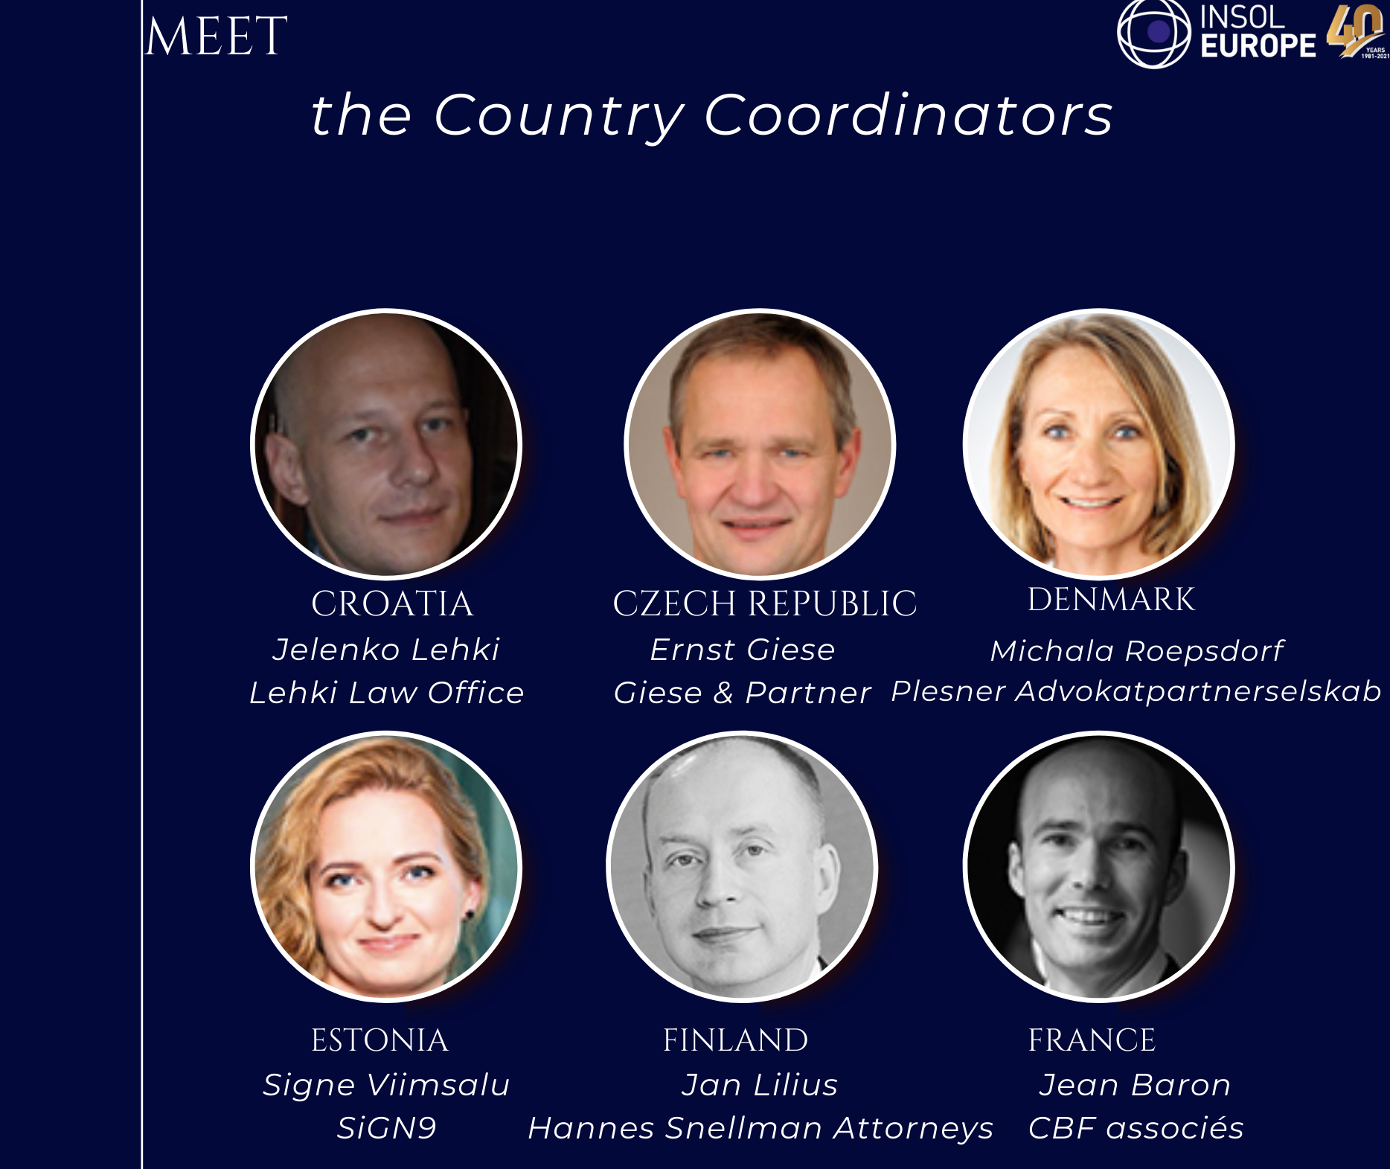

Slide 55
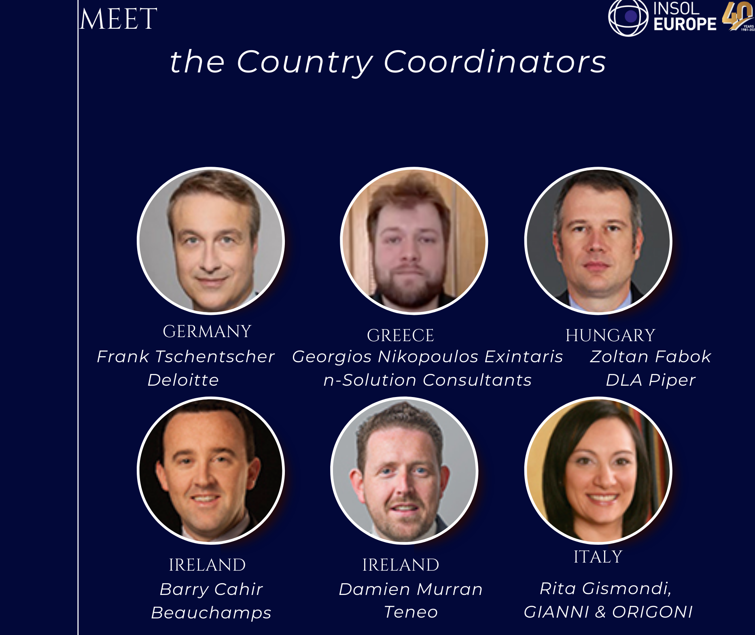

Slide 56
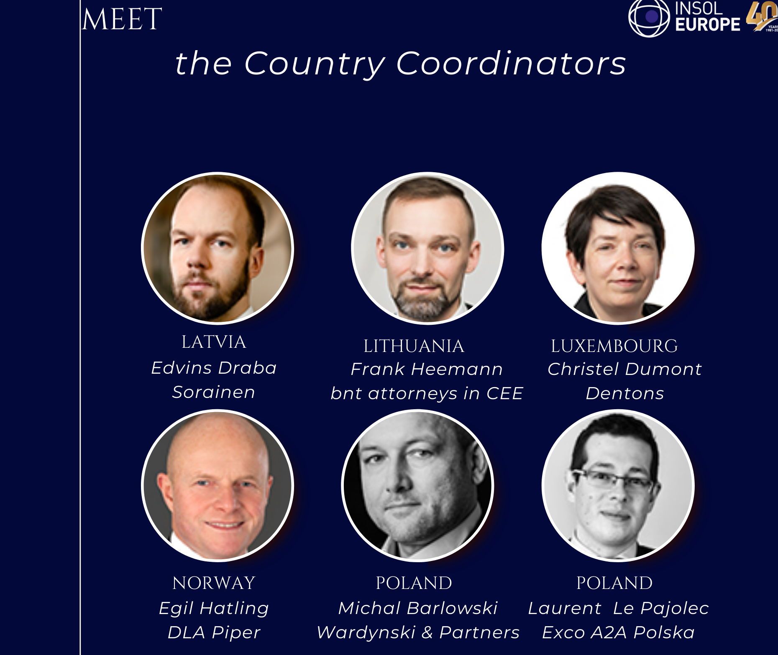

Slide 57
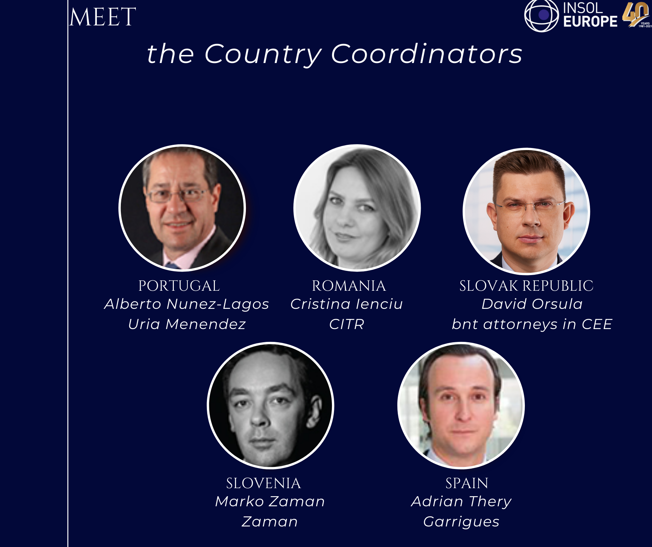

Slide 58
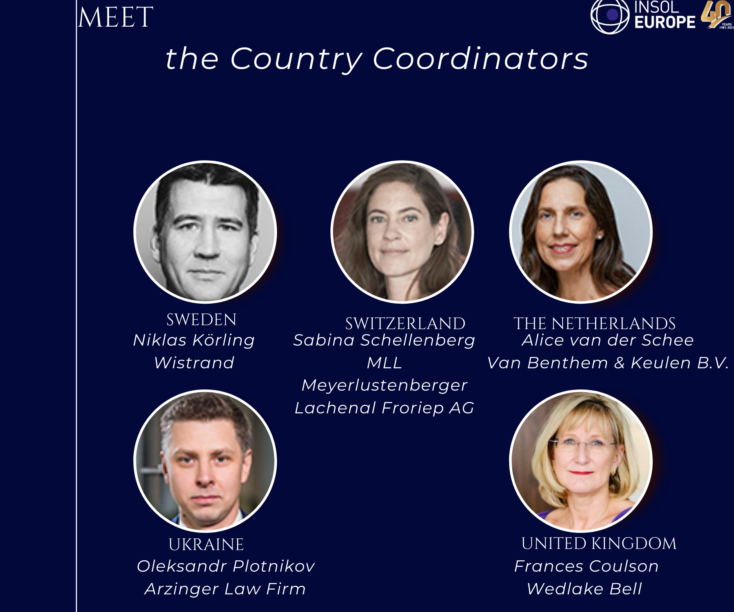

Slide 59
﻿Consumer debt discharge
﻿Panel leader: Stathis Potamitis, Potamitisvekris, Greece
Panellists: Gauthier Vandenbossche, Ghent University, Belgium
Alexandros Rokas, Bank of Greece, Greece
Prof. Stephan Madaus, Martin Luther University Halle-Wittenberg, Germany

Slide 60
﻿Real Estate Industry – Cross border issues and court cases
﻿Panel leader: Giorgio Corno, Studio Corno Avvocati, Italy
Panellists: John Briggs, South Square, UK
Kelley Smith, Law Library, Ireland
Michael Thierhoff, Andersen, Germany

Slide 61
The issue

Slide 62
Disposing of contracts conferring the right to … make use of immoveable property within restructuring proceedings
What happens when the property is located in a MS different from the one of opening of the insolvency proceeding?
Rules and recent court cases, following covid pandemic

Slide 63
Domestic Legal Regimes

Slide 64
﻿UK

Slide 65

Disclaimer (termination) of lease as “onerous property” through formal liquidation of insolvent company or individual by notice given by liquidator (sections 178 & 179 Insolvency Act 1986)
English law regards a lease not as security but as a property right of the landlord so there is otherwise no provision for disclaimer but the tenant can effectively bring the lease to an end by compromising the obligation to pay past and future rent through a company or individual voluntary arrangement (CVA/IVA) (or probably a scheme or restructuring plan) leaving the landlord to recover his property and limit his loss

Slide 66
﻿Ireland

Slide 67

Section 537 of the Companies Act 2014
“537. (1) Where proposals for a compromise or scheme of arrangement are to be formulated in relation to a company, the company may, subject to the approval of the court, affirm or repudiate any contract under which some element of performance other than payment remains to be rendered both by the company and the other contracting party or parties.
(2) Any person who suffers loss or damage as a result of such repudiation shall stand as an unsecured creditor for the amount of such loss or damage.
(3) …”

Slide 68
Section 537
the insolvent company may elect to affirm or repudiate the contract
the High Court has a discretion to approve any repudiation.
that discretion may only be exercised where proposals for a compromise or scheme of arrangement are to be formulated in relation to the company (Re Arctic Aviation Assets DAC [2021] IEHC 268)
the Court can immediately quantify the damages arising from the repudiation without the need for prolonged litigation.
Section 537 does not provide a power to alter the terms of a contract, including a lease.
Section 544(1)(a) provides that any scheme of arrangement should not contain proposals the result of which would be a “reduction in the amount of any rent or other periodical payment reserved under a lease of land…”

Slide 69
Effect of repudiation of lease
The landlord’s loss is treated in similar way to company’s monetary creditors.
The landlord’s damages are treated as an unsecured debt and can be included in any scheme of arrangement. (McGovern J in Re Linen Supply of Ireland [2010] IEHC 28)
Repudiation is usually effective on the sanction of the scheme of arrangement.

Slide 70
﻿Italy

Slide 71

Substantial and procedural rules
a. Following publication of the application for concordato preventivo proceedings, contracts:
  may be terminated or suspended by the court
    CCII: If contracts neither consistent with provisions of the plan nor functional to its execution
  termination does not extend to the arbitration clause contained in it
b. Proceeding for termination or suspension of contracts
  application of the debtor → other party may challenge it
  reasoned decree by the court or deputy judge
    effective from notification of the authorization decision to the other party
    other party may challenge it

Slide 72
Suspension
Until 15 May 2022:
  for no more than 60 days, which may be extended for the same duration but only once
  either before or after plan and proposal’s filing
From 16 May 2022:
  before plan and proposal’s filing: between 30 and 60 days. Such term may be extended up to 60 days on justified grounds and if no application for winding up was filed;
  following plan and proposal’s filing: for no more than thirty days from the date of the admission decree

Slide 73
Other party’s indemnity claim
Compensation claim
  equal to damages for non-performance
  as an unsecured claim prior to the composition
if no agreement → court’s jurisdiction
  until 15 May 2022: ordinary courts
  from 16 May 2022:
    court having ordinary jurisdiction: amount for voting and calculation of majorities’ requested for approval of the composition only
    ordinary courts: sets the amount for distribution purposes

Slide 74
Germany

Slide 75

Commercial Leases in German preventive restructuring proceedings
Draft of the German StaRuG of 9 November 2020
Section 51
Termination of Contracts
Upon application by the debtor, the restructuring court shall terminate a mutual contract which is not mutually fully performed and to which the debtor is a party if the other party fails to comply with the debtor's request for adjustment or termination and the debtor is pending illiquid. The application pursuant to sentence 1 may only be filed simultaneously with an application for confirmation of a restructuring plan providing for further restructuring measures.*
* Deleted as part of final editing, enacted 1 January 2021

Slide 76
Commercial Leases in German insolvency proceedings
Section 108 Insolvency Code
Continuation of Certain Debt Relationships
Section 109 Insolvency Code
Debtor as Tenant or Leaseholder
Section 112 Insolvency Code
Termination Restrictions
(1) Tenancies and leases of the debtor relating to immovable property or premises and employment relationships of the debtor shall continue with effect for the insolvency estate […].
(2) [...]
(3) Claims for the period prior to the opening of insolvency proceedings may be asserted by the other party only as an insolvency creditor.
(1) The insolvency administrator may terminate a tenancy or lease of immovable property or premises entered into by the debtor as tenant or lessee without regard to the agreed term of the contract or an agreed exclusion of the right of ordinary termination; the period of notice shall be three months to the end of the month unless a shorter period is applicable. […] If the insolvency administrator gives notice in accordance with sentence 1 […], the other party may claim damages as an insolvency creditor on account of the premature termination of the contractual relationship [...].
(2) [...]
A tenancy or lease entered into by the debtor as tenant or lessee may not be terminated by the other party after the application for the opening of insolvency proceedings:
on account of a delay in payment of rent or lease that occurred in the period prior to the application for the opening of insolvency proceedings,
because of a deterioration in the debtor's financial situation.

Slide 77
EU and MS Cross-border Regimes

Slide 78
Art. 11 EIR - Contracts relating to immoveable property
Law of the Member State within the territory of which the immoveable property is situated governs effects of insolvency proceedings on them
Jurisdiction of the court which opened main insolvency proceedings to approve the termination or modification of the contracts referred to in this Article where:
  the law of the Member State applicable to those contracts requires that such a contract may only be terminated or modified with the approval of the court opening insolvency proceedings; and
  no insolvency proceedings have been opened in that Member State.

Slide 79
﻿UK

Slide 80
A. England
Apperley Investments v Monsoon Accessorize 2020
Irish case: English CVA of Monsoon unsuccessfully seeking to bind Irish landlords
B. Italy
Italian concordato preventive proceeding
Inability of Italian insolvency process to dispose of English leases under article 11.2 EIR
Necessity for secondary proceedings?
Role of negotiating with landlord?!

Slide 81
Post-Brexit
Recognition of UK insolvency in the EU: Any likelihood that EU Member States would recognise the disclaimer of property/cram down of landlord’s rights in their jurisdiction through an English insolvency process? No application of Article 11.2 EIR !
Recognition in the UK of EU insolvency process terminating UK landlord’s rights: in principle this may be possible through recognition of foreign main proceedings under UNCITRAL Model Law pursuant to article 21.1 (g) subject to protection of rights in article 22 – foreign representative’s rights equivalent to rights of UK officeholder

Slide 82
﻿Ireland

Slide 83
UK Company Voluntary Arrangement
Treatment of Irish Landlords
Irish retail outlets, Irish landlords and UK tenant. UK tenant sought to impact Irish leases through CVA.
Article 11 EIR (Contracts relating to immoveable property) Irish law applies to proposed treatment of Irish landlords.
McDonald J in Apperley Investments Limited v Monsoon Accessorize Limited [2020] IEHC 523 considered the CVA there ‘did not provide any mechanism to permit any necessary representations to be made by the Irish landlords and or for an appropriate mechanism to consider those representations by all of the creditors in advance of casting their votes.’ (Emphasis in original). [Para 119]
Mechanism to address fair procedures deficit and allow landlords to make representations – provided for written observations to be made and placed on a portal.
Importance of timing
Landlords able to access representations before casting votes and consider in advance of delivery of proxies.

Slide 84
Irish examinership/Treatment of UK landlords
Compu B Retail
Irish COMI company and related companies in the UK.
Network of retail premises across Ireland and UK
Ultimately landlords (including UK landlords) agreed to renegotiation of the lease arrangements.
Parallel Insolvency processes
High Street retailers – structure whereby Irish company obtains suite of services from UK parent. Irish company has few trade creditors but has Irish leases.
UK parent engages in CVA and Irish company enters examinership in parallel
Irish company seeks to shed itself of Irish lease arrangements.

Slide 85
﻿Italy

Slide 86
Recent cross-border cases
Restructuring proceeding (concordato preventivo in continuità aziendale) opened by court of Mantova
Debtor with high street shops’ leases
  in foreign countries (UK, France) governed by lex rei sitae
  not functional to the plan
No secondary proceedings opened where shops located
Suspension granted by Italian insolvency court (11 EIR - art. 169bis Italian insolvency law):
  UK →
    CVA: no specific provision
    Winding up proceedings (Art. 178 Insolvency Act 1986: power to disclaim onerous property) may be properly invoked?
  France
    Saufguarde proceeding (L. 622-14 code de commerce)
    But no approval of the court requested

Slide 87
Germany

Slide 88
Commercial Leases in non German insolvency proceedings
EIR Article 11
Section 343 Insolvency Code
Recognition
Section 336 Insolvency Code
Contract regarding an Immovable Asset
(1) Law of the Member State within the territory of which the immoveable property is situated governs effects of insolvency proceedings on them
(2) …
(1) The opening of foreign insolvency proceedings shall be recognized. This shall not apply
1. if the courts of the state of the opening of proceedings do not have jurisdiction in accordance with German law;
2. where recognition leads to a result which is manifestly incompatible with major principles of German law, in particular where it is incompatible with basic rights.
(2) Subsection (1) shall apply mutatis mutandis to safeguarding measures taken after the request for the opening of insolvency proceedings, as well as to judgments handed down to implement or terminate recognized insolvency proceedings.
The effects of the insolvency proceedings on a contract relating to a right in rem in an immovable asset or a right to use an immovable asset shall be subject to the law of the state in which the object is situated […].

Slide 89

Delegate Coffee Break
Kindly Sponsored By
www.horten.dk

Slide 90
﻿Come together – further harmonisation of insolvency laws on EU-level?
﻿Panel leader: Robert Hänel, Anchor, Germany
Panellists: Miha Zebre, DG Justice & Consumers, European Commission, European Union
Robert van Galen, NautaDutilh
David Conaway, Shumaker Loop & Kendrick, USA

Slide 91




Come together
Further Harmonization of Insolvency Laws on EU-Level?
David H. Conaway
Shumaker, Loop & Kendrick, LLP
Robert van Galen
NautaDutilh
Robert Hänel
Anchor
Miha Zebre
EU-Commission, DG Just

Slide 92
The capital markets union (CMU) is a plan to create a single market for capital. The aim is to get money – investments and savings –
flowing across the EU so that it can benefit consumers, investors and companies, regardless of where they are located.
CMU
2020 Action Plan
Support a green, digital, inclusive and resilient economic recovery by making financing more accessible to European companies
Make the EU an even safer place for individuals to save and invest long-term
Integrate national capital markets
into a genuine single market
  Making companies more visible to cross-border investors
  Supporting access to public markets
  Supporting vehicles for long-term investment
  Encouraging more long-term and equity financing from institutional investors
  Directing SMEs to alternative providers of funding
  Helping banks to lend more to the real economy
  Empowering citizens through financial literacy
  Building retail investors‘ trust in capital markets
  Supporting people in their retirement
  Alleviating the tax associated burden in cross-border investment
  Making the outcome of cross-border investment more predictable as regards insolvency proceedings
  Facilitating shareholder engagement
  Developing cross-border settlement services
  Consolidate tape
  Investment protection and facilitation
  Supervision

Slide 93
CMU
Inception Impact Assessment on Insolvency Laws
(November 2020)
Public Consultation
on Insolvency Laws
(ending March 2020)
GERIL
Discussions &
Recommendations
(April 2021 – January 2022)
2020 Action Plan
Integrate national capital markets
into a genuine single market
Discussed Areas for possible Harmonization
Pre-pack
Sales
Opening of
Insolvency
Proceedings
Specific System
for (M)SMEs
Transaction
Avoidance
  Alleviating the tax associated burden in cross-border investment
  Making the outcome of cross-border investment more predictable as regards insolvency proceedings
  Facilitating shareholder engagement
  Developing cross-border settlement services
  Consolidate tape
  Investment protection and facilitation
  Supervision
Asset
Tracing
Lodgment
of Claims
Ranking
of Claims
Creditors‘
Committees
Directors‘ duties
and liabilities
Role of
Courts
Professional
Standards for IPs
Applications/Platforms
Facilitating Creditor Action
Data Protection
Guidelines for IPs

Slide 94
Discussed Areas for possible Harmonization
Opening of
Insolvency Proceedings
Specific System for (M)SEs
Transaction Avoidance
Pre-pack Sales
Expedited liquidation via going-concern sale after
simplified M&A-process
Harmonized entry test and/or preconditions for opening of proceedings / filing obligations?
Modular approach for simplified, more flexible, effective and cheaper
restructuring or liquidation of MSEs
Minimium harmonization according to
Bork/Veder-Study with Model Law for a
harmonized Transaction Avoidance Law
Asset Tracing
Lodgment of Claims
Ranking of Claims
Creditors‘ Committees
Facilitating cross-border
asset tracing, freezing and recovery
Standardized creditor notification and (minimum / maximum) lodgment time period?
Treatment of pre-commencement entitlements and unsecured claims
(preferences, subordinations?)
Standards on establishment, appointment, composition, powers, duties, voting, etc.
Directors‘ duties
and liabilities
Applications/Platforms
Facilitating Creditor Action
Role of Courts
Professional Standards for IPs
Enhancement of alert systems;
clarification of (shift of) duties
Continuing professional development and training
Harmonzied standards like EBRD 2021 insolvency office holder principles
Remote access to registries and (general) information about insolvency, online applications, etc.
(Data Protection Guidelines for IPs)

Slide 95
Closing remarks of the day
﻿David Rubin
Begbies Traynor, UK

Slide 96

Young Members’ Group Reception
Kindly Sponsored By
www.schiebe.de

