Slide 1
Our grateful thanks go to our 2022 Annual Congress Sponsors

Slide 2



﻿Access the Congress App at:
https://crowdcomms.com/dublincongress2022
We are grateful to CITR and
PROF. DR. PANNEN RECHTSANWÄLTE for
sponsoring our Congress App.
www.citr.ro
www.drpannen.de

Slide 3




Saturday Morning Technical Session
Kindly Sponsored By
www.alixpartners.com
www.dentons.com
www.hoche-avocats.com
www.wedlakebell.com

Slide 4
Opening remarks
Congress Facilitator
David Rubin, Begbies Traynor, UK
President
Frank Tschentscher, Deloitte, Germany
Co-Chair
﻿Barry Cahir, Beauchamps, Ireland

Slide 5
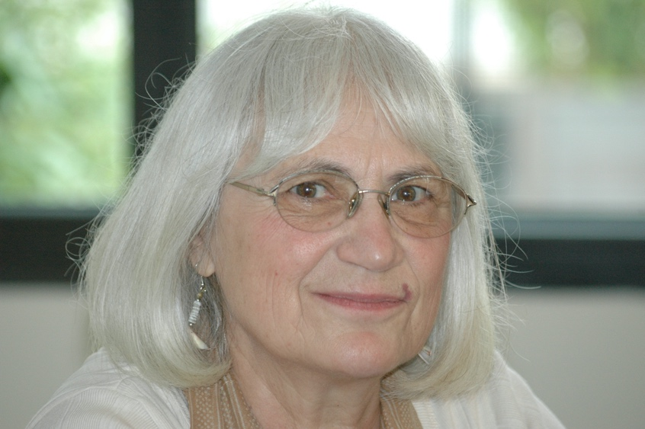

Florica Sincu
Nigel Davies

Slide 6
Keynote Speaker:
﻿﻿Paul Gallagher SC
﻿2007-2011 and 2020-present
Attorney General, Ireland

Slide 7
﻿IPs faced with GDPR:
“Little Shop of Horrors”
﻿Panel leader: Daniel Fritz, Dentons, Germany
Panellists: Jan Pohle, DLA, Germany
Hanneke De Coninck, Florent, The Netherlands

Slide 8
Brief history and effects of the GDPR
Predecessor: Directive 95/46/EC of the European Parliament and of the Council of 24 October 1995 on the protection of individuals with regard to the processing of personal data and on the free movement of such data (end of validity: 24/05/2018)
Now: Regulation (EU) 2016/679 of the European Parliament and of the Council of 27 April 2016 on the protection of natural persons with regard to the processing of personal data and on the free movement of such data, and repealing Directive 95/46/EC (General Data Protection Regulation, “GDPR”)
GDPR went into effect on 25 May 2018
Its purpose: Set of standardized data protection across the Union and making it easier for EU citizens to understand how their data is being used as well as how to raise complaints, irrespective of the Member State they are located in.
Due to its type of act as a regulation, GDPR – like the EIR - has direct effect and therefore is directly applicable in Member States (Art. 288 of Treaty on the Functioning of the European Union)

Slide 9
Personal Data (Art. 4(1) GDPR)
Any information relating to an identifiable natural Person

Slide 10
Personal Data (Art. 4(1) GDPR)
Any information relating to an identifiable natural Person
Identifiable Natural Person (Art. 4 (1) GDPR)
A person who can be identified directly or indirectly, in particular by reference to an identifier such as a name or identification number, location data or one or more factors specific to the physical, physiological, genetic, mental, economic culture or social identity of that person.

Slide 11
Personal Data (Art. 4(1) GDPR)
Any information relating to an identifiable natural Person
Identifiable Natural Person (Art. 4 (1) GDPR)
A person who can be identified directly or indirectly, in particular by reference to an identifier such as a name or identification number, location data or one or more factors specific to the physical, physiological, genetic, mental, economic culture or social identity of that person.
Data Controller (Art. 4 (7) GDPR)
The natural or legal person(s) which, alone or jointly with others, determine(s) the purpose and means of the processing of personal data

Slide 12
Personal Data (Art. 4(1) GDPR)
Any information relating to an identifiable natural Person
Identifiable Natural Person (Art. 4 (1) GDPR)
A person who can be identified directly or indirectly, in particular by reference to an identifier such as a name or identification number, location data or one or more factors specific to the physical, physiological, genetic, mental, economic culture or social identity of that person.
Data Controller (Art. 4 (7) GDPR)
The natural or legal person(s) which, alone or jointly with others, determine(s) the purpose and means of the processing of personal data
Data Processor (Art. 4 (8) GDPR)
A natural or legal person(s) which processes personal data on behalf of a Data Controller.

Slide 13
Personal Data (Art. 4(1) GDPR)
Any information relating to an identifiable natural Person
Identifiable Natural Person (Art. 4 (1) GDPR)
A person who can be identified directly or indirectly, in particular by reference to an identifier such as a name or identification number, location data or one or more factors specific to the physical, physiological, genetic, mental, economic culture or social identity of that person.
Data Controller (Art. 4 (7) GDPR)
The natural or legal person(s) which, alone or jointly with others, determine(s) the purpose and means of the processing of personal data
Data Processor (Art. 4 (8) GDPR)
A natural or legal person(s) which processes personal data on behalf of a Data Controller.
Processing (Art. 4 (2) GDPR)
Any operation or set of operations which is performed on Personal Data, whether or not by automated means, such as the following: collection; recording; organisation; structuring; storage; adoption or alteration; retrieval; consultation; use; disclosure; dissemination; alignment or combination; restriction; erasure; destruction.

Slide 14
Personal Data (Art. 4(1) GDPR) Any information relating to an identifiable natural Person
Identifiable Natural Person (Art. 4 (1) GDPR) A person who can be identified directly or indirectly, in particular by reference to an identifier such as a name or identification number, location data or one or more factors specific to the physical, physiological, genetic, mental, economic culture or social identity of that person.
Data Controller (Art. 4 (7) GDPR) The natural or legal person(s) which, alone or jointly with others, determine(s) the purpose and means of the processing of personal data.
Data Processor (Art. 4 (8) GDPR) A natural or legal person(s) which processes personal data on behalf of a Data Controller.
Processing (Art. 4 (2) GDPR) Any operation or set of operations which is performed on Personal Data, whether or not by automated means, such as the following: collection; recording; organisation; structuring; storage; adoption or alteration; retrieval; consultation; use; disclosure; dissemination; alignment or combination; restriction; erasure; destruction.
Personal Data Breach (Art. 4 (12) GDPR) A breach of security leading to the accidental or unlawful destruction, loss, alteration, unauthorized disclosure of, or access to, personal data transmitted, stored or otherwise processed.

Slide 15
GDPR vs. EIR
CoCo between Main and Secondary Proceedings (same legal entity)
Art. 41 (1) and (2a) EIR: To the extent such cooperation is not incompatible with the rules applicable of the respective proceedings, insolvency practitioners in the main and secondary insolvency proceedings concerning the same debtor shall communicate each other any information which may be relevant to the other proceedings.
CoCo between legal entities of the same group
Art: 56 (1) and (2a) EIR: Where insolvency proceedings relate to two or more members of a group of companies, the respective insolvency practitioners shall communicate each other any information which may be relevant to the other proceedings to the extent such cooperation is not incompatible with the rules applicable of the respective proceedings.
Group Coordination
Art. 74 (1) and (2) EIR: Insolvency practitioners appointed in relation to members of a group and the coordinator shall communicate any information that is relevant for the coordinator to perform his or her tasks to the extent such cooperation is not incompatible with the rules applicable of the respective proceedings.

Slide 16
INSOL International
﻿Scott Atkins
President of INSOL International
Norton Rose Fulbright, Australia

Slide 17
Coffee Break
Kindly Sponsored By
www.heuking.de

Slide 18
﻿Joint INSOL Europe Insolvency Tech & Digital Assets Wing/
Anti-Fraud Forum panel:
Roads? Where we’re going, we don’t need (Silk) Roads!
Cryptoassets and fraud – what the insolvency practitioner needs to know
﻿Panel leaders: Carmel King, Grant Thornton, UK / Co-Chair of the Anti-Fraud Forum
José Carles, Carles Cuesta, Spain / Co-Chair of the Insolvency Tech & Digital Assets Wing
Panellists: Danielle Haston, Chainalysis, UK
Aidan Larkin, Asset Reality, UK and Ireland

Slide 19
﻿INSOL Europe Judicial Wing panel:
The Courtroom of the future –
Which way forward?
﻿Panel leader: Michael Quinn, High Court, Ireland /
Co-Chair of the Judicial Wing
Panellists: Jeanette Melchior, Maritime and Commercial Court, Denmark
Caterina Macchi, Civil Court of Milan, Italy

Slide 20
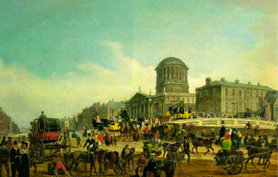
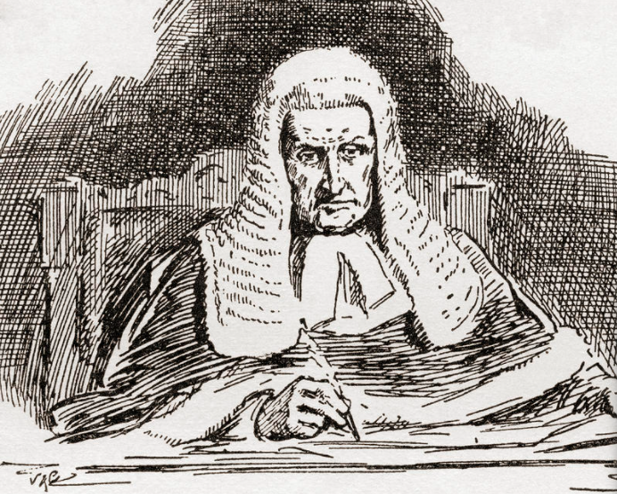
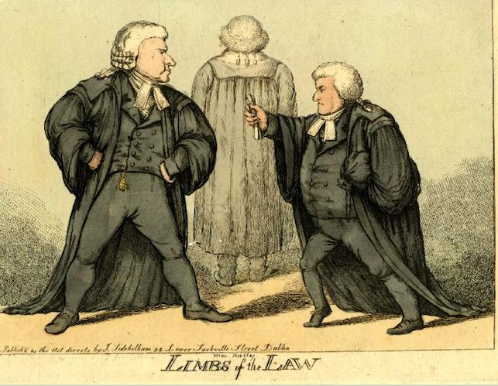

Slide 21
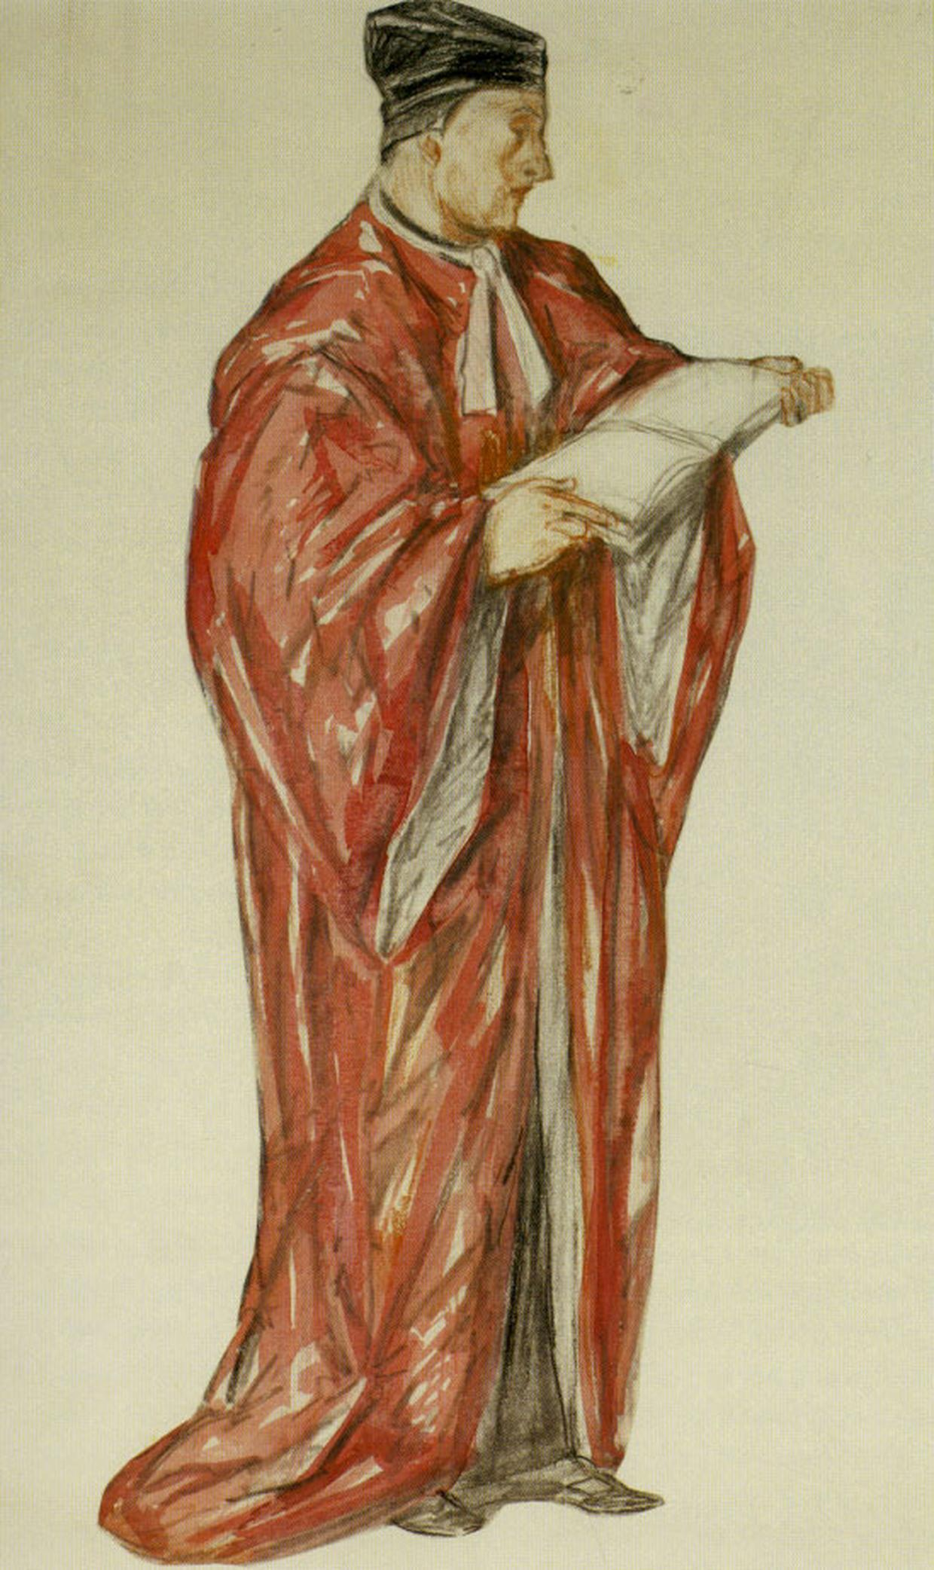
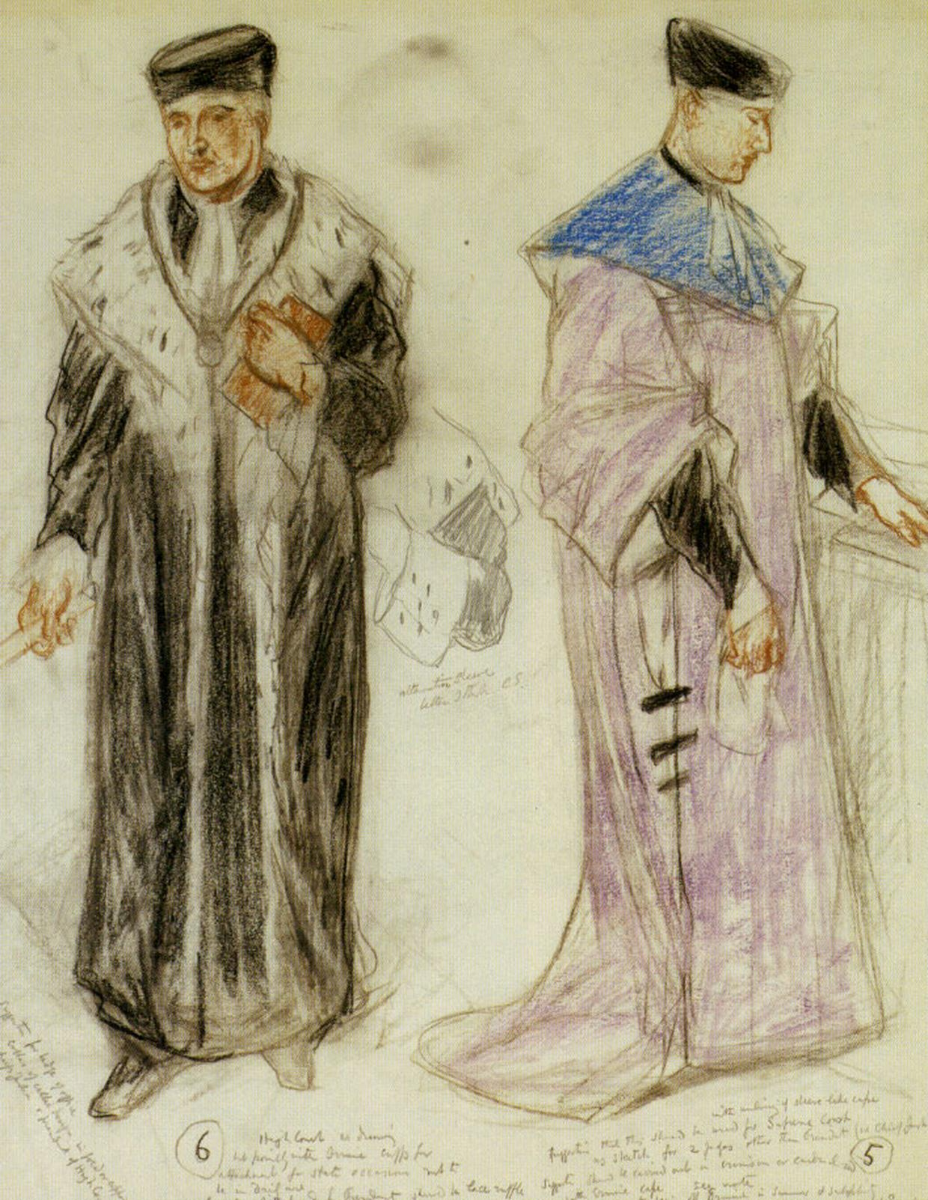

Slide 22
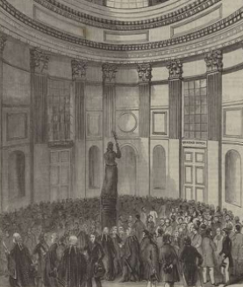
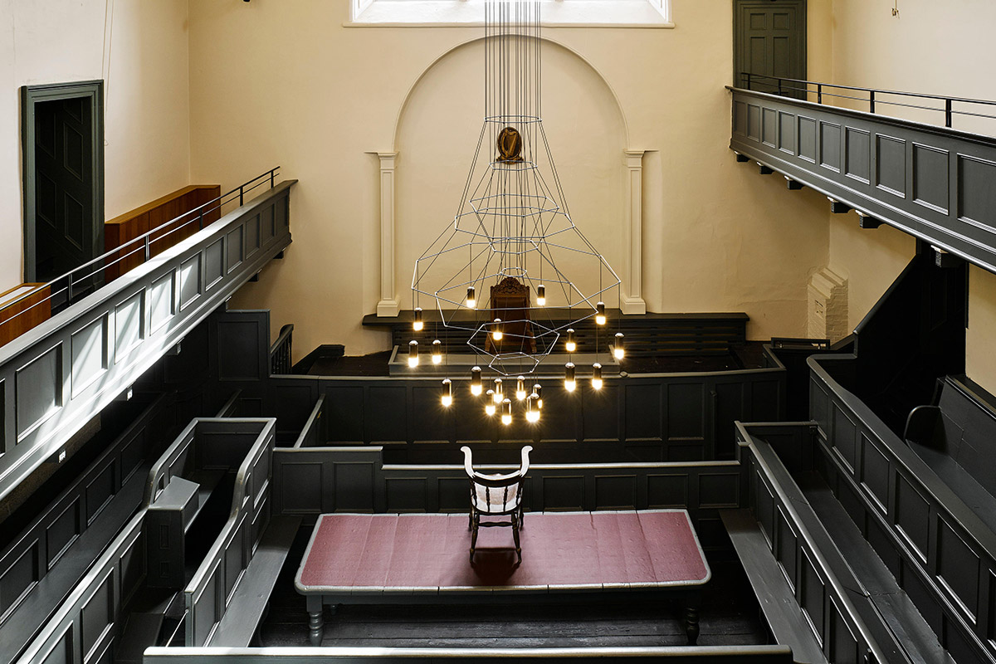
Notes:
Kilmainham Gaol refurbished courthouse
Round Hall during the riots

Slide 23
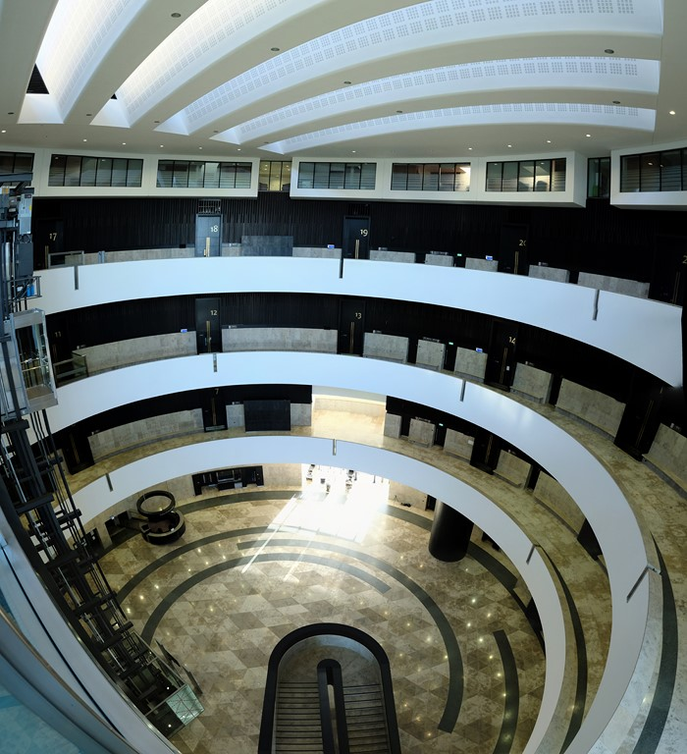
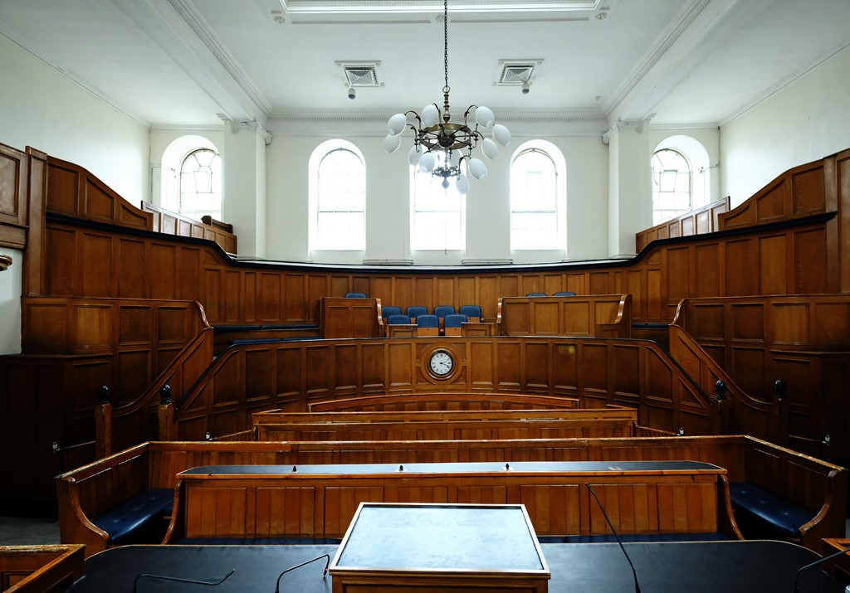

Slide 24
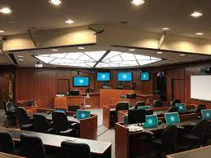
Notes:
The McGlothlin Courtroom – 1992

Slide 25


Slide 26
﻿New Financing Opportunities for Businesses in distress
﻿Panel leader: Alina Zechiu, CITR, Romania
Panellist: Damiano Pascucci, PRELIOS CREDIT SERVICING, Italy
Alessandra Biotti, Chiomenti, Italy
Francesco Uggenti, Prelios Innovation, Italy

Slide 27
Closing of the day
﻿David Rubin, Begbies Traynor, UK
Barry Cahir, Beauchamps, Ireland
Giorgio Corno, Studio Corno Avvocati, Italy
Marcel Groenewegen, CMS, The Netherlands
Frank Tschentscher, Deloitte, Germany

Slide 28

Delegate & Guest Lunch
Kindly Sponsored By
www.hww.eu

Slide 29


Slide 30
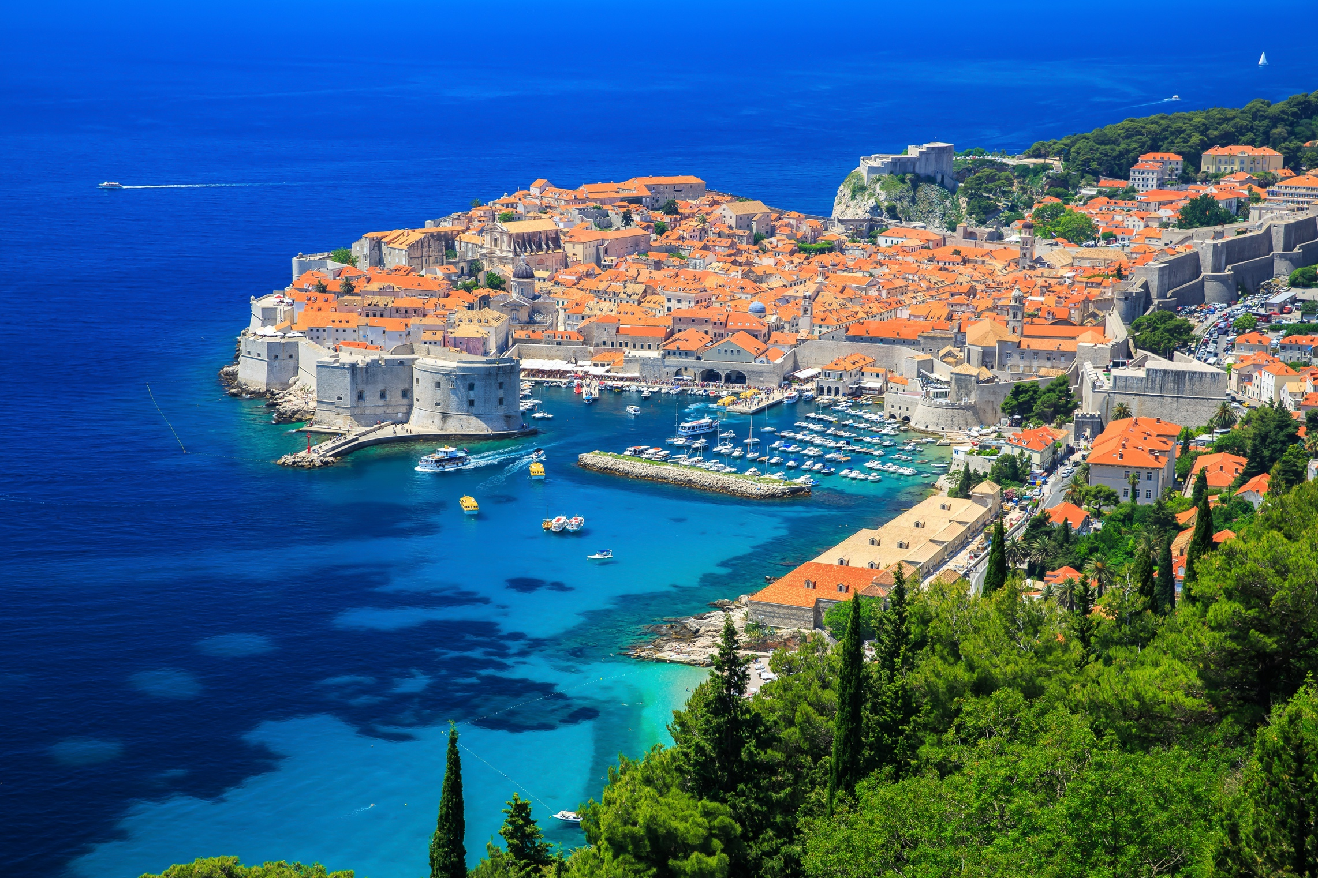
DATE FOR YOUR DIARY
Annual Congress
Dubrovnik
6-9 October 2022
www.insol-europe.org

Slide 31

Gala Evening Drinks Reception
Kindly Sponsored By
www.anchor.eu

Slide 32
Gala Evening Dinner and Entertainment
Kindly Sponsored by
www.nautadutilh.com

