Slide 1
Recognising Climate Change as Insolvency Risk
Eva Müller
Attorney-at-law, LL.M.
Lenz & Staehelin, Zurich

Slide 2
Climate change-related risks can become insolvency risks
  "Climate change poses the biggest long-term risk to the global economy." (SwissRe, 2021)
  A company's exposure to climate change correlates with its risk of bankruptcy, i.e. the greater a company's exposure to climate change, the greater its risk of bankruptcy. (Fan Feng et al., Climate Change Exposure and Bankruptcy Risk, British Journal of Management (2024)
  5 risk categories
    Physical risks
    Transition risks
    Litigation risks
    Market risks
    Insurance risks
How insolvency laws could be amended to take climate change-related risks into account

Slide 3
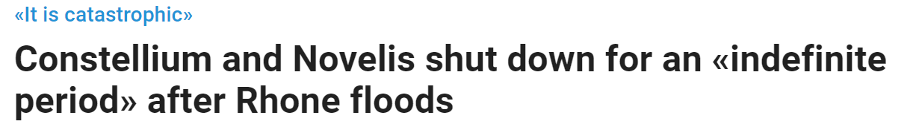
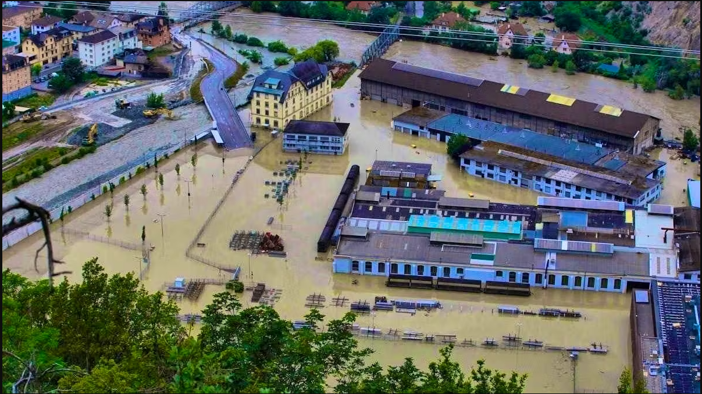
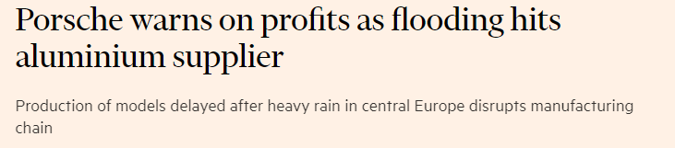
Physical Risks
= risks of acute or chronic physical impacts of climate change, e.g. heat waves, droughts, floods, sea level rise, reduced freshwater supply
(Source: Pomona, 2 July 2024)
(Source: Financial Times, 23 July 2024)
(Source: 20 min, 30 July 2024)

Slide 4
Transition Risks
= adverse ancillary impacts of regulations and policies implemented by governments and regulators to mitigate the physical risks of climate change and to transition to a low-carbon economy (e.g. carbon taxes, carbon emission reduction and renewable energy targets)
Can lead to disruptive financial losses, macroeconomic challenges and corporate uncertainty.
Stranded assets = investment that loses its value earlier than expected because of the impact of changing regulations

Slide 5
Litigation Risks
= risks related to lawsuits against companies emitting greenhouse gases or (allegedly) committing greenwashing, including risk of shareholder lawsuits
Legal grounds vary: tort, environmental or climate laws, corporate law, deceptive advertising or unfair competition laws etc.
As of December 2023, over 2'500 climate change lawsuits were filed in
54 jurisdictions; expected to become more frequent and successful.
Scholars warn that existing climate risk assessments do not account for risks associated with litigation and regulatory enforcement, even though legal action amplifies transition risks and accelerates their manifestation.

Slide 6
Market Risks
= as consumer preferences, investment concerns, and stakeholder demands for sustainable and environmentally responsible operations shift, markets are being reshaped
Companies that fail to adapt to these changing dynamics risk losing competitiveness, market share, and revenue streams.
After Paris Agreement was signed in 2015, credit ratings of companies exposed to transition risks deteriorated, and today, credit rating agencies factor carbon risk and climate change into credit ratings.
In 2023, Fitch warned that 20% of global companies could face climate-related downgrades in the next decade.

Slide 7
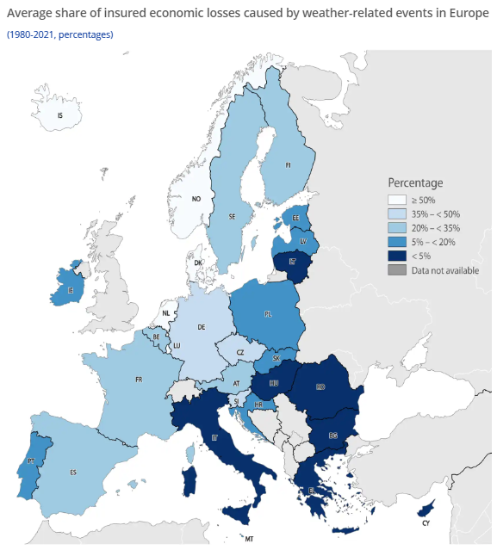
Insurance Risks
= while insurance plays a critical role in mitigating the economic impact of physical climate risks materialising, the so-called "climate insurance gap" is estimated at 65%, i.e. only 35 % of economic losses caused by extreme weather and climate-related disasters in Europe are insured.
Additionally, only about 20% are covered by reinsurance (so-called reinsurance gap).
(Source: European Environment Agency)

Slide 8
How insolvency laws could be amended to recognise climate change-related risks
"Green plan" or "green chapter" in restructuring plan; could require an appointed administrator and/or the board members to specifically consider climate change-related risks of the restructured company
Extension of disclosure obligations to insolvency proceedings (and SMEs)
Clear regulation of treatment of environmental/climate liabilities in insolvency proceedings
Climate/environmental officer in insolvency proceedings
→ Benefit: Greater transparency for creditors, investors, lenders, and other stakeholders; could make restructuring more robust

