Slide 1
Environmental Claims in Insolvency Law
Laura Knöpfel
Dr., attorney-at-law
University of Lucerne, Switzerland

Slide 2
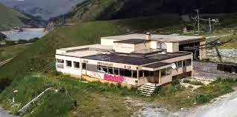
Source: Tagesanzeiger, 26th December 2023, available under: https://www.tagesanzeiger.ch/skigebiet-entdecker-dieser-mann-findet-lost-places-303552299077

Slide 3
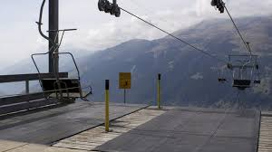
Source: SRF, 16th December 2022, available under: https://www.srf.ch/news/schweiz/lost-ski-area-projekt-das-ende-des-skibooms-und-vieler-skigebiete-hat-laengst-begonnen

Slide 4
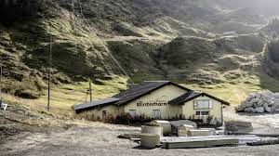
Source: Beobachter, 24th November 2021, available under: https://www.beobachter.ch/geld/wirtschaft/die-spur-der-toten-lifte-354029

Slide 5
An empirical, tangible problem
A question of the law in books or law in action?

Slide 6
An empirical, tangible problem
Planetary boundaries
Nature
Environmental law
Creditors
Insolvency law
Environmental system

Slide 7
Environmental claims in bankruptcy and composition proceedings de lege lata
Remediation of polluted sites
Future environmental claims
Public environmental claims
Private environmental claims
Creditors

Slide 8
‘Greening’ insolvency law
Insolvency law
Statutory preference of environmental claims
Widening of actors with standing («nature as creditor»)
Environmental sustainability as a prerequisite for restructuring
Security/collateral
Director liability

Slide 9
Thank you very much for your attention.

