Slide 1
Building an AI-tool for the detection of financially distressed companies by Belgian Commercial Courts
Joke Baeck
Henri Arno

Slide 2

Chambers for Companies in Difficulty (CCD)
AI-tool to assist judges of the CCD
Pilot project with CCD Antwerp

Slide 3
I. Chambers for
Companies in Difficulty

Slide 4

Chambers for Companies in Difficulty

Slide 5
Detection of companies
1. Detection via red flags
Examples: unpaid taxes, unpaid social security contributions, asset seizures, non-filing of annual accounts,…
2. KNICLI: digital red flags database

Slide 6
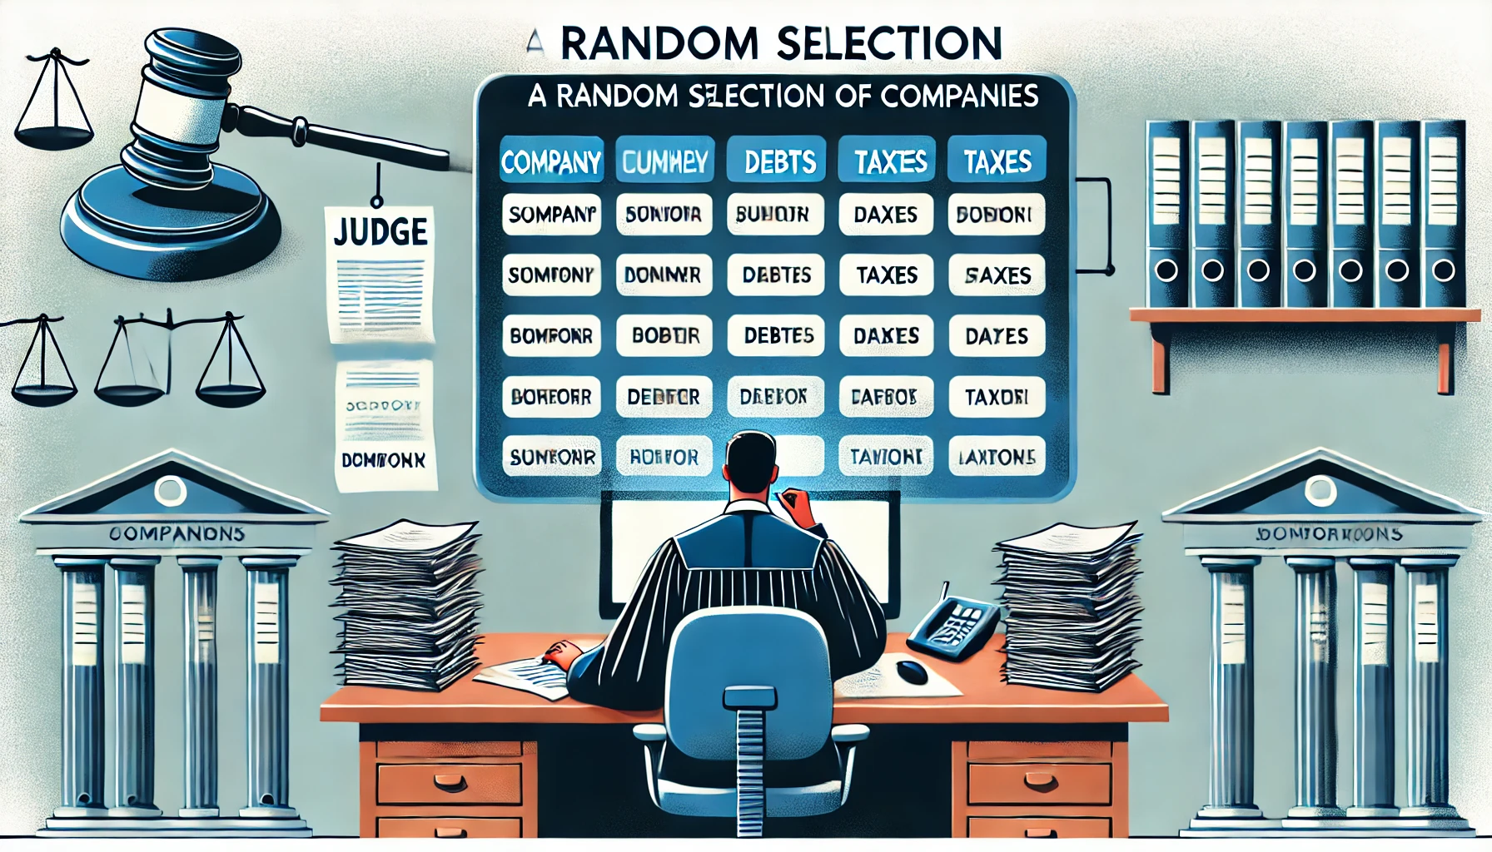
Selection of companies
1. Manual selection by judges and/or clerks
2. Criteria vary across chambers and can be inconsistent
3. Time-consuming process due to large volumes of data

Slide 7
Possible decisions CCD
1. Request additional financial information
2. Assign a judge to further investigate the company
3. Refer the case to the prosecutor’s office to initiate bankruptcy proceedings
4. Refer the case to another chamber of the Commercial Court to initiate dissolution proceedings
5. Close the case if no further action is required

Slide 8
II. AI tool to assist judges of the CCD

Slide 9
Manual selection process
KNICLI
Selection by
judge and/or clerk
CCD

Slide 10
AI-assisted selection process
KNICLI
Recommendations for selection by AI-model
Proposal
for selection
Review possible by
judge and/or clerck
CCD

Slide 11

AI-assisted selection process
1. AI reviews KNICLI data and previous CCD decisions
2. AI proposes companies for investigation and ranks them
3. Judges remain fully responsible for final decisions

Slide 12
III. Pilot project with CCD Antwerp

Slide 13


Overview of the data sources
Monthly meetings
x2
x2
x2
x2
Pre-meeting:
All companies in KNICLI (snapshot of database)
Post-meeting:
Selected companies
(sorted on selected variable)
and decisions

Slide 14

Overview of the data collection
Monthly meetings
x2
x2
x2
x2
Research data:
KNICLI
Decisions CCD
[Annual accounts]
Storage
CCD
Pseudonymization
and processing
Original excel files

Slide 15
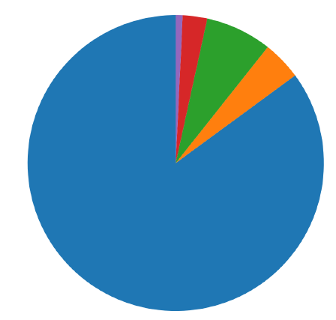

Overview of the research data
Company ID | Hearing date | VAT debt | Soc. Sec. Debt | ... | Decision
74e63ce… | 01-01-2024 | - | 1,135.00 | ... | File
B5b03bd… | 03-07-2023 | - | - | ... | Not selected
74e63ce… | 01-02-2024 | - | 2,235.00 | ... | Refer to CP
Data distribution
Not selected
Close case after hearing
Investigate further after hearing
Refer to prosecutor / dissolution
Immediate referral / dissolution

Slide 16

Prediction tasks and preliminary results
Model 1: Improve consistency
Select or
dismiss
KNICLI
Model 2: Improve efficiency
Act or
close case
KNICLI
Acc. 72%

Slide 17
Limitations and future work
1. Limited annotated data
(selected companies with a decision)
Collaborate with more enterprise courts (CCDs)
2. Judges collect additional information during hearing
(e.g. on company size)
Augment dataset with annual accounts data
3. Limited number of sparse features
(often only 1 red flag per company)

