Slide 1
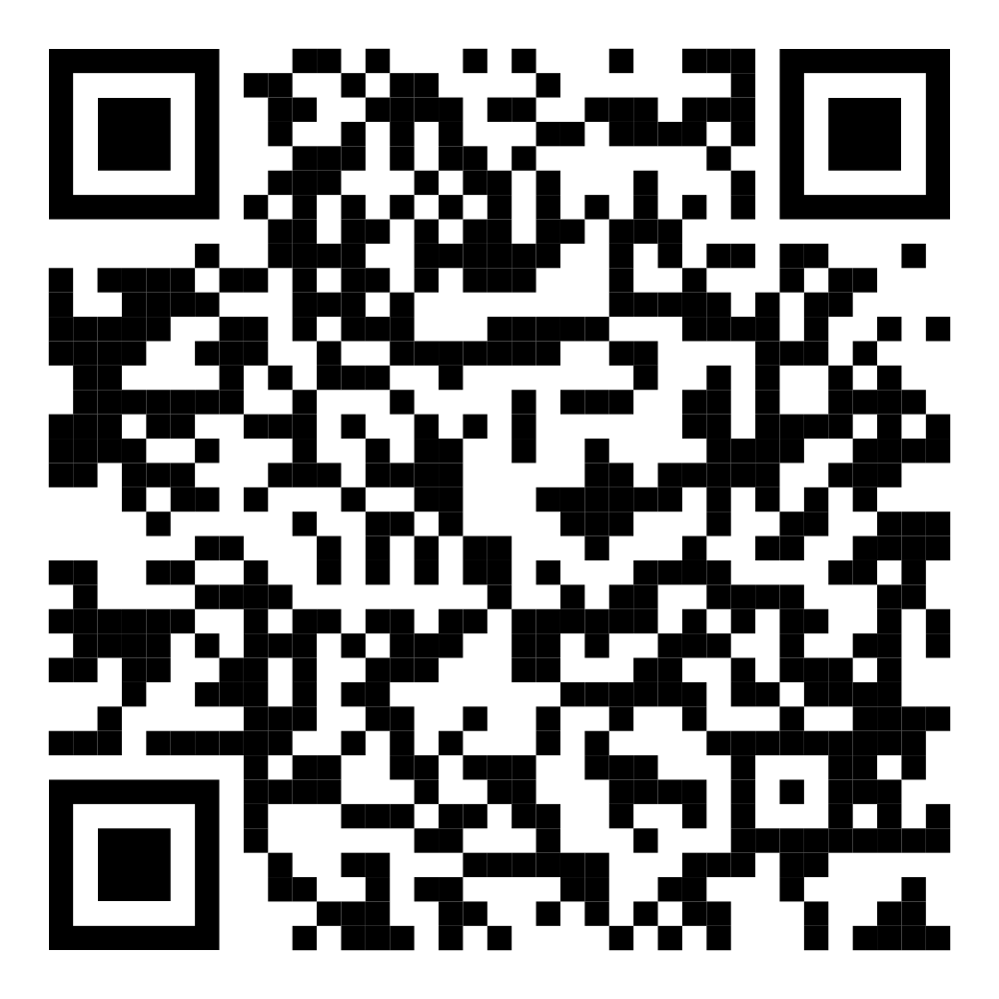
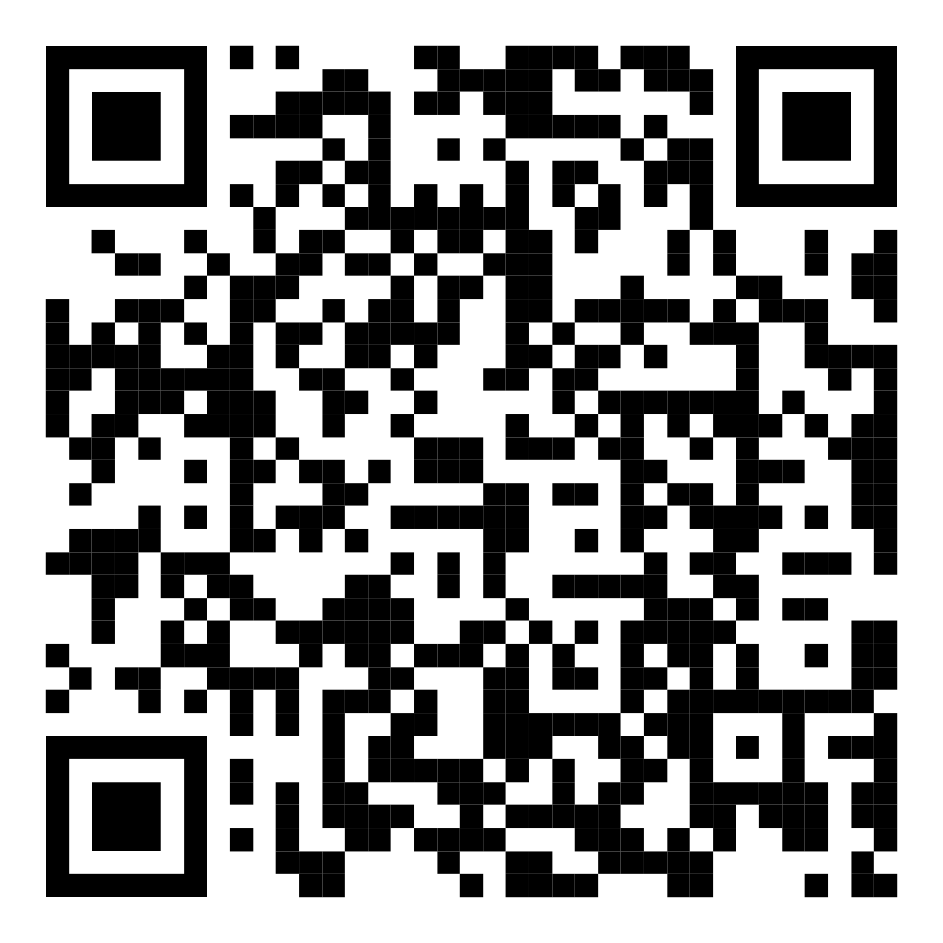
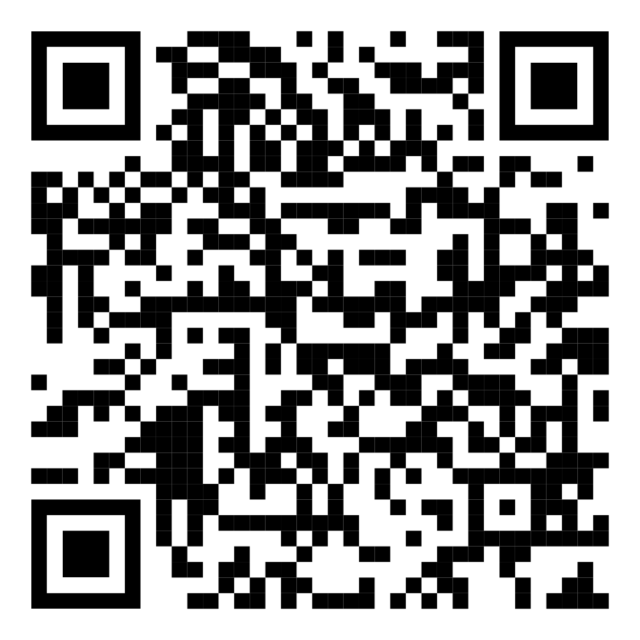
Congress Survey
Non-Member Delegates
New-Member
1st-Time Attendees
All Other
Delegates

