Slide 1


WITH THANKS TO OUR MAIN SPONSOR
CONFERENCE SPONSORS
INSOL EUROPE GENERAL SPONSORS

Slide 3


EECC Website
Delegate List

Slide 4
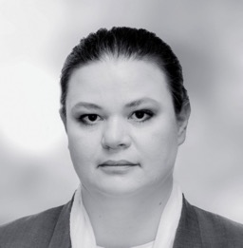

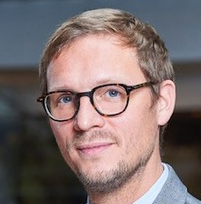

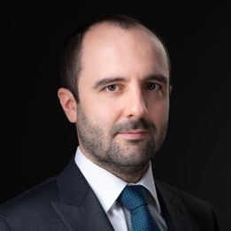
Welcome Address
Stela Ivanova
bnt attorneys in CEE / INSOL Europe EECC Co-Chair & Country Coordinator, Bulgaria
Alice van der Schee Van Benthem
& Keulen, The Netherlands / INSOL Europe President
Georges-Louis Harang
INSOL Europe EECC Co-Chair / Addleshaw Goddard (Europe), France
Andreea Zvac
Wolf Theiss, Romania / 2025 Bucharest EECC Conference Technical Committee Co-Chair
Paul-Dieter Cirlanaru
CITR / 2025 Bucharest EECC Conference Technical Committee Co-Chair

Slide 5
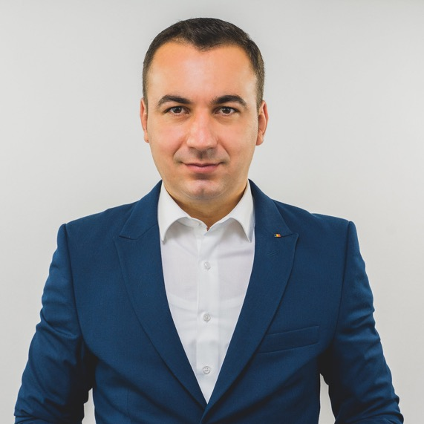
Keynote Speaker:
Bogdan Ivan
PhD, Minister of Economy, Digitalization, Entrepreneurship, and Tourism, Romania

Slide 6
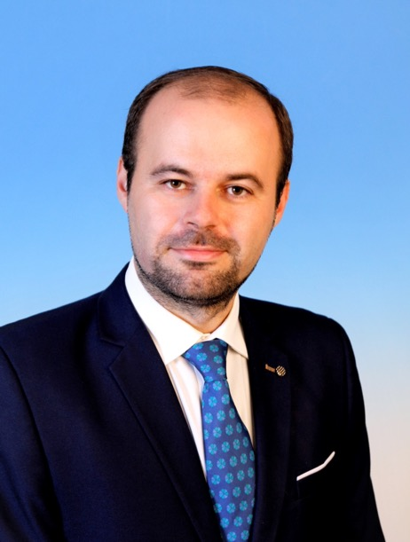
Keynote Speaker:
Cristian Popa
CFA, CAIA, Member of the Board of the National Bank of Romania

Slide 7
Insights on the economy, finance and trade tariffs.
Opinions and published analyses.
Cristian Popa, CFA, CAIA
May 2025

Slide 8
Recent macroeconomic developments

Slide 9
Recent macroeconomic developments (2)

Slide 10
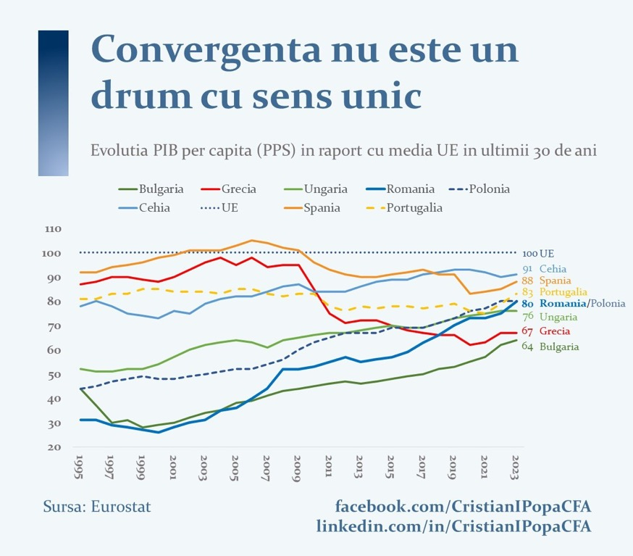

Slide 11
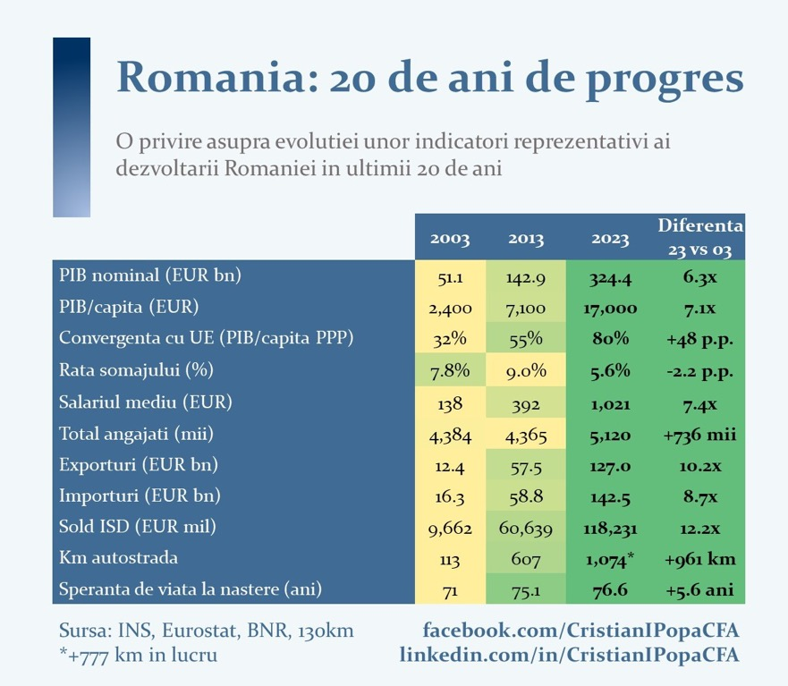

Slide 14
Romania: heightened vulnerabilities

Slide 18
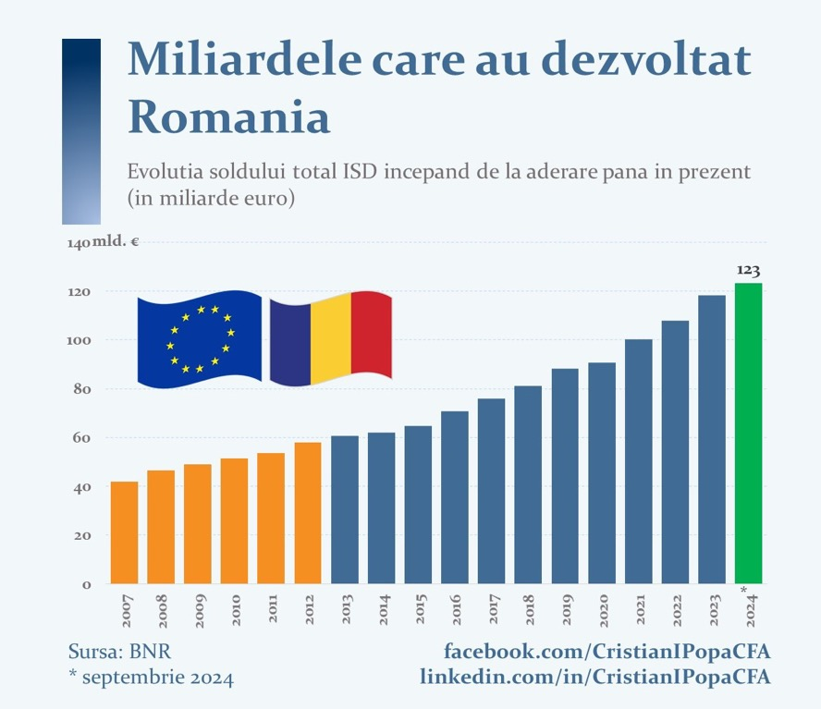

Slide 19
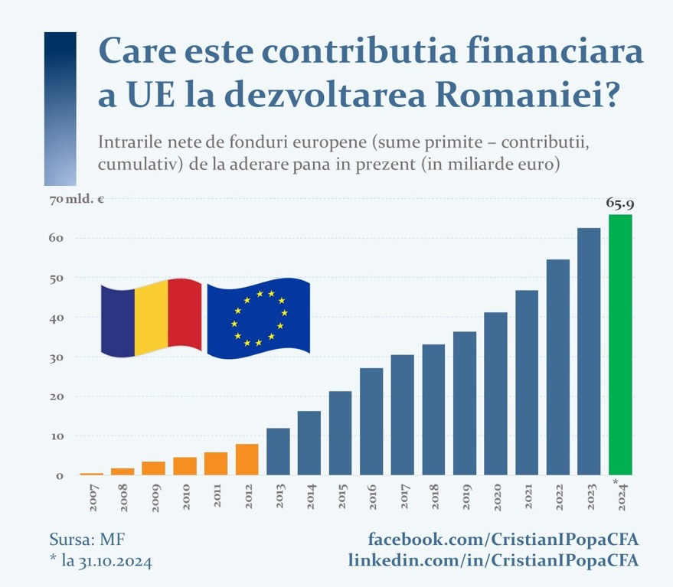

Slide 22
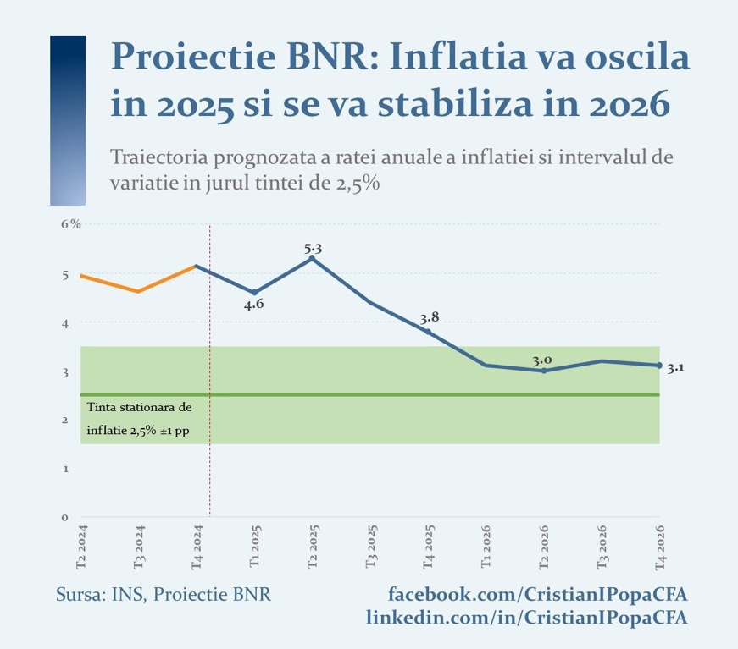

Slide 23
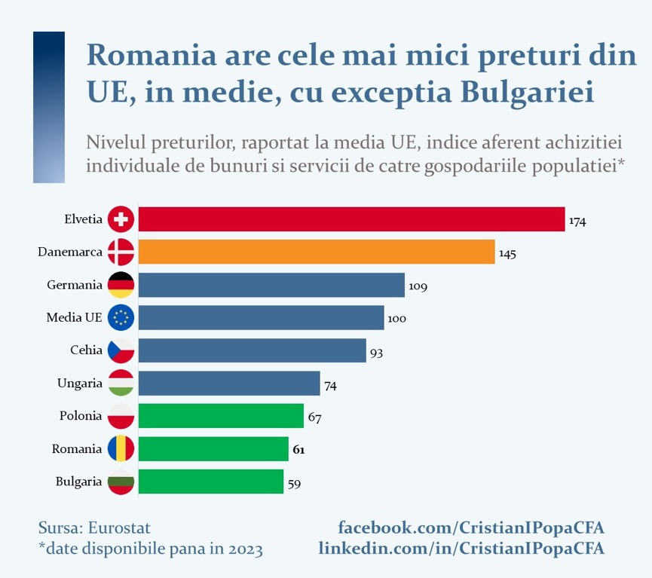

Slide 29
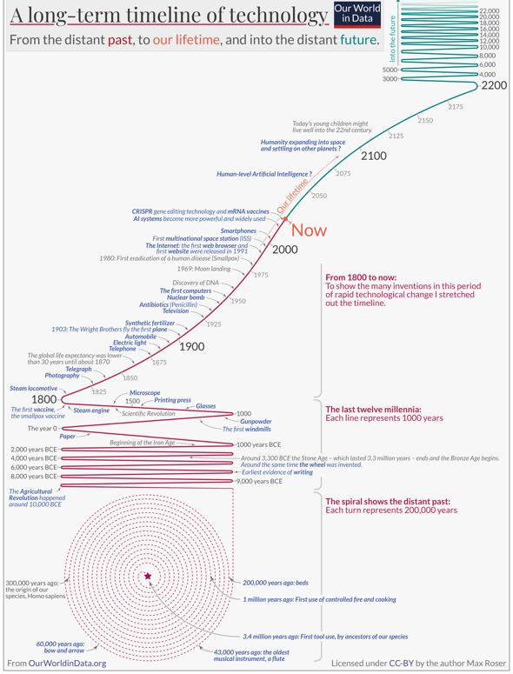

Slide 30

Imagine how much harder physics would be
if electrons had feelings
RICHARD FEYNMAN

Slide 31
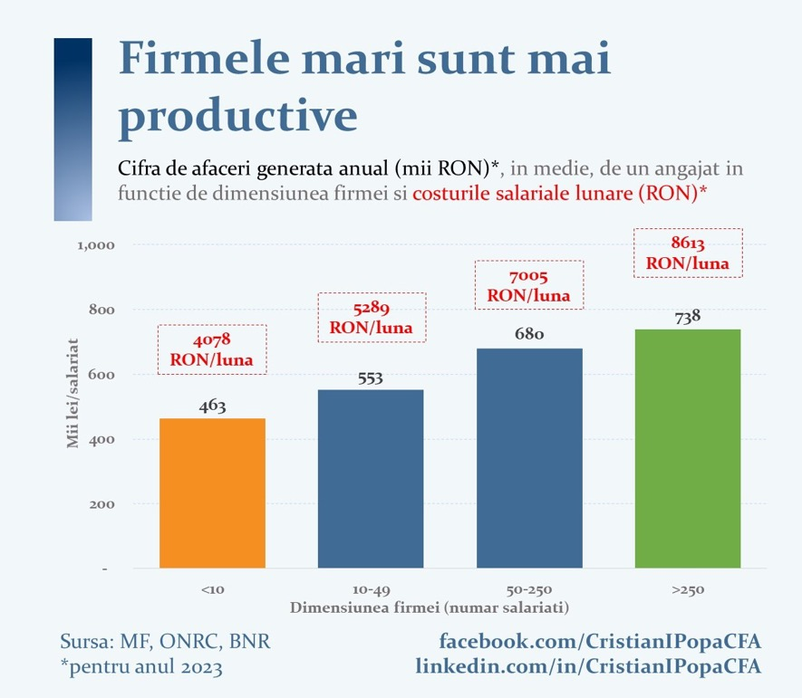

Slide 32
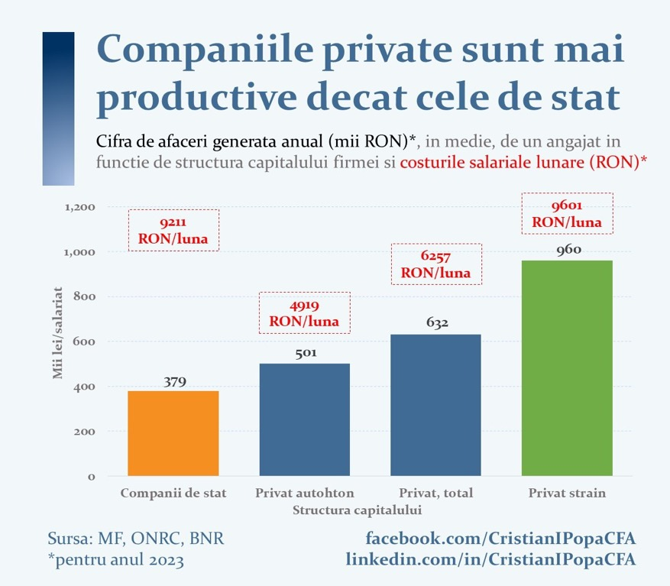

Slide 33
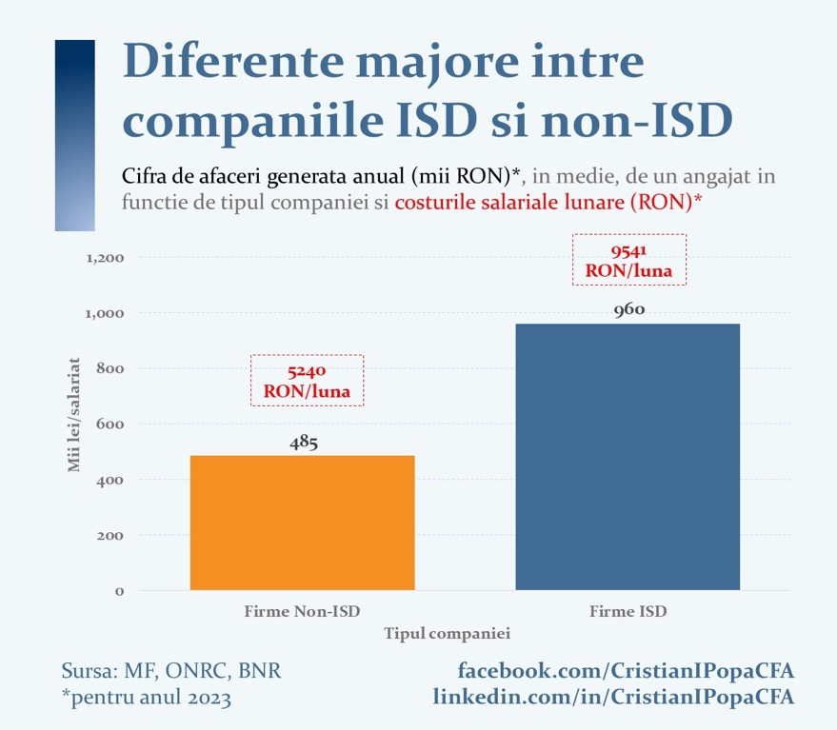

Slide 34
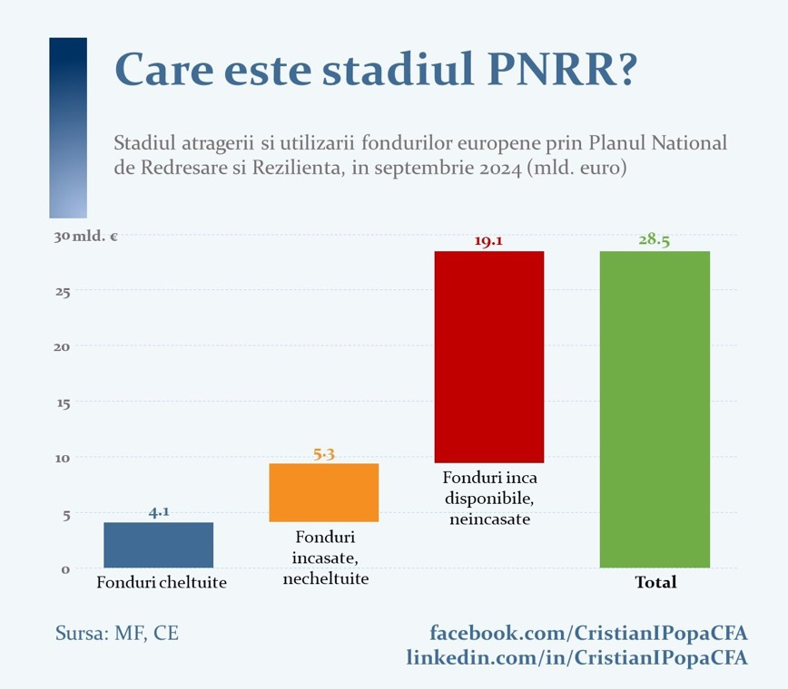

Slide 35
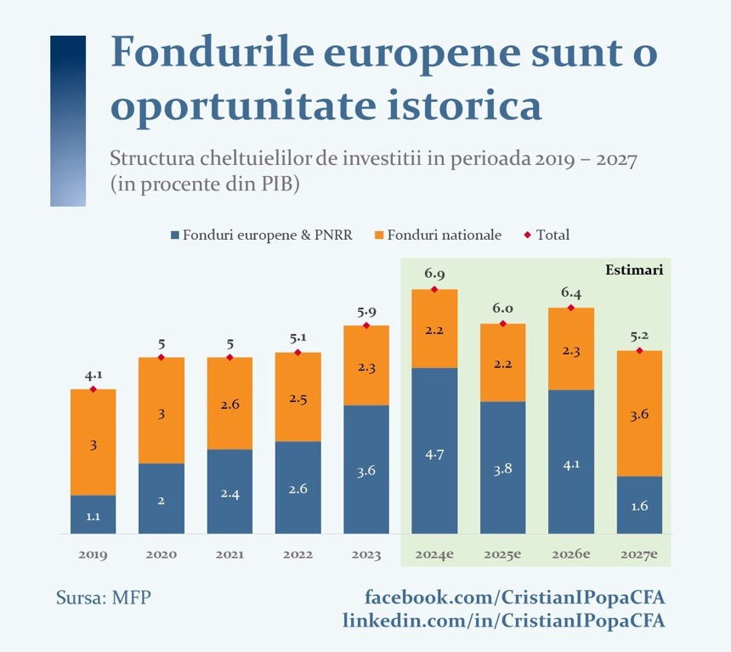

Slide 36


Slide 37
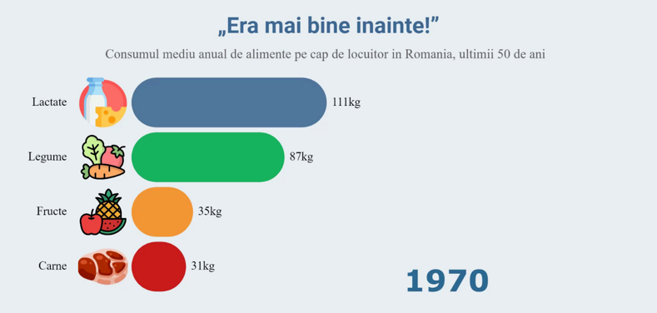
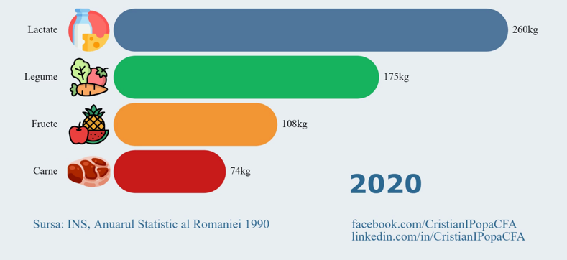

Slide 40
Decisions of the NBR Board*
To keep the monetary policy rate at 6.50 percent per annum
To leave unchanged the lending (Lombard) facility rate at 7.50 percent
per annum and the deposit facility rate at 5.50 percent per annum
To maintain the existing levels of minimum reserve requirement ratios on both leu- and foreign currency-denominated liabilities of credit institutions
*) meeting of 7 April 2025
Notes:
40
40

Slide 41
Additional key considerations

Slide 42
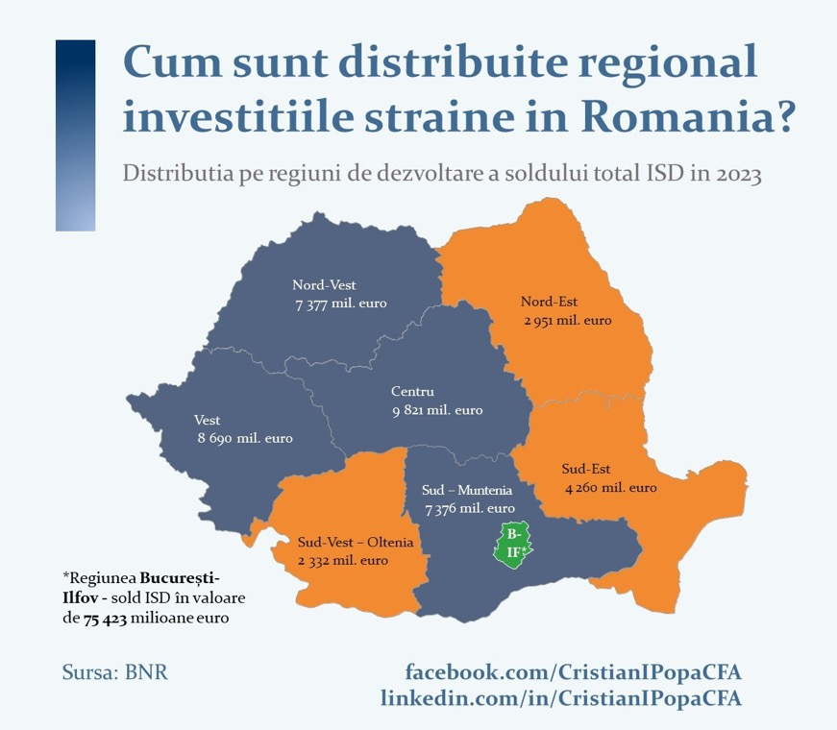

Slide 43
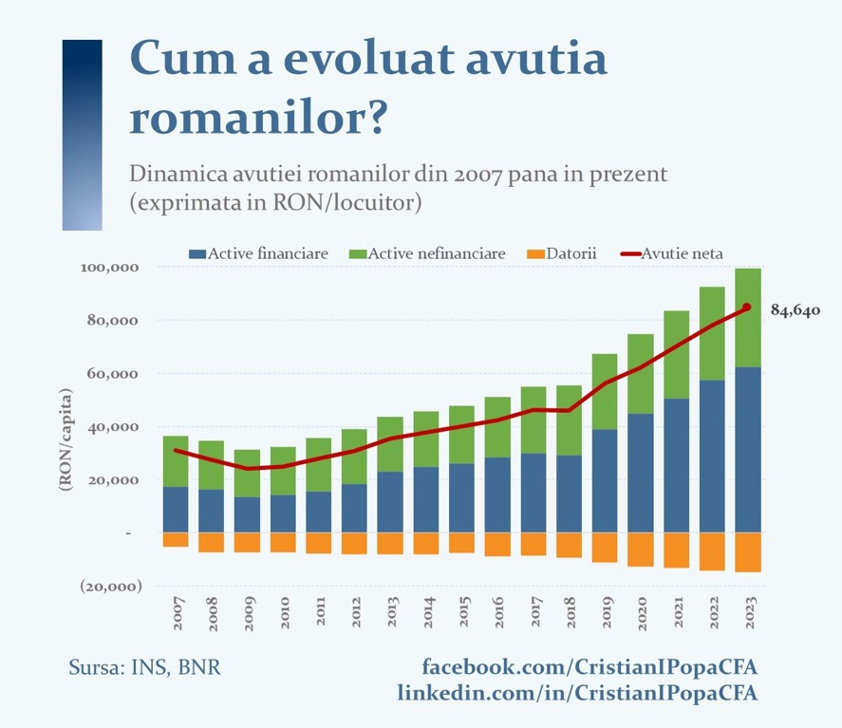

Slide 44
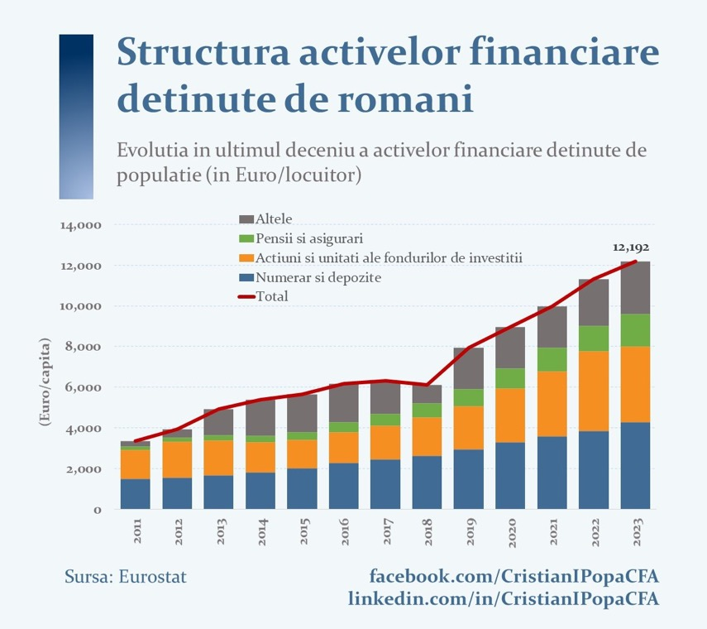

Slide 45
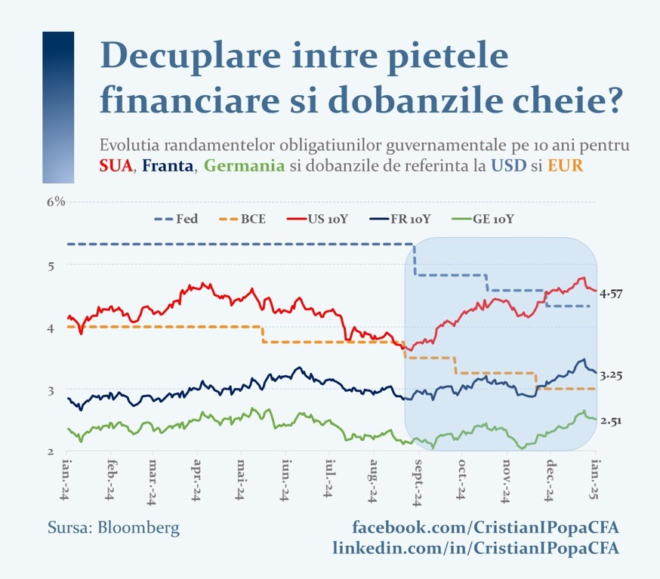

Slide 46
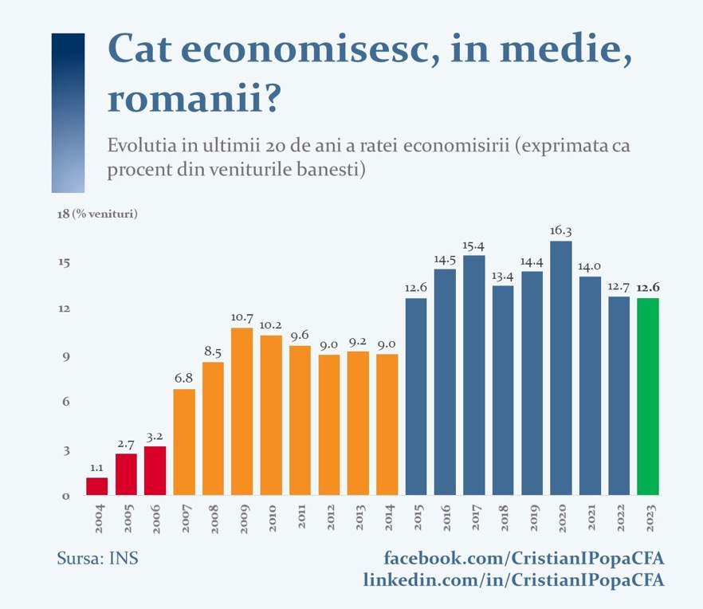

Slide 47
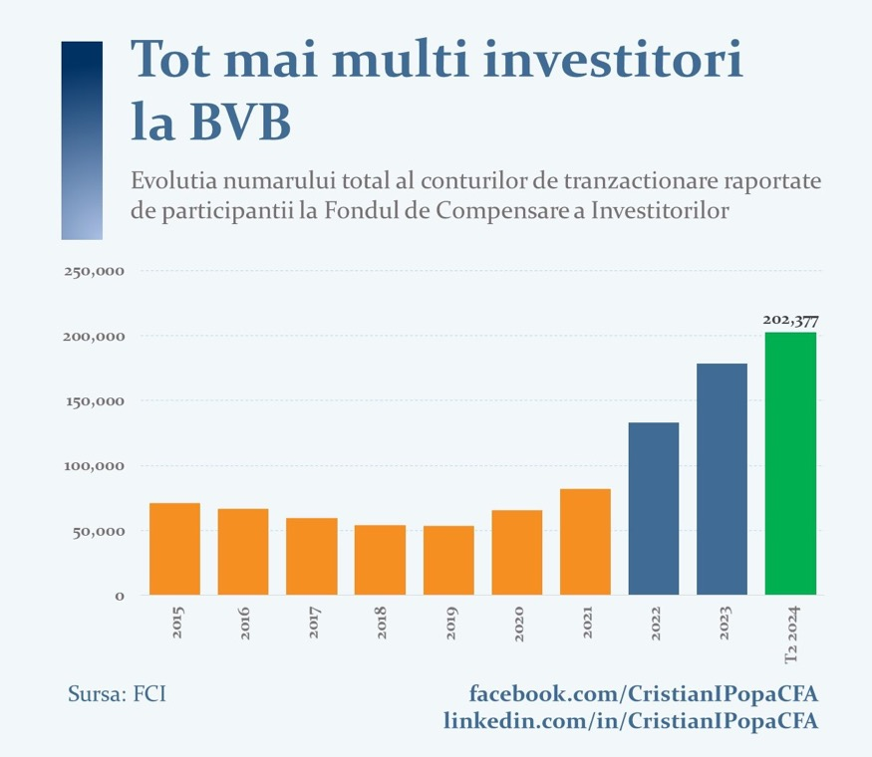

Slide 48
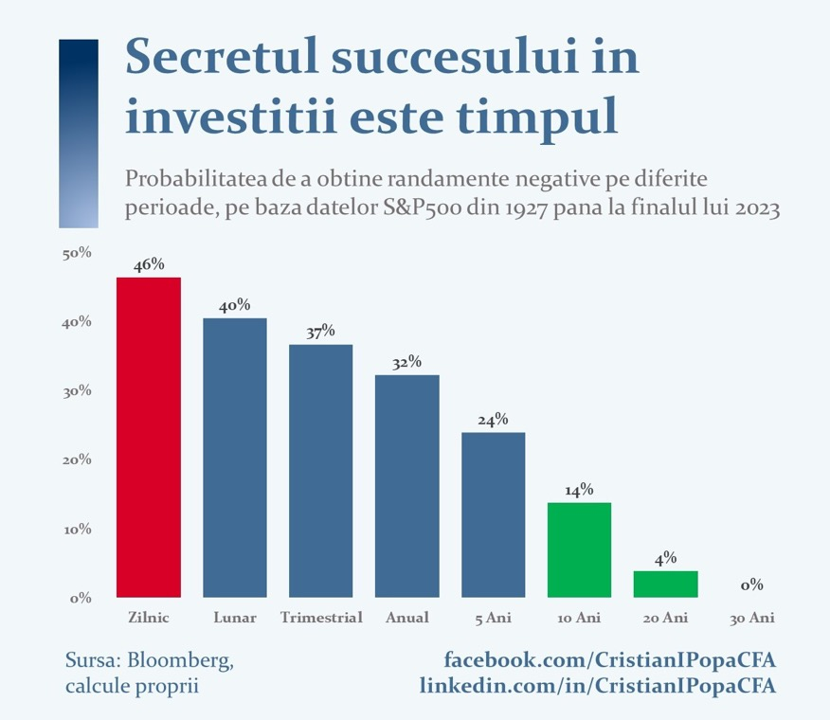

Slide 49
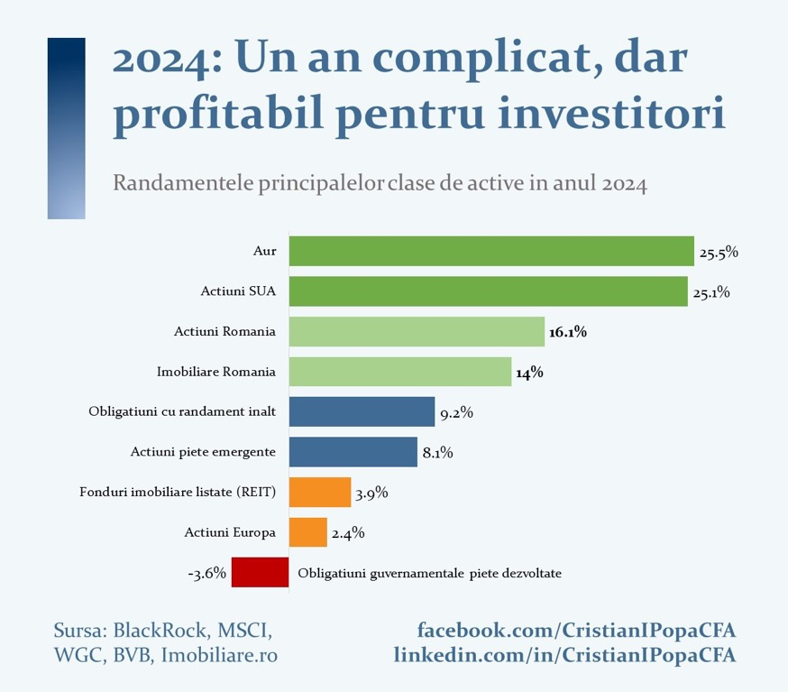

Slide 65
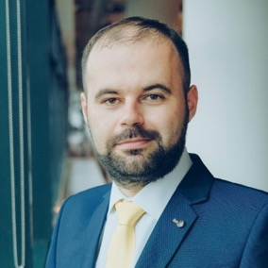


Thank you!
Follow me:
facebook.com/CristianIPopaCFA
linkedin.com/in/CristianIPopaCFA

Slide 66

Coffee Break
Kindly Sponsored by:

Slide 67
Technical Sessions
Kindly Sponsored by:

Slide 68
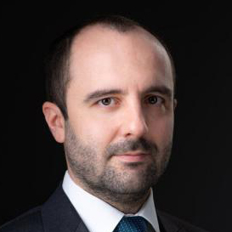
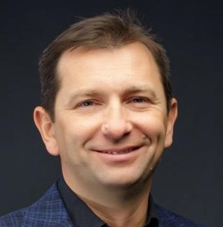
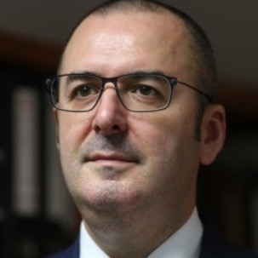

Session 1. Financial modelling for restructuring
Panel leader:
Paul-Dieter Cirlanaru
CITR, Romania
Andrei Cionca
Roca, RocaX, Agista, Romania
Ioan Ciprian Chiorean
CEC Bank,
Romania
⁠Adrian Netea
Morphosis Capital,
Romania

Slide 69


FROM DISTRESS TO 50x EXIT

Slide 70
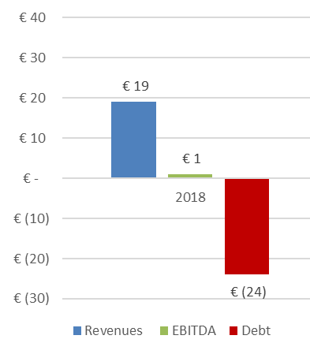
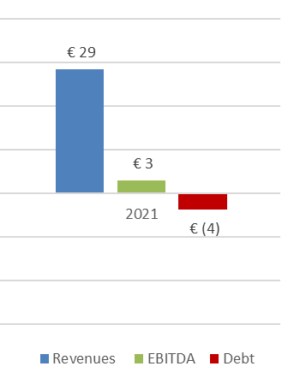
2021: Exit to Vinci Energies, 50x MoIC
2018 DISTRESS
2021 SUCCESS
3
New Commercial strategy:
focus on industrial cold equipment
leadership in cold service
Million eur
Million eur
2
Operational restructuring:
Modern HR & efficient work allocation
Data-driven decisions via ERP & digital tools
1
Capital infusion
Debt restructuring

Slide 71
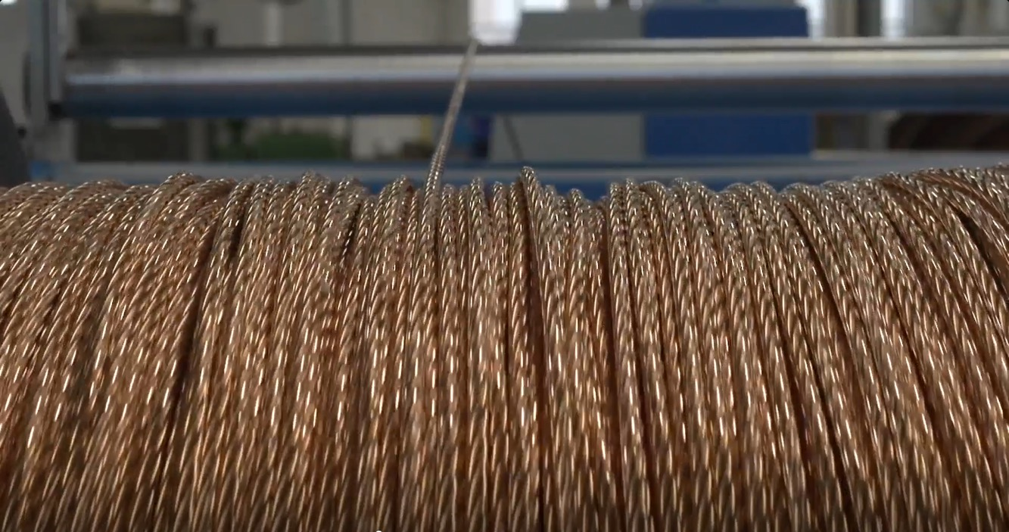

THE STORY KEEPS ROLLING

Slide 72
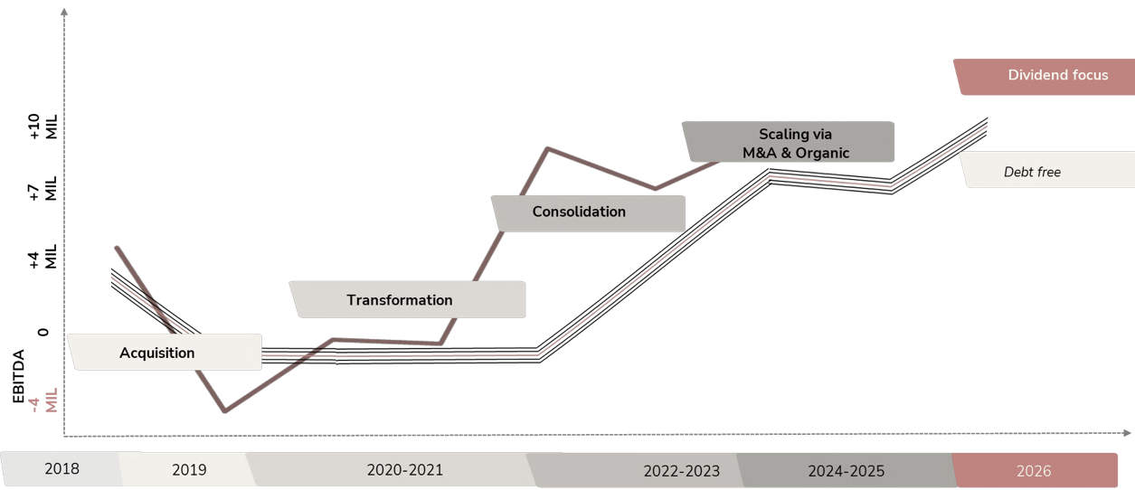

2024: Revenue Growth +100%, +13M EUR Technology investment
Best EBITDA ever
Prior investment:
Early distress signs
Capital Infusion
Allocation of skilled resources (CFO / CEO/COO)
Transformation:
Debt restructuring
ERP
Technological refurbishment
Consolidation:
New Equipment
Export
New products
Expansion:
New Markets
New technology
Revenue: 16.6M eur in 2019 > 40.4M eur in 2025 (est)

Slide 73

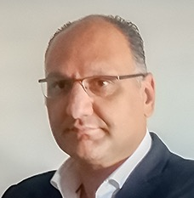
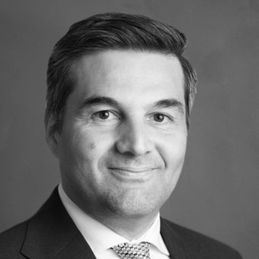
Session 2. Valuation: the pillar of restructuring
Panel leader: Roman-Knut Seger
BDO Restructuring,
Germany
Marios Ieropoulos
Financial and Insolvency Solutions, Cyprus
Bogdan Plesuvescu
Banca Transilvania, Romania

Slide 74
The stage of crisis: is it just a shortage of liquidity, or …?
Stage
Early crisis detection
Corporate crisis
Proximity to insolvency
Monitoring of key company figures to identify crisis prone developments at an early stage
If necessary, external support for the optimization and development of leeway in working liquidity
Protection by IBR (independent business review)
Analysis of the causes of the crisis
Examination and monitoring of the (non-)existence of reasons to file for insolvency
Preparation and/or review of reorganization and restructuring concepts
Moderation of negotiations with creditors and other stakeholders to overcome the crisis
Development of Plan B, insofar as the conditions and possibilities exist:
    preventive: court-moderated restructuring negotiations
    Self-administration & insolvency plan to enforce a haircut

Slide 75
Legal framework according to EU Directive 2019/1023 of June 29, 2019
Act on the Further Development of Restructuring and Insolvency Law closes the gap between out-of-court restructuring and insolvency proceedings
Consensual restructuring, e.g. based on a restructuring concept in accordance with the standards of the chamber of auditors, IDW S 6
Stabilization and restructuring framework for companies (StaRUG) -
Restructuring to avoid insolvency
better value retention,
avoidance of negative publicity and loss of control
enabling a majority decision
new
Implementation of insolvency proceedings
self-administration, e.g. as protective shield proceedings
insolvency plan as settlement with the creditors (with cram-down-rules)
third-party administration by an insolvency administrator

Slide 76

Safeguarding through accompanying planning calculation
To avoid liability risks and to document that there are no grounds for insolvency, a scenario-accompanying planning calculation is required, considering a comprehensive financing concept that documents the financing of the company and the valuation of assets/balance positions.
Obligation to apply
today
LIQUIDITY RANGE
12 months
24 months
    Statement of liquidity status as at the reporting date
    Liquidity planning on a daily basis (3 months)
    Liquidity planning on a weekly basis (12 months)
    Liquidity planning on a monthly basis (24 months, or more depending on the situation)
Proof that there is no insolvency, if necessary, audit according to IDW S11
Comparison of cash and cash equivalents and payment obligations due
Proof that no payment delay is recognizable
Proof that there is no over-indebtedness
Hedging of going concern
Proof that there is no threat to existence
Proof of going concern even in liquidation
In the event of a positive outcome of the sales process, hedging against the risk of rescission
    Selected measures to avoid insolvency:
    Selected measures to avoid over-indebtedness:
(Writing down existing) deferral/standstill agreements
Provision of a (possibly secured) bridging loan for the period until the successful implementation of a restructuring concept
Shareholders increase equity
Debt waivers or tax-neutral subordination
Selling non-current/current assets (at market prices) to the shareholders
Letter of comfort
Shareholders increase equity
    The period of (follow-through) financing shown in the planning is (also) of decisive importance for going concern in the context of the audit of the annual financial statements;

Slide 77

Sustainable restructuring for crisis management in accordance with to legal framework for restructuring plans
Minimum requirements BGH for restructuring reports
Contents of the restructuring report
Remediation report
"Analytical deep drilling"
The view of an unbiased industry expert
1
External ana-
lysis (market, competition...)
Consideration of actual circumstances, submission of required accounting documents
Cash flow
2
Analysis of the economic situation of the company
Balance
sheet/
P&L
Integrated restructuring plan
Internal
Analysis
3
Causes/stage of crisis
Requirements Jurisdiction
+
Analysis of the causes of the crisis
Remediation
expert
pinion
4
Contents of the restructuring
report
Competition
commercial
ability
Measures
definition
Strategic
Mission statement
5
Appropriate assessment of the net assets, results of operations and financial position
Mission statement
=
6
Measures objectively suitable for thorough remediation within a reasonable period
Financial
Mission statement
"Analytical deep drilling"
(full analysis) of the company and thus the opportunity to improve the company's long-term position
Continuation
ability
7
Renovation measures already implemented in the early stages
"Analytical deep drilling" requires a high level of commitment from all those involved and extensive data, but also offers the opportunity to improve the company's long-term position

