Slide 1


WITH THANKS TO OUR MAIN SPONSOR
CONFERENCE SPONSORS
INSOL EUROPE GENERAL SPONSORS

Slide 2
Technical Sessions
Kindly Sponsored by:

Slide 3
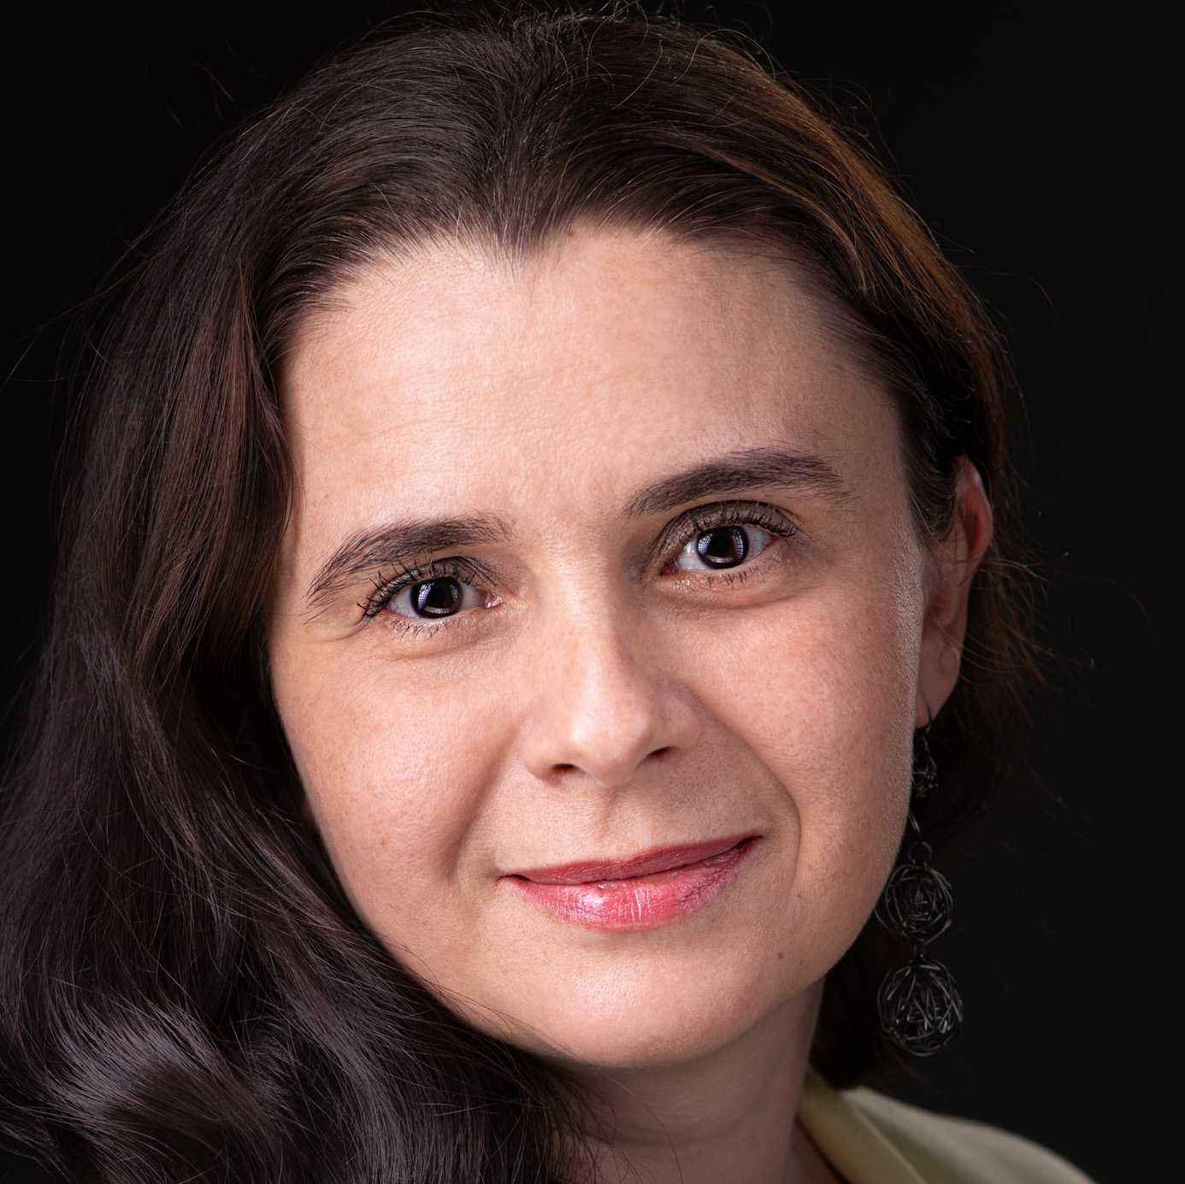
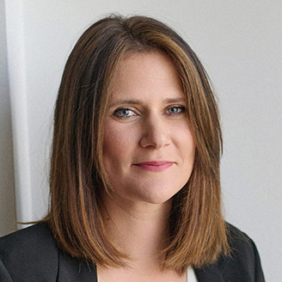

Session 3. Riskier than you think? Liquidation of Banks, Fintechs and Insurance Companies
Panel leader: Alina Popa CITR / INSOL Europe Country Coordinator, Romania
Antonija Galić Kondža JLMIG Law Firm,
Croatia
Ieva Strunkienė
Cobalt Law Firm,
Lithuania

Slide 4
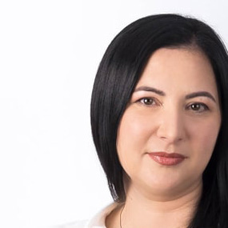
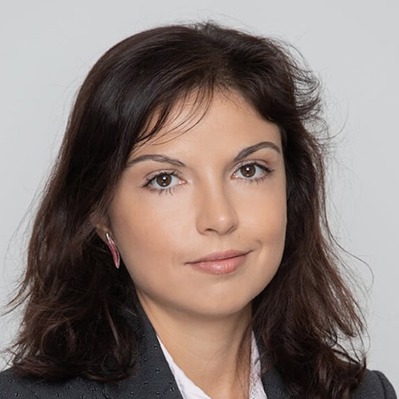


Session 4. Preventive restructuring frameworks in practice
Panel leader:
Andreea Zvac
Wolf Theiss, Romania
Tsvetelina Koleva
Dimitrov, Petrov & Co.
Law Firm, Bulgaria
Judge Flavius Motu
Cluj Specialized Court, Romania
Olha Stakheyeva-Bogovyk McDermott Will
& Emery, UK

Slide 5
Coffee Break
Kindly Sponsored by:

Slide 6
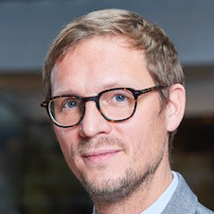
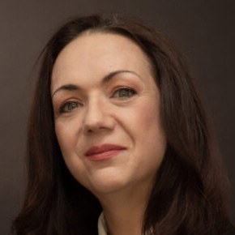
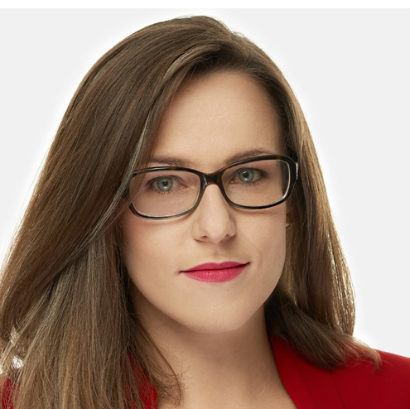
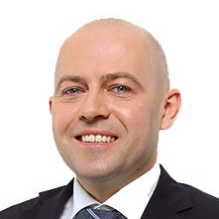
Session 5. The challenges and opportunities of pre-packs
Panel leader:
Georges-Louis Harang
Addleshaw Goddard (Europe) / EECC Co-Chair, France
Andreea Deli-Diaconescu SCA Deli & Asociatii, Romania
Katarzyna Kostępska
KKG Legal,
Poland
Nikita Lundin
WE Advokater AB,
Sweden

Slide 7
Jurisdictional Framework
Does a pre-pack sale have a common definition?
Is the pre-pack sale a reality in your jurisdiction?
How it works?

Slide 8
Eligibility and Suitability
  Is the pre-pack the most appropriate procedure compared to other insolvency or restructuring mechanisms (e.g., schemes of arrangement, preventive restructuring frameworks)?

Slide 9
Transparency and Oversight
  What level of court or regulatory oversight is required for a pre-pack?
  How is compliance with transparency requirements ensured?
  Is confidentiality a necessary criterion for the successful execution of a pre-pack?

Slide 10
Insolvency practitioner’s Role and Duties
  What are the specific duties of the insolvency practitioner or administrator (“monitor”)?
  Are there statutory obligations to act in the best interests of creditors?
  Or any other parties ?

Slide 11
Risk of Challenge
  Could the pre-pack sale be challenged on fraudulent or preferential transactions?
  Are there risks of claims against directors for wrongful trading or breach of fiduciary duties?

Slide 12
Timing and Execution
  Are there specific timelines or procedural requirements for concluding the pre-pack sale?
  How will the sale agreement be structured to comply with the legal requirements?

Slide 13
Impact of the Proposal
  Does the EU Commission’s Proposal on Pre-Pack Sales will impact your practise of pre-pack sale?
  If no formal pre-pack procedure does exist, any ongoing discussions on the harmonisation directive ? Is the professional community rather waiting for the final shape of the European regulation ?

Slide 14
Closing Remarks
  Is the pre-pack sale a useful tool to rebuild success and achieve the restructuring of the business?

Slide 15
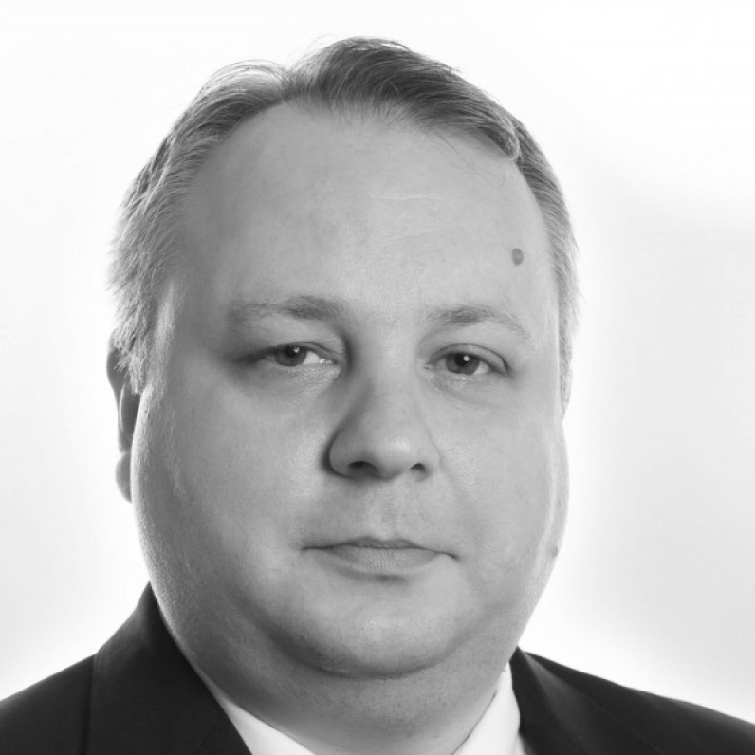
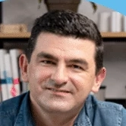

Session 6. AI: Reshaping the restructuring and insolvency Industry
Panel leader: Andrei Zamfirescu
bnt attorneys in CEE,
Romania
Piotr Sarecki
Infino Legal,
Poland
Daria Niculcea
Juridice AI,
Romania

Slide 16
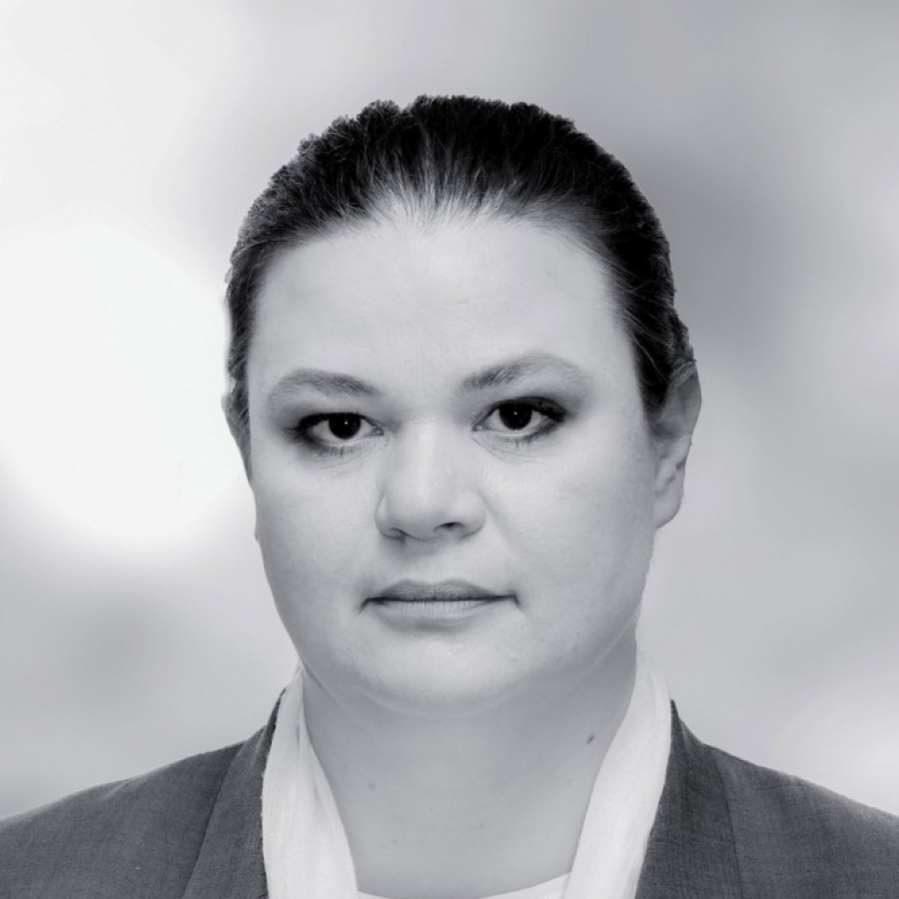
Closing Remarks
Stela Ivanova
bnt attorneys in CEE /
INSOL Europe EECC Co-Chair, Bulgaria

Slide 17
EECC Meeting
Stela Ivanova
INSOL Europe EECC Co-Chair /
bnt attorneys in CEE,
Bulgaria
Georges-Louis Harang
INSOL Europe EECC Co-Chair / Addleshaw Goddard (Europe), France

Slide 18



Slide 19
INSOL Europe Annual Subscriptions
Membership type | 2025/26
Academic (Full time) | €130
Eastern European Countries | €160
Financiers | €130
Full Member | €400
Judiciary | €130
Retired | €130
Student | €130
Young Member (under age 40) | €180
On joining a one-off admission fee of €220 will apply to all member types, but this will be waived under certain circumstances.
If three people join at the same time, and they are from the same company and country, the admission fee of €220 will be waived for each person.

Slide 20

Young Members Group
Drinks Reception
Kindly Sponsored by:

