Slide 1

Ignorance isn’t bliss: why directors’ legal literacy matters for corporate rescue
Emilie Ghio
Donald Thomson

Slide 2

01
The rescue culture

Slide 3
Law
in
books
1942
1997
Italy: Concordato preventivo
UNCITRAL Model Law
1955
1999
France: Redressement judiciaire
IMF, Orderly & Effective Insolvency Procedures
1978
2004
United States: Chapter 11
UNCITRAL Legislative Guide
1986
2019
United Kingdom: Administration + Company
Voluntary Arrangement
EU Directive on Preventive Restructuring
1990
2021
World Bank, Principles for Effective Insolvency and Creditor/Debtor Regimes
Ireland: Examinership

Slide 4
Law in action (2024)

Slide 5
Nothing new
“Many companies which are capable of being saved are forced into liquidation with loss to creditors. The goal of promoting rehabilitation and rescue is not being adequately served by the existing procedures.”
N. Segal - 1994
“[f]igures suggest failure of rescue culture in the most productive part of the economy, and merit immediate attention to analyse the reasons for failure, the rescue procedures available to the debtor companies, and the reasons why they could not be, or were not, invoked.”
M. Hunter - 1999

Slide 6
What’s been done?
Prohibitive costs (e.g. Ellias et al. (2023); Hotchkiss et al. (2024))
Procedural barriers such as procedural complexity (e.g. World Bank (2017))
Difficulties in accessing finance (e.g. Mokal et al. (2018))
Disengaged creditors (e.g. World Bank (2017))
Limited or non-existent assets (e.g. Hotchkiss et al. (2024); Hardman & MacPherson (2023))
Weak financial recordkeeping (e.g. World Bank (2017))

Slide 7
What’s been done?
The literature on this issue is vastly rooted in the law and economics approach, which presumes that the economic agent – homo economicus – acts rationally, assessing costs and benefits to maximise wealth.
“The basis of an economic approach to law is the assumption that the people involved with the legal system act as rational maximizers of their satisfactions.” – Posner (1975)
Debtors’ actions are presumed to respond predictably to incentives and disincentives embedded in the law.
In the context of corporate rescue, this logic assumes that directors will choose to initiate restructuring if it is in the best interest of the company, provided that the costs are manageable, and that the legal pathways are available.
The result is a policy and academic landscape that focuses heavily on removing external obstacles (streamlining procedures, reducing costs, ensuring creditor cooperation, including debtor in possession procedures).
Yet, although reforms have increasingly addressed economic barriers, rescue filings have remained disproportionately low.

Slide 8
Our approach
1. Rescue culture:
2. Small firms:
Insolvency literature slow to integrate behavioural insights.
→ We go beyond economic factors to socio-legal factors that go beyond economic arguments, such as the perception and understanding of, as well as attitudes towards, business failure.
Literature presumptions: rationality of directors. But reality: decision-making shaped by cognitive, informational, and emotional limits (bounded rationality).
→ The law and economics approach is more likely to work in the context of large firms with sophisticated and governance structure, with boards of directors and expert directors, and access to professional advice. Yet, MSME represent 90% of the corporate population in virtually all economies in the world.

Slide 9
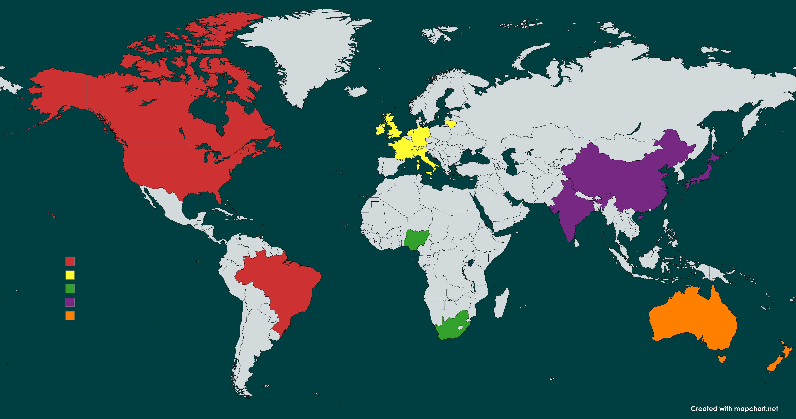
Brazil: Sheila Neider Cerezetti
China: Shuai Guo + Rebecca Parry
Canada: Alfonso Nocilla + Anna Lund
India: Neeti Shikha
United States: Laura N. Coordes
Japan: Junko Sugimoto
France: Celia Magras
Australia: Amanda Bull
Germany: Stephan Madaus
New Zealand: Trish Keeper
Ireland: Michael Boland
Lithuania: Ieva Strunkiene +Remigijus Jokubauskas
Switzerland: Laura Knoppfel + Rodrigo Rodriguez
Nigeria: Bolanle Adebola + Kayode Olunde
Italy: Francesca Burigo + Eugenio Vaccari
Netherlands: Gert-Jan Boon + Jessie Pool
United Kingdom: Emilie Ghio + Donald Thomson
South Africa: Christiaan Swart + Andre Borraine

Slide 10

02
Directors’ knowledge

Slide 11
Is there a problem?
How familiar are directors with insolvency procedures?
Yes, there is
Academic views
Practitioners’ views
This is particularly problematic when directors make insolvency decisions for the company in all jurisdictions surveyed (either alone or with other stakeholders)

Slide 12
Interviews with directors in the UK (2022)
Do you know what insolvency means?
Do you know what liquidation means?
Do you know what restructuring means?
Sorry, no.
I’m not very sure.
I’m not sure.
I can’t remember.
To take the money from the company, the cash, no?
Yes, but I guess it only applies to a company that maybe has a board or a CEO.
Is it not just when you go bankrupt and the business gets taken apart?
That would be for a franchise, where the Government would intervene.
It would be if there was a take-over.

Slide 13
Does it matter?
Does a lack of understanding affect the uptake of rescue procedures?
Yes, it does
Academic views
Practitioners’ views

Slide 14
03
Understanding the lack of understanding

Slide 15
Academic research done on the topic of lack of knowledge among directors?
1
Interest
Official governmental or industry reports or studies on the knowledge of insolvency law?
No = 71%
No = 67%

Slide 16
Official campaigns to improve insolvency knowledge?
2.1
Campaigns
Official campaigns to improve legal knowledge in other areas?
Yes = 39%
Yes = 71%

Slide 17
2.2
Comparative levels of knowledge
How does directors’ knowledge of insovlency law compare to the knowledge that they have in other legal areas?
Insolvency law
Data protection
Labour law
Company law
Tax law

Slide 18
Official resources/websites informing directors about insolvency?
3
Resources available to directors
How accessible are they?
How often are they used?

Slide 19
Mandatory training /qualification to become director?
Insolvency resources available in fewer than 50% of jurisdictions surveyed
4
Qualifications and training
Optional training available?
How often is it used?

Slide 20

04
Findings

Slide 21
Knowledge deficit:
Directors' knowledge of insolvency is generally lower than in other areas of law - and where their general legal knowledge is low, the insolvency knowledge gap is especially critical.
Impact on rescue uptake:
There is strong evidence that lack of understanding among directors negatively affects the use of rescue procedures, contributing to premature liquidations and value loss.
Resources underutilised:
Some jurisdictions provide official resources on insolvency and optional training, but these rely on directors recognising when they need them - something many are not equipped to do.
Limited interest:
Very little academic research or systemic effort exists globally to address directors' insolvency knowledge gaps, with few examples of proactive interventions.

Slide 22
Knowledge
Timing
Training
Duty
Responsibility
Efficacy
Resources
Interest

Slide 23
Conclusion
• Literature assumes, rather than examines, directors’ legal knowledge
• Duties (fiduciary, wrongful trading, creditors’ interests) require legal understanding
• Training often vague, limited focus on legal literacy (especially insolvency)
• Directors’ knowledge is pivotal: a core variable, not background
• Without legal literacy, obligations unmet and rescue tools unusable
• Lack of knowledge = quasi-self-imposed structural exclusion from rescue

