Slide 1
To Be or Not to Be an Insolvency Proceeding: That is the Question – in Switzerland and Abroad
Rodrigo Rodriguez & Antonia Mottironi

Slide 2
Overview
The importance of being an insolvency proceeding
Sources (Swiss – Europe – World)
The path to recognition in Switzerland
Special cases
The recognition game in Europe

Slide 3

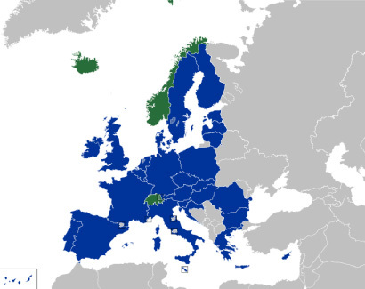

Sources
«civil and commercial decision» | «insolvency-related decision» | «insolvency decree»
Brussels I «recast» Reg | EuInsReg (Art. 32 Subpara 2) | EuInsReg
Lugano Convention (EU + CH + N + ICL) | Nat. Law. (mostly nothing) | Nat. Law. (often similar to UNCITRAL ML)
Hague Choice of Court 2005 Hague Judgments 2019 | UNCITRAL 2018 ML on insolvency related decisions | UNICTRAL ML on cross-border insolvency

Slide 4
Are the Hague Conventions filling the gap?
Convention of 30 June 2005 on Choice of Court Agreements
Convention of 2 July 2019 on the Recognition and Enforcement of Foreign Judgments in Civil or Commercial Matters
Exclusions: (e) insolvency, composition, resolution of financial institutions, and analogous matters;
“It includes the winding-up or liquidation of corporations in insolvency proceedings, while the winding-up or liquidation of corporations for reasons other than insolvency is dealt with by sub-paragraph (i). The term “composition” refers to proceedings where the debtor enters into an agreement with their creditors to restructure or reorganise a company to prevent its liquidation. These agreements usually imply a moratorium on the payment of debts and a discharge. Purely contractual arrangements – i.e., voluntary out-of-court agreements – are, however, not covered by the exclusion.”
(i) – the validity, nullity, or dissolution of legal persons or associations of natural or legal persons, and the validity of decisions of their organs;
Notes:
Convinced that the RP is covered by the exclusion
As to the Scheme:
Clearly: Non-voluntary
But: «their creditors» (does that imply all of them?)

Slide 5

SWISS PRIVATE INTERNATIONAL LAW – RECOGNITION
General requirements for recognition,(25 PILA) in particular public policy and proper notice (Jetivia SA v. BILTA (UK) limited in liquidation and HMRC claims)
Specific requirements for insolvency decrees Article 166 PILA
An insolvency decision (Qualification)
Issued by a Court (Sovereign power)
At the place of the COMI or seat – exception: Swiss companies (Forum, indirect jurisdiction)
Enforceable in the place of main proceedings (Enforceability)
No Reciprocity
➔ Definition by Cause, Effect and “Insolvency and the like”

Slide 6
SPECIFIC MEASURES ORDERED AT THE PLACE OF MAIN PROCEEDINGS
Qualification & Causes: “Insolvency and the like”
  “Insolvency” measures: solvent Restructuring plans?
  Judicial composition or corporate law: Creditors Voluntary Liquidations
Effects: Similar as a Swiss bankruptcy:
  Universality and Reciprocity: EU schemes
  Equality of creditors and estate: Receiverships
Forum: COMI vs. Seat:
  Forum convenient vs. Jurisdiction: Claims for misconduct of directors
  Exclusive jurisdiction over Swiss companies: Winding-up orders against SwissCo over foreign assets – an interim relief?

Slide 7
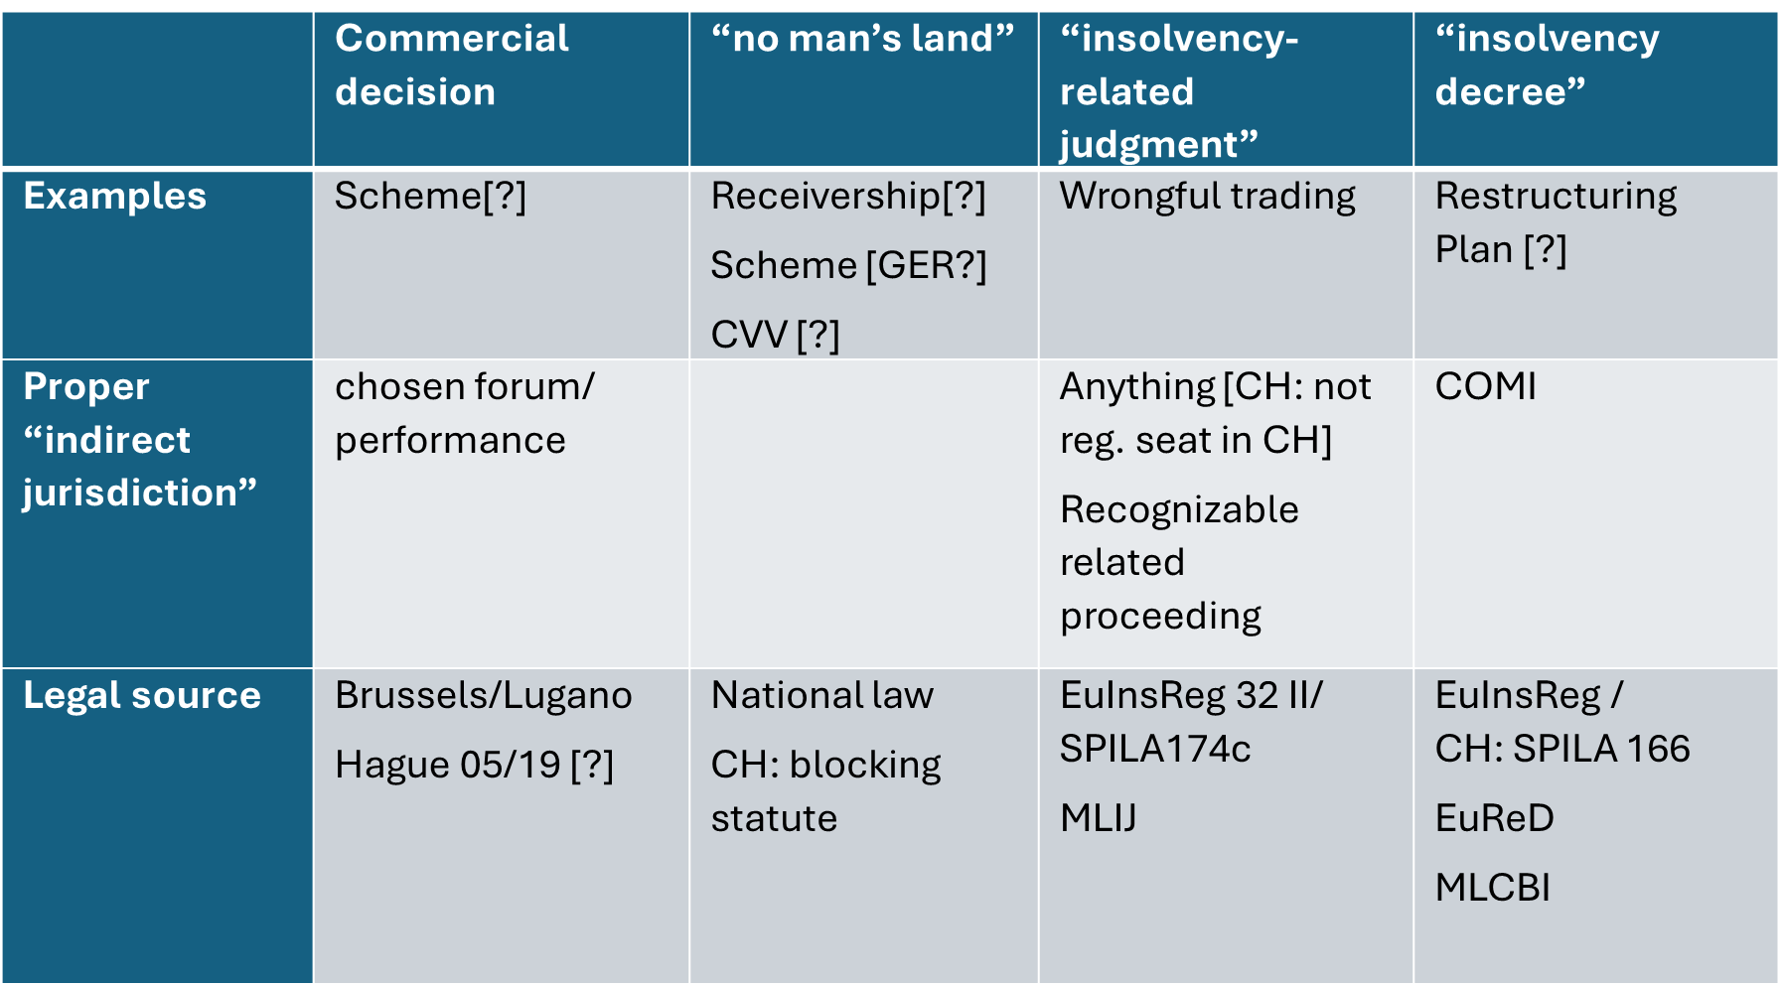
The recognition game – faites vos jeux!

Slide 8

Takeaways…

