Slide 1
Re-examining pari passu: an interdisciplinary approach of the division of proceeds
Niels Pannevis & Dirck Bouwhuis
Utrecht University, RESOR & Tilburg University
.. …….

Slide 2
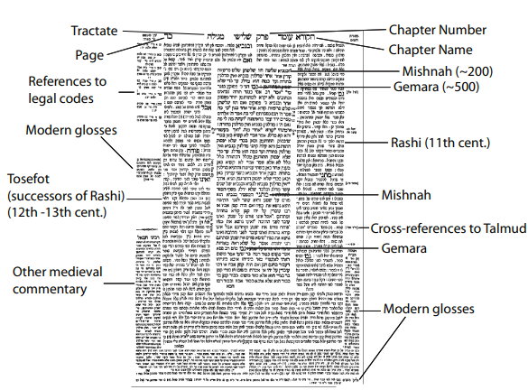
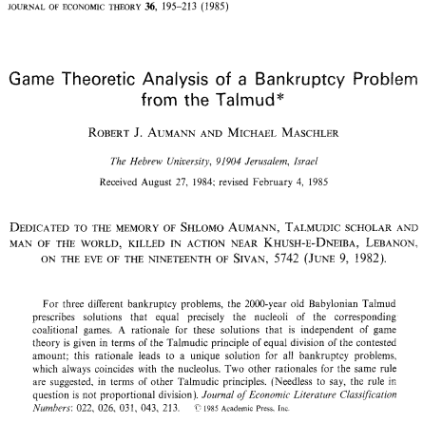
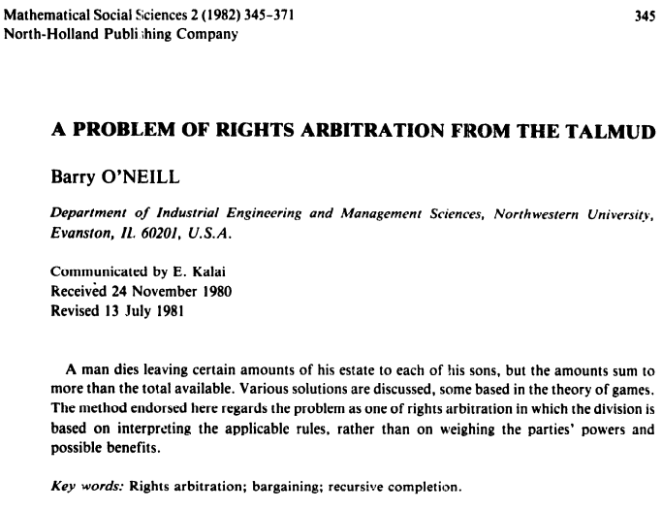
The Talmud divides an estate

Slide 3
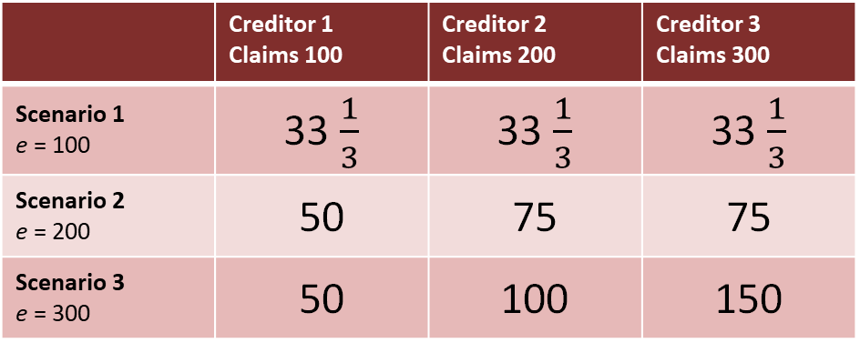
The Talmud divides an estate
 | Creditor 1 Claims 100 | Creditor 2 Claims 200 | Creditor 3 Claims 300
Scenario 1 e = 100 | 33 $\frac{1}{3}$ | 33 $\frac{1}{3}$ | 33 $\frac{1}{3}$
Scenario 2 e = 200 | 50 | 75 | 75
Scenario 3 e = 300 | 50 | 100 | 150
What is the governing division rule?

Slide 4
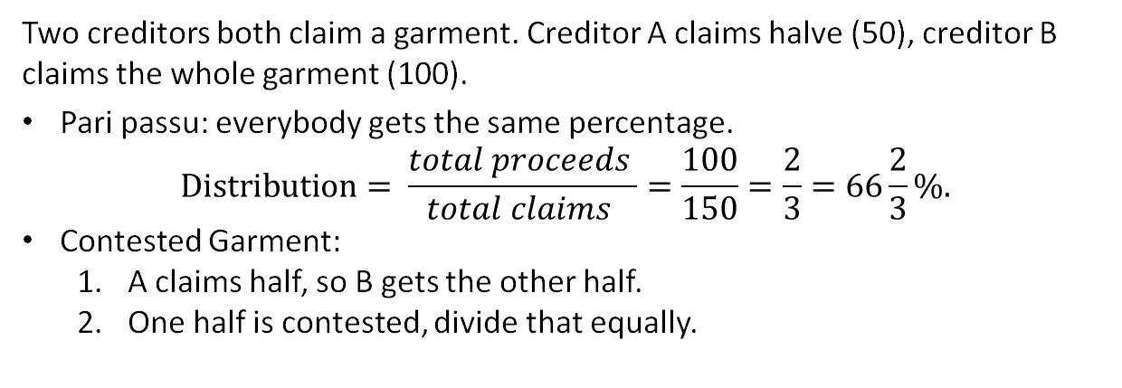
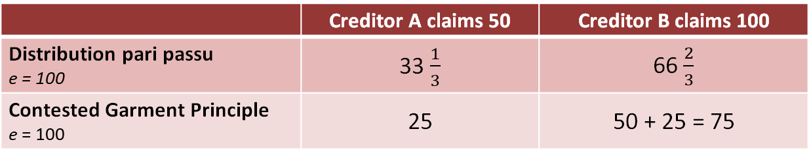
The Contested Garment principle
Two creditors both claim a garment. Creditor A claims halve (50), creditor B claims the whole garment (100).
Pari passu: everybody gets the same percentage.
$$Distribution= \frac{total proceeds }{total claims }=\frac{100}{150}=\frac{2}{3}=66\frac{2}{3}\%.$$
Contested Garment:
  A claims half, so B gets the other half.
  One half is contested, divide that equally.
 | Creditor A claims 50 | Creditor B claims 100
Distribution pari passu e = 100 | 33 $\frac{1}{3}$ | 66 $\frac{2}{3}$
Contested Garment Principle e = 100 | 25 | 50 + 25 = 75

Slide 5
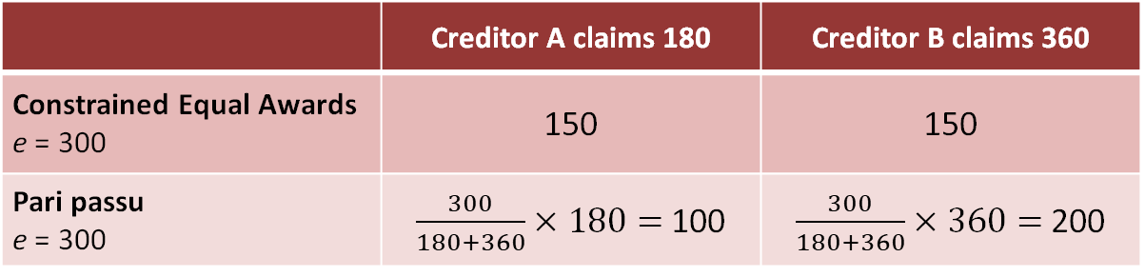
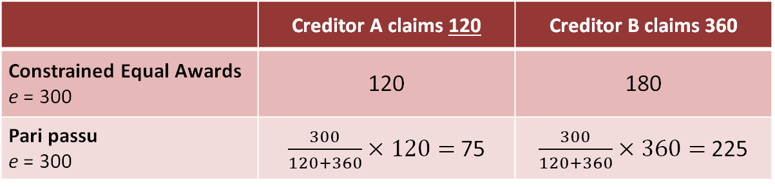
Constrained equal awards
Every claimant is awarded the same amount.
Unless their claim is smaller, then they get their claim.
 | Creditor A claims 180 | Creditor B claims 360
Constrained Equal Awards e = 300 | 150 | 150
Pari passu e = 300 | $\frac{300}{180+360}×180=$100 | $\frac{300}{180+360}×360=$200
 | Creditor A claims 120 | Creditor B claims 360
Constrained Equal Awards e = 300 | 120 | 180
Pari passu e = 300 | $\frac{300}{120+360}×120=$75 | $\frac{300}{120+360}×360=$225

Slide 6
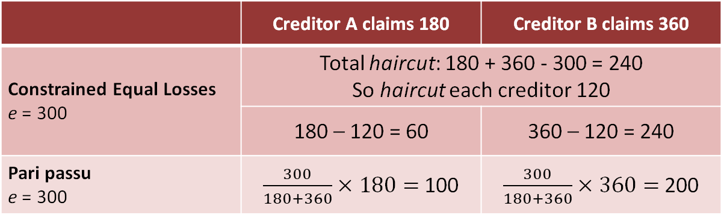
Constrained equal losses
Every claimant gets the same haircut, where no claimant ends up with a negative amount.
 | Creditor A claims 180 | Creditor B claims 360
Constrained Equal Losses e = 300 | Total haircut: 180 + 360 - 300 = 240 So haircut each creditor 120
Constrained Equal Losses e = 300 | 180 – 120 = 60 | 360 – 120 = 240
Pari passu e = 300 | $\frac{300}{180+360}×180=$100 | $\frac{300}{180+360}×360=$200

Slide 7
Random arrival rule
Insolvency proceedings exist to coordinate recourse; alternative is first come first serve.
  Consider all possible orderings, and distribution based on ‘first come first serve’.
  Award each creditor what he gets on average over all orderings.
Order e = 1200 | Creditor A claims 300 | Creditor B claims 600 | Creditor C claims 900
A → B → C | 300 | 600 | 300
A → C → B | 300 | 0 | 900
B → A → C | 300 | 600 | 300
B → C → A | 0 | 600 | 600
C → A → B | 300 | 0 | 900
C → B → A | 0 | 300 | 900
Average | 200 | 350 | 650

Slide 8
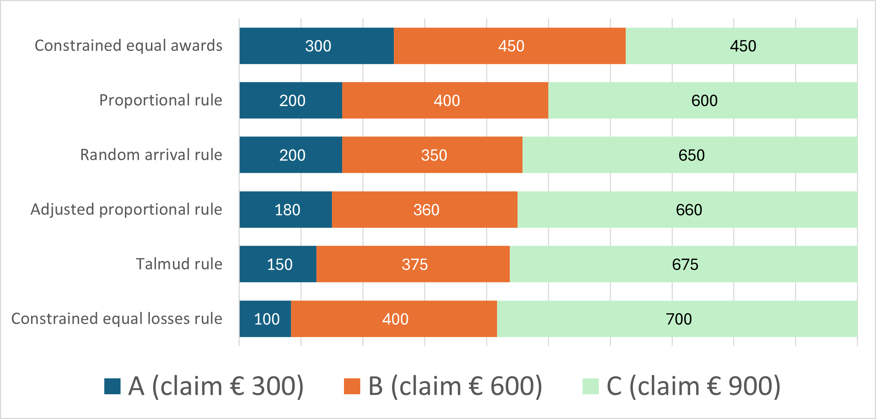

Slide 9
Mathematical properties of bankruptcy rules
Split & merge-proofness
  Creditors cannot gain by artificially splitting or merging claims.
Truncation invariance
  If a claim exceeds the estate, we can cap it at the estate size without changing the outcome.
Self-duality
  The rule divides the estate in the same way whether we think in terms of awards or losses.
  So, how do we pick a distribution rule?

Slide 10
Creditors’ Bargain Theory
Core idea: bankruptcy law should reflect what creditors would have agreed upon from an ex-ante position.
  Bankruptcy law solves collective action problem.
Challenge: What exactly would creditors have agreed upon?
Legal literature speculates, game theory can model the bargain.

Slide 11
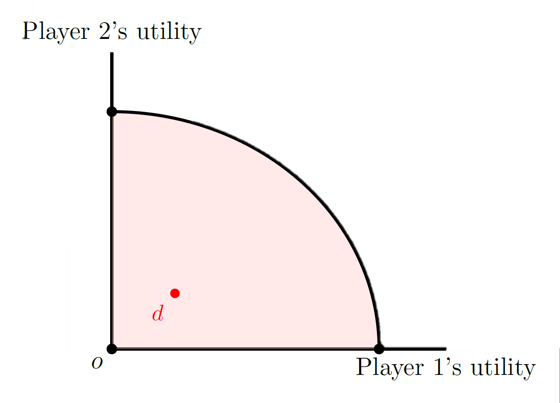
Game theory
Game theory: mathematical analysis
of strategic interaction.
Model CBT as a bargaining problem
  Nash (1950)
  1. All possible agreements (estate divisions).
  2. Disagreement point (alternative).

Slide 12
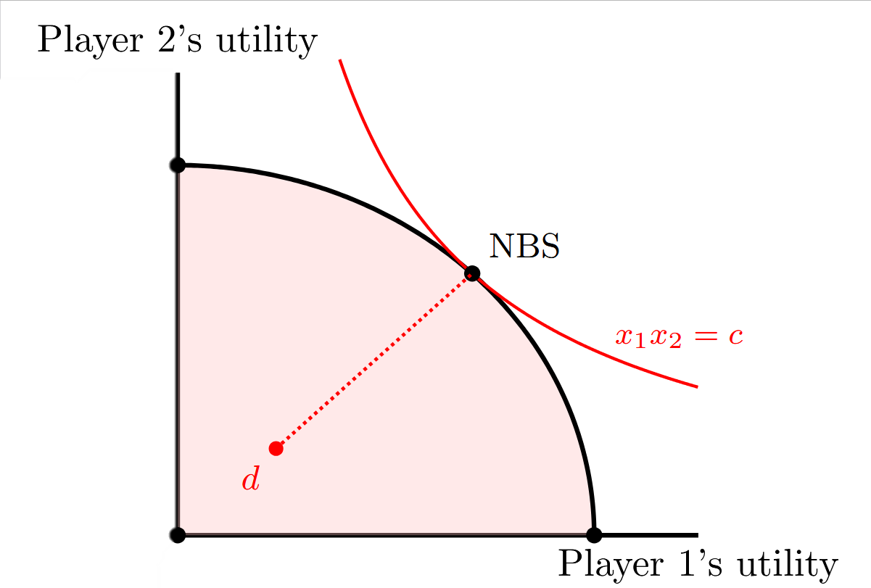
Nash bargaining solution
Idea: maximize product of utilities
relative to disagreement point.
Widely used benchmark across economics,
political science and philosophy.
Assumes equal bargaining power.

Slide 13
A game theoretic Creditors Bargain Theory
We need to specify the bargaining problem in the context of CBT
  In legal literature this is often left implicit.
Game theoretic model:
  All possible agreements are estate divisions (implies knowledge of claims)
  Disagreement results in 0 for every claimant
  Equal bargaining power
Nash bargaining solution in the context of claims problems corresponds to constrained equal awards (not pari passu!).
Realistic? Formalizes assumptions and outcome.

Slide 14
In conclusion
  There is so much more than pari passu.
  Game theory may model creditors bargain theory.
  To be reconsidered: distribution pari passu.
  Onwards to picking one!

