Slide 1
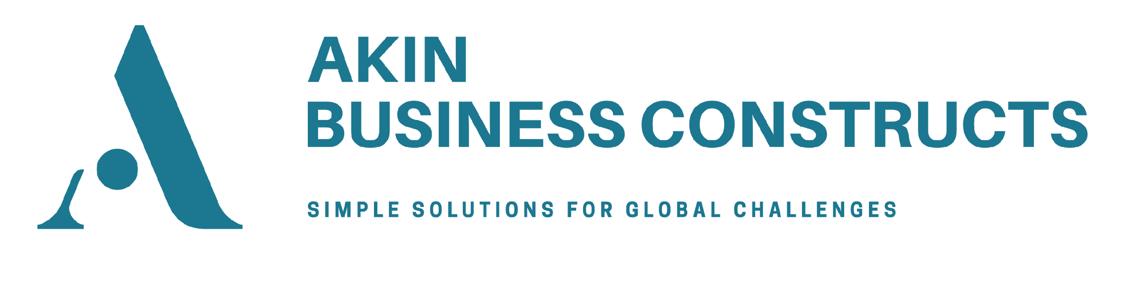
EXPLORING ARTIFICIAL INTELLIGENCE IN CORPORATE INSOLVENCY LAW
Dr Kayode Akintola

Slide 2

Research Objectives
1
2
3
Establish AI-adaptable corporate insolvency tasks
Determine the insolvency outcomes of deploying AI to such tasks
Outline barriers to and risks of AI adoption in this context and possible mitigation protocols

Slide 3

Research Composition
Stakeholder Survey
Quantitative Research

Slide 4
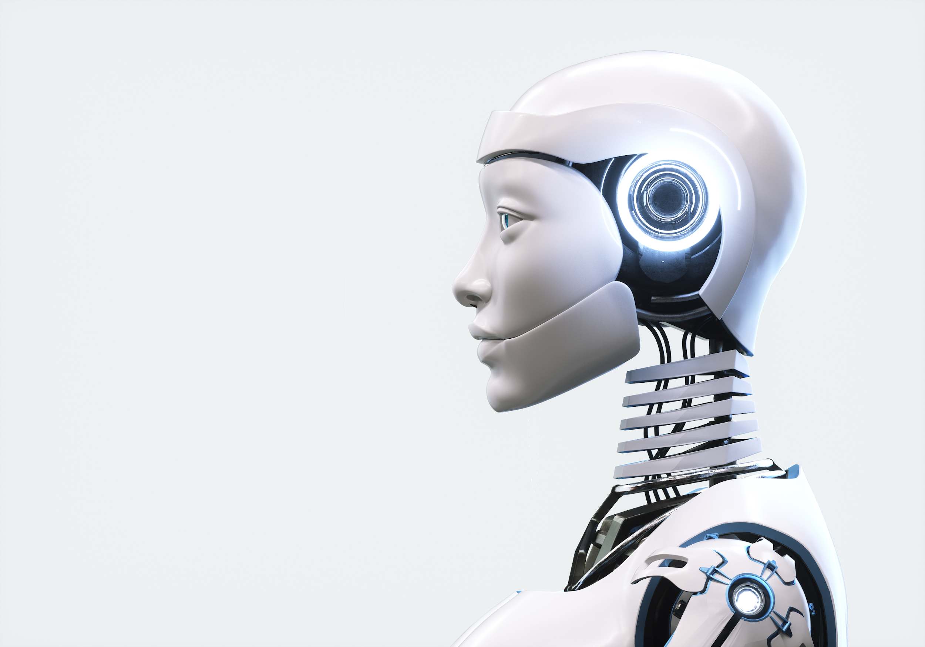
Stakeholder Survey

Slide 5
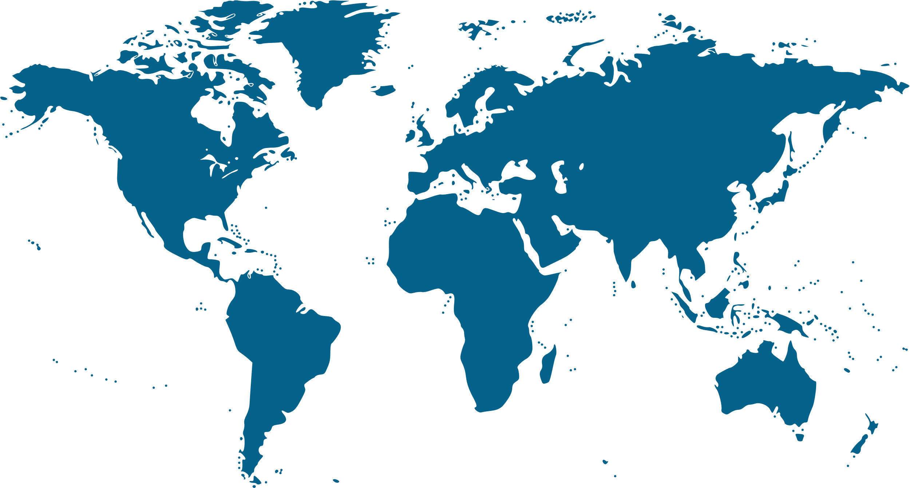

Stakeholder Survey Responses
Responses
47
Jurisdictions
22
IPs, Academics and Legal
Professionals
91%

Slide 6
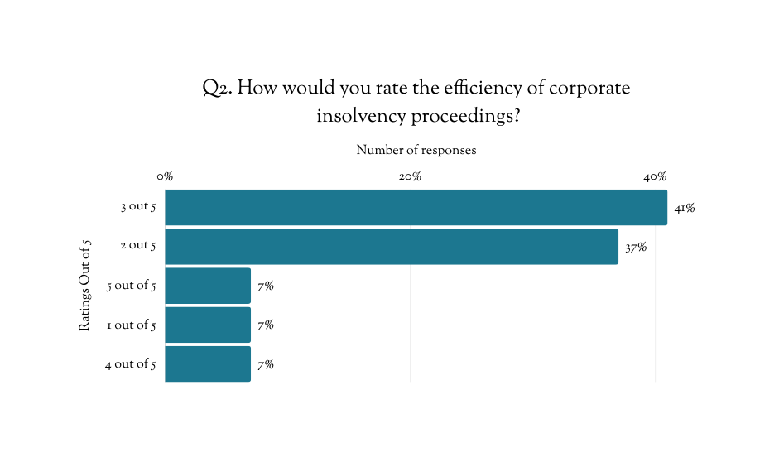
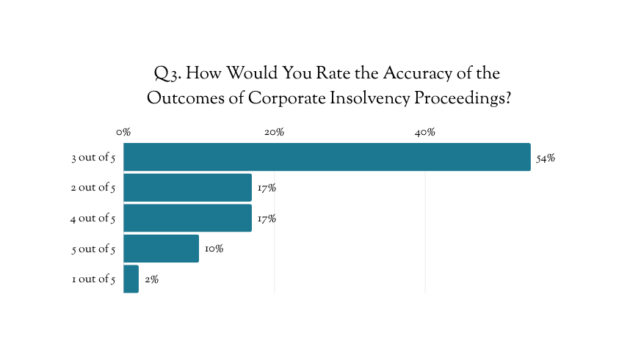
Stakeholder Survey Responses
Views on the Current Regime

Slide 7

Stakeholder Survey Responses
AI Usage in Corporate Insolvency Proceedings
Concerned about:
63% “Accuracy”
“Reduces time and cost” 46%
47% “Data privacy”
“Increases efficiency” 25%
37% “Legality of use”
“Helps to streamline processes” 16%
37% “Authentication or verification of outputs”
36%
Have Used AI
64%
Have Not Used AI
37% “Lack of knowledge about tools to use”
26% “No/limited AI knowledge or capability”
26% “No access to AI tools”

Slide 8
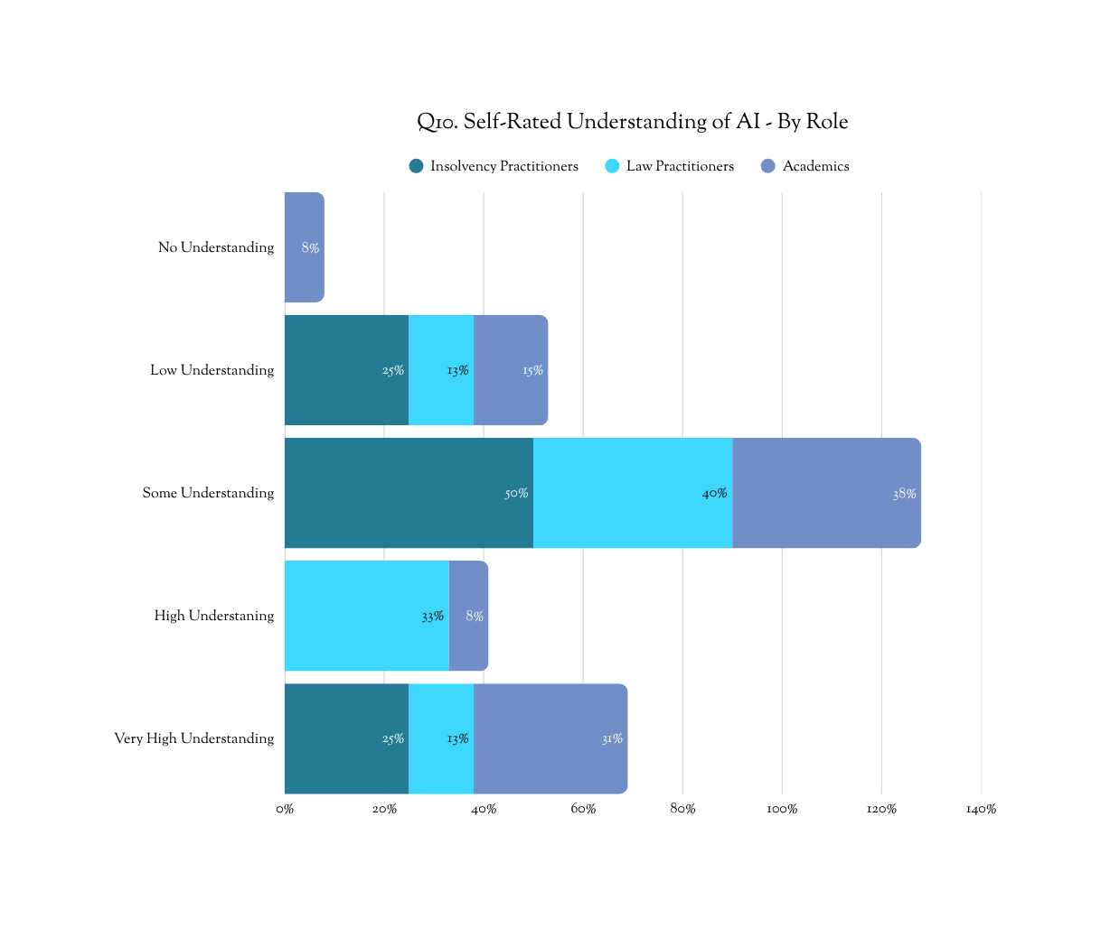
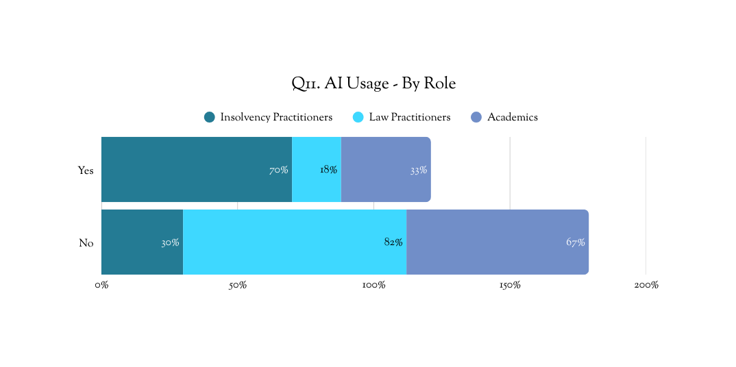
Stakeholder Survey Responses
AI Usage Volume by Role

Slide 9
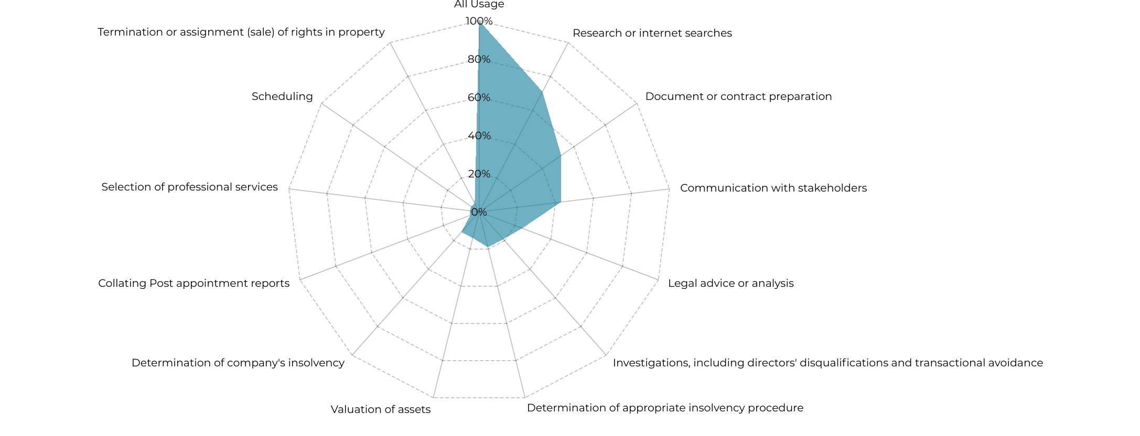
Stakeholder Survey Responses
AI Usage: Typology

Slide 10
Our Hypothesis

Slide 11
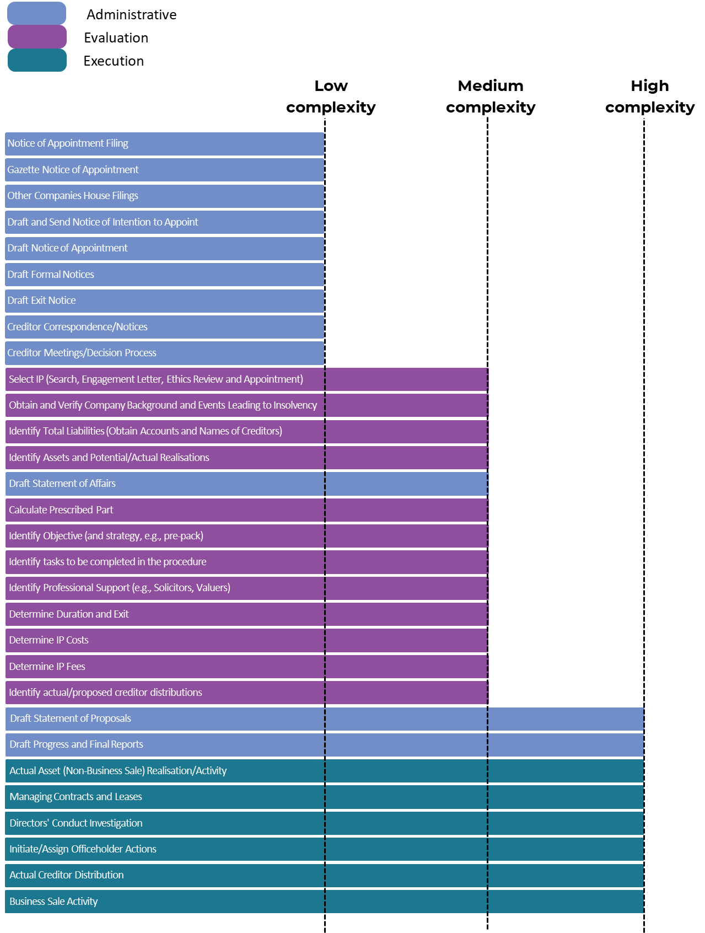
Where is AI Adaptable in Corporate Insolvency?

Slide 12
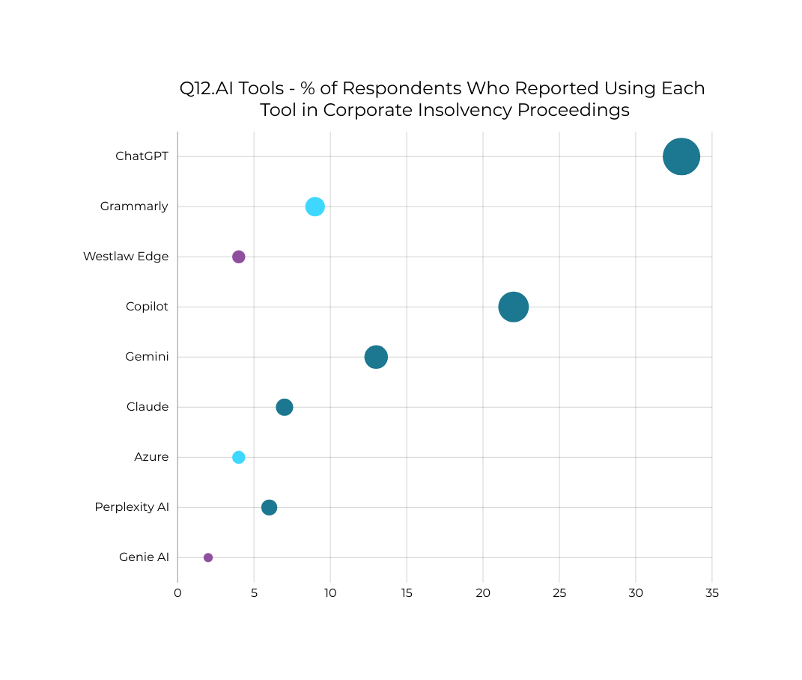



Stakeholder Survey Responses
AI Usage: Tools
86% of AI Users - Generic Open-Source AI
35% of AI Users - Specialised Non-Legal Closed AI
14% of AI Users - Specialised Legal Closed AI

Slide 13
Our Hypothesis
Specialised Legal Closed AI
Specialised Non-Legal Closed AI
Generic Open-Source AI
 | Low Complexity Task | Medium Complexity Task | High Complexity Task

Slide 14
Next Step: Quantitative Research
A design experiment applying selected AI tools to AI-adaptable tasks in randomly selected corporate insolvency cases

Slide 15
THANK YOU
For more information:
AKINBC.COM/RESEARCH

