Slide 1
Harmonizing European Insolvency Regimes: The Impact of Artificial Intelligence and the Role of the EU AI Act
ANIMESH KHANDELWAL
Partner, Senatus Legal
e. khandelwalanimesh@gmail.com
m. +91-900-44-88967

Slide 2


INTRODUCTION
Scope of the research
To study the multifaceted impact of AI on Insolvency Practice
To examine its potential to enhance efficiency, transparency and predictability
To explore the crucial implications of the EU AI Act on the present insolvency framework
Aim of the research
To develop a set of best practices and learnings
How AI and the EU AI Act can contribute towards fostering greater efficiency, transparency and fairness.
Focus Jurisdictions- Germany (Western Europe) and Poland (Eastern Europe)

Slide 3
INSOLVENCY AND AI
“A duty to act in the best interests of our clients goes to the heart of the legal profession, both functionally and ethically.”*
Role of AI in Insolvency Practice (Legal Practitioner’s Side)
Achievement of positive outcomes for clients, review and categorization of documents in a matter of seconds, research on latest case laws etc.
Role of AI in Insolvency Process (Insolvency Practitioner’s Side)
Document management systems, valuation software, financial predictions, due diligence of resolution applicants/bidders etc.
Limitations of utilization of AI
How to maintain ethical standards? How to curb misinterpretation of legal provisions and practices? Can human interaction be replaced?
*https://www.nortonrosefulbright.com/en-de/knowledge/publications/c4af263b/the-role-of-ai-in-insolvency-litigation

Slide 4
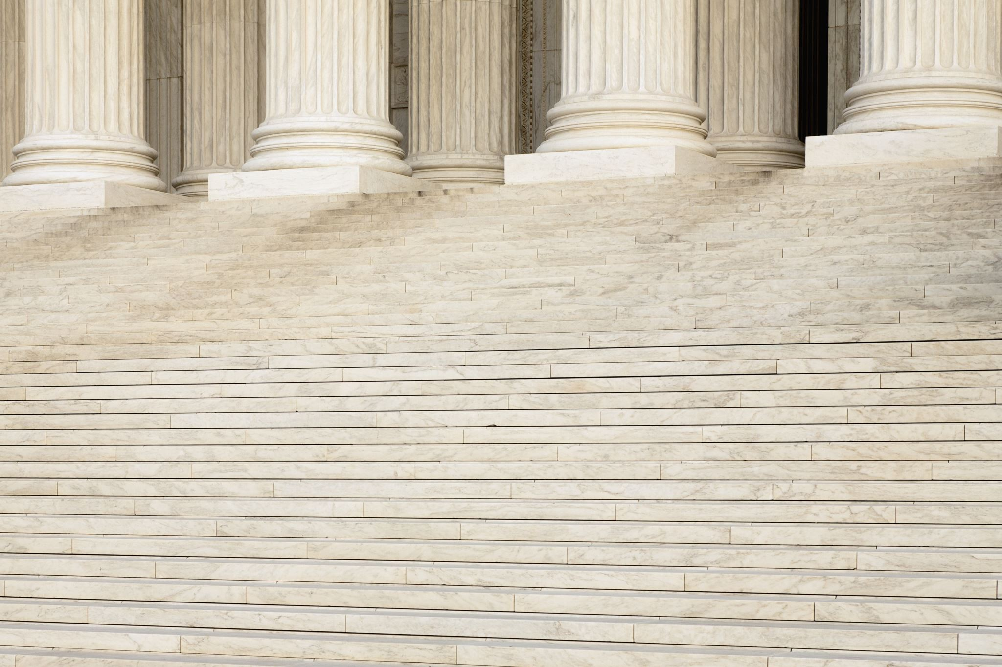

JURISDICTIONS
AI AND INSOLVENCY PRACTICE IN GERMANY
Present insolvency processes- Governed by InsO under the supervision of Insolvency Courts (Insolvenzgericht), Preliminary Insolvency Proceeding, Final Insolvency Proceeding, Self-Administration, Restructuring under StaRUG, Personal Insolvency (Verbraucherinsolvenzverfahren).
Use of AI- primarily by insolvency administrators and law firms, Document and Data Processing, Administrative Automation, Investigation and Fraud Detection
EU AI Act and German laws- Draft implementation law, designation of central authority, Indirect impact on Insolvency Proceedings: High Risk Classification, Key Compliance Obligations for Deployers, Compliance Costs, Financial Penalties, Legal Scrutiny.

Slide 5
JURISDICTIONS
AI AND INSOLVENCY PRACTICE IN POLAND
Present insolvency processes- Governed by Bankruptcy Law (Liquidation) and Restructuring Law (Arrangement/Uklad approval, Accelerated Arrangement, Remedial Proceedings).
Use of AI- No official mandate, Focus on Digitalization in Poland’s court system: Krajowy Rejestr Zadluzonych (KRZ), Indirect utilization in Document Review, Due Diligence, Claim analysis & verification, litigation and drafting.
EU AI Act and Polish laws- Draft implementation law is still under consideration, no designation of central authority, Indirect impact on Insolvency Proceedings: High Risk Classification, Key Compliance Obligations for Deployers, Compliance Costs, Slowing AI Adoption initially, Emphasis on transparency

Slide 6
CONCLUSION
Learnings from the research- How to harmonize?
The Future of AI in insolvency proceedings- Significant potential for efficiency and prediction constrained by strict compliance and liability rules of the EU AI Act
Heavy utilization in back-office processes, however, heavy regulation of core, high-stakes legal decisions.
Change in the role of Insolvency Practitioner
Human Oversight: All high-risk systems require Ips to understand the AI’s output, interpret it correctly and override, if necessary
Strategic Advisory: Focus of IPs on more complex legal issues
AI Compliance Officer- Primary duty will be on the IP to ensure AI Compliances

