Slide 1

Blockchain and Smart Contracts in Insolvency: Enhancing Transparency, Efficiency and Fairness
Dr Charles Mak
Lecturer in Law, University of Bristol

Slide 2
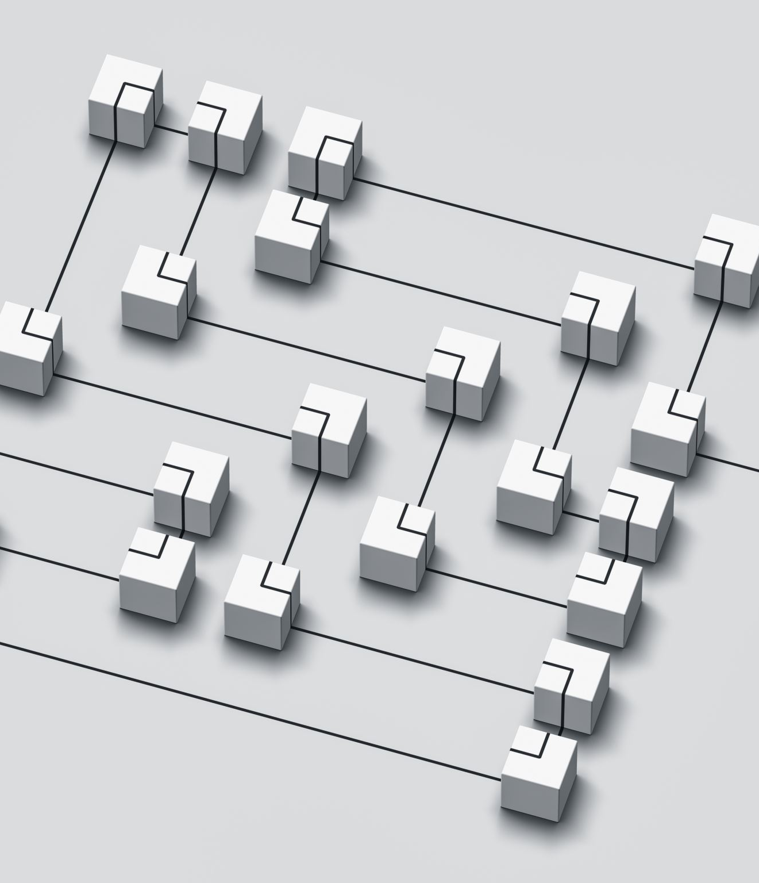
Overview of Blockchain Technology
What is Blockchain?
  A decentralised, immutable digital ledger.
  Records transactions in 'blocks' linked by cryptography.
  Creates a tamper-proof and transparent record of transactions and asset ownership.
Core Characteristics
  Decentralisation: Data is stored across a peer-to-peer network, not a single authority.
  Immutability: Once data is confirmed, it is resistant to alteration.
  Trust: Trust is established through transparent processes and consensus protocols, not intermediaries.
  Cryptographic Hashing: Each new block contains a cryptographic 'hash' of the previous block, ensuring data integrity.
Types of Blockchains
  Public (Permissionless): Open to anyone (e.g., Bitcoin, Ethereum).
  Permissioned: Access is restricted to certain participants.
Relevance to Insolvency
  Provides a single, verifiable source of truth for asset tracing.
  Fosters trust among stakeholders from different jurisdictions.
  Minimises fraud and data tampering.

Slide 3
Smart Contracts: An Introduction
What are Smart Contracts?
Self-executing agreements written in computer code.
Automate tasks when predefined conditions are met, following 'if/then' logic.
Originally popularised by computer scientist Nick Szabo.
Key Distinctions
Smart Contract vs. Smart Legal Contract: A smart contract is code; a smart legal contract is a legally enforceable agreement that uses smart contract technology.
Pure code doesn't automatically satisfy legal requirements (e.g., offer, acceptance, consideration).
Advantages of Smart Contracts
Efficiency & Speed: Automatic execution reduces delays.
Cost Reduction: Minimises or eliminates the need for third-party intermediaries.
Precision: Rules are embedded directly in the code, reducing subjective interpretation.
Challenges of Smart Contracts
Rigidity: Code is deterministic and lacks human discretion or flexibility.
Bugs: Errors or vulnerabilities in the code can lead to irreversible and unintended outcomes.
Legal Interpretation: Translating complicated legal clauses into code can be difficult.

Slide 4

Blockchain and Smart Contracts in Cross-border Insolvency Proceedings
Enhancing Transparency and Trust
  Blockchain provides an immutable and real-time record of transactions and asset ownership.
  Allows all authorised stakeholders to access consistent data, regardless of location.
  Mitigates the risk of fraud and data tampering in complex multi-jurisdictional cases.
Automating Asset Distribution
  Smart contracts can automate the distribution of assets to creditors based on predefined, legally aligned rules.
  Reduces administrative delays and potential for human error.
  Ensures equitable treatment and adherence to statutory priorities.
Legal and Regulatory Considerations
  Alignment with Existing Laws: The deterministic nature of smart contracts must be carefully aligned with the fluid and interpretative nature of insolvency law.
  International Frameworks: Compatibility with frameworks like the UNCITRAL Model Law on Cross-Border Insolvency is essential.
  Jurisdictional Issues: Determining which legal system has authority over a blockchain transaction can be complex.
  Data Protection: The transparency of blockchain can conflict with privacy laws (e.g., the right to be forgotten).

Slide 5
Practical Implementation Issues and Challenges
Technical Challenges
Coding Vulnerabilities: Smart contracts can be prone to bugs and exploits (e.g., the DAO incident).
Scalability: Public blockchains can experience congestion, leading to high transaction fees and delays.
Legal Translation
Difficult to translate subjective legal principles and discretionary judgements into rigid code.
Automated outcomes can be technically correct but legally inequitable.
Operational & Integration Issues
Expertise: Requires specialised technical expertise that many insolvency practitioners lack.
Legacy Systems: Integrating blockchain with conventional databases and paper-based records is a significant challenge.
Regulatory Uncertainty
Lack of clear legal frameworks for digital records and smart contract executions.
Inconsistent enforcement and varying legal interpretations across different jurisdictions.
Cost and Resistance
Financial Cost: High initial investment for secure development and auditing.
Organisational Culture: Resistance to change from traditional, well-established practices.

Slide 6

Future Prospects and Developments
Improved Interoperability
  Future protocols will enable seamless data exchange across different blockchain platforms.
  This will lead to quicker validation and reconciliation of asset records.
Advanced Smart Contracts
  The development of adaptive algorithms and AI will allow smart contracts to incorporate more complex legal conditions.
  They may feature built-in 'escape clauses' for human oversight in unforeseen circumstances.
Evolving Legal & Regulatory Landscape
  International regulatory bodies are expected to develop unified legal frameworks.
  This will provide clarity on the admissibility of blockchain records and enforceability of smart contracts.
Technological Convergence
  AI Integration: AI could be used to rapidly identify asset discrepancies and flag potential fraud.
  IoT Devices: Live data from IoT could enable real-time adjustments to asset valuations or creditor claims.
  This creates a dynamic ecosystem where insolvency processes adapt instantly to external variables.

Slide 7
Thank you!

