Slide 1
European Insolvency Chatbot
Marton Ribary (Royal Holloway, University of London)
Thomas Wood (Fast Data Science Ltd / Ulster University)
Eugenio Vaccari (Royal Holloway, University of London)

Slide 2

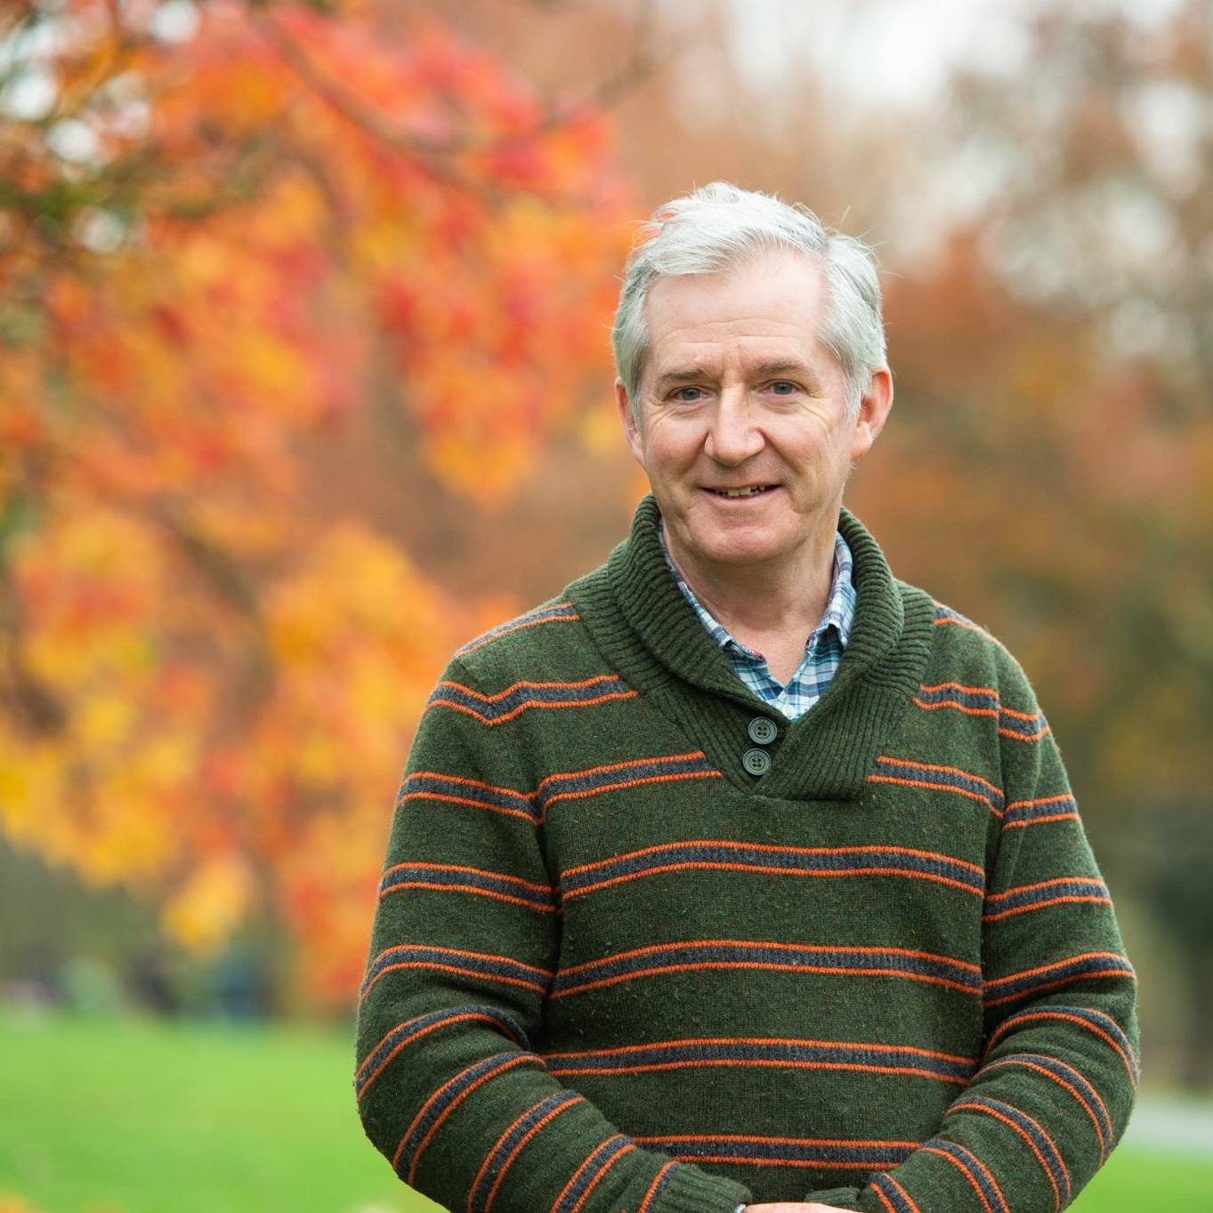
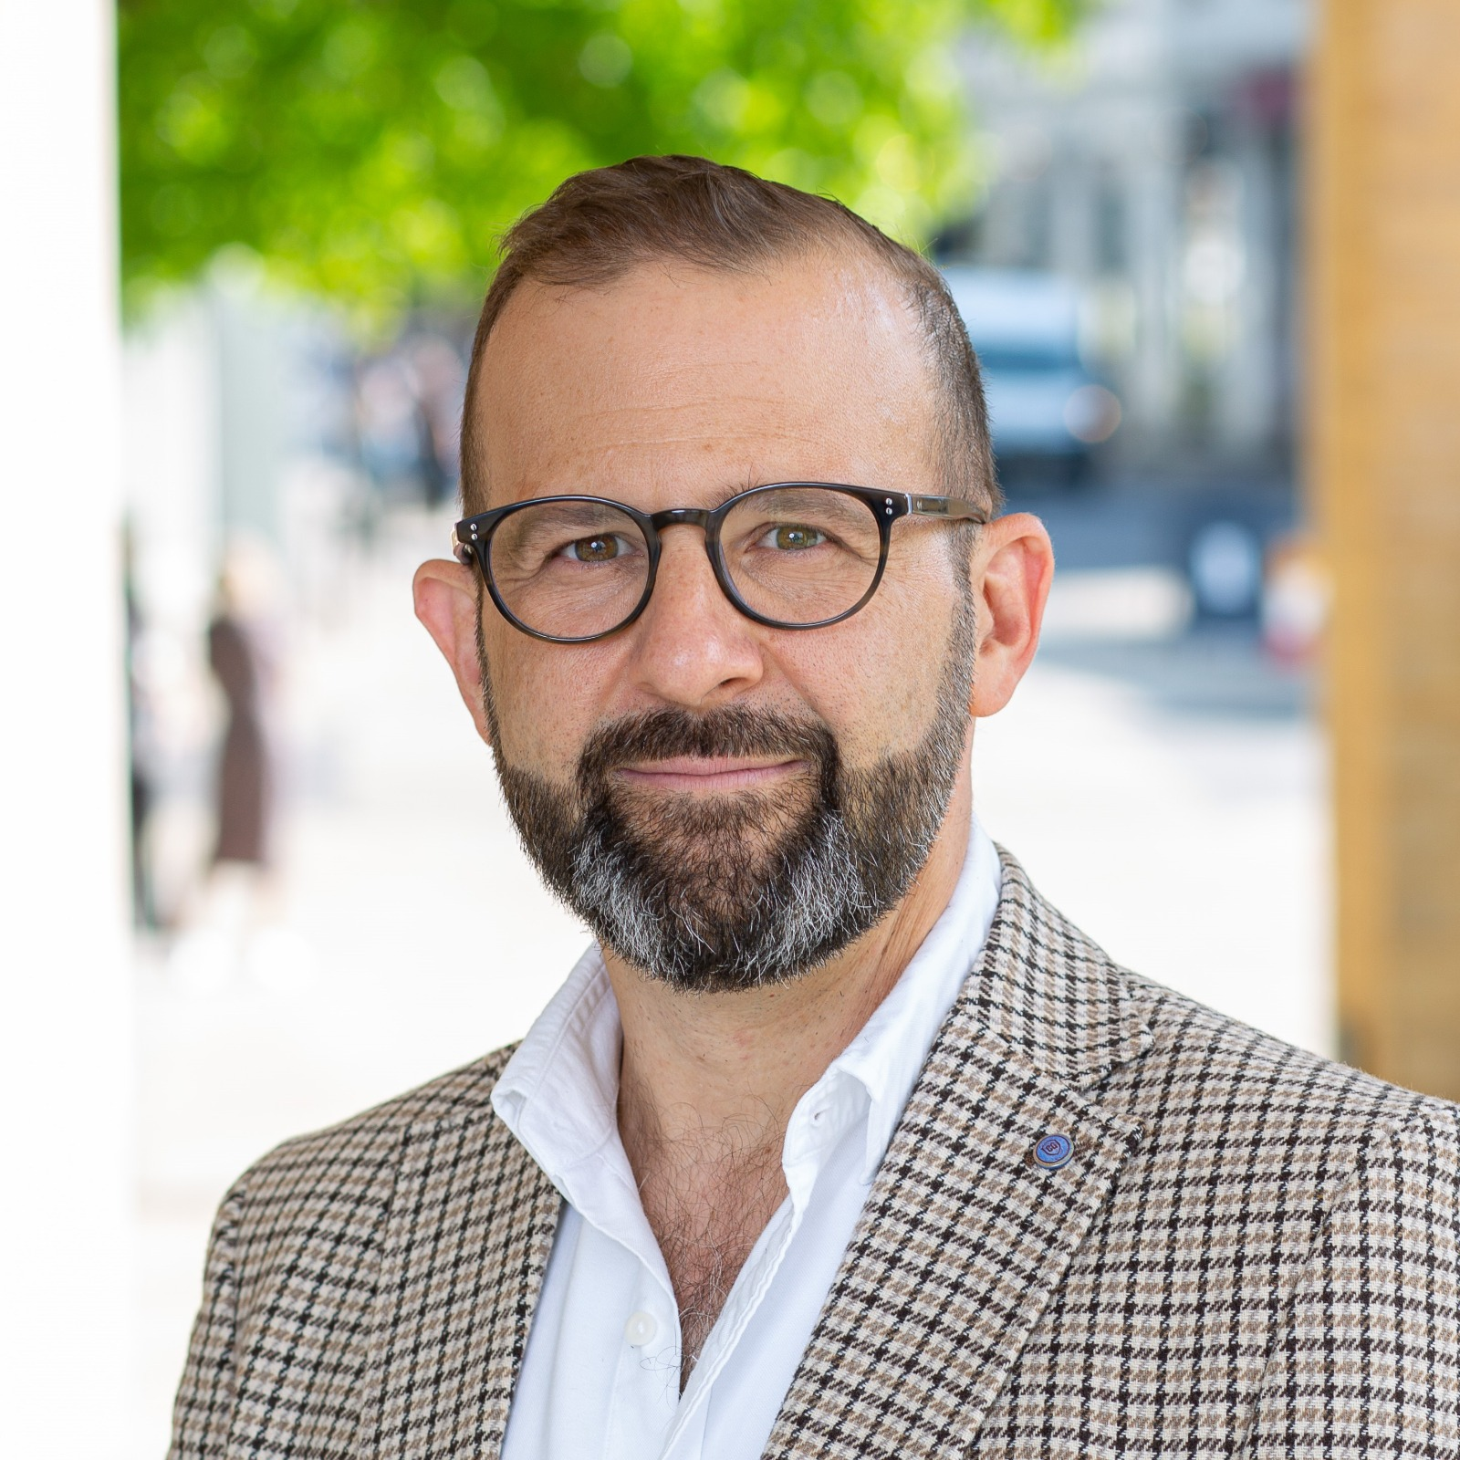
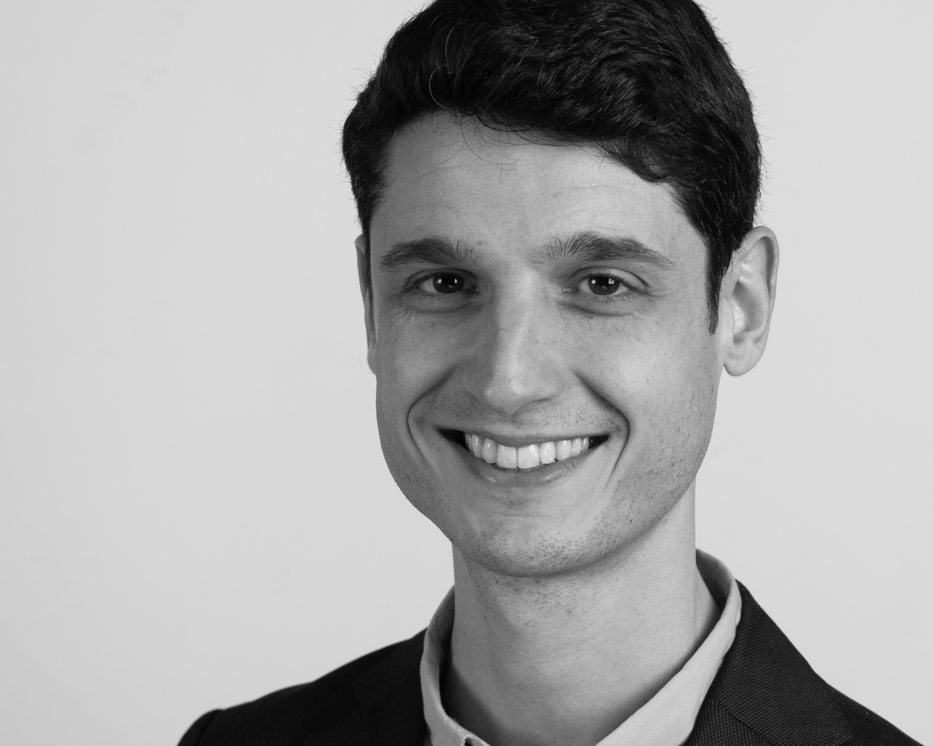
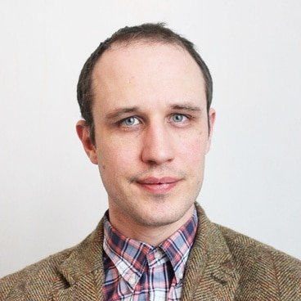
Marton Ribary
(Royal Holloway, University of London)
legal reasoning, private law, computational methods
Paul Krause
(University of Surrey)
complex systems, theoretical and practical aspects of AI
Miklós Orbán
(OPL gunnercooke / Surrey)
legal tech, industry perspective, data-driven legal analysis
Eugenio Vaccari
(Royal Holloway, University of London)
qualified Italian lawyer, corporate insolvency and bankruptcy law
Thomas Wood
(Fast Data Science / Ulster University)
data science, machine learning models, information extraction

Slide 3






How many of you use Large Language Models on a regular basis and/or for work?
How many of you have used Large Language Models this morning?

Slide 4
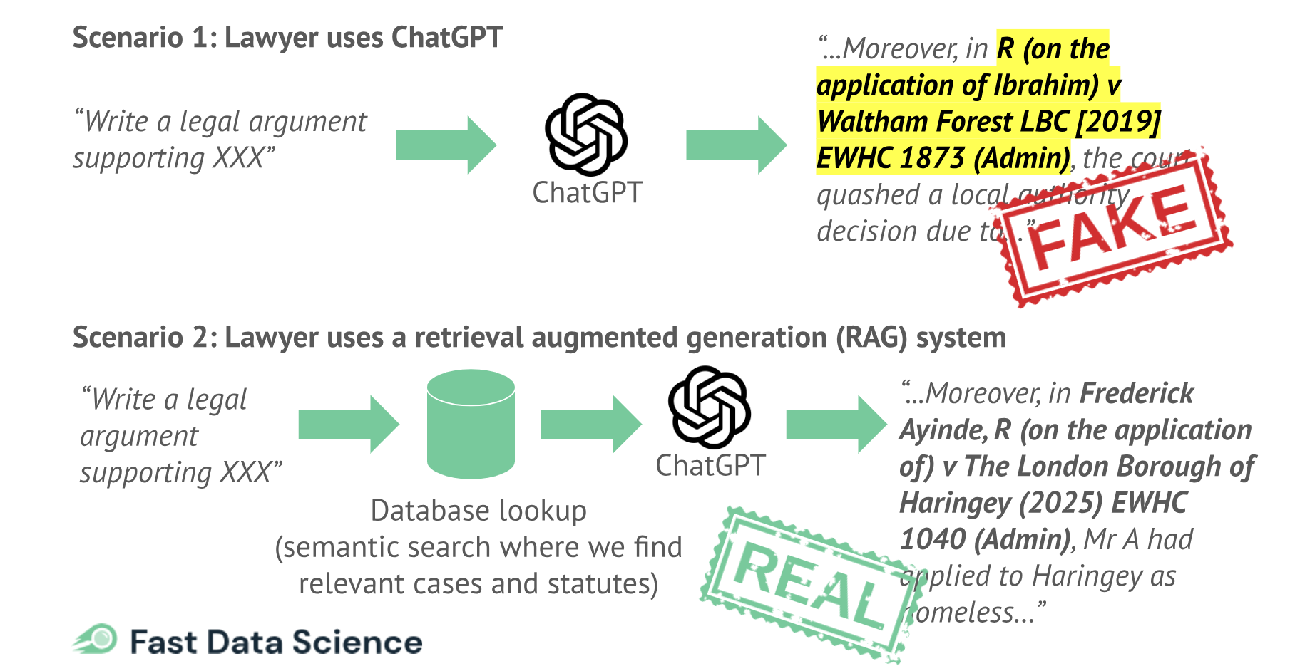
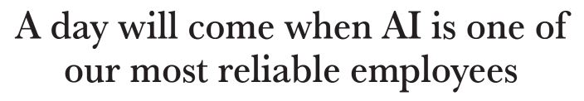
Recovery, Summer 2025

Slide 5
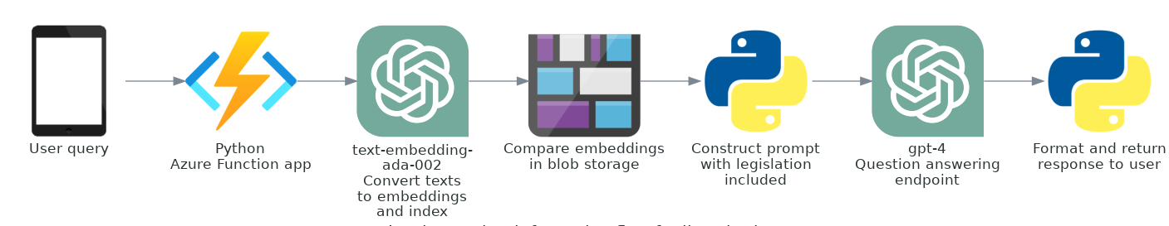
From LLMs (Large Language Models) to RAG (Retrieval Augmented Generation) Systems

Slide 6
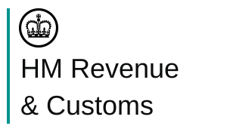



Statute
custom database of relevant statutes (5), one row for each section
source: legislation.gov.uk
structure: chapter, subchapter, preamble, paragraph, title, text
2898 rows in total
HMRC forms
custom database of relevant HMRC forms
source: forms for insolvency rules and forms for limited companies
structure: form name, form instruction, cited legislation
190 rows in total
Case law
custom database of related cases
source: Find Case Law (The National Archives)
structure: summary (some custom written), manually assigned keywords (plain English), cited legislation
200+ cases in total

Slide 7
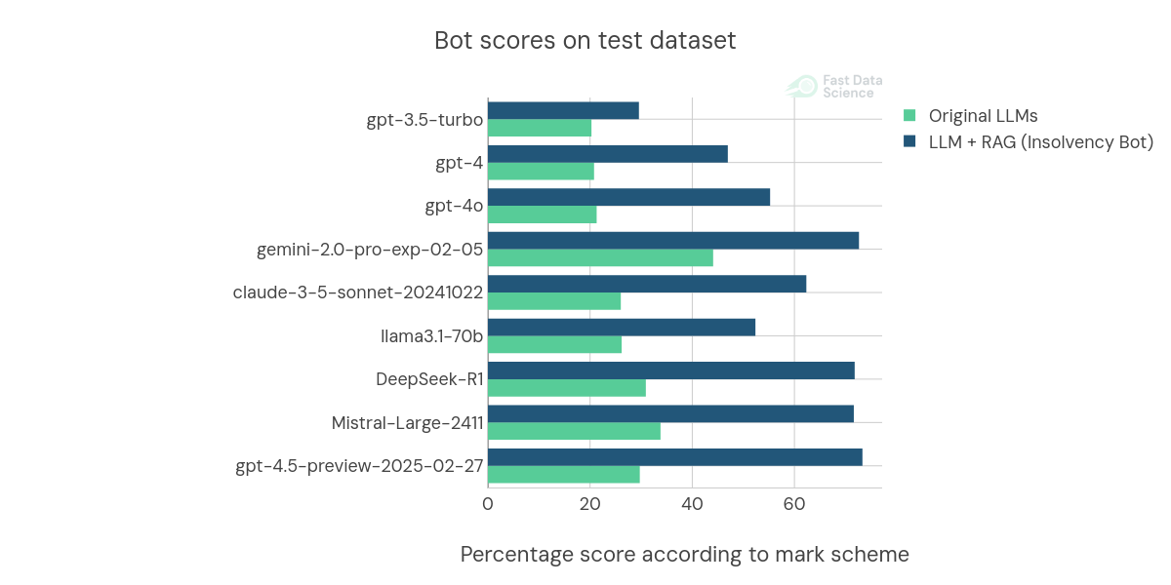

Slide 8
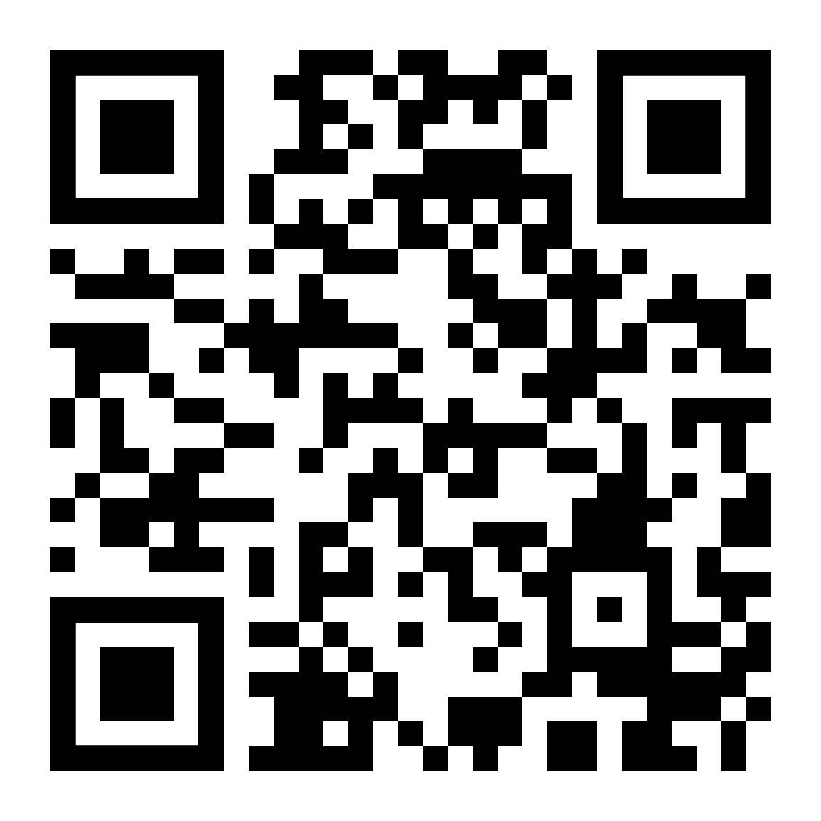

Slide 9
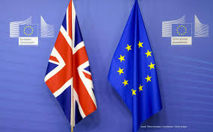

Slide 10

expand the Insolvency Bot expertise to European law (European Insolvency Regulation and Preventive Restructuring Directive) and related case law;
test the efficacy of the revised Insolvency Bot compared to other LLMs, but also to assess the quality of the advice provided;
identify ways to further improve the Insolvency Bot’s technical architecture.

Slide 11



Project Timeline
Create the national and EU Knowledge Repositories
Assess, Mark and Test
Improve and Repeat
Oct. 2025
Dec. 2025

Slide 12


UK: Marton Ribary and Thomas Wood
EU: Kayode Akintola and Eugenio Vaccari
Belgium: Aruna Audenaert and Joke Baeck
France: Emilie Ghio
Germany: TBC
Italy: Daniele Buoncristiani and Luca della Tommasina
Spain: Jaime Vazquez
Netherlands: Gert-Jan Boon

