Slide 1
The Impact of the Discharge Period on Effective and Efficient Plan Performance:
Empirical Evidence from Belgium
Gauthier Vandenbossche

Slide 2


Slide 3
Research question
To what extent does the duration of amicable repayment plans influence the effectiveness and efficiency of the Belgian collective debt settlement procedure?
  In other words: Does a longer repayment plan actually lead to higher repayments, and therefore better outcomes for creditors and debtors?
  Or, do longer plans undermine the efficiency of the procedure and prolong hardship unnecessarily?

Slide 4
(i) The Belgian collective debt settlement procedure
Filing request
Debt mediator drafts repayment plan
Approval of repayment plan by court
Payments
End of the repayment plan and discharge residual debts
Admission, with appointment of debt mediator
From admissibility:
*Debtor’s income goes to mediator
*Debtor receives family support budget
Early termination:
*Request of debtor
*Revocation by mediator
Starting point
Max. 7 years

Slide 5
Setting the scene
Policy developments on length of the discharge period [of compliance with a repayment plan], considering Directive 2019/1023
  3 year-discharge period (<> Belgium statutory maximum of 7 years for amicable plans)
Lack of systematic data collection in personal insolvency regimes means assumptions remain largely untested
  little empirical research at case-file level
  evidence-based picture of how repayment plans function in practice

Slide 6
(ii) Effectiveness and efficiency
How does the discharge period (plan length) affects plan performance?
  Effectiveness – measured by recovery rate
  Efficiency – comparing payments to creditors with the procedural costs of the debt mediator

Slide 7
Data
Stratified random sample of 118 terminated amicable repayment plans of the Labour Court of Ghent, Ghent division
  Unique dataset
  Both regularly completed and prematurely terminated plans
    78 cases (66.1%) were completed regularly
    40 (33.9%) ended prematurely
      21 revoked,
      19 voluntarily withdrawn

Slide 8
Approach
Descriptive analysis
Bivariate analysis
Multivariate Tobit regression
Efficiency index

Slide 9
(i) Descriptive Findings
Average recovery rate: 48.5%
  Regularly completed arrangements: 67.3%
Average duration of repayment plans: 5.5 years
  Regularly completed plans: 6.3 years
  Many plans cluster around the legal maximum of seven years
→ Importance of distinguishing between regular and irregular terminations.

Slide 10
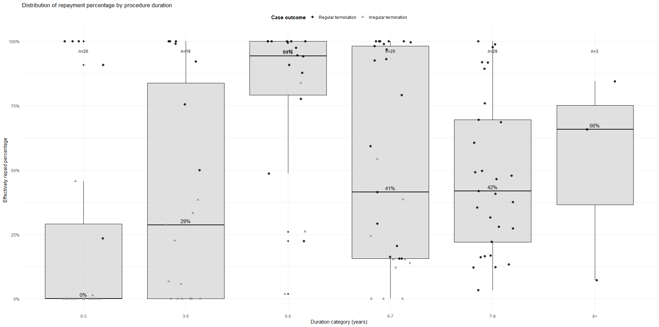
(ii) Bivariate Analyses
Recovery rate
Plan duration

Slide 11
(ii) Bivariate Analyses
Longer duration categories:
*higher recovery rates
*regularly completed plans dominate
Shortest duration categories:
*low recovery rates
*high share of irregularly terminated plans
Recovery rate
Plan duration

Slide 12
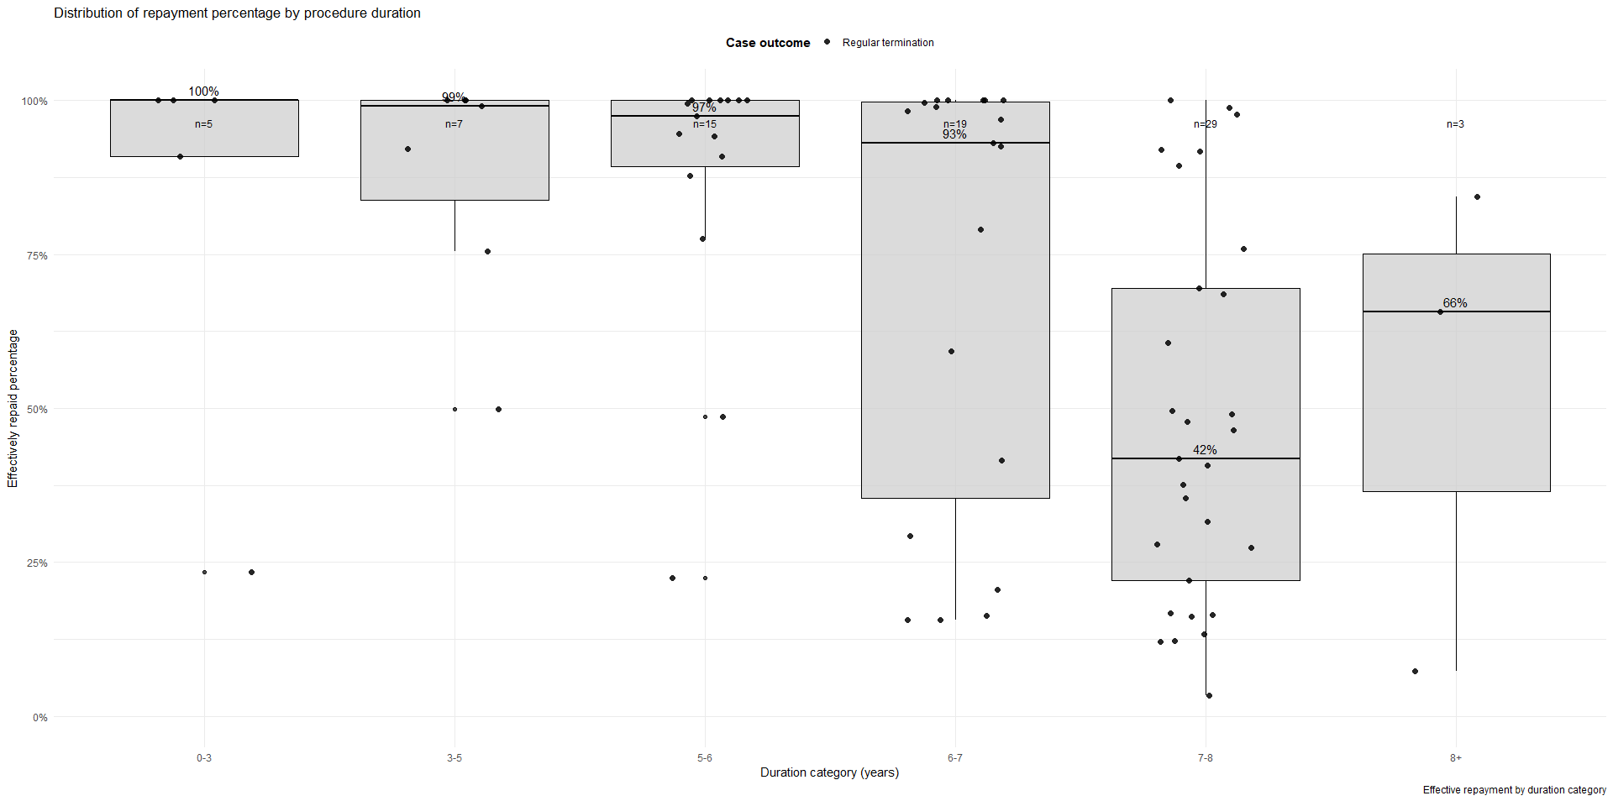
(ii) Bivariate Analyses
Recovery rate
Plan duration

Slide 13
(ii) Bivariate Analyses
Plans reach 7-year maximum
among regularly completed cases, longer plans are associated with lower repayments
Recovery rate
repayment rates are systematically higher
Plan duration

Slide 14
(iii) Tobit regression
Full dataset
  Plan duration shows no significant effect on the recovery rate (p = 0.228)
  Irregular termination is highly significant and strongly negative (p < 0.001)
Sub-sample: regularly completed plans only
  Significantly negative (p = 0.0016)
    Longer plans systematically achieve lower recovery rates
      Longer plans are usually assigned to debtors with more ‘problematic’ profiles—higher debts and lower incomes—rather than causing lower repayment outcomes in themselves.
      In this sense, duration partly serves as a proxy for debtor vulnerability.

Slide 15
(iii) Tobit regression
Sub-sample: regularly completed plans only
  Total debt burden has a negative effect – larger debts mean lower repayment rates.
  Employment income increases repayment by about 13 percentage points
Plan performance depends not only on duration but also on debtor characteristics.
  Duration as a proxy for more vulnerable debtors – those with lower incomes and higher debts – which explains why their repayment outcomes are worse.

Slide 16
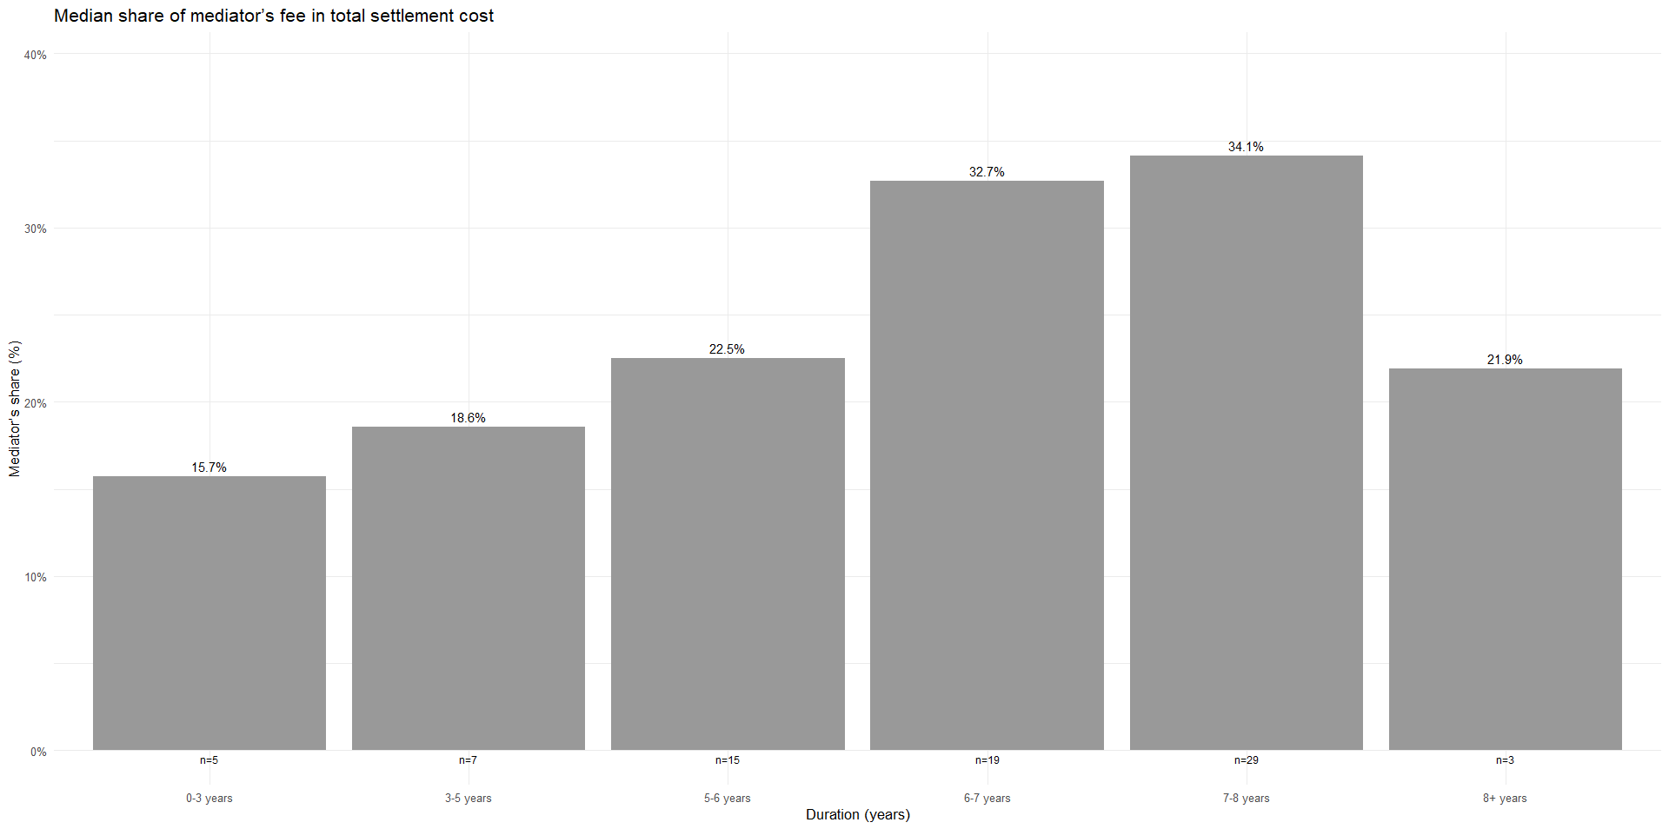
(iv) Efficiency
The mediator’s share in total distributions systematically increases with plan duration

Slide 17

(iv) Efficiency
Duration of procedure | Mean efficiency index | Median efficiency index | n
0–3 years | 4.17 | 5.36 | 5
3–5 years | 4.48 | 4.48 | 7
5–6 years | 3.43 | 3.44 | 15
6–7 years | 5.92 | 2.06 | 19
7–8 years | 2.82 | 1.93 | 29
8+ years | 2.76 | 3.56 | 3

Slide 18
(iv) Efficiency
less than 2 EUR flows to creditors for every euro spent on the procedure
Duration of procedure | Mean efficiency index | Median efficiency index | n
0–3 years | 4.17 | 5.36 | 5
3–5 years | 4.48 | 4.48 | 7
5–6 years | 3.43 | 3.44 | 15
6–7 years | 5.92 | 2.06 | 19
7–8 years | 2.82 | 1.93 | 29
8+ years | 2.76 | 3.56 | 3
the efficiency index declines systematically with longer plans

Slide 19

Shorter repayment plans are not only more successful in terms of recovery rates, but also more efficient
  Longer repayment plans not lead to higher recovery (regularly completed longer plans show systematically lower repayment rates)
  Efficiency declines with duration (growing share of resources is consumed by mediator costs, leaving less for creditors)
  Plan duration as proxy for the key real drivers of repayment, namely income and debt burden
Cost-effectiveness of very long repayment trajectories?

Slide 20
Policy implications
Belgium’s 7 maximum is increasingly hard to defend
Shorter, intensive repayment plans for debtors with strong repayment capacity
Quicker discharge for vulnerable debtors where repayment is unrealistic
Strong case for systematic data collection

