Slide 1
Nationalisation as a Response to Failing Public Service Providers: Challenges and Alternatives
Rebecca Parry and Hakan Sahin

Slide 2
Where an enterprise with public interest aspects e.g. energy, water, transport, gets into financial difficulties, there can be public demand for it to be nationalised.
This raises questions as to whether private entities should retain the privilege of profit accumulation during prosperous periods while the public bears the financial burden during crises.
Nationalisation may be an expensive option, however, and shareholders may consider it unfair – these aspects have become more evident in the UK in recent years.

Slide 3
Nationalisations
By 2000, over 1,400 cases of remunicipalisation and nationalisation have been documented across 58 countries, encompassing more than 2,400 cities:
  Stoko Kishimoto, Lania Steinfort & Olivier Petitjean, The Future is Public: Towards Democratic Ownership of Public Services, Transnational Institute, Amsterdam & Paris 2020. Available at https://www.tni.org/en/publication/the-future-is-public-democratic-ownership-of-public-services
  Some of these were where entities were distressed

Slide 4
Reasons for nationalisations
Service continuity, including in insolvencies
Addressing poor service
Ideologies
  Obsolescing bargains around natural resources

Slide 5
Alternatives to Nationalisations
Oscar Couwenberg and Stephen J Lubben, ‘Not a Bank, Not a SIFI; Still Too Big to Fail’ (2019) 35 Emory Bankr Dev J 53, using a case study method, identified that the normal approaches are:
  Ordinary insolvency procedures, with or without government funding
  Bailouts

Slide 6
Alternatives to Nationalisations
Special Administrations
  UK sectoral statutes that enable the appointment of an administration with modified objectives, public funding and an indemnity
  The state recovers the funding in priority
  Market-based solutions are preferred

Slide 7
The problem of bailouts
Moral hazard, see Rolef de Weijs, “Too Big to Fail as a Game of Chicken with the State: What Insolvency Law Theory Has to Say about TBTF and Vice Versa” (2013) 14(2) EBOLR 201

Slide 8
Brief Historical UK Overview
1970s-1980s: Major privatisations, mainly domestic ownership of public services
1990s-2000s: Increasing foreign acquisition of UK infrastructure
2008: Financial crisis nationalisations (still manageable due to ownership patterns)
2010s-2020s: Sovereign wealth fund investments, complex ownership structures
Present: Nationalisation is complicated by BITs and foreign ownership

Slide 9
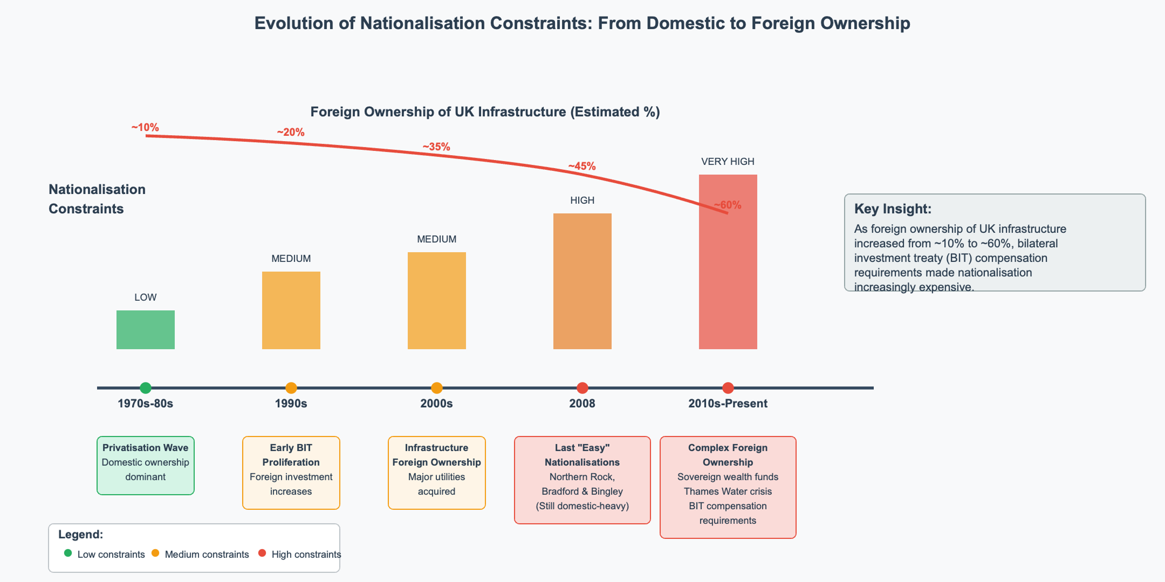

Slide 10
Railway Nationalisation
An easier process due to the context. Rail services operated on a contract basis and nationalisation of each service could be done when contract terms ran out:
  Passenger Railway Services (Public Ownership) Act 2024, .

Slide 11
Thames Water
Struggling even though it has 16 million customers who use its services every day.
Problems with maintenance of aged infrastructure.
Debt-free upon privatisation; progressively loaded with debt subsequently.

Slide 12
Thames Water
Interim step of a restructuring plan to gain finance to fund ongoing trading.
  Achieved using Companies Act 2006, s 26A restructuring plan – creditors vote in classes and the court must sanction. The court has cramdown powers.
  First instance – competing bids by Class A and Class B bondholders.

Slide 13
Thames Water
Restructuring plan cramdown requires consideration of whether the dissenting party would be ‘no worse off’ than under the relevant alternative.

Slide 14
Thames Water
Appeal – consideration of relevance of public interest considerations but these were not part of Part 26A.
Examination of special administration as the ‘relevant alternative’ – this was for the state to consider.

Slide 15
Process of nationalisation
E.g. formation of a holding company by Act of Parliament to acquire the undertaking of the entity that is to be nationalised
  Done in the UK for aerospace and shipbuilding etc. under the Aircraft and Shipbuilding Industries Act 1977

Slide 16
The problem of nationalisations
Expropriation of shares requires compensation. Under Bilateral Investment Treaties this may end up being not far short of market value.

Slide 17
Ownership of Thames Water
Shareholders | Shares (%) | Investment Year(s)
Ontario Municipal Employees Retirement System (OMERS) (Canada) | 31.777 | 2017-2018
Universities Superannuation Scheme (UK) | 19.711 | 2017, 2021
Infinity Investments SA (Abu Dhabi Investment Authority Subsidiary) | 9.900 | 2011
British Columbia Investment Management Corporation (BCI) (Canada) | 8.706 | 2006
Hermes GPE (Europe) | 8.699 | 2012
China Investment Corporation | 8.688 | 2012
Queensland Investment Corporation (Australia) | 5.352 | 2006
Aquila GP Inc. (Germany) | 4.995 | 2013
Stuching Pensioenfonds Zorg en Wilzihn (SPFZW) (Netherland) | 2.172 | 2006

Slide 18
Bilateral Investment Treaties (BITs)
Aims to promote and protect foreign investors’ investments by establishing legal standards for how host states must treat investors.
  A total of 2848 Bilateral Investment Treaties have been concluded since 1960s mostly between developed and developing countries across the globe.
  The UK has concluded 110 BITs, with mostly developing countries yet only 81 remain in force. Available at https://investmentpolicy.unctad.org/international-investment-agreements/countries/221/united-kingdom

Slide 19
Legal Requirements for Lawful Taking under BITs
To consider nationalisation as lawful, the state must fulfil specific requirements under international treaties:
  Public purpose/interest, non-discrimination, due process of law and prompt, adequate and effective compensation (the latter known as Hull Formula)

Slide 20
Elements of Hull Formula
Prompt: compensation must be paid without any delay.
Adequacy: payment of the full market value of the nationalised business.
Effective: the payment must be in a currency that is freely transferable and convertible currency.

Slide 21
Valuation Benchmarks of BITs
Most BITs specify valuation benchmarks by using terms such as “market value”, “fair market value”, ”fair value”, “real value’” ‘full value” or “genuine value” variations for nationalised or expropriated investment.
  In Simens V. Argentina, the tribunal interpreted the unqualified term ‘value’ in the relevant BIT as referring to ‘full market value’.

Slide 22
Valuation Benchmarks of The UK Model BIT
The UK BITs use ‘real value’, ‘full value’ or ‘genuine value’ variations for nationalised or expropriated assets meaning the ‘full market value’ of the investment.
  Article 5 of the UK-China BIT (1986): ‘such [prompt, adequate and effective] compensation shall amount to the real value of the investment expropriated….’

Slide 23
The UK BIT Compensation Standard to Thames Water’s Covered Shareholders
Shareholders of Thames Water who are nationals of states that have BITs with the UK, providing investor-state dispute settlement mechanisms, can initiate arbitration against the UK.
  Only Infinity Investments S.A and the China Investment Corporation have a treaty-based arbitration route-UK-UAE BIT Art. 8, and UK-China BIT Art 5.
  Both BITs treat company shares, stock and debentures as covered investments under Art. 1(a)(iii) of UK-UAE, and Art. 1(a)(iii) UK-China.

Slide 24
The UK BIT Compensation Standard to Thames Water’s Uncovered Shareholders
Investor’s nationality is pivotal both for accessing treaty protection against state measures and for establishing an arbitral tribunal’s jurisdiction over investment related disputes.
  What can an investor do if no investment treaty exists between their home country and the host state that grants consent to international arbitration?
  Investors cannot compel investor-state arbitration by relying on general international law. Once domestic remedies are exhausted, the ECHR may serve as a last resort.

Slide 25
Investors who don’t have BIT protection
There may be political demands that domestic shareholders such as institutional shareholders (e.g. UK pension funds) are not left without equivalent compensation.
Human rights arguments can be made for these and others who lack BIT protection.

Slide 26
Compensation for Expropriation under the ECHR
Property rights of investors are protected by the Article 1 of the Protocol No 1(A1P1) under the ECHR.
  The crux of this article is that states must guarantee peaceful enjoyment possession to both natural and legal persons irrespective of nationality.

Slide 27
Nationals vs. Non-nationals
Approach established in James and Others v United Kingdom (1986) and Lithgow and Others v United Kingdom (1986)
  Explained why compensation under Article 1 of Protocol No (A1P1) of ECHR can differ for nationals and non-nationals.
  Domestic investors in the company would have to bear greater loss and in the event of nationalisation, receive less compensation than non-nationals.

Slide 28
Does the Court's Approach Violate Art 14 of ECHR?
Differentiating nationals and non-nationals in the determination of the compensation, does not violate Article 14 of the Convention’s non-discrimination principle.
Non-nationals are more vulnerable to domestic law: They did not elect or help choose lawmakers. Had little say in law-making process.
Public interest takings may burden nationals more: Expropriation must serve public interest, but states may-within a margin of appreciation and subject to proportionality-legitimately require nationals to carry more burden than foreigners.

Slide 29
Suggested Roadmap for Nationalisation of Failing Public Service Providers
Development of an approach to BIT compensation that takes account of the entity’s unviability after alternative market-based approaches have been considered.
  Northern Rock example
  An independent valuer conducted a valuation and determined that shareholders of Northern Rock were entitled to “zero” compensation.

Slide 30
English Courts' Decisions
Litigation was brought by Northern Rock shareholders, Grainger v United Kingdom (2012).
  Ruled that the government’s 'decision to take the company into public ownership was a strategic exercise of government policy intended to preserve for the sake of the national economy the benefits of the LOLR (Lender of Last Resort) operation at the least possible cost to the taxpayer.'

Slide 31
ECtHR's Decision
Dismissed the claims and held the UK owed no compensation to Norther Rock shareholders under Article 1 of Protocol No 1.
  Applied “wide margin appreciation” : To stabilise the economy, deter moral hazard and protect taxpayers and gave the UK broad leeway.
  Deference to national judgement: National authorities are better placed to judge the public interest on social and economic grounds, and the Court will respect the legislature’s policy choices unless manifestly without reasonable foundation.

Slide 32
Shareholder Standing under ECHR
Under the ECHR, standing is strict, and shareholders rarely qualify as “victims” under Article 34.
  Shareholders in Thames Water who are not beneficiaries of applicable BITs or trade agreements, would be unlikely to have any standing in Court in their own right.
  Shareholder applications are admissible only in exceptional circumstances( e.g., direct and personal rights are affected- See Agrotexim v. Greece (1996). In the absence of such an exception, the natural applicant would be Thames Water itself.

