Slide 1
Arbitration Agreements in Bankruptcy and other Insolvency Cases
Stephen J. Ware
Frank Edwards Tyler
Distinguished Professor of Law
University of Kansas
ware@ku.edu
+1 785 864 9209

Slide 2
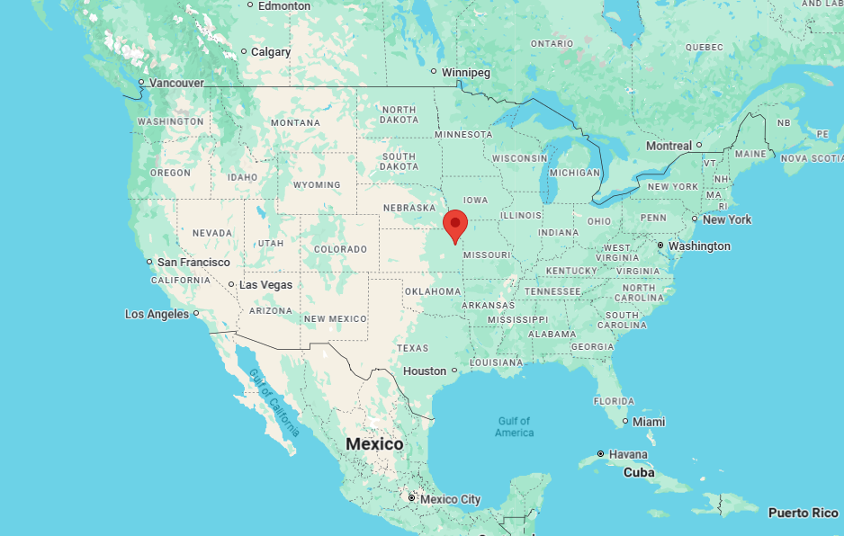
I traveled from the University of Kansas.
Where is the University of Kansas?

Slide 3

I traveled from the University of Kansas.
Where is Kansas?
Halfway between New York and San Franciso.

Slide 4
Arbitration Agreements in Bankruptcy and other Insolvency Cases
Stephen J. Ware
Frank Edwards Tyler
Distinguished Professor of Law
University of Kansas
I think I am the only law professor in the US who regularly teaches and writes on both arbitration and bankruptcy (insolvency)

Slide 5

Tension between
Arbitration law’s separation of related disputes into different forums for adjudication
and
Insolvency law’s need for collective action involving several creditors of the same debtor
Insolvency

Slide 6
Convention on the Recognition and Enforcement of Foreign Arbitral Awards (NY Convention)
173 Contracting States.
Requires States to enforce arbitration agreements and arbitration awards (arbitrators’ decisions),
But only “concerning a subject matter capable of settlement by arbitration.”
So, a State is not obligated to enforce an arbitration agreement or award concerning matters that State’s lawmakers have declared nonarbitrable.

Slide 7
Domestic Arbitration Law
Generally, around the developed world, courts enforce:
arbitration agreements, and
arbitrators’ decisions (arbitration awards) (“awards”).
Exceptions vary from nation to nation.
Most or all nations except some or all bankruptcy & other insolvency matters, from courts’ enforcement of arbitration agreements and awards.

Slide 8
Why except some insolvency matters from arbitration?
Tension between
Arbitration law’s separation of related disputes into different forums for adjudication, and
Insolvency law’s need for collective action involving several creditors of the same debtor
Insolvency

Slide 9
General compromise on arbitrability of Bankruptcy and other Insolvency Matters
Core Insolvency Functions Nonarbitrable
Most jurisdictions hold that “core” bankruptcy and insolvency functions are non-arbitrable. These include starting, administering, and winding-up insolvency proceedings, such as liquidating an insolvent company, rescheduling its debts, operating in receivership or administration, and distributing payments to creditors.
Maybe Arbitrate Disputes that Merely Involve the Insolvent Debtor
States differ on the arbitrability of disputes merely involving a company in bankruptcy or other insolvency proceedings. For example, claims against or by the insolvent debtor.
Insolvency

Slide 10
Choice-of-law analysis may be needed when
the seat of arbitration
differs from
the jurisdiction of the insolvency case.
Arbitration law says law of the seat governs non-arbitrability.
So, an arbitration award may be enforced at the seat and some other jurisdictions, even when not enforced in jurisdiction of the insolvency case.

Slide 11
Why except some insolvency matters from arbitration?
Tension between
Arbitration law’s separation of related disputes into different forums for adjudication, and
Insolvency law’s need for collective action involving several creditors of the same debtor
Insolvency

Slide 12
Corporate Insolvency Law
Reduces Collective Action Problems from Race of Creditors
Corporate Insolvency Law:
Pauses race of creditors to collect
Supervises insolvent debtor’s property to maintain value
Restructure or liquidate in orderly manner
Distribute to creditors by priority, not race

Slide 13
Corporate Insolvency Law
Reduces Collective Action Problems
This view of insolvency law may lead to a reluctance to enforce arbitration agreements between the debtor and one of its creditors because this view of insolvency worries that arbitration may privilege the arbitrating creditor at the expense of other creditors and the goal (especially in restructuring) of cooperating with the debtor and its other creditors to maximize value for creditors as a whole.

Slide 14
Corporate Insolvency Law
Reduces Collective Action Problems
US insolvency scholars Anthony Casey & Joshua Macey warn that “Resolving some claims in arbitration could allow [arbitrating] creditors to jump the line and receive property that would otherwise go to secured creditors or creditors with a priority claim.”

Slide 15
“Resolving some claims in arbitration could allow [arbitrating] creditors to jump the line and receive property that would otherwise go to secured creditors or creditors with a priority claim.”
But:
“Resolving” a creditor’s claim ≠ allowing that creditor “to jump the line and receive property that would otherwise go to” other creditors.
Arbitrating a claim to award the creditor $X (or € or £ etc.) ≠ enforcing that award against property of the debtor.
Insolvency law can permit arbitration to determine the allowed amount of claim, resulting in an award, while pausing enforcement of that award.

Slide 16




Concerns about Arbitration of Claims v. Debtor in Insolvency
Privacy Concerns
Arbitration hearings are typically private, preventing other creditors from attending or contesting claims. This contrasts with insolvency law, which may give all creditors the right to contest each other’s claims.
Solution
Court-Ordered Conditions
Insolvency courts can address concerns by conditioning orders for arbitration on:
(1) granting appearance rights to other parties in interest,
(2) setting strict timetables, and
(3) capping arbitration fees.
By so conditioning arbitration, courts can reconcile arbitration and insolvency law.
Speed Concerns
While arbitration is typically faster than ordinary litigation, insolvency cases can be even faster. Restructuring may need quick confirmation of plans to preserve going concern value.
Cost Concerns
Courts receive government subsidies, while arbitration parties must pay arbitrator fees, administrative costs, and venue expenses. This creates additional financial burden on the insolvent debtor or administrator.
This Photo by Unknown Author is licensed under CC BY-NC

Slide 17

Reconciling Arbitration and Insolvency Law
Insolvency law can reconcile with arbitration of a claim by distinguishing between determining the allowed amount of a claim and enforcing it. Arbitration can determine the allowed amount of a claim, resulting in an award, while insolvency law pauses enforcement to prevent line-jumping by arbitrating creditors.
Stay arbitration
Until court overseeing insolvency orders it to proceed
Condition arbitration
Court can require assurances about privacy, speed, and cost
Review award
Court can vacate (“set aside” or annul) award under arbitration law’s usual grounds for vacatur
Control enforcement
Only insolvency court can confirm or enforce award
Delay payment
Until other creditors’ claims are determined
Equal treatment
Treat confirmed award like any other determined claim

Slide 18
One Remaining (Irresolvable?) Concern:
Will the arbitrator be more likely to rule for Creditor than would the judge overseeing the insolvency case?

Slide 19
Two reasons why US may more than Europe resolve this tension against arbitration:
Tension between
Arbitration law’s separation of related disputes into different forums for adjudication, and
Insolvency law’s need for collective action involving several creditors of the same debtor
Insolvency

Slide 20
Two reasons why US may more than Europe resolve this tension against arbitration:
1. Corporate insolvency law’s role in overcoming “race of creditors” dominates in US, and
2. Upon commencement of bankruptcy (insolvency) case, US law creates new legal person (the bankruptcy estate) separate from the debtor. This separateness encourages US courts to see the pre-bankruptcy debtor’s arbitration agreements as contracts that do not bind the bankruptcy estate because it is not a party to them.
Insolvency

Slide 21
Debtor
Bankruptcy/Insolvency Estate
property
$
arb
arb
$
$
Creditor A
claims
Creditor
B
Creditor
C

Slide 22
Arbitration Agreements in Bankruptcy and other Insolvency Cases
Stephen J. Ware
Frank Edwards Tyler
Distinguished Professor of Law
University of Kansas
ware@ku.edu
+1 785 864 9209

