Slide 1
Thanks to all our 2025 Annual Congress Sponsors

Slide 2


Vienna Congress Website
General Information
Programme & Slides

Slide 3




Technical Session Sponsors

Slide 4
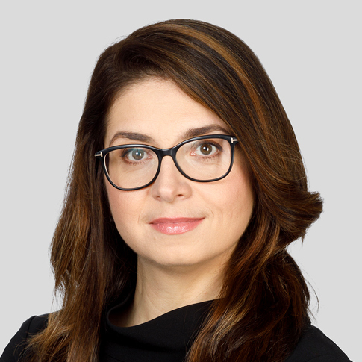
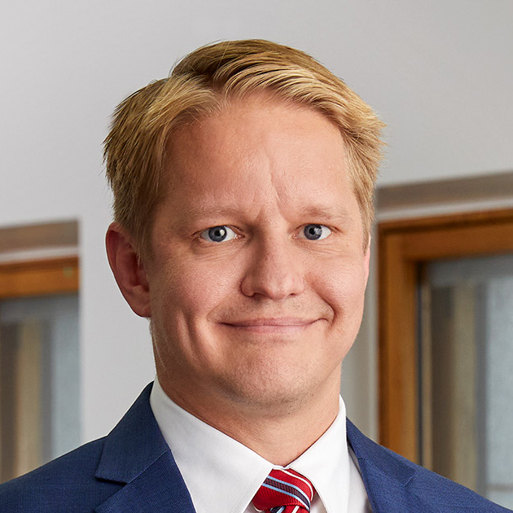
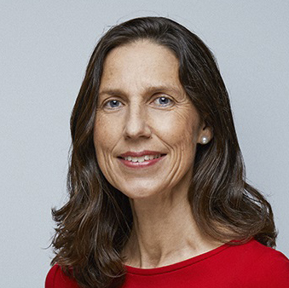
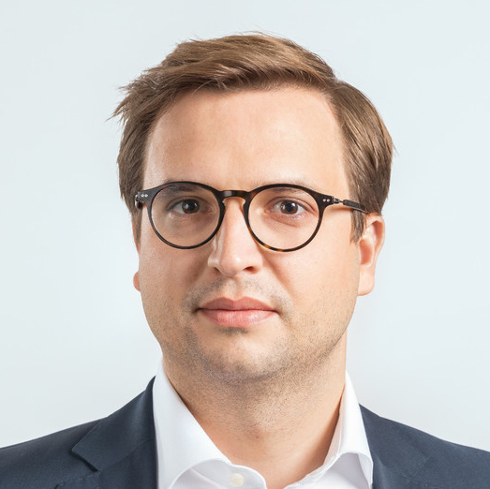
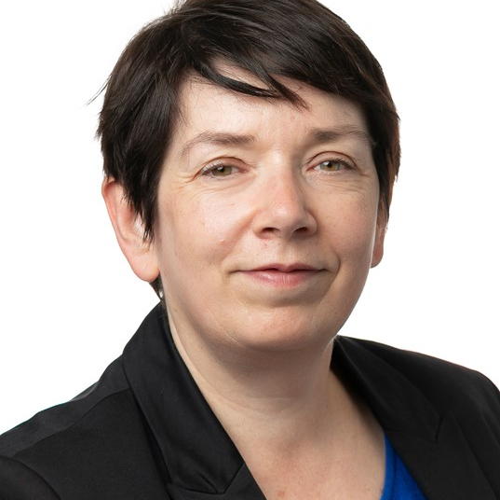
Opening remarks of the Annual Congress
Joint Facilitators, President and Technical Committee Co-Chairs
Klaudia Frątczak-Kospin
Westminster Polska, Poland / INSOL Europe YMG Co-Chair
Robert Peldán
BORENIUS ATTORNEYS, Finland / Past INSOL Europe YMG Co-Chair
Alice van der Schee
Van Benthem & Keulen, The Netherlands /
INSOL Europe President
Matthias Prior
Abel Rechtsanwälte, Austria / INSOL Europe Council member & Country Coordinator
Christel Dumont
Dentons, Luxembourg / INSOL Europe Council member & Country Coordinator

Slide 5

Keynote Speaker:
Christopher Pratt
Professional Skipper,
France

Slide 6
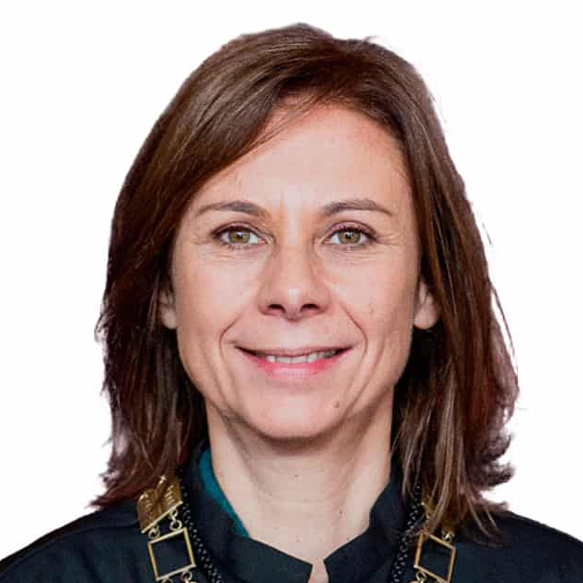
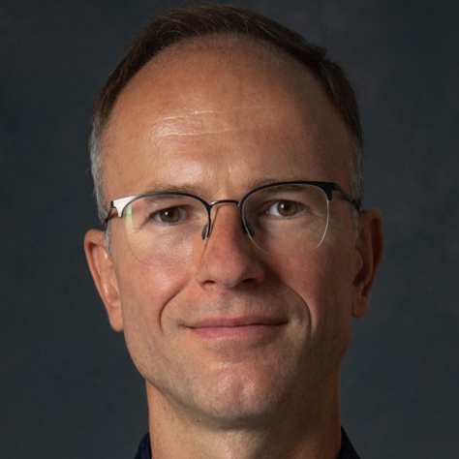
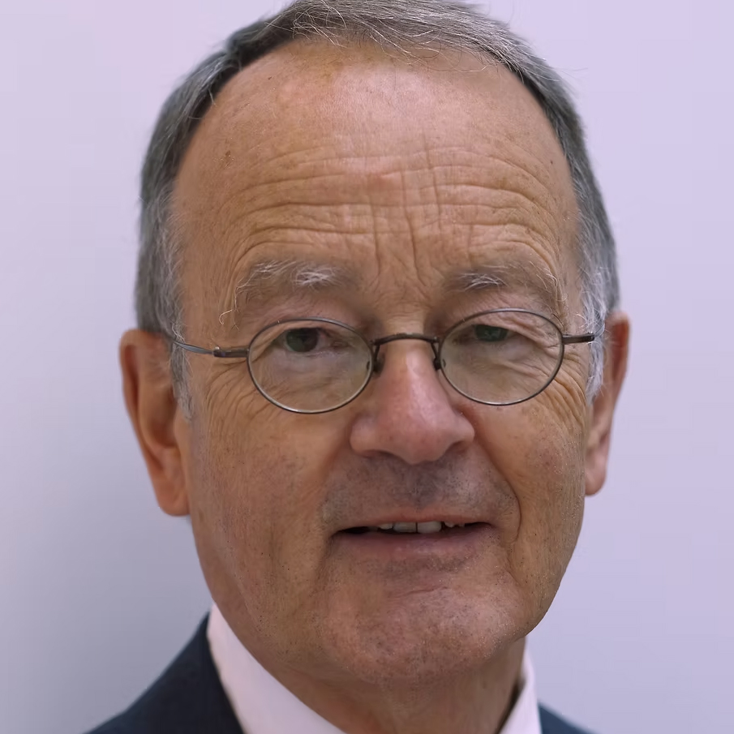
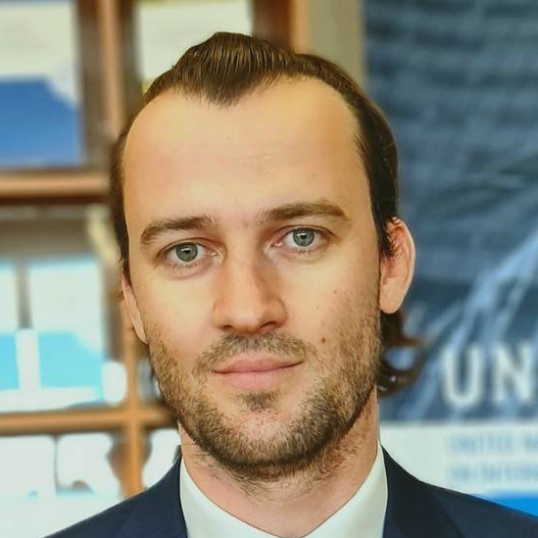
Happy 10th Anniversary Recast EIR!
Panel leader:
Judge Catarina Serra
Supreme Court / University of Minho, Portugal
Advocate General Rimvydas Norkus
European Court of Justice
Em. Prof. Reinhard Bork
University of Hamburg, Germany / INSOL Europe EIR Case Register Chair
Benjamin Herisset
UNCITRAL

Slide 7
Coffee Break
Kindly Sponsored By

Slide 8
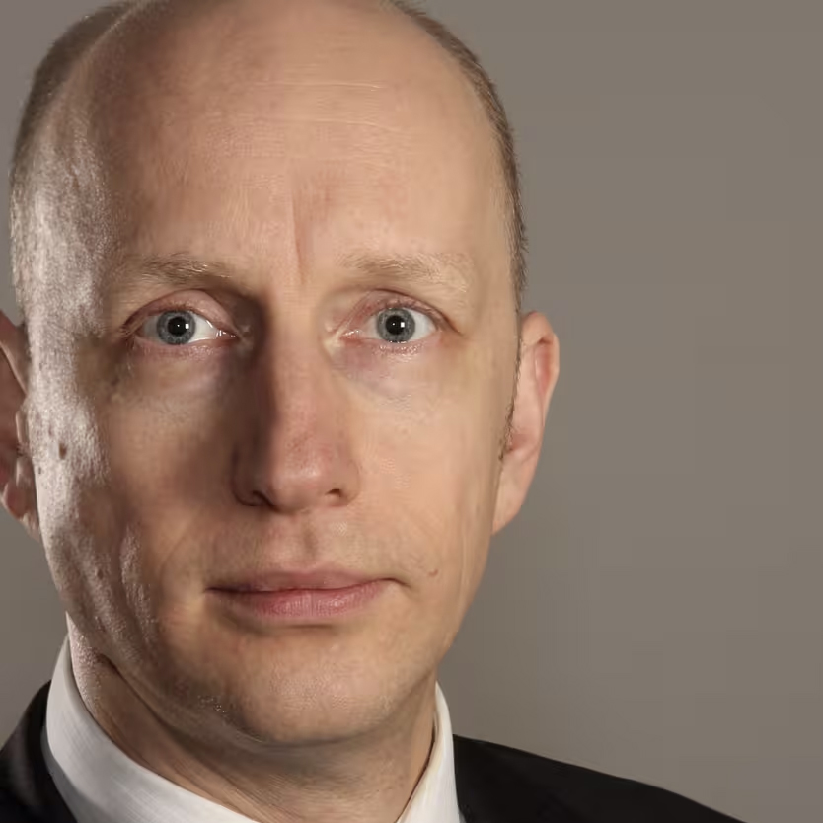
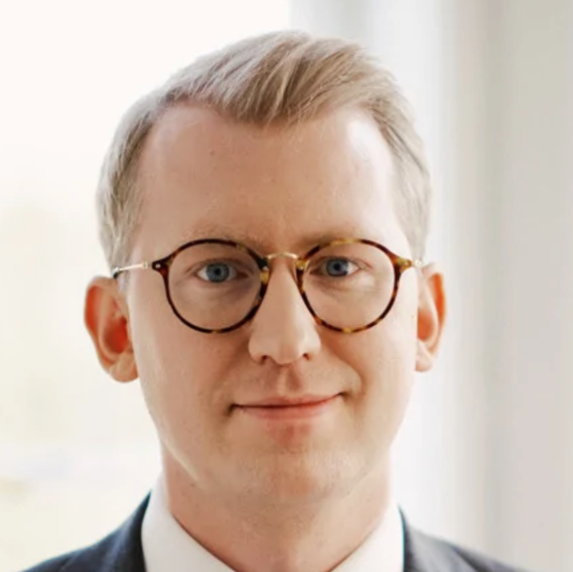
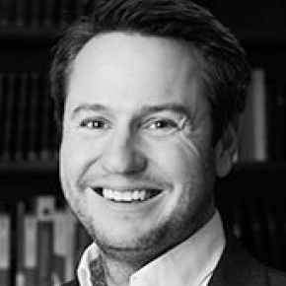
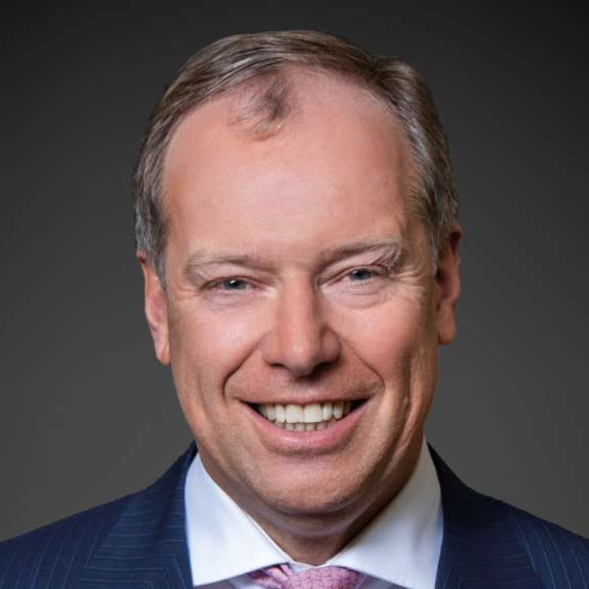
Between Brick and Debt: Restructuring Strategies for Real Estate Companies in a Downturn
Panel leader:
Matthias Prior
Abel Rechtsanwälte, Austria / INSOL Europe Council member & Country Coordinator
Christian Bärenz
GÖRG Rechtsanwälte, Germany
Patrick Gensbichler
Abel Rechtsanwälte, Austria
Max Mailliet
E2M,
Luxembourg
Markus Fellner
Fellner Wratzfeld
& Partner,
Austria

Slide 9
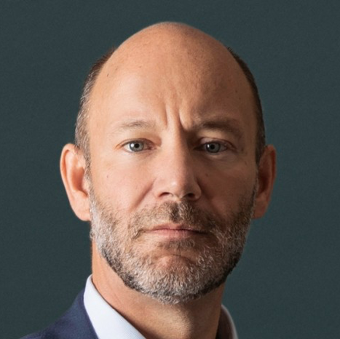
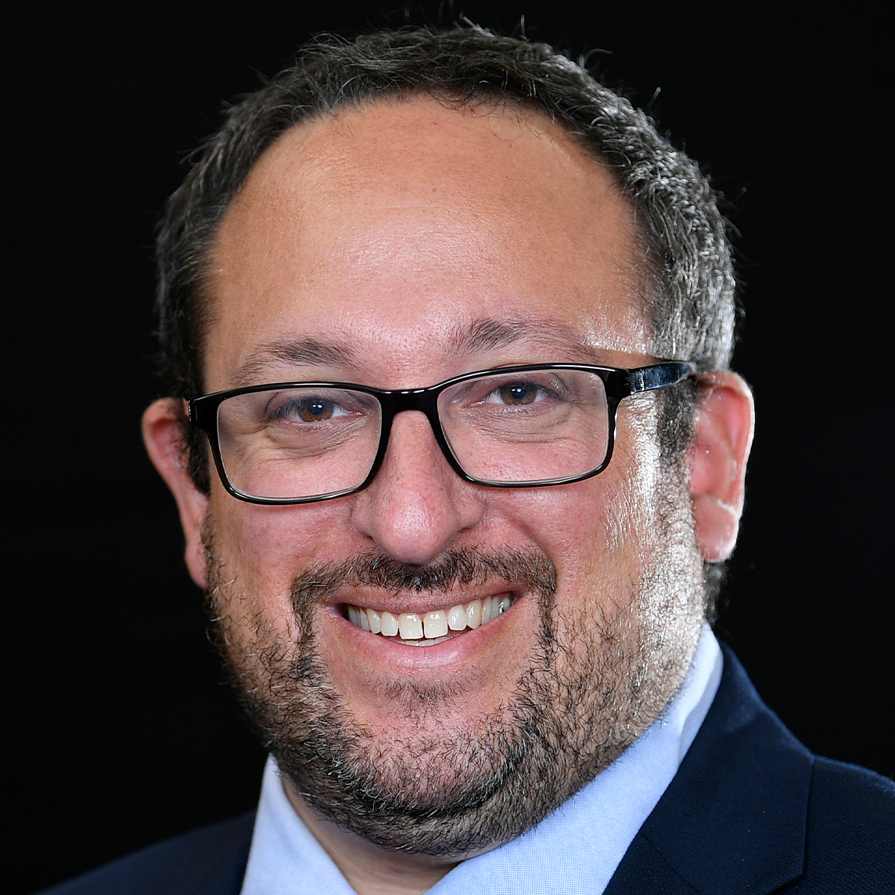
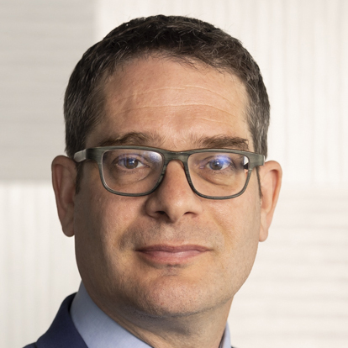
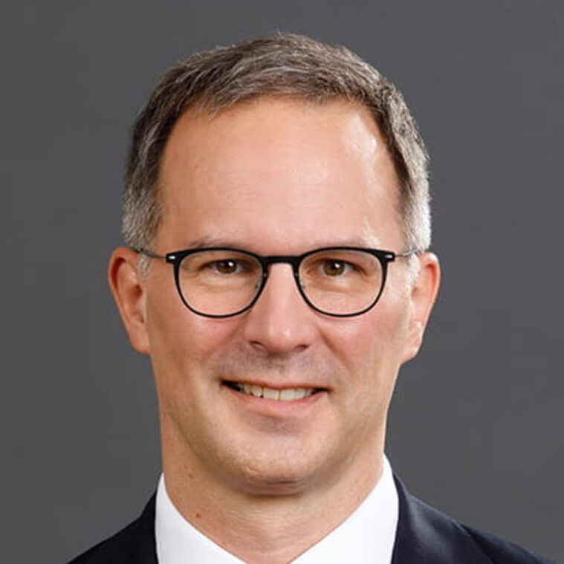
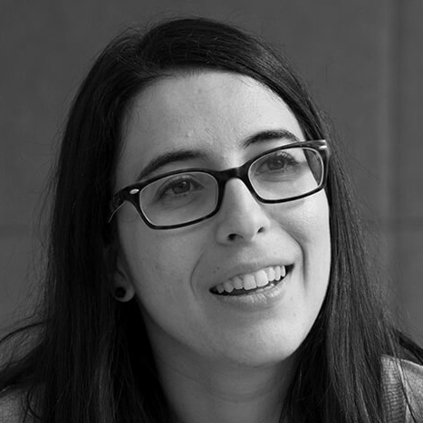
Shareholders Rights in Restructurings
Panel leader:
Joaquim Shearman
de Macedo
PLMJ, Portugal
Ian Benjamin
Stephenson Harwood, UK / INSOL Europe Council member
Lukas Bopp
Kellerhals Carrard Basel, Switzerland / INSOL Europe Council member
Florian Bruder
DLA Piper,
Germany
Laura Ruiz
Pérez-LLorca Abogados, Spain

Slide 10
Battle of the Break-out Sessions!
BoS I. Financiers’ Trends to Watch – Room Park Suite 7
Bos II. Failure to Prevent! – Room Park Suite 8
BoS III. Valuation in Restructuring – Grand Park Hall
BoS IV. Parallel Proceedings – Room Park Suite 9

Slide 11

Delegate Lunch
Kindly Sponsored By

Slide 12
Break-out Sessions

Slide 13
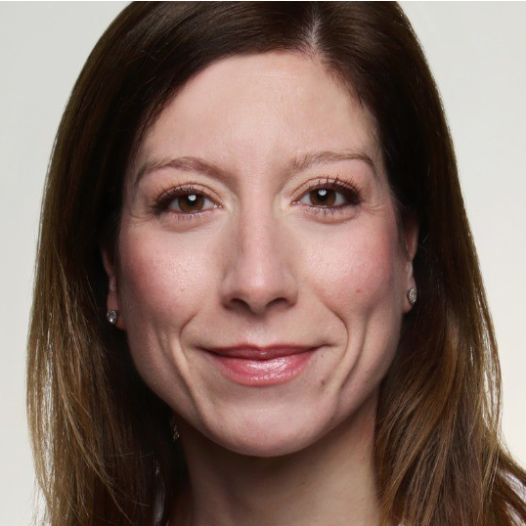
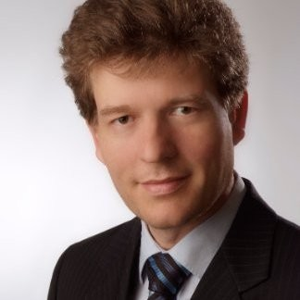
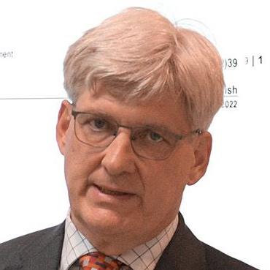

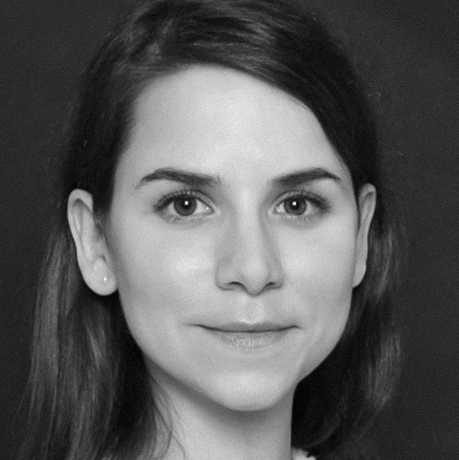

Breakout Session I. Financiers’ Trends to Watch
Panel leader:
Flavia Pezzetta
NATIXIS Bank,
France / INSOL
Europe Financiers Group Co-Chair
Panel leader:
Florian Joseph
Helaba Landesbank Hessen-Thüringen, Germany / INSOL Europe Financiers Group Co-Chair
Johan Jol
ABN AMRO Bank,
The Netherlands
Philip Janis
European Investment Bank
Catherine Marchal-Gralitzer
Pristine, France
Dana Dulciu Raiffeisen Bank International, Austria

Slide 14


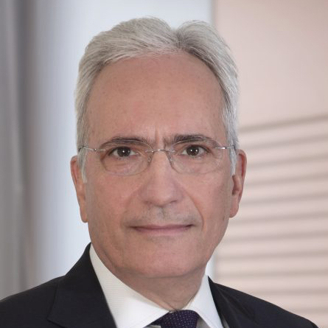
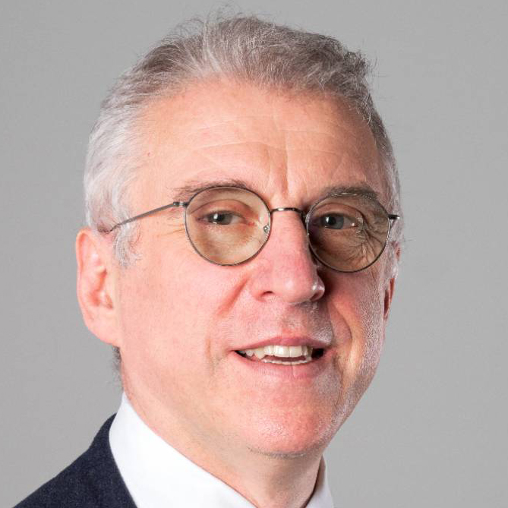
Breakout Session II.
﻿Anti-Fraud Forum: Failure to Prevent
Panel leader:
Bart Heynickx
ALTIUS, Belgium /
INSOL Europe Anti-Fraud Forum Co-Chair
Louise Brittain
Azets, UK
Konstantinos S. Issaias
Kyriakides Georgopoulos Law Firm, Greece
Giorgio Corno
SCAI Legal, Italy

Slide 15
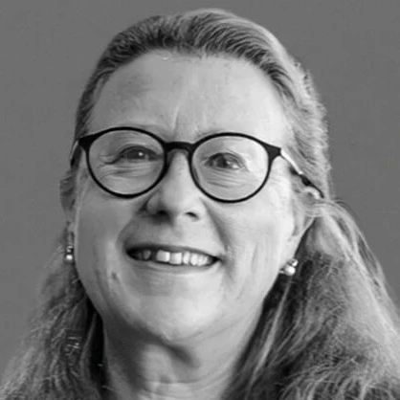
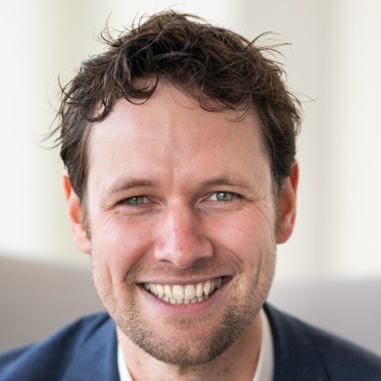
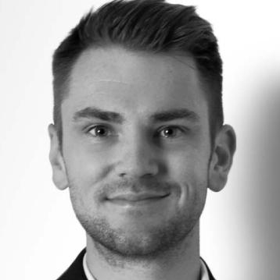

Breakout Session III.
﻿Valuation in Restructuring
Fedra Valencia
Cuatrecasas, Spain /
INSOL Europe Council member
Koos Beke
PwC, The Netherlands
Friedrich Andreae
Attestor, UK
Judge Flavius Motu
Cluj Specialized Court, Romania

Slide 16
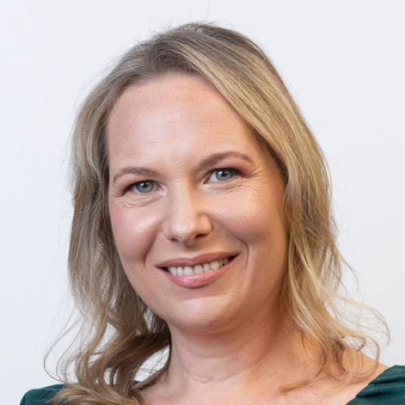
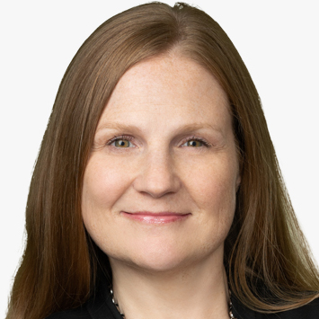
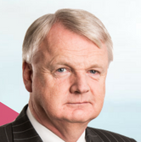
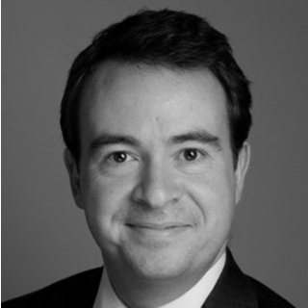
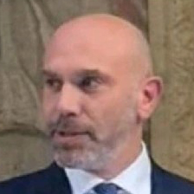
Breakout Session IV. Parallel Proceedings:
The Restructuring Double Act
Panel leader:
Kat Burke
Maples, Ireland
Stacey Lutkus
McDermott Will
& Schulte, US
Judge Michael Quinn
The High Court, Ireland / INSOL Europe Judicial
Wing Co-Chair
Garret Byrne
The Bar of Ireland, Ireland
Carlo Ghia
Ministry for Enterprises and Made in Italy, Italy

Slide 17

Coffee Break
Kindly Sponsored By

Slide 18
Technical Session Sponsors

Slide 19
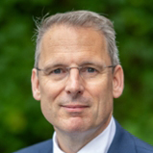
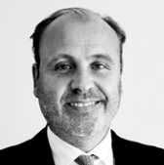
﻿ INSOL Europe Workout Game
Let’s rescue the Utopia Hotel-Casino Group. Or not…?
Prof. Jan Adriaanse
Leiden University,
The Netherlands
Prof. Marc Broekema
University of Groningen, The Netherlands

Slide 20
Closing remarks of the day by the Facilitator
Klaudia Frątczak-Kospin
Westminster Polska, Poland / INSOL Europe YMG Co-Chair

Slide 21
Thanks to all our 2025 Annual Congress Sponsors

Slide 22


5km run
Saturday 11 October
Meet outside lobby @ 07:20am!
Kindly Sponsored by

Slide 23

Young Members’ Group Reception
Kindly Sponsored By

