Slide 1
Thanks to all our 2025 Annual Congress Sponsors

Slide 2
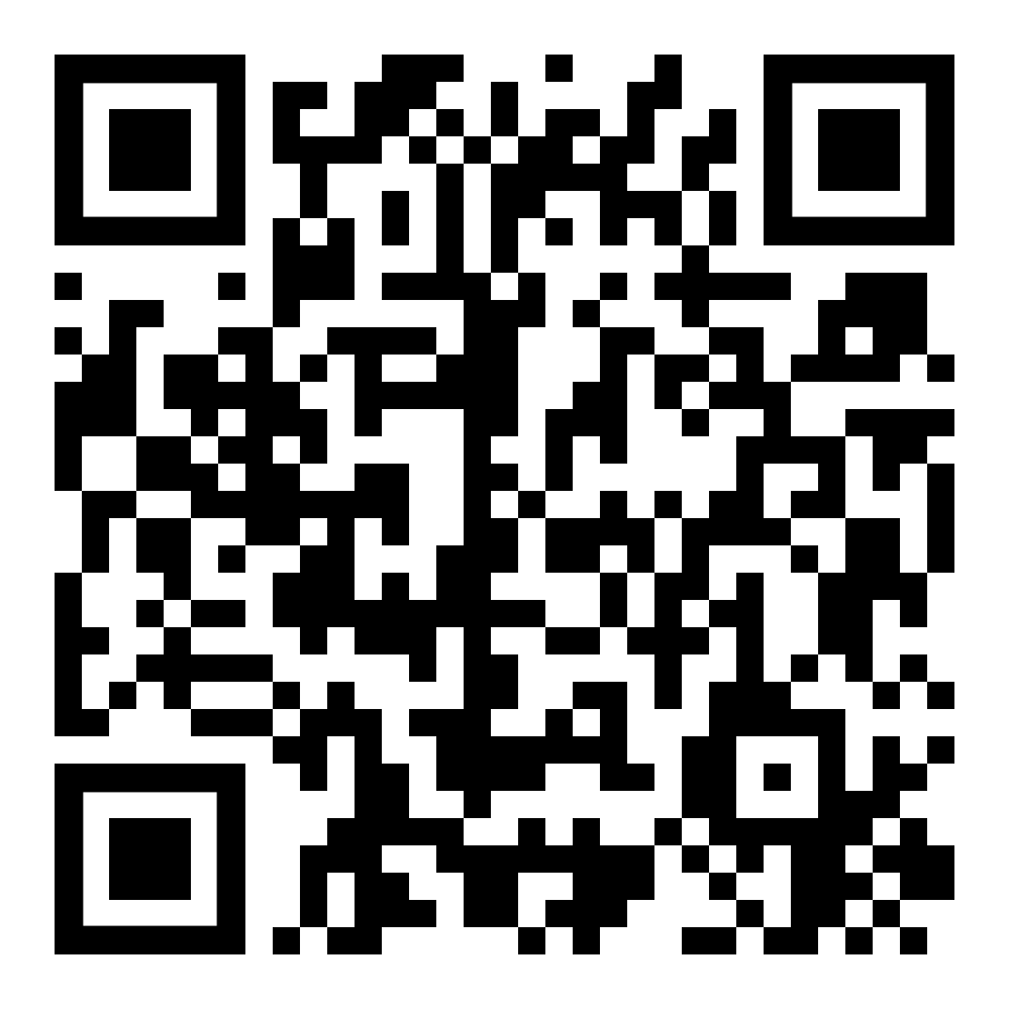
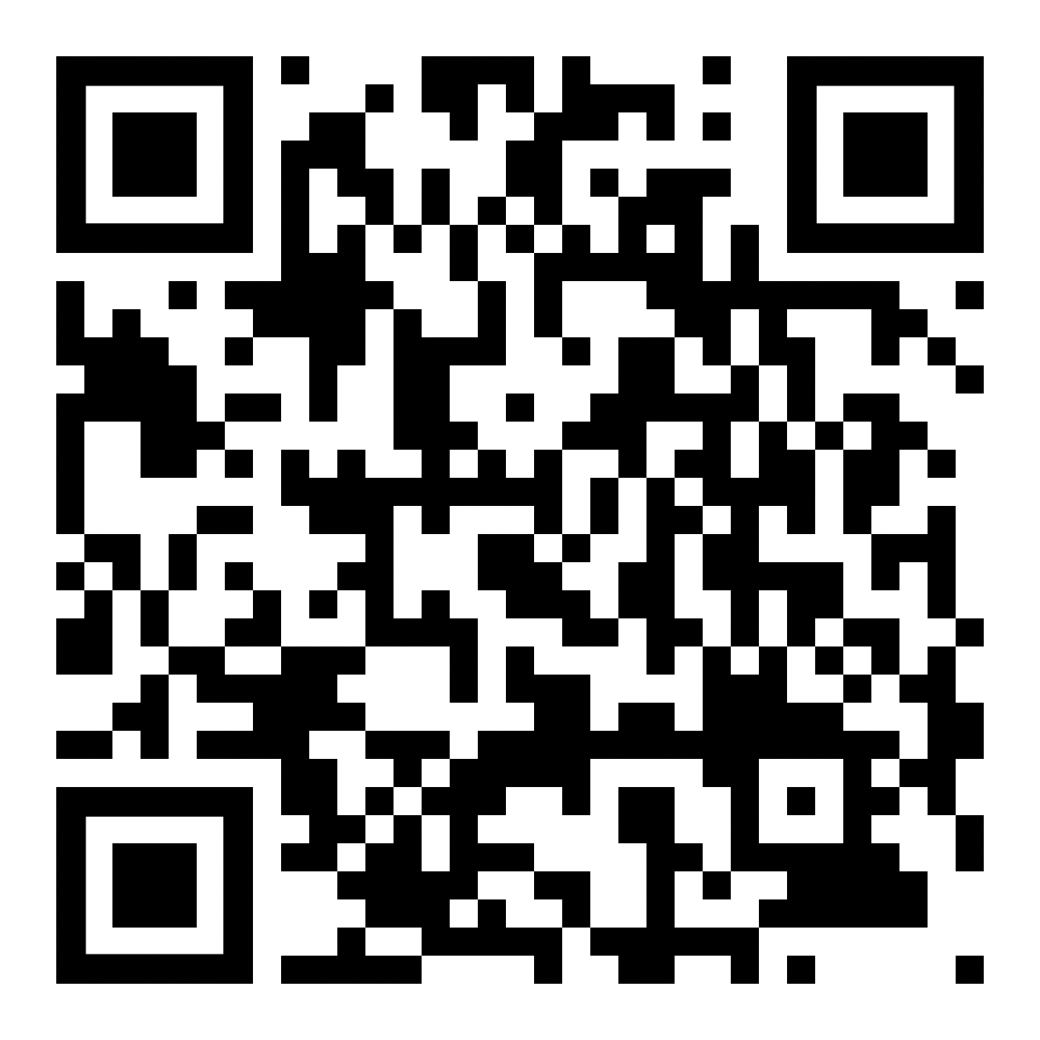
Vienna Congress Website
General Information
Programme & Slides

Slide 3




Technical Session Sponsors

Slide 4

Opening remarks of the day
Klaudia Frątczak-Kospin
Westminster Polska, Poland / INSOL Europe YMG Co-Chair

Slide 5
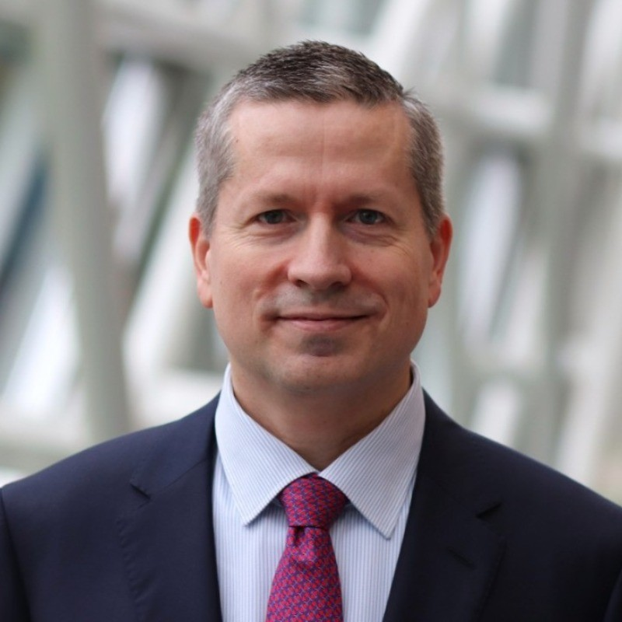
Keynote Interview:
AI and Corporate Insolvency Law
Professor Felix Steffek
University of Cambridge, UK by Christel Dumont
Dentons, Luxembourg / INSOL Europe Council member & Country Coordinator

Slide 6
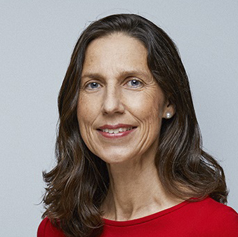
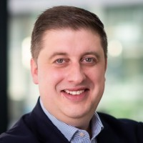
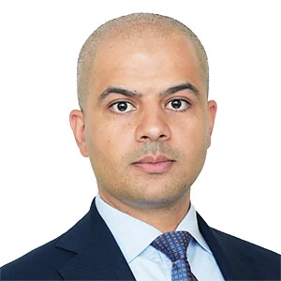
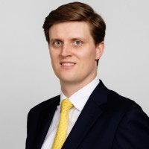
﻿ Game of Loans
Liability Management Exercises (LMEs)
Alice van der Schee
Van Benthem & Keulen
The Netherlands
INSOL Europe President
Ian Partridge
AlixPartners
UK
Prof. Omar Salah
Norton Rose Fulbright
Tilburg University
The Netherlands
James Simpson
Lazard
UK

Slide 7
﻿
﻿ Game of Loans
Liability Management Exercises (LMEs)
Poll
1. Are you familiar with LMEs?
2. Are you involved in LMEs?
Notes:
Alice will start with a poll to the audience.

Slide 8
﻿
﻿ Game of Loans
Liability Management Exercises (LMEs)
What are Liability Management Exercises/Transactions?
Notes:
Alice will ask James (who worked in the US) what are Liability Management Exercises/Transactions.

Slide 9
﻿
﻿ Game of Loans
Liability Management Exercises (LMEs)
What types of LMEs are available?
Notes:
James will then present the types of LMEs are available (James will add diagrams).

Slide 10
﻿ Game of Loans
Liability Management Exercises (LMEs)
﻿
Non-Guarantor or Unencumbered Asset Financings
Vanilla Uptier Using Existing Baskets
Borrower
Capital Structure
 | Face Value | Adj. | PF Value | Current Leverage | PF Leverage
ABL Facility | -- | -- | -- | -- | --
Term Loan | 1,200 | -- | 1,200 | 6.0x | 6.0x
New Second Lien Notes | -- | 400 | 400 | -- | 2.0x
Total Secured Debt | $1,200 | $400 | $1,600 | 6.0x | 8.0x
Unsecured Debt | 1,000 | (600) | 400 | 5.0x | 2.0x
Total Debt | $2,200 | ($200) | $2,000 | 11.0x | 10.0x
Memo:
Illustrative LTM EBITDA | $200
Credit Facility
1
2
Guarantor
Non-Guarantor
New Structurally Senior Debt
Discount to company / residual stakeholders
Notes:
James will then present the types of LMEs are available (James will add diagrams).

Slide 11
﻿ Game of Loans
Liability Management Exercises (LMEs)
﻿
The Drop Down
Borrower
1
Asset Transfer or
Designation as Unrestricted Subsidiary
Credit Facility
Unrestricted
Subsidiary
Guarantor Restricted Subsidiaries
Restricted Group
New Debt
Notes:
James will then present the types of LMEs are available (James will add diagrams).

Slide 12
﻿ Game of Loans
Liability Management Exercises (LMEs)
﻿
Pari Plus
Double Dip
Restricted Group
Restricted Group
2
Guarantee
3
2
Secured Intercompany Loan
Secured Intercompany Loan
New Secured Notes
1
NewCo
(No Assets)
New Secured Notes
1
NewCo
(Assets)
4
Pledged as collateral
3
Pledged as collateral
Notes:
James will then present the types of LMEs are available (James will add diagrams).

Slide 13



R3 & INSOL Europe
Joint International Restructuring Conference
3 July 2025, London
﻿ Game of Loans
Liability Management Exercises (LMEs)
﻿
Super Priority Uptier
Existing
Lenders
Borrower
Participating Lenders
(bought out of existing debt and buy into new debt)
Borrower
Super-Priority
Credit Facility
Credit Facility
Non-Participating
Lenders
(get left behind and contractually subordinated)
Credit Facility
Notes:
James will then present the types of LMEs are available (James will add diagrams).

Slide 14
﻿
﻿ Game of Loans
Liability Management Exercises (LMEs)
What makes LMEs attractive?
Notes:
Alice will ask James (from investment banker point of view), Ian (from IP point of view) and Omar (from lawyer point of view) what makes LMEs attractive.
Alice will add her comments.

Slide 15
﻿
﻿ Game of Loans
Liability Management Exercises (LMEs)
Why are LMEs criticised?
Notes:
Alice will ask James (from investment banker point of view), Ian (from IP point of view) and Omar (from lawyer point of view) why are LMEs criticised.
Alice will add her comments.

Slide 16
﻿
﻿ Game of Loans
Liability Management Exercises (LMEs)
Why are LMEs relevant in Europe?
Notes:
Alice will ask Ian why are LMEs relevant in Europe, especially for our industry.
Omar will present the cases in Europe.

Slide 17
﻿
﻿ Game of Loans
Liability Management Exercises (LMEs)
LMEs Challenge Risks
Notes:
Alice will ask James (from investment banker point of view), Ian (from UK IP point of view) and Omar (from Dutch lawyer point of view) what are the LMEs challenge risks.
Alice will add her views as a Dutch IP and conclude.
➔ breach of contracts, abuse of rights, breach of directors’ duties, restructuring & insolvency law claims (e.g. avoidance actions), applicable law issues, …

Slide 18
Coffee Break
Kindly Sponsored By

Slide 19
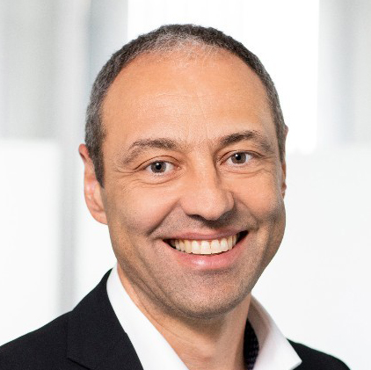
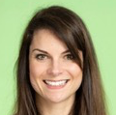
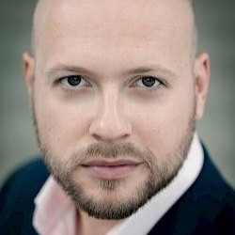
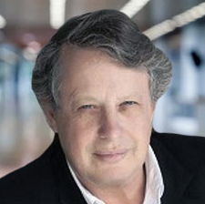
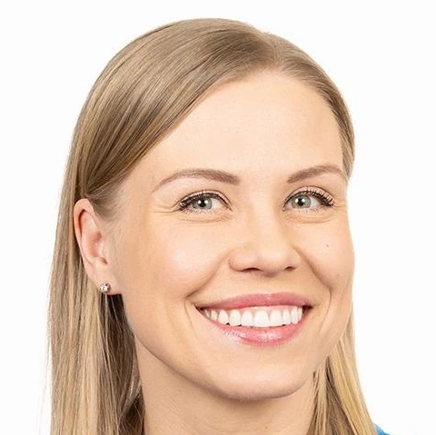
Stigma of Insolvency
Karl-Heinz Götze
Kreditschutzverband von 1870, Austria
Emilie Ghio
University of Edinburgh, UK
Donald Thomson
Thorntons Law / University of Dundee, UK
Nuno Lobo Antunes
Partners in Neuroscience, Portugal
Noora Fagerström
Entrepreneur and Politician, Finland

Slide 20
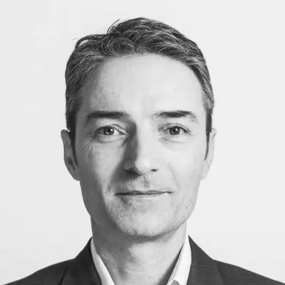
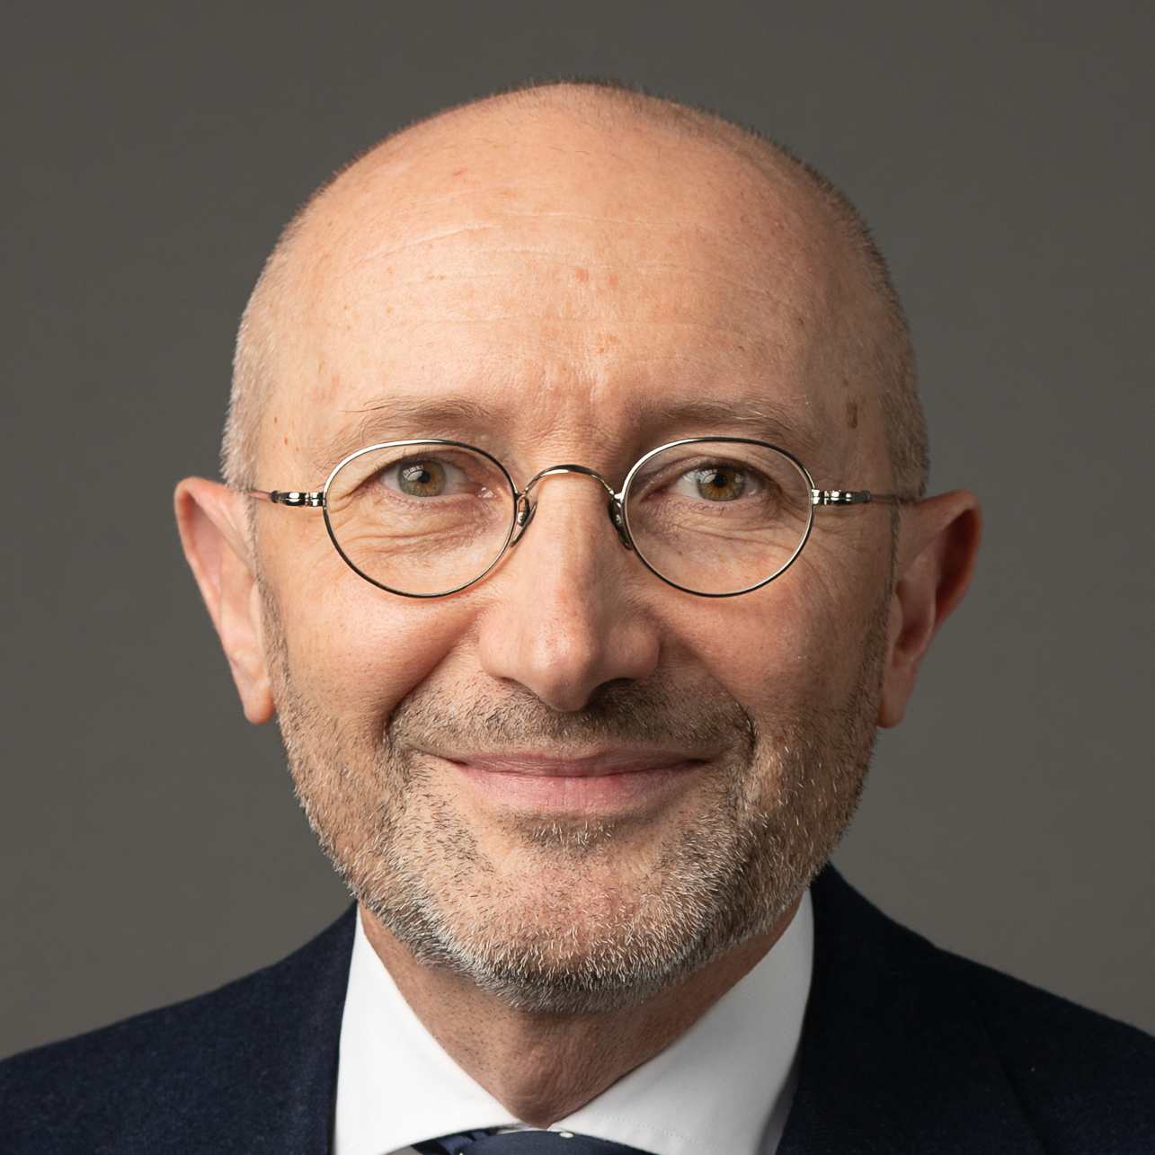
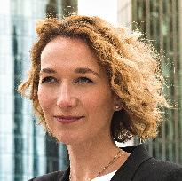
Grand Prix d’Harmonisation
Robert Hänel
Anchor, Germany /
INSOL Europe TRIP
Group Co-Chair
Christophe Thevenot
Thevenot Partners,
France / INSOL Europe
TRIP Group Co-Chair
Sabine Vorwerk
Linklaters,
Germany

Slide 21
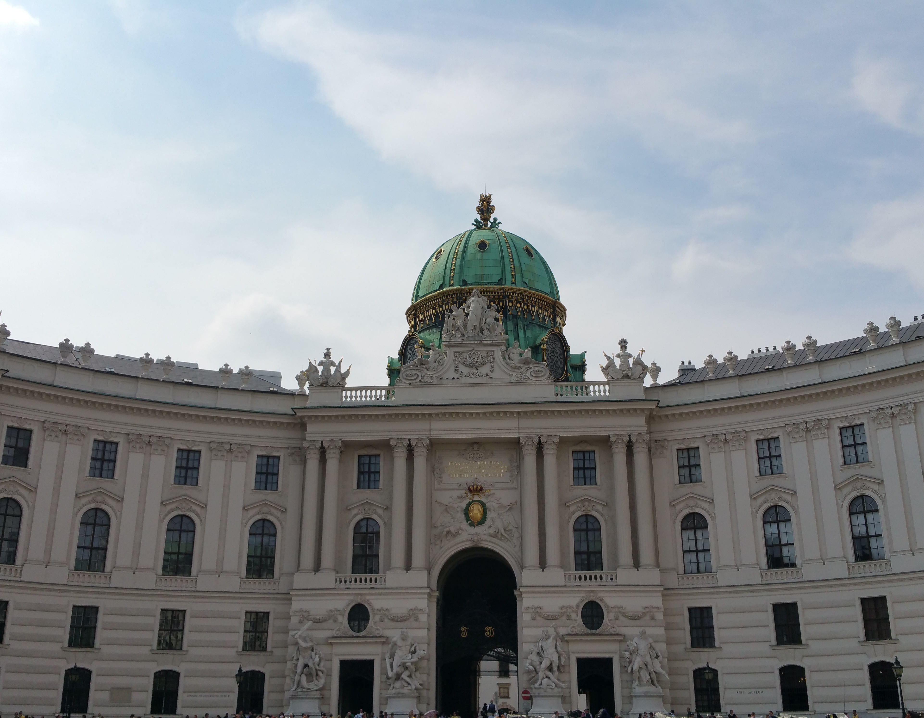
INSOL Europe Annual Congress
Grand Prix d’Harmonisation
Dr. Sabine Vorwerk
11 October 2025

Slide 22
1
The Ballad of Europe’s Common Cause –
a Harmonised Insolvency Path

Slide 23
The Ballad of Europe’s Common Cause - a Harmonised Insolvency Path
Within the halls where statutes grow,
Where wisdom shapes each line,
The need for order, long we know,
Runs deep across the Rhine.
Yet in our market, splintered wide,
Distress and doubt abide —
For when a debtor’s fortunes slide,
There’s justice, yet denied.

Slide 24
The Ballad of Europe’s Common Cause - a Harmonised Insolvency Path
Diverse the laws, diverse the ends,
The tools at each one’s hand,
So creditor and debtor tends
To falter as they stand.
Some see assets swiftly gone,
Some watch in slow decay,
While recoveries are withdrawn,
And value drifts away.

Slide 25
The Ballad of Europe’s Common Cause - a Harmonised Insolvency Path
Then gathered wise the learned folk,
In Brussels’ storied halls,
To forge one framework; thus they spoke
Of bridging legal walls.
Let rules for clawback - loud and strong -
Be drawn by common pen:
No gifts pre-filing lasting long,
No tricks to shield from ken.

Slide 26
The Ballad of Europe’s Common Cause - a Harmonised Insolvency Path
So actio pauliana finds its twin,
In all the Union’s lands;
Transactions voided, debtors pinned—
No fraud slips through our hands.
With clarity in winding back
Those acts that injure trust,
We mend the crack, and keep the track
Of assets fair and just.

Slide 27
The Ballad of Europe’s Common Cause - a Harmonised Insolvency Path
Yet more: pre-pack, that modern art,
To save the business whole,
Finds now a form, set firm apart -
A single, outlined goal.
No secret deals behind closed doors,
But open, clear advance -
Transparency at every store,
All bidders have their chance.

Slide 28
The Ballad of Europe’s Common Cause - a Harmonised Insolvency Path
The insolvency practitioner stands,
Appointed at the gate,
No conflict’s blight, no hidden hands,
A process fair and straight.
So jobs survive, the trade persists,
Value preserved anew;
Where pre-pack’s ordered justice lists
What’s right for all the crew.

Slide 29
The Ballad of Europe’s Common Cause - a Harmonised Insolvency Path
They write of tracing, searching far
Where assets fled the scene,
A cross-border legal star,
Pursuing what has been.
No border halts the tracing claim,
No silence shields the loot;
In harmonised law’s beacon-flame,
We prosecute pursuit.

Slide 30
The Ballad of Europe’s Common Cause - a Harmonised Insolvency Path
Directors now, with duties set,
In twilight’s troubled phase,
Their actions watched, lest they forget
To act in loyal ways -
No reckless run, nor wilful blind,
No debts to mount unwise;
Yet early reach for rescue find,
And signal frank replies.

Slide 31
The Ballad of Europe’s Common Cause - a Harmonised Insolvency Path
For creditors, a stronger voice:
Not shadows on the floor,
But called to casting vote and choice,
Their needs are heard once more.
Information, timely told,
A seat at every stage -
This, the future we behold,
Inscribed upon the page.

Slide 32
The Ballad of Europe’s Common Cause - a Harmonised Insolvency Path
O nations, let our chorus swell,
From Baltic north to south -
Harmonised laws, and fair as well,
A vow from every mouth.
And if beyond our Union’s shore,
A gaze is drawn our way -
Let trust and order travel more,
And lead them to our bay.

Slide 33
The Ballad of Europe’s Common Cause - a Harmonised Insolvency Path
So let us build this common might,
And share, not just defend;
For in our law, both just and right,
New harmonies attend.
Where fair procedure binds the land,
Where confidence is grown -
There others gladly join our band,
And justice seeds are sown.

Slide 34
1
QUIZ

Slide 35
Which literary work served as the basis for this ballad?
First Hint:
“The author is German”
Second Hint:
“The author is not Johann Wolfgang von Goethe”
Third Hint:
“It is about loyalty and friendship”

Slide 36
2
THE HOSTAGE
by Friedrich Schiller

Slide 37
The Hostage - Friedrich Schiller
The tyrant Dionys to seek,
Stern Moerus with his poniard crept;
The watchful guard upon him swept;
The grim king marked his changeless cheek:
"What wouldst thou with thy poinard? Speak!"
"The city from the tyrant free!"
"The death-cross shall thy guerdon be."

Slide 38
The Hostage - Friedrich Schiller
"I am prepared for death, nor pray,"
Replied that haughty man, "to live;
Enough, if thou one grace wilt give
For three brief suns the death delay
To wed my sister - leagues away;
I boast one friend whose life for mine,
If I should fail the cross, is thine."

Slide 39
The Hostage - Friedrich Schiller
The tyrant mused, - and smiled, - and said
With gloomy craft, "So let it be;
Three days I will vouchsafe to thee.
But mark - if, when the time be sped,
Thou fail'st - thy surety dies instead.
His life shall buy shine own release;
Thy guilt atoned, my wrath shall cease."

Slide 40
The Hostage - Friedrich Schiller
He sought his friend - "The king's decree
Ordains my life the cross upon
Shall pay the deed I would have done;
Yet grants three days' delay to me,
My sister's marriage-rites to see;
If thou, the hostage, wilt remain
Till I - set free - return again!"

Slide 41
The Hostage - Friedrich Schiller
His friend embraced - No word he said.,
But silent to the tyrant strode -
The other went upon his road.
Ere the third sun in heaven was red,
The rite was o'er, the sister wed;
And back, with anxious heart unquailing,
He hastes to hold the pledge unfailing.

Slide 42
The Hostage - Friedrich Schiller
Down the great rains unending bore,
Down from the hills the torrents rushed,
In one broad stream the brooklets gushed
The wanderer halts beside the shore,
The bridge was swept the tides before -
The shattered arches o'er and under
Went the tumultuous waves in thunder.

Slide 43
The Hostage - Friedrich Schiller
Dismayed he takes his idle stand -
Dismayed, he strays and shouts around,
His voice awakes no answering sound.
No boat will leave the sheltering strand,
To bear him to the wished-for land;
No boatman will Death's pilot be,
The wild stream gathers to a sea!

Slide 44
The Hostage - Friedrich Schiller
Sunk by the banks, awhile he weeps,
Then raised his arms to Jove, and cried,
"Stay thou, oh stay the maddening tide,
Midway behold the swift sun sweeps,
And, ere he sinks adown the deeps,
If I should fail, his beams will see
My friend's last anguish - slain for me!

Slide 45
The Hostage - Friedrich Schiller
More fierce it runs, more broad it flows,
And wave on wave succeeds and dies
And hour on hour remorseless tries,
Despair at last to daring grows -
Amidst the flood his form he throws,
With vigorous arms the roaring waves
Cleaves - and a God that pities, saves.

Slide 46
The Hostage - Friedrich Schiller
He wins the bank - he scours the strand?
He thanks the God in breathless prayer;
When from the forest's gloomy lair,
With ragged club in ruthless hand,
And breathing murder - rushed the band
That find, in woods, their savage den,
And savage prey in wandering men.

Slide 47
The Hostage - Friedrich Schiller
"What," cried he, pale with generous fear;
"What think to gain ye by the strife?
All I bear with me is my life -
I take it to the king!" - and here
He snatched the club from him most near:
And thrice he smote, and thrice his blows
Dealt death - before him fly the foes!

Slide 48
The Hostage - Friedrich Schiller
The sun is glowing as a brand;
And faint before the parching heat,
The strength forsakes the feeble feet:
"Thou hast saved me from the robbers' hand,
Through wild floods given the blessed land;
And shall the weak limbs fail me now?
And he! - Divine one, nerve me, thou!

Slide 49
The Hostage - Friedrich Schiller
Hark! like some gracious murmur by,
Babbles low music, silver-clear -
The wanderer holds his breath to hear;
And from the rock, before his eye,
Laughs forth the spring delightedly;
Now the sweet waves he bends him o'er,
And the sweet waves his strength restore.

Slide 50
The Hostage - Friedrich Schiller
Through the green boughs the sun gleams dying,
O'er fields that drink the rosy beam,
The trees' huge shadows giant seem.
Two strangers on the road are hieing;
And as they fleet beside him are flying
These muttered words his ear dismay:
"Now - now the cross has claimed its prey!"

Slide 51
The Hostage - Friedrich Schiller
Despair his winged path pursues,
The anxious terrors hound him on -
There, reddening in the evening sun,
From far, the domes of Syracuse! -
When towards him comes Philostratus
(His leaf and trusty herdsman he),
And to the master bends his knee.

Slide 52
The Hostage - Friedrich Schiller
"Back - thou canst aid thy friend no more.
The niggard time already down -
His life is forfeit - save shine own!
Hour after hour in hope he bore,
Nor might his soul its faith give o'er;
Nor could the tyrant's scorn deriding,
Steal from that faith one thought confiding!"

Slide 53
The Hostage - Friedrich Schiller
"Too late! what horror hast thou spoken!
Vain life, since it cannot requite him!
But death with me can yet unite him;
No boast the tyrant's scorn shall make -
How friend to friend can faith forsake.
But from the double death shall know,
That truth and love yet live below!"

Slide 54
The Hostage - Friedrich Schiller
The sun sinks down - the gate's in view,
The cross looms dismal on the ground -
The eager crowd gape murmuring round.
His friend is bound the cross unto....
Crowd - guards - all bursts he breathless through:
"Me! Doomsman, me!" he shouts, "alone!
His life is rescued - lo, mine own!"

Slide 55
The Hostage - Friedrich Schiller
Amazement seized the circling ring!
Linked in each other's arms the pair -
Weeping for joy - yet anguish there!
Moist every eye that gazed; - they bring
The wondrous tidings to the king -
His breast man's heart at last hath known,
And the friends stand before his throne.

Slide 56
The Hostage - Friedrich Schiller
Long silent, he, and wondering long,
Gazed on the pair - "In peace depart,
Victors, ye have subdued my heart!
Truth is no dream! - its power is strong.
Give grace to him who owns his wrong!
'Tis mine your suppliant now to be,
Ah, let the band of love - be three!"

Slide 57
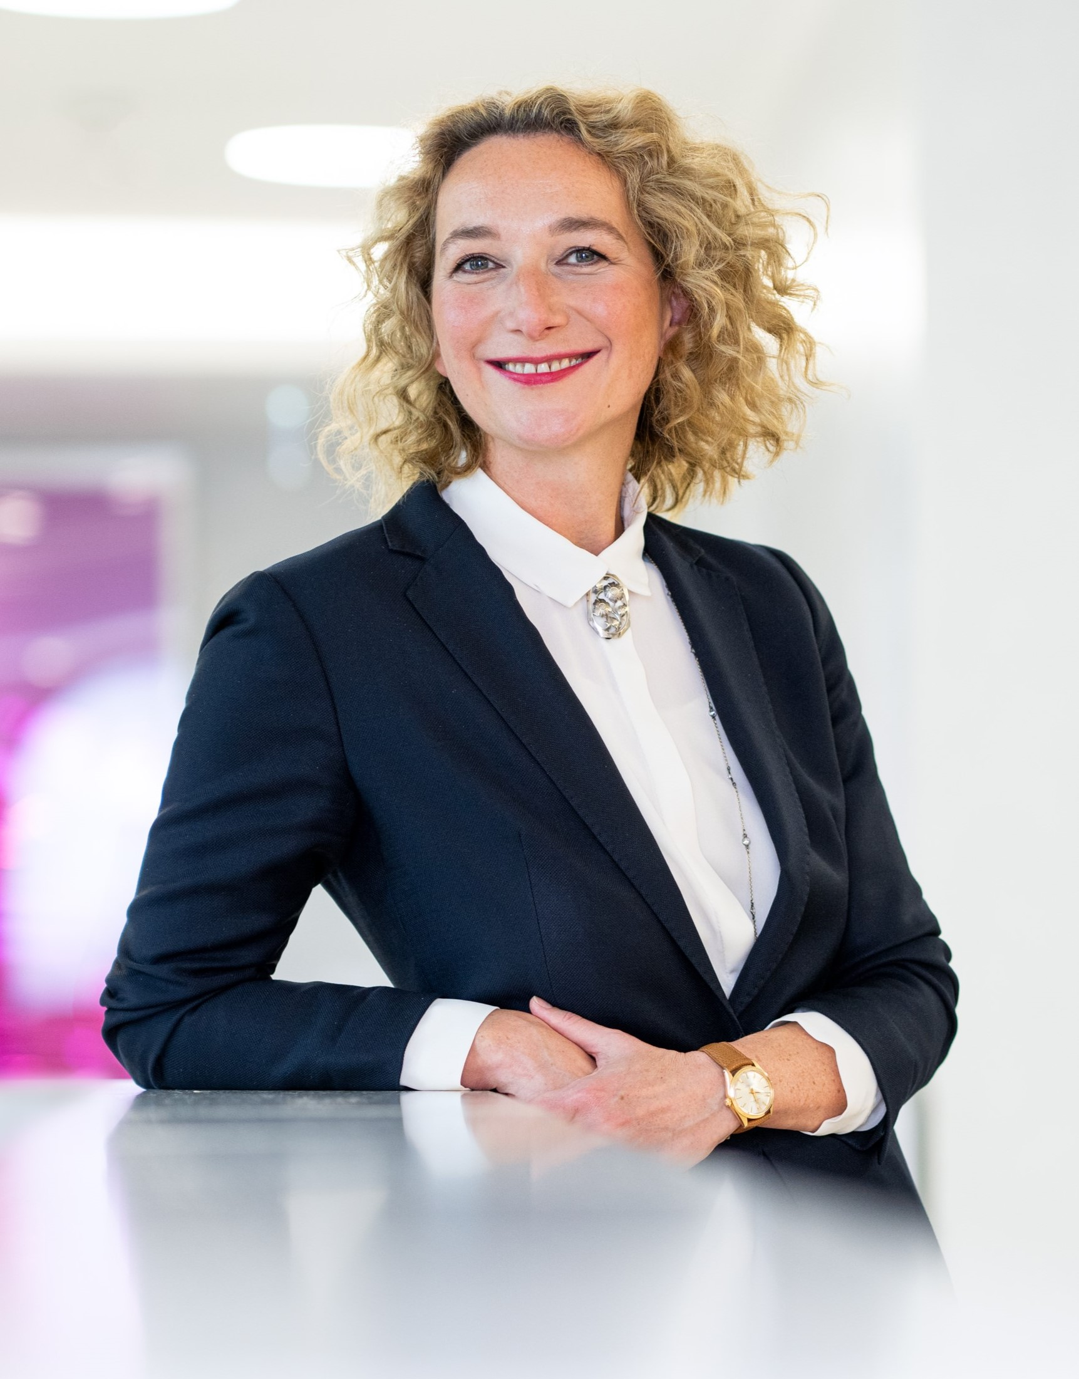
Thank you very much for your attention!
Dr Sabine Vorwerk
Linklaters LLP
Partner
Restructuring & Insolvency
Frankfurt am Main, Germany
Tel: +49 69 71003-308
sabine.vorwerk@linklaters.com

Slide 58
imagine

Slide 59
imagine
no comi

Slide 60
no comi
cloud

Slide 61
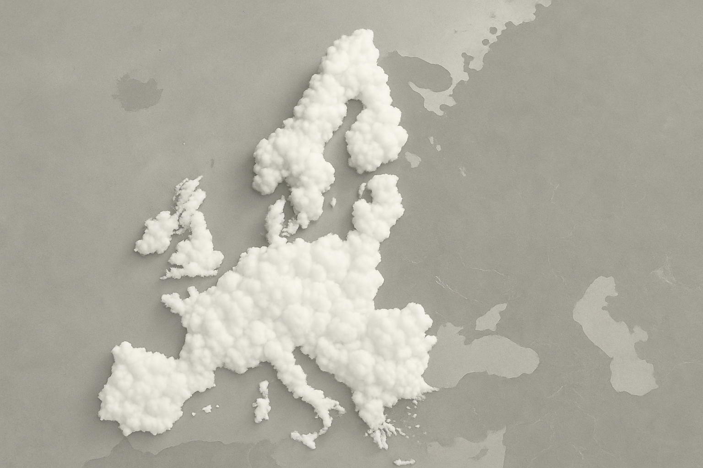
Europia

Slide 62


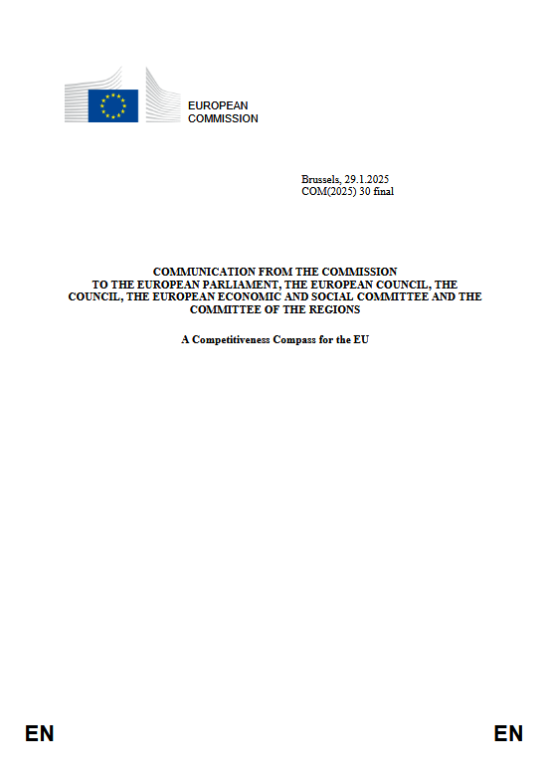
EU start-up and scale-up strategy
friendly environment for young
and innovative businesses
simplify rules and laws
one set of rules across EU
28

Slide 63
SE
Societas Europeae
PEPP
Pan-European Personal
Pension Product
SPE
Societas Privata Europeae
UCITS
Investment Funds
28
SUP
Societas Unius Personae
Unitary Patent
ECS
European Cooperative Society
CESL
Common European
Sales Law
?
EEIG
European Economic
Interest Grouping

Slide 64

Competence = Legal Basis
Legislative Instrument
qualified majority
Artt. 50, 114 TFEU
Recommendation
(model company/law)
unanimity
28
Art. 352 TFEU
Directive
(maximum harmonisation)
(Artt. 20, 326 ff. TFEU)
Regulation
unanimity
(Change of TFEU)
“The 28th regime will provide a single set of rules, potentially in a progressive and modular way. It will include an EU corporate legal framework, based on digital-by-default solutions, and will help companies overcome barriers in setting up, scaling up and operating companies across the Single Market. The 28th regime will simplify applicable rules and reduce the cost of failure by addressing specific aspects within relevant areas of law, including insolvency, labour and tax law.”

Slide 65
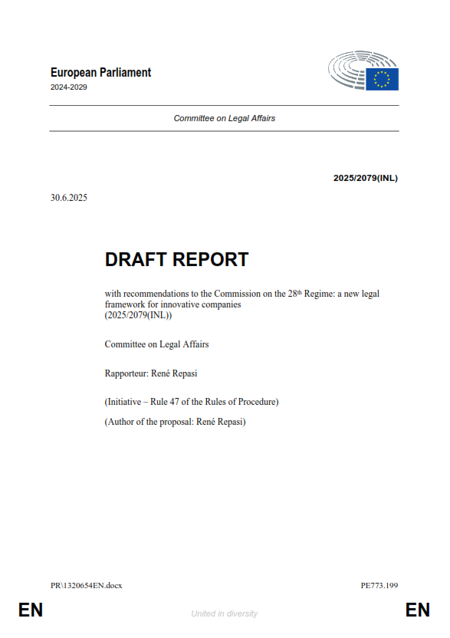
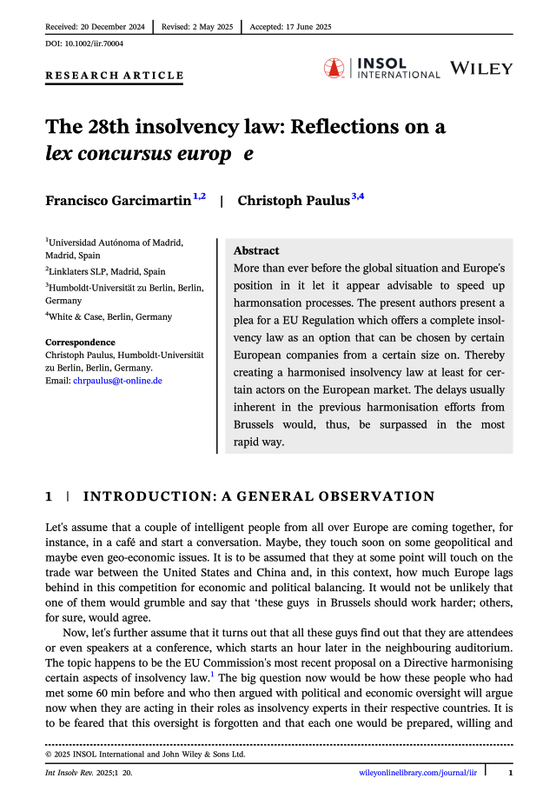
corporate law
labour law
tax law
insolvency law
28
… ESSU
European Start-up &
Scale-up Company
opt-in with binding committment
digital company register
protection from „killer acquisitions“
consideration of ADR mechanism
without prejudice to EU- and
national individual and collective
labour law

Slide 66
what
28
do start-ups, scale-ups
and investors need?

Slide 67
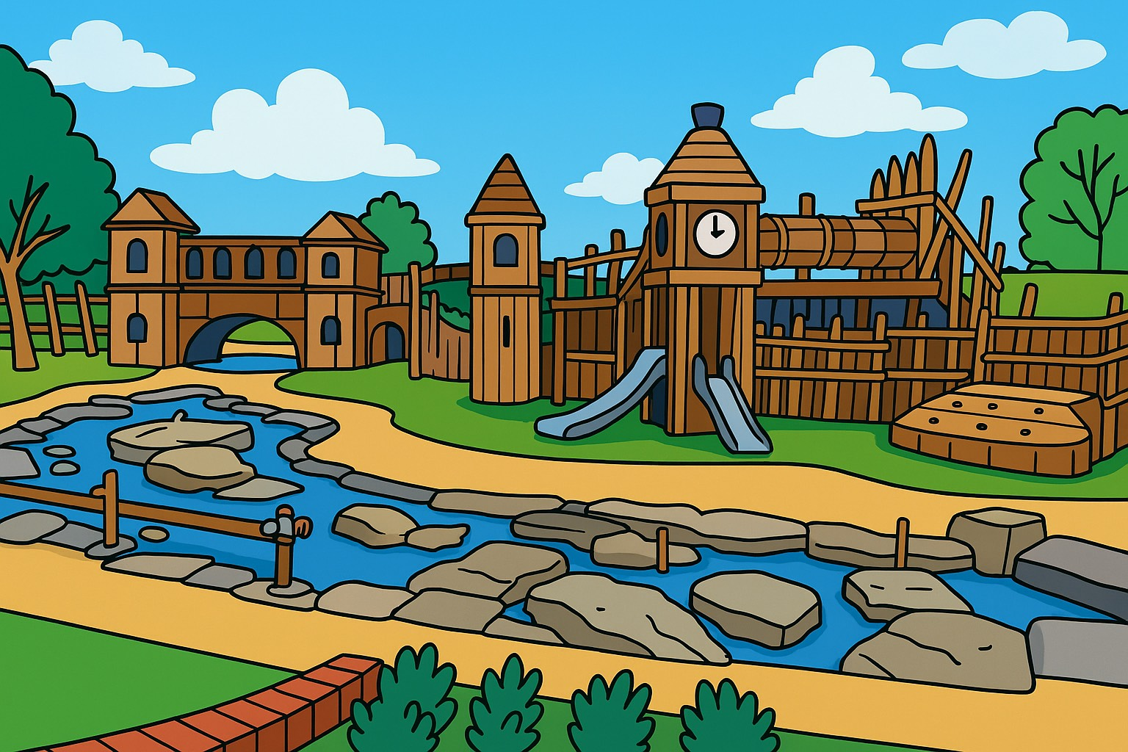
corporate law
labour law
tax law
insolvency law

Slide 68
features
corporate law
labour law
tax law
insolvency law
only start-ups / scale-ups
grace-period of X years
easy hire & fire
uniform & simple
prev. restructuring framework
quick online-incorporation
tax authorities of first real
office remain competent
creditor oriented insolvency law
(UNCITRAL legislative guide)
(insolvency III directive features)
virtual registered seat
opt-in by choice of legal form
fully digitalised (ex. Belgium)
protection from killer-acquisition
28
court: pool of qualified experts
one real office within EU
IP: introduction of EU-IP licence
equity capital >100k€
(including insolvency deposit)
opening reasons: (imminent) illiquidity
distinction of claims:
no opt-out
unsecured ↔ secured
mandatory exit after X years
pre-opening ↔ post opening
(no ranking)

Slide 69
timeframe
Q1 2026
20
28

Slide 70


Slide 71
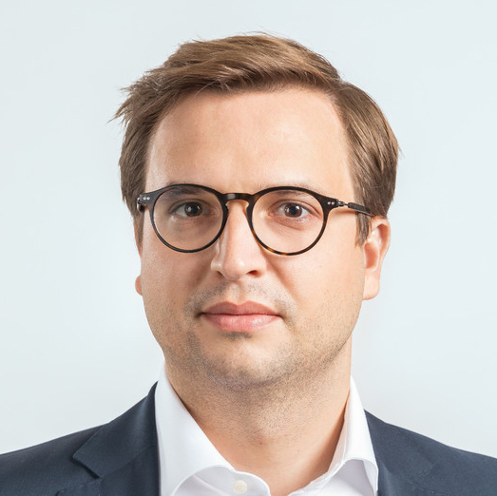
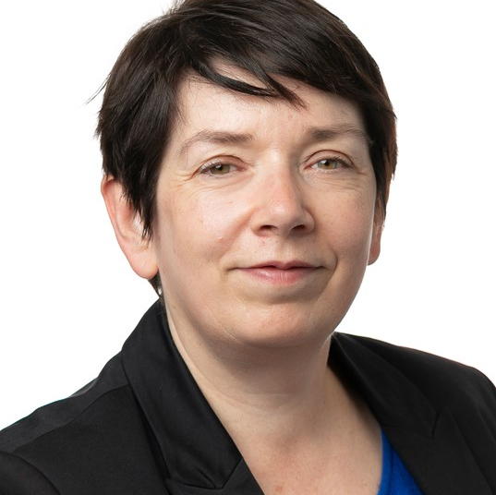
Closing remarks of the Annual Congress
Klaudia Frątczak-Kospin
Westminster Polska, Poland / INSOL Europe YMG Co-Chair
Alice van der Schee
Van Benthem & Keulen, The Netherlands / INSOL Europe President
Matthias Prior
Abel Rechtsanwälte, Austria / INSOL Europe Council member & Country Coordinator
Christel Dumont
Dentons, Luxembourg / INSOL Europe Council member & Country Coordinator

Slide 72
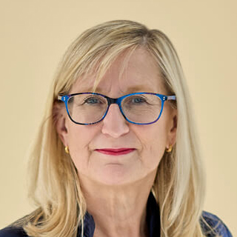
President Handover
Alice van der Schee
Van Benthem & Keulen, The Netherlands
INSOL Europe President
2024-2025
Frances Coulson
Wedlake Bell, UK
INSOL Europe President 2025-2026

Slide 73

Delegate & Guest Lunch
Kindly Sponsored By

Slide 74
Gala Dinner
Kindly Sponsored by

