Slide 1
Thanks to all our 2026 Annual Congress Sponsors

Slide 2
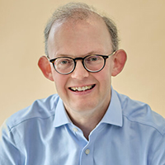

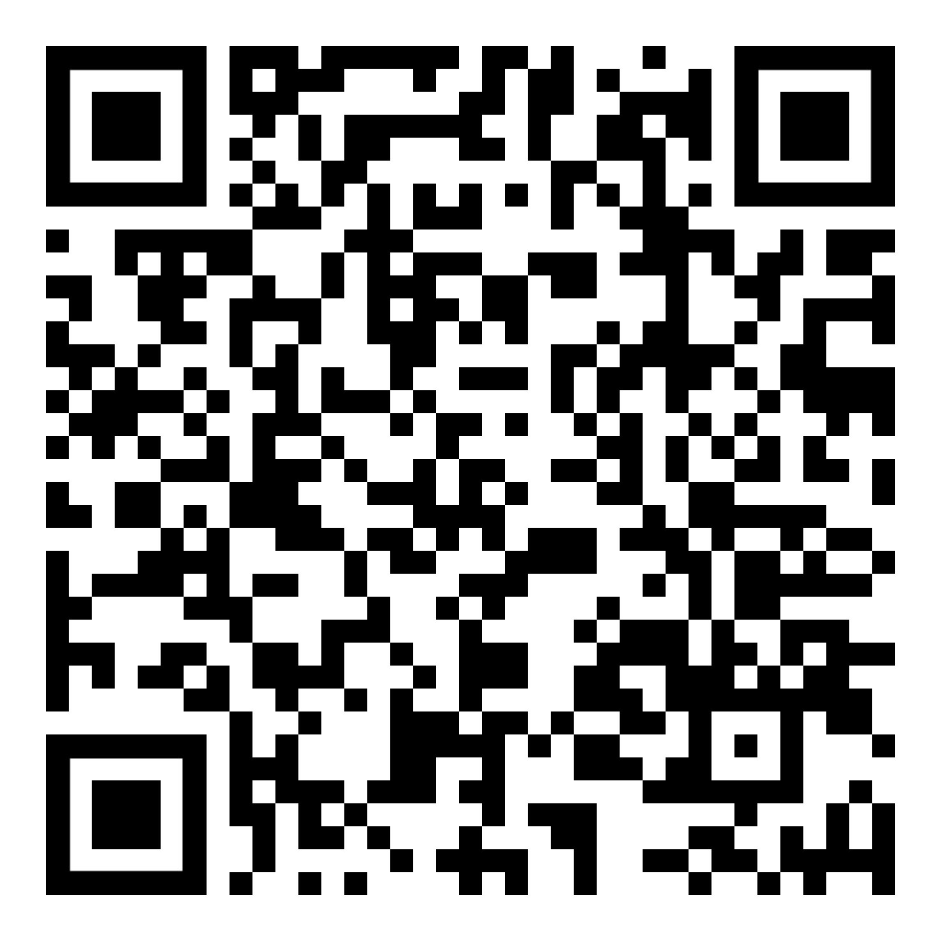
Opening remarks of the day by the Facilitators
Robert Paterson
Wedlake Bell, UK /
INSOL Europe
Council Member
Katarzyna Kostępska
KKG Legal,
Poland
Delegate List &
Latest Programme

Slide 3

Congress Main Sponsor
Notes:
Our main Congress sponsor, Eight Advisory

Slide 4

Local Firm Sponsor
Notes:
Our local firm sponsor, PLMJ

Slide 5





Congress General Sponsors
Notes:
Our Congress General Sponsors: Advant, Begbies Traynor Group, Kroll, McDermott Will & Schulte and Resor

Slide 6





Technical Session Sponsors

Slide 7
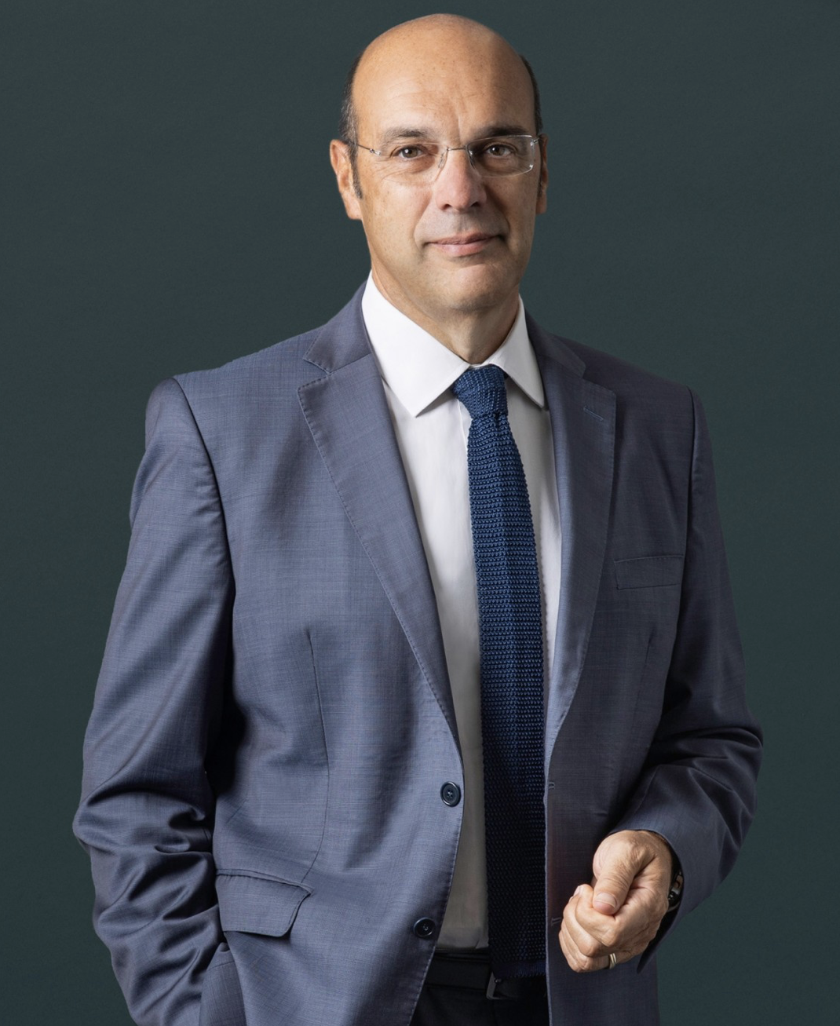
Keynote Speaker:
Pedro Siza Vieira
Former Minister of State for the Economy and Digital Transition, Portugal

Slide 8
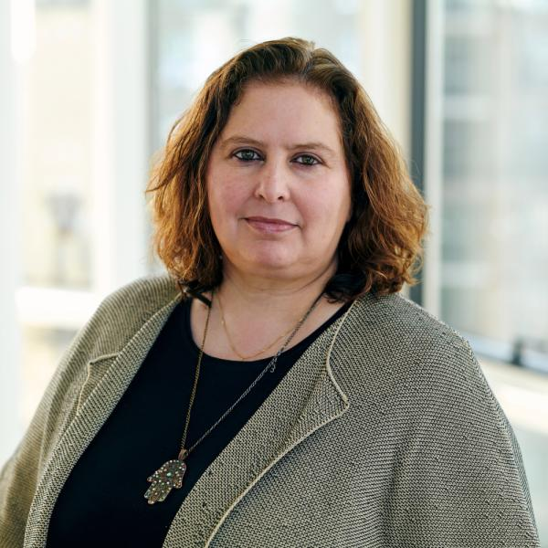
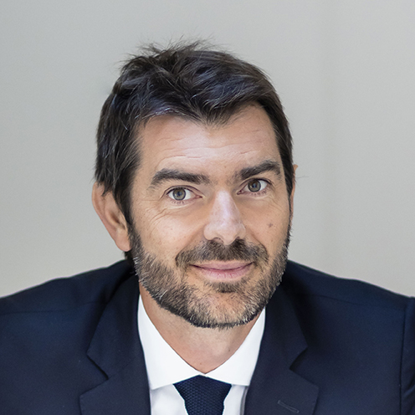

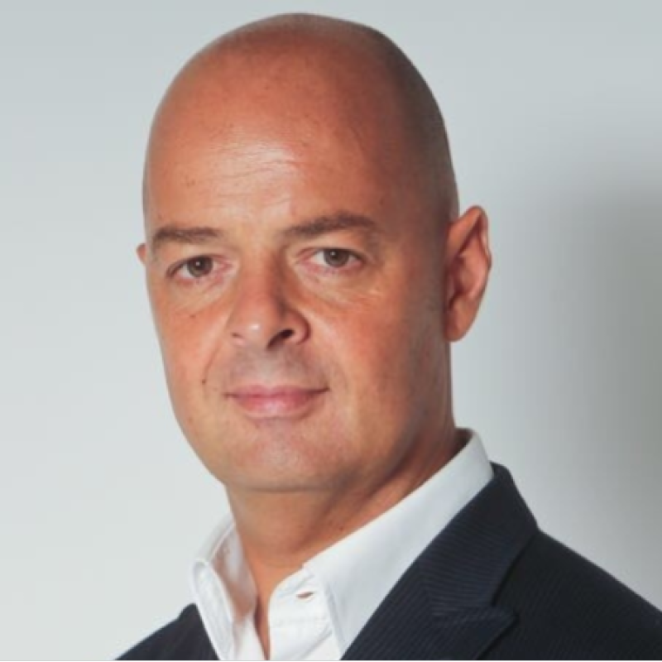
Soft skills in Financial Distress Situations
Panel leader:
Barbara Rumora-Scheltema
Cali Law, Netherlands
Xavier Bailly
Eight Advisory,
France
Kelly Jones
Chief Restructuring Officer, British Steel, UK
André Macedo
Journalist, Media
Executive, and Strategic Communication Consultant

Slide 9
Coffee Break
Kindly Sponsored By

Slide 10
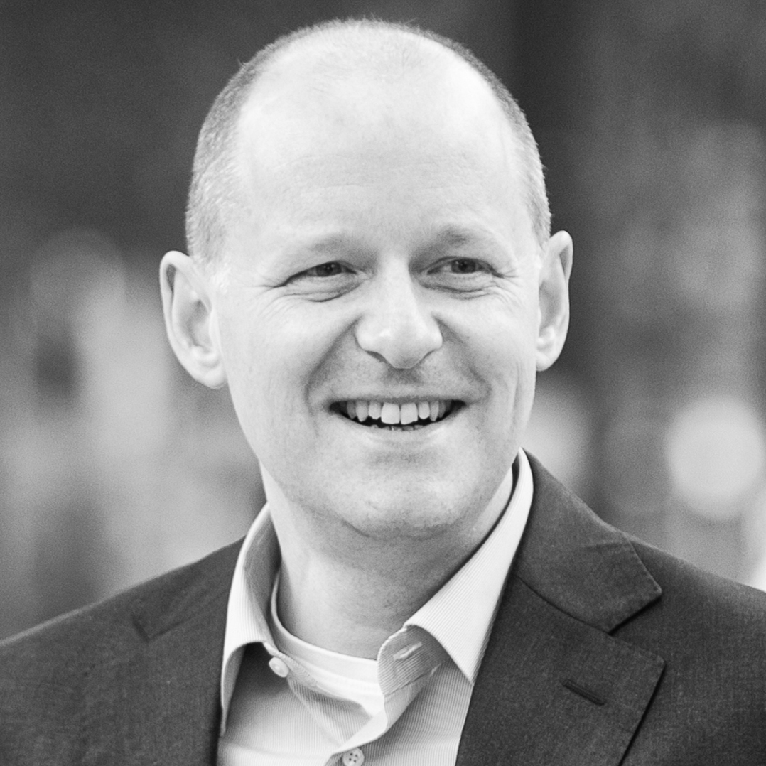
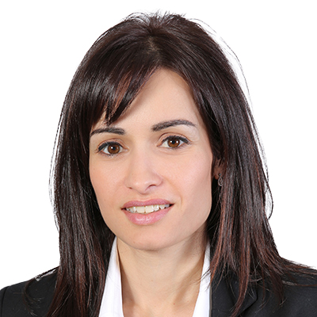
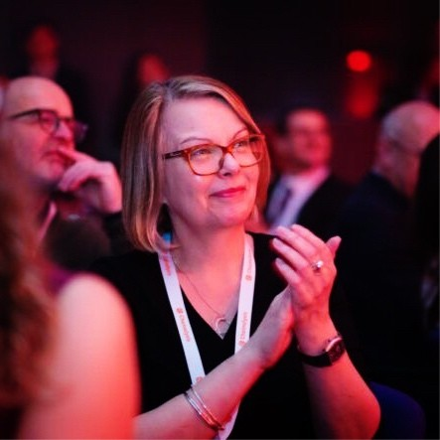
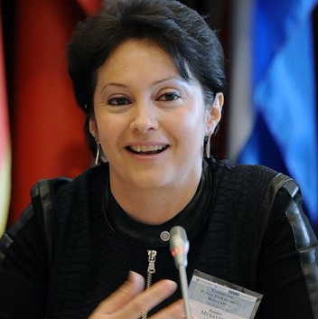
Asset Tracing and Recovery: What's New?
Panel leader:
Bart Heynickx
Altius, Belgium / INSOL Europe Anti-Fraud Forum (AFF) Co-Chair
Andri Antoniou
CRI Group, Cyprus / INSOL Europe Council Member & Country Coordinator
Louise MacDonald
HM Revenue
& Customs, UK
Samira Musayeva
Secretariat,
UNCITRAL

Slide 11
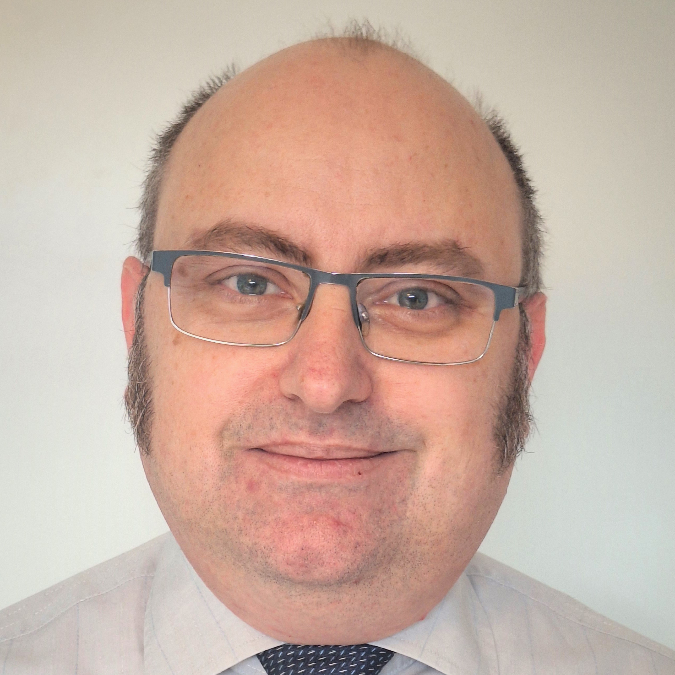
Setting the Course Ahead:
An EU Update on Restructuring and Insolvency
Pál Szirányi
Directorate-General for Justice and Consumers (DG JUST), European Commission

Slide 12
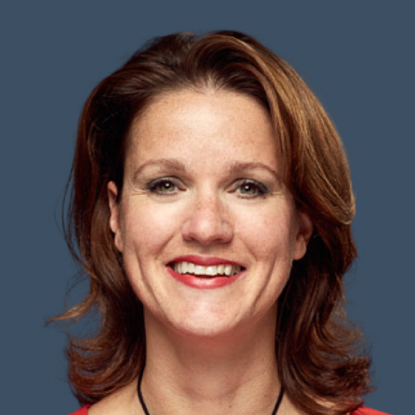
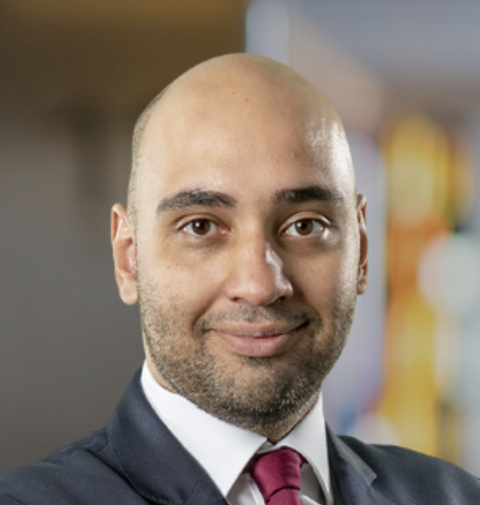
Closing Remarks of the Annual Congress
Robert Paterson
Wedlake Bell, UK /
INSOL Europe
Council Member
Katarzyna Kostępska
KKG Legal,
Poland
Noor Zetteler
Wijn en Stael Advocaten, The Netherlands / INSOL Europe Council Member, Country Coordinator & 2026 Congress Technical Committee Co-Chair
David Sequeira Dinis
Uria Menéndez Abogados, Portugal / INSOL Europe Council Member, Country Coordinator & 2026 Congress Technical Committee Co-Chair

Slide 13
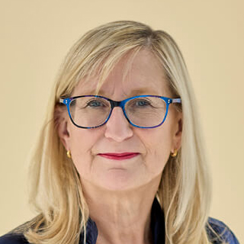
Closing remarks by the President
Frances Coulson
Wedlake Bell, UK
INSOL Europe President 2025-2026

Slide 14
Congress Main Sponsor
Notes:
Our main Congress sponsor, Eight Advisory

Slide 15
Local Firm Sponsor
Notes:
Our local firm sponsor, PLMJ

Slide 16
Congress General Sponsors
Notes:
Our Congress General Sponsors: Advant, Begbies Traynor Group, Kroll, McDermott Will & Schulte and Resor

Slide 17
Technical Session Sponsors

Slide 18
Thanks to all our 2026 Annual Congress Sponsors

Slide 19
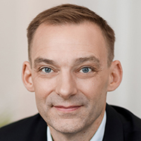
President Handover
Frances Coulson
Wedlake Bell, UK
INSOL Europe President 2025-2026
Frank Heemann
LYNX, Lithuania
INSOL Europe President
2026-2027

Slide 20

Delegate & Guest Lunch
Kindly Sponsored By

Slide 21

Gala Drinks Reception Sponsor
Kindly Sponsored By

Slide 22
Gala Dinner
Kindly Sponsored by

