Slide 1

Setting the Course Ahead
An EU Update on Restructuring and Insolvency
Pal Sziranyi
EC - DG JUST

Slide 2
Summary
Insolvency harmonisation directive
  Targeted harmonisation
  Minimum harmonisation
  Implementation timeline
„28th regime”
Current work relating to existing instruments
  EIR – Digitalisation of communication
  DRI – Transposition check and data collection

Slide 3

Insolvency harmonisation directive
Directive (EU) 2026/799 of the European Parliament and of the Council of 30 March 2026 harmonising certain aspects of insolvency law

Slide 4
„Targeted” harmonisation
Transaction avoidance (Title II)
Asset tracing (Title III)
Pre-pack proceedings (Title IV)
Directors’ duty and liability to request the opening of insolvency proceedings (Title V)
Creditors’ committee (Title VI)
Measures enhancing the transparency of national insolvency laws (Title VII)

Slide 5
Asset tracing – Title III
Access to bank account registers -> and BARIS
Access to beneficial ownership registers -> and BORIS
Access to national registers and databases

Slide 6
Pre-pack proceedings – Title IV
„Confidentiality” of the Preparation phase
Tools ensuring a „fair market price” for the business
„Best-interest-of-creditors” test vs. valuation of the business
Insider buy-out possible with extra safeguards
„Clear and free” sale of the business, as a rule
Credit bidding possible – within limits

Slide 7
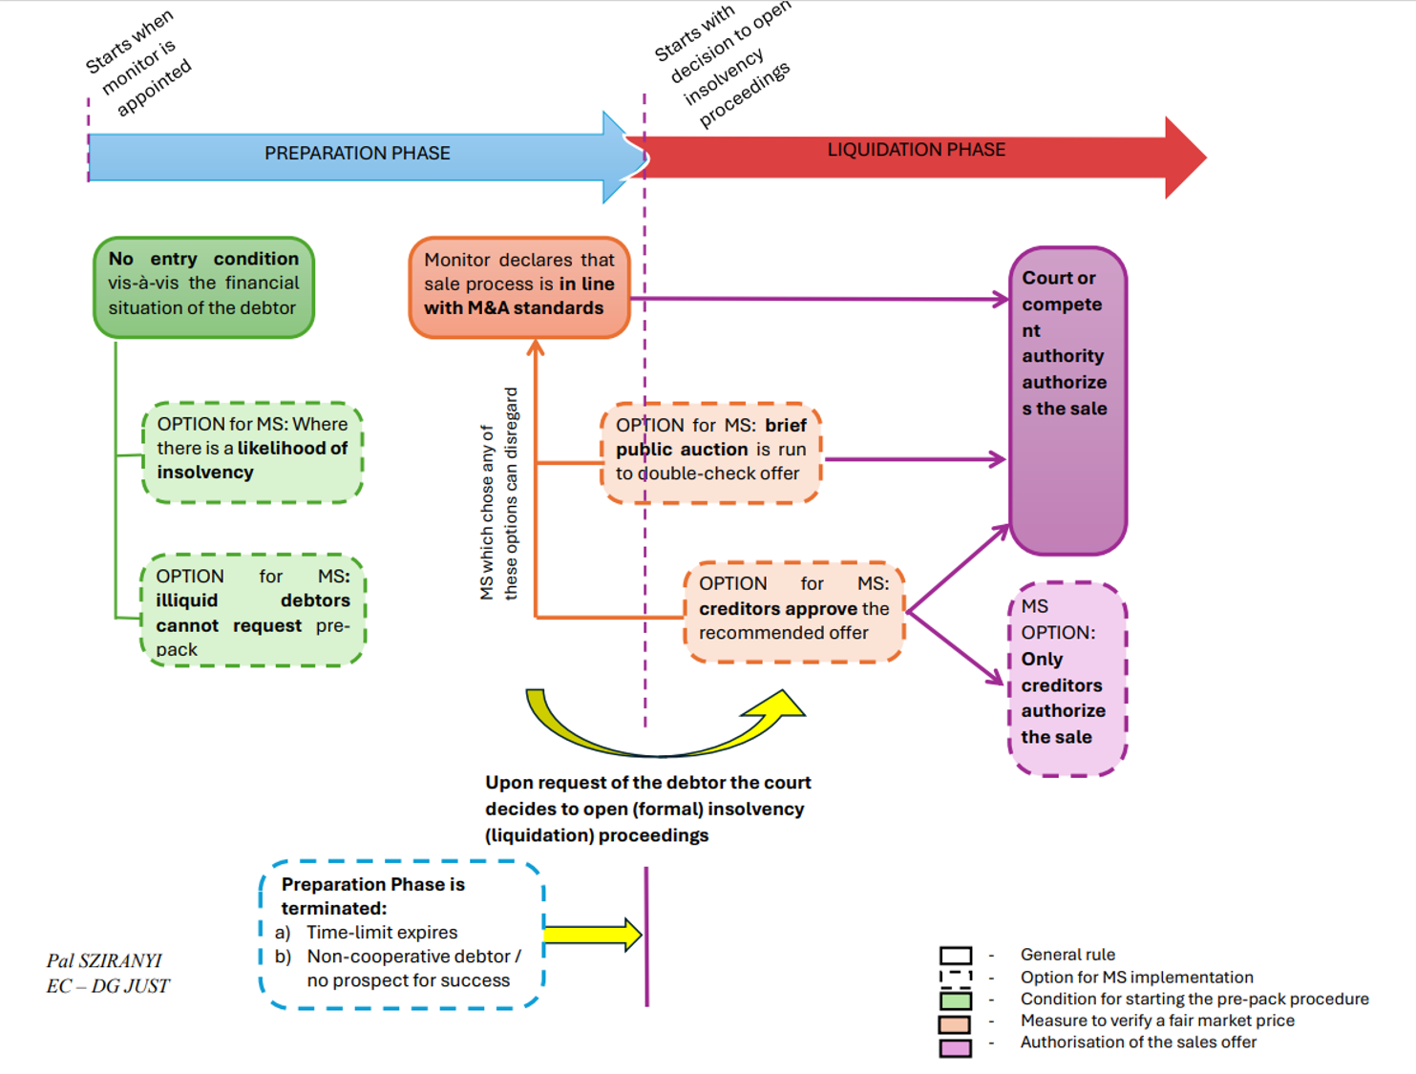

Slide 8
A minimum harmonisation directive
Article 4 - National law and minimum harmonisation
„Member States may adopt or maintain laws which…
  Title II & V: „provide for a greater level of protection for the general body of creditors”
  Title VI: „provide for a greater participation of creditors in insolvency proceedings”
  Title III: „facilitate access by insolvency practitioners to bank account information held in their bank account registers, beneficial ownership information and national registers and databases to a greater extent”
What about Tile IV (pre-pack proceedings)?

Slide 9
Implementation timeline
Transposition period expires on
  22 January 2029
  10 July 2029, at the latest – for provisions relating to BARIS
Commission plans three „Transposition workshops” with Member States in 2027 and 2028

Slide 10
„28th regime”
Chapter X of the proposal for the EU Inc. Regulation

Slide 11
Chapter X – Insolvency proceedings
„Winding-up of insolvent EU Inc. companies that are innovative startups”
Rationale: the cost of failure aspect
  cost of failure remains an important factor for stakeholders and investors alike
Despite all appearances: Chapter X is not a re-cycling of the discarded „Title VI” (the simplified microenterprise liquidation procedure deleted from the Insolvency harmonisation directive) – it is the opposite:
  Legislative approach, scope, structure and content, all four aspects are different now

Slide 12
Chapter X – Insolvency proceedings (cont’d)
the Chapter consists of two distinct parts:
  Elements of procedural simplification (Articles 89 to 96 and the last article of the Chapter (102)
  efficient and quick realization of existing assets remaining in the company (e-auction platforms - Articles 97 to 101)
Legislative procedure - will Chapter X survive?
  Council
  EP – draft Repasi Report (PE790.143v02) promising

Slide 13
Current work relating to existing instruments
Regulation (EU) 2015/848 on insolvency proceedings (EIR)
Directive (EU) 2019/1023 – Directive on Restructuring and Insolvency (DRI)

Slide 14
EIR
Digitalisation of communication

Slide 15
EIR - Digitalisation
Regulation (EU) 2023/2844 of 27 December 2023 (the Digitalisation Regulation)
  obliges the competent authorities under the Insolvency Regulation to communicate electronically through a decentralised IT system
  allows citizens/businesses or their representatives to communicate electronically with the competent authorities through the European Electronic Access Point (EEAP).
According to Recital 13 of the Digitalisation Regulation where insolvency practitioners are competent under national law to receive claims lodged by a foreign creditor in insolvency proceedings under Article 53 of EIR, they should be considered to be competent authorities within the meaning of the Digitalisation Regulation.
Business processes concerned:
  Claims by Foreign creditors (Art 53-55 EIR)
  Cooperation and communication between courts over the same debtor (Art 42 EIR);
  Coordination and communication between courts relating to two or more members of a group of companies (EIR 57)
Timeline: Implementing Act by January 2027, Deployment: by January 2031

Slide 16
DRI
Transposition check and Data collection

Slide 17
DRI – Transposition check
„Non-communication” phase of transposition check closed: All MS have notified their implementing measures
Compliance (conformity) phase of transposition check is on-going
  On the basis of correlation tables communicated by MS
  + compliance study on transposition by Milieu (Final Report April 2025)

Slide 18
DRI – Data collection
Article 29 DRI
Commission Implementing Regulation on standard data communication form
  Is to be adopted by the end of this year
  First reference year: 2027
  First communication of the data to COM: in 2028

Slide 19
Review of application
EIR – Article 90
  Study on cross-border issues in the area of directors' liability and disqualifications: „no later than 1 January 2016” – delivered: Leeds Study Jan 2016
  Study on abusive forum shopping: „no later than 27 June 2020” – delivered: Spark/Tipik Study in 2022
  Report on group coordination proceedings: „No later than 27 June 2022”
  General review: „No later than 27 June 2027 and every five years thereafter”
DRI – Article 33
  General review: „No later than 17 July 2026 and every five years thereafter”

Slide 20
Thank you
Fill in copyright information.
© European Union 2026
Unless otherwise noted the reuse of this presentation is authorised under the CC BY 4.0 license. For any use or reproduction of elements that are not owned by the EU, permission may need to be sought directly from the respective right holders.

