Slide 1
INSOL EUROPE IOH FORUM
Hot Topics for an Insolvency Office Holder in 2016 presented by the Forum´s Co-Chairs
Stephen Harris, EY, London
Daniel F. Fritz, hww hermann wienberg wilhelm, Frankfurt am Main

Slide 2

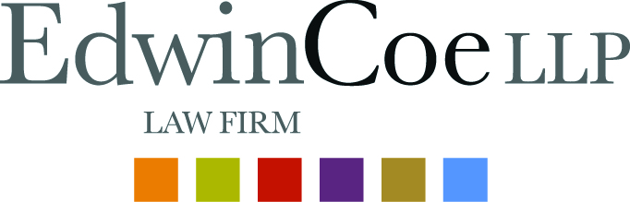
Thank you!

Slide 3
Remember September …
Berlin 2015 Poll results
Highlights
Harmonise qualifications?
50/50 IPs and 66/33 Non IPs (Yes / No)
Should the EU implement legislation re IPs?
50/50 IPs and 48/52 Non IPs (Yes / No)
Does national legislation work effectively re IPs?
75/25 IPs and 54 /46 Non IPS (Yes / No)

Slide 4
IOH Forum Survey 2015/16
Questions asked: the types of insolvency office holders; size of the profession; practising norms; qualification training and entry into the profession; professional bodies; continuing professional education (“CPE”); body corporate or individual; sanction for acting as an IOH without proper authorisation; bonding and insurance; appointment of IOHs; remuneration; personal liability of IOHs; release of IOHs from liability; and independence.

Slide 5
Answers received:
Austria (Norbert ABEL from Abel Rechtsanwälte);
Belgium (Bart DE MOOR from STRELIA Law Firm);
Bulgaria (Peneva MIGLENA from Georgiev, Todorov & Co. Law Offices);
Czech Republic (Ernst GIESE from Giese & Partner);
Denmark (Piya MUKHERJEE from Horten Law Firm);
Estonia (Peter VIIRSALU from VARUL);
France (André MARC from Etude Marc André);
Germany (Axel BIERBACH from MHBK Rechtsanwälte, Daniel FRITZ from hww hermann wienberg wilhelm and Robert HAENEL from Anchor Rechtsanwälte);
Greece (George BAZINAS and Yiannis SAKKAS from Bazinas Law Firm);
Ireland (Jim LUBY and Enda LOWRY from McStay Luby);
Italy (Gofredo CAVERNI from Goffredo Caverni);
Latvia (Edvins DRABA from SORAINEN);
Lithuania (Ieva STRUNKIENE from Triniti);
Luxembourg (Martine GERBER from Dentons);
The Netherlands (Krijn HOOGENBOEZEM from BOEKEL);
Portugal (Nuno SALAZAR CASANOVA and David SEQUEIRA DINIS from Uría Menéndez – Proença de Carvalho);
Romania (Radu LOTREAN from CITR);
Slovakia (Slavomir CAUDER from Giese & Partner);
Spain (Vicente Estrada from Forest Partners);
Sweden (Niklas KÖRLING from Wistrand);
Switzerland (Sabina SCHELLENBERG from Froriep); and
United Kingdom (Alastair BEVERIDGE from AlixPartners).

Slide 6
IOH Forum Survey 2015/16
Lessons learned?

Slide 7
Harmonization
Perfect Harmony or…

Slide 8
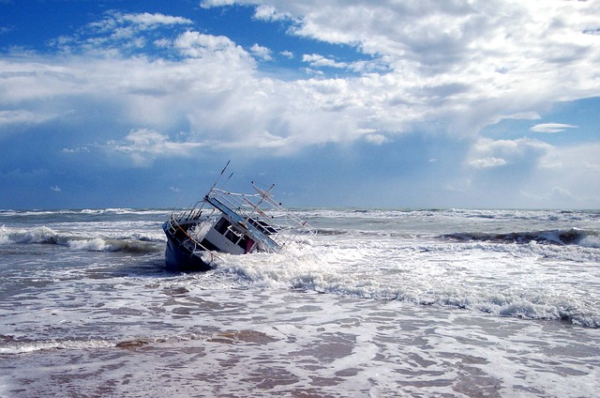

Slide 9
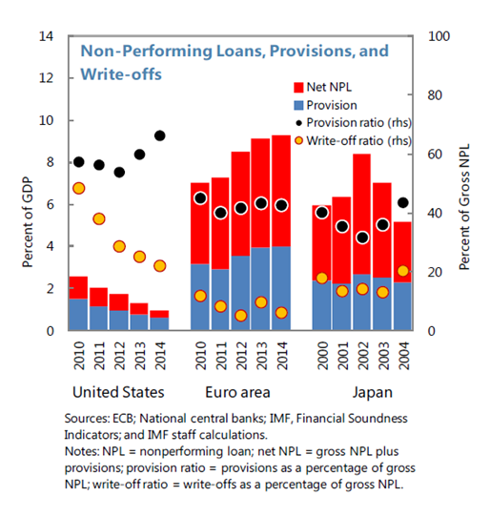
    Action Plan on Building a Capital Markets Union, COM(2015) 468 final, 30.9.2015
The Commission, working with Member States, will map and work to resolve unjustified national barriers to the free movement of capital, stemming, amongst other things, from insufficient implementation or lack of convergence in interpretation of the single rulebook and from national law that are preventing a well-functioning Capital Markets Union and publish a report by the end of 2016.
Convergence of insolvency and restructuring proceedings would facilitate greater legal certainty for cross-border investors and encourage the timely restructuring of viable companies in financial distress. Consultation respondents broadly agreed that both the inefficiency and divergence of insolvency laws make it harder for investors to assess credit risk, particularly in cross-border investments.
The Commission will propose a legislative initiative on business insolvency, including early restructuring and second chance, drawing on the experience of the Recommendation. The initiative will seek to address the most important barriers to the free flow of capital, building on national regimes that work well.

Slide 10
Harmonization
Pre-Insolvency Proceedings as Safe Harbor?

Slide 11
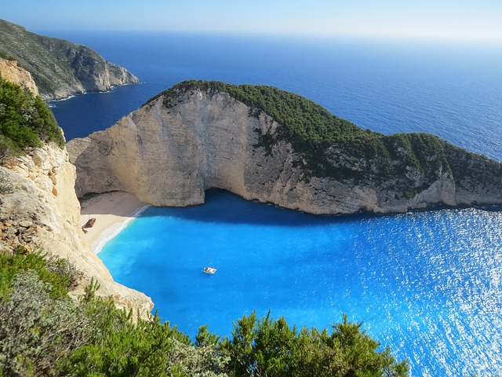

Slide 12
Harmonization beyond Pre-Insolvency Proceedings
Who´s your Captain?

Slide 13
    Study on a new approach to business failure and insolvency
    Insolvency report 2016
    e.g. IOH
    Licensing and registration
    Qualification and Training
    Appointment System
    Work Standards
    Powers and Duties
    Remuneration
    etc.
IOH
Director´s
Liability
and Disq.
Avoidance Law
13

Slide 14
Revised Minimum Standards for IOH
IOH Forum Proposal

Slide 15
Minimum Standards as proposed by the IOH Forum:
1. Licensing and Registration -IOH licensing and registration should be governed by the Member States. Member States should be free to have IOHs licensed and registered as such, i.e. as a profession of its own, or as members of other professions (e.g. as lawyers or chartered accountants), and by self-regulated or public bodies, or by agencies or courts.
2. Regulation, supervision and discipline - Given the nature of their work and responsibilities, IOHs should be subject to a regulatory framework with supervisory, monitoring and disciplinary features. Member States should be free how to organize such supervision and disciplinary actions and whether and to which extend to delegate such supervision and disciplinary actions to IOHs’ self-regulated or public bodies, to agencies or to courts.

Slide 16
Minimum Standards as proposed by the IOH Forum:
3. Qualification and training - IOHs candidates should meet relevant qualification and practical training Standards. Qualified IOHs should keep their professional skills updated with regular continuing training. Member States should encourage cross-border training and exchange of knowledge and best practice standards. For this purpose any CPE system in the Member States should encourage and allow for theoretical and practical training in other Member States.
4. Appointment system - There should be a clear system in the Member States for the appointment of IOHs safeguarding the independence and avoiding conflicts of interest for the appointee. As far as not harming the general independence of the specific IOH the appointment system in each Member State may formally vary, but may reflect debtor and creditor preferences with regards to the skills and experience of the IOH and should encourage the appointment of an appropriate IOH candidate.

Slide 17
Minimum Standards as proposed by the IOH Forum:
5. Work standards and ethics - the work of IOHs should be guided by a set of specific work standards and ethics for the profession.
6. Legal powers and duties - IOHs should have sufficient legal powers and standing to carry out their duties, including powers aimed at recovery of assets belonging to the debtor’s estate. IOHs should hold some form of official authorization making sure that the identification of an IOH as the responsible person for the assets he is responsible for is possible and to be acknowledged in all Member States

Slide 18
Minimum Standards as proposed by the IOH Forum:
7. Transparency – Member States should take care, that IOHs are subject to a duty to keep all parties to the proceedings regularly informed of the progress of the insolvency case.
8. Remuneration - a statutory framework for IP remuneration should exist to regulate the payment of IP fees and protect stakeholders. The framework should provide ample incentives for IOHs to perform well and protection for IOH fees in all types of insolvency proceedings, including but not limited to preliminary, hybrid and restructuring or reorganization proceedings

Slide 19
What´s your view?

Slide 20

Q1: “Are you an IOH?”
54
1 - Yes
2 - No

Slide 21
Q1: “Are you an IOH?”
1 - Yes
44%
2 - No
56%

Slide 22
0
Minimum Standards as proposed by the IOH Forum:
1. Licensing and Registration -IOH licensing and registration should be governed by the Member States. Member States should be free to have IOHs licensed and registered as such, i.e. as a profession of its own, or as members of other professions (e.g. as lawyers or chartered accountants), and by self-regulated or public bodies, or by agencies or courts.
Agree:
1) Yes 2) No

Slide 23
1. Licensing and Registration -IOH licensing and registration should be governed by the Member States. Member States should be free to have IOHs licensed and registered as such, i.e. as a profession of its own, or as members of other professions (e.g. as lawyers or chartered accountants), and by self-regulated or public bodies, or by agencies or courts.
57
1 - Yes
2 - No

Slide 24
1. Licensing and Registration -IOH licensing and registration should be governed by the Member States. Member States should be free to have IOHs licensed and registered as such, i.e. as a profession of its own, or as members of other professions (e.g. as lawyers or chartered accountants), and by self-regulated or public bodies, or by agencies or courts.
1 - Yes
84%
2 - No
16%

Slide 25
Minimum Standards as proposed by the IOH Forum:
2. Regulation, supervision and discipline - Given the nature of their work and responsibilities, IOHs should be subject to a regulatory framework with supervisory, monitoring and disciplinary features. Member States should be free how to organize such supervision and disciplinary actions and whether and to which extend to delegate such supervision and disciplinary actions to IOHs’ self-regulated or public bodies, to agencies or to courts.
Agree:
1) Yes 2) No

Slide 26
Minimum Standards as proposed by the IOH Forum:
2. Regulation, supervision and discipline - Given the nature of their work and responsibilities, IOHs should be subject to a regulatory framework with supervisory, monitoring and disciplinary features. Member States should be free how to organize such supervision and disciplinary actions and whether and to which extend to delegate such supervision and disciplinary actions to IOHs’ self-regulated or public bodies, to agencies or to courts.
51
1 - Yes
2 - No

Slide 27
Minimum Standards as proposed by the IOH Forum:
2. Regulation, supervision and discipline - Given the nature of their work and responsibilities, IOHs should be subject to a regulatory framework with supervisory, monitoring and disciplinary features. Member States should be free how to organize such supervision and disciplinary actions and whether and to which extend to delegate such supervision and disciplinary actions to IOHs’ self-regulated or public bodies, to agencies or to courts.
1 - Yes
92%
2 - No
8%

Slide 28
Minimum Standards as proposed by the IOH Forum:
3. Qualification and training - IOHs candidates should meet relevant qualification and practical training Standards. Qualified IOHs should keep their professional skills updated with regular continuing training. Member States should encourage cross-border training and exchange of knowledge and best practice standards. For this purpose any CPE system in the Member States should encourage and allow for theoretical and practical training in other Member States.
Agree:
1) Yes 2) No

Slide 29
Minimum Standards as proposed by the IOH Forum:
3. Qualification and training - IOHs candidates should meet relevant qualification and practical training Standards. Qualified IOHs should keep their professional skills updated with regular continuing training. Member States should encourage cross-border training and exchange of knowledge and best practice standards. For this purpose any CPE system in the Member States should encourage and allow for theoretical and practical training in other Member States.
54
1 - Yes
2 - No

Slide 30
Minimum Standards as proposed by the IOH Forum:
3. Qualification and training - IOHs candidates should meet relevant qualification and practical training Standards. Qualified IOHs should keep their professional skills updated with regular continuing training. Member States should encourage cross-border training and exchange of knowledge and best practice standards. For this purpose any CPE system in the Member States should encourage and allow for theoretical and practical training in other Member States.
1 - Yes
91%
2 - No
9%

Slide 31
Question 6
0
Minimum Standards as proposed by the IOH Forum:
4. Appointment system - There should be a clear system in the Member States for the appointment of IOHs safeguarding the independence and avoiding conflicts of interest for the appointee. As far as not harming the general independence of the specific IOH the appointment system in each Member State may formally vary, but may reflect debtor and creditor preferences with regards to the skills and experience of the IOH and should encourage the appointment of an appropriate IOH candidate.
Agree:
1) Yes 2) No

Slide 32
Minimum Standards as proposed by the IOH Forum:
4. Appointment system - There should be a clear system in the Member States for the appointment of IOHs safeguarding the independence and avoiding conflicts of interest for the appointee. As far as not harming the general independence of the specific IOH the appointment system in each Member State may formally vary, but may reflect debtor and creditor preferences with regards to the skills and experience of the IOH and should encourage the appointment of an appropriate IOH candidate.
44
1 - Yes
2 - No

Slide 33
Minimum Standards as proposed by the IOH Forum:
4. Appointment system - There should be a clear system in the Member States for the appointment of IOHs safeguarding the independence and avoiding conflicts of interest for the appointee. As far as not harming the general independence of the specific IOH the appointment system in each Member State may formally vary, but may reflect debtor and creditor preferences with regards to the skills and experience of the IOH and should encourage the appointment of an appropriate IOH candidate.
1 - Yes
95%
2 - No
5%

Slide 34
Minimum Standards as proposed by the IOH Forum:
5. Work standards and ethics - the work of IOHs should be guided by a set of specific work standards and ethics for the profession.
Agree:
1) Yes 2) No

Slide 35
Minimum Standards as proposed by the IOH Forum:
5. Work standards and ethics - the work of IOHs should be guided by a set of specific work standards and ethics for the profession.
52
1 - Yes
2 - No

Slide 36
Minimum Standards as proposed by the IOH Forum:
5. Work standards and ethics - the work of IOHs should be guided by a set of specific work standards and ethics for the profession.
1 - Yes
90%
2 - No
10%

Slide 37
Minimum Standards as proposed by the IOH Forum:
6. Legal powers and duties - IOHs should have sufficient legal powers and standing to carry out their duties, including powers aimed at recovery of assets belonging to the debtor’s estate. IOHs should hold some form of official authorization making sure that the identification of an IOH as the responsible person for the assets he is responsible for is possible and to be acknowledged in all Member States
Agree:
1) Yes 2) No

Slide 38
Minimum Standards as proposed by the IOH Forum:
6. Legal powers and duties - IOHs should have sufficient legal powers and standing to carry out their duties, including powers aimed at recovery of assets belonging to the debtor’s estate. IOHs should hold some form of official authorization making sure that the identification of an IOH as the responsible person for the assets he is responsible for is possible and to be acknowledged in all Member States
41
1 - Yes
2 - No

Slide 39
Minimum Standards as proposed by the IOH Forum:
6. Legal powers and duties - IOHs should have sufficient legal powers and standing to carry out their duties, including powers aimed at recovery of assets belonging to the debtor’s estate. IOHs should hold some form of official authorization making sure that the identification of an IOH as the responsible person for the assets he is responsible for is possible and to be acknowledged in all Member States
1 - Yes
98%
2 - No
2%

Slide 40
Minimum Standards as proposed by the IOH Forum:
7. Transparency – Member States should take care, that IOHs are subject to a duty to keep all parties to the proceedings regularly informed of the progress of the insolvency case.
Agree:
1) Yes 2) No

Slide 41
Minimum Standards as proposed by the IOH Forum:
7. Transparency – Member States should take care, that IOHs are subject to a duty to keep all parties to the proceedings regularly informed of the progress of the insolvency case.
44
1 - Yes
2 - No

Slide 42
Minimum Standards as proposed by the IOH Forum:
7. Transparency – Member States should take care, that IOHs are subject to a duty to keep all parties to the proceedings regularly informed of the progress of the insolvency case.
1 - Yes
95%
2 - No
5%

Slide 43
Minimum Standards as proposed by the IOH Forum:
8. Remuneration - a statutory framework for IP remuneration should exist to regulate the payment of IP fees and protect stakeholders. The framework should provide ample incentives for IOHs to perform well and protection for IOH fees in all types of insolvency proceedings, including but not limited to preliminary, hybrid and restructuring or reorganization proceedings
Agree:
1) Yes 2) No

Slide 44
Minimum Standards as proposed by the IOH Forum:
8. Remuneration - a statutory framework for IP remuneration should exist to regulate the payment of IP fees and protect stakeholders. The framework should provide ample incentives for IOHs to perform well and protection for IOH fees in all types of insolvency proceedings, including but not limited to preliminary, hybrid and restructuring or reorganization proceedings
42
1 - Yes
2 - No

Slide 45
Minimum Standards as proposed by the IOH Forum:
8. Remuneration - a statutory framework for IP remuneration should exist to regulate the payment of IP fees and protect stakeholders. The framework should provide ample incentives for IOHs to perform well and protection for IOH fees in all types of insolvency proceedings, including but not limited to preliminary, hybrid and restructuring or reorganization proceedings
1 - Yes
79%
2 - No
21%

Slide 46
Thank you for your vote!

